Slide 1

Serious Adverse Reactions 2023
Niall Flavin

Slide 2

How has Haemovigilance made transfusion safer?
Patient Blood Management
Reduced risk of bacterial contamination
Reduction in incidence of TRALI
Reduction in ABO incompatible errors
Reduced incidence of Graft vs Host Disease
International collaboration
Rapid Alert System
Notes:
As our theme is 25 years of haemovigilance I thought it would be appropriate to start the presentation with a slide demonstrating how haemovigilance systems have positively impacted transfusion practice and reduced SARs.
Patient Blood Management- Avoiding unnecessary transfusions is the best way to avoid a SAR. It includes adopting nontransfusion alternatives when possible and blood management strategies such as cell salvage post surgery.
Implementation of measures to reduce risk of bacterial contamination.- these measures include- the diversion of the first few millimeters of blood into a sample pouch at blood donation, improvements in venipuncture site disinfection and introduction of pathogen reduction technologies
Reduction in incidence of TRALI.-using male plasma for clinical treatment, exclusion of donors implicated in TRALI.
Reduction in ABO incompatible errors.- lower incidence of patient misidentification and sampling errors through the introduction of electronic identification systems. the introduction of transfusion training and competency assessments.
Reduced incidence of Graft vs Host Disease- with the use of leukodepleted products
International collaboration has identified patients at increased risk of transfusion reactions. – groups such as infants, the elderly and those that require special requirements. International collaboration has also standardized SAR definitions to allow us to compare findings between countries.
Rapid Alert System.- Allows for swift removal of implicated components and follow up with associated patients.
This is not an exhaustive list and there are a lot more benefits

Slide 3

Serious Adverse Reactions Reported from 2013 until 2023
Report types received in 2023
Total | Mandatory | Non-Mandatory | Did not progress
147 | 67 | 67 | 13
Notes:
Blue line represents total number of SARs received
Red line represents the SARs that were not reportable to Europe
Green line represents SARs that were reportable to Europe
Purple line are those that did not progress.
It appears that we received more reports from 2013-2015 however the NHO historically collected information on delayed serological transfusion reactions but in January 2016 we ceased collecting these as we received a large volume of reports and no new findings were identified.
In 2023 ours total number of SARs received was 147. we had 67 mandatory and 67 non mandatory, 13 did not progress.

Slide 4
Summary of SARs Received by Classification 2023
Notes:
FNHTRs was the most commonly reported reaction. It was also the most commonly reported non mandatory reaction followed by anaphylaxis/hypersensitivity.
TACO was the most common mandatory reaction reported this was followed by anaphylaxis/hypersensitivity, unclassified reactions and FNHTR.
Other reactions received included- TAD, hypotensive transfusion reactions, DHTR and TRALI.
We received no reports of PTP or Graft vs host disease
We received 1 report of acute haemolytic Tx reaction and 2 TTIs but these did not progress.

Slide 5
Haemovigilance Incidents Reported
January-December 2000
Notes:
As a means of comparison to the previous slide this was taken from a presentation of the reported figures from January to December 2000.
There were 55 reactions reported vs 147 in 2023 so there is an obvious increase in awareness and reporting
Which is demonstrated by the increase in reported TACOs there was 8 TACOs reported in 2000 vs our 32 in 2023.
The number of TTIs (7 in 2000) reported has also decreased.

Slide 6
Overall SAR Summary
Total n=147
Implicated Components |  | Age Profile |  | Imputability |  | Clinical Outcome
Red Cells | 120 | Infant (1-12 months) | 1 | Excluded | 3 | Complete Recovery | 117
Platelets Apheresis | 19 | Infant (1-4 years) | 4 | Unlikely | 4 | Minor sequalae | 14
Platelets Pooled | 8 | Child (5-11 years( | 1 | Possible | 77 | Serious Sequalae | 0
FFP | 0 | Adolescent (12-17 years) | 4 | Likely/ Probable | 49 | Death | 0
SD Plasma | 2 | Adult (18-30 years) | 17 | Certain | 14 | Death Unrelated to Transfusion | 4
Multiple Components | 1 | Adult (31-50 years) | 18 |  |  | Unknown as case did not progress | 12
 |  | Adult (51-70 years) | 32
 |  | Elderly (70+) | 70
Notes:
RCC was the most associated with SAR, followed by platelets apheresis and pooled.
One patient had RBC, SD plasma and pooled platelets
No SARs in 2023 that implicated neonates.
The elderly were most commonly implicated in Tx reactions and reactions increased with age.
The majority of SARs had an imputability of possible (77) indicating that hospitals are good reporters of reactions as they are attributing the transfusion to symptoms that could be transfusion related.
The majority of patients made a complete recovery with 14 suffering minor sequalae.

Slide 7
Underlying speciality and indications for transfusion
Notes:
When examining the underlying speciality and indication for transfusion
The majority of patients were oncology/haematology patients 45% followed by medical, surgical, other and obstetric.
The most common indication to transfuse was anaemia.

Slide 8
Emergency versus non-emergency transfusion and time of commencement
For the purpose of this report core working hours are between 7AM and 8PM.
Emergency versus routine transfusion |  | Transfusion start time
Non- Emergency Transfusion | 104 | Within Core Hours | 102
Emergency Transfusion | 10 | Outside Core Hours | 28
Unknown | 20 | Non-Emergency Transfusion administered outside core hours | 17
Notes:
This slide depicts Emergency versus non-emergency transfusion and time of commencement of transfusion
Core working hours are between 7AM-8pm.
104 transfusions were non emergency and 10 were emergency. There was 17 non-emergency transfusions administered outside core working hours.
I am not saying that patients should not receive blood components outside core working hours but it may be easier to manage a patient reaction during core working hours.
It is a clinical decision

Slide 9
Febrile Non-Haemolytic Transfusion Reactions 2007-2023
Notes:
This slide depicts febrile reactions from 2007 to 2023- Change in reporting guidelines in 2014 whereby we lowered the non mandatory reportable temperature degree level from 1.5 to 1 degree rise in temperature from baseline. Some hospitals still report a 1.5 degrr rise only.

Slide 10
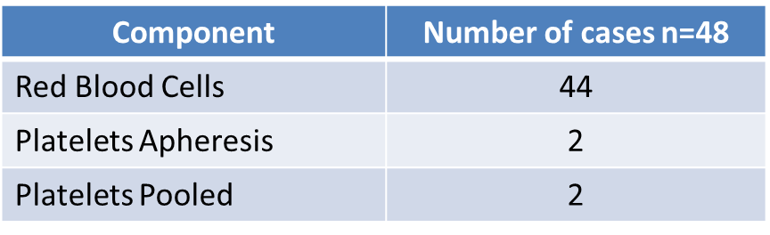
Febrile Reactions
Findings
52 Reports received
Males vs Females
Males=15
Females=33
Demographics
1-4 yr= 1
48 Reports accepted
9 Reports Mandatory
18-30 yr= 5
31-50 yr=9
51-70 yr= 11
70+= 22

Slide 11
Febrile Reactions
Investigations
Bacterial Screening of patient= 41
Bacterial Screening of patient= 39 negative, 1 positive VRE, 1 positive epedermidis
Bacterial Screening of unit= 25, 1 unit positive for Staphylococus Warneri but patient culture negative
Clinical Outcome
Complete Recovery: 44
Minor Sequelae: 3
Death: 1 (unrelated to transfusion)
Notes:
Antipyretics most commonly administered treatment.
Other treatments included antibiotics, fluids, steroids, antihistimines, O2 therapy

Slide 12

Febrile Reactions
Inappropriate use of steroids and antihistamines continues with staff not using the patients' symptoms and signs to differentiate allergic from febrile reactions. (SHOT,2023)
Febrile- reaction patient should receive paracetamol
Educate patients prior to transfusion on symptoms
Notes:
4 steroids and 3 antihistimines. Has decreased from 2022 7 steroids and 5 antihistimines were administered.
Patients should be educated to self report symptoms prior to treatment
This is concerning as steroids may further immunosuppress patients making them more susceptible to infections

Slide 13
Anaphylaxis/hypersensitivity Reports 2007-2023
Notes:
This slide represents the number of Anaphylaxis/hypersensitivity Reports from 2007-2023. Prior to 2016 we received a few reports whereby cases of urticaria alone were accepted.

Slide 14
Anaphylaxis/Hypersensitivity
Findings
33 Reports received
32 Reports accepted
13 Reports Mandatory
Males vs Females
Males=19
Females=13
Demographics
1-4 yr= 2
5-11 yr=1
12-17 yr=3
18-30 yr= 5
31-50 yr=6
51-70 yr= 8
70+= 7
Component | Number of cases n=32
RBC | 12
Solvent Detergent Plasma | 1
Platelets Apheresis | 15
Platelets Pooled | 4

Slide 15
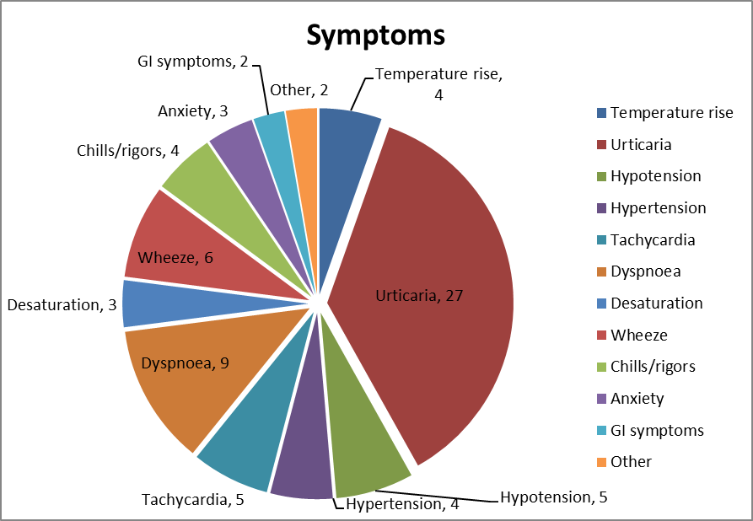
Anaphylaxis/ Hypersensitivity
Clinical Outcome
Complete Recovery: 31
Minor Sequelae: 1
IgA levels: 12
IgA levels within normal range: 12
Notes:
Urticaria was most reported symptom, other common symptoms included hypo and hypertension, dyspnoea and wheeze.
Antihistamines and steroids were most commonly administered. 4 patients received adrenaline

Slide 16

Anaphylaxis/Hypersensitivity
Pre- medication with antihistimines may be considered in those with recurring reactions.
In cases of severe and/or recurrent allergic reactions with worsening symptoms, washed cellular blood products may be considered.
If subsequent transfusions are required, these should only be carried out where patients can be observed directly.
All areas administrating blood components need to be appropriately equipped and staff trained to manage a severe allergic reaction.
Notes:
As per SHOT 2023- steroids should not be used routinely.

Slide 17
Anaphylaxis /Hypersensitivity
Background:
Male aged 18-30 years with a history of B-cell acute lymphoblastic anaemia received 2 units of pooled platelets. Patient had extensive transfusion history and received 1 unit of pooled platelets prior to this reaction with no issues
Symptoms :
Transfusion was stopped and discontinued as the patient developed:
Urticaria on trunk
Dyspnoea
Wheeze
Feeling of throat tightening and angioedema to face, trunk, arms, and lips
Intervention:
oxygen
IV hydrocortisone
piriton
adrenaline nebulisers
Outcome:
Complete recovery in 30 minutes

Slide 18

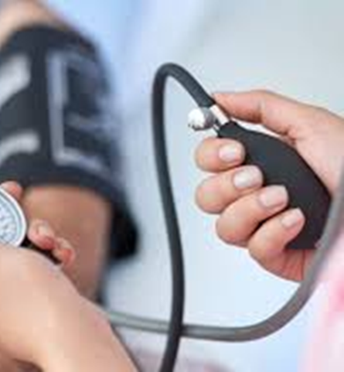
Hypotensive Transfusion Reactions
The NHO received 4 reports of hypotensive transfusion reactions, 3 of these were accepted and 2 were considered mandatory.
Case | Gender | Age | Component | Imputability | Intervention | Outcome | Detail
1 | Male | 70+ | RBC | Possible | IV fluids | Complete recovery | BP drop to 96/56, 20 minutes into Transfusion
2 | Male | 70+ | RBC | Possible | IV fluids, steroids | Complete recovery | BP dropped to 78/49 1hrs and 20 minutes into donation
3 | Female | 70+ | RBC | Possible | IV fluids | Complete recovery | BP dropped to 69/41, Pt had headache, nausea and weakness

Slide 19

Unclassified Transfusion Reactions
Unclassified SAR is the occurrence of an adverse symptom / sign with no risk factor other than the transfusion and which on its own does not allow the reaction to be classified within the defined categories of SAR
Notes:
Unclassified reactions are those that occur whereby the patients symptoms do not fit into any already defined SAR category.

Slide 20
Unclassified Transfusion Reactions 2007-2023
Notes:
The number of unclassified SARs has increased. This increase might be due to associating unusual symptoms to a transfusion

Slide 21
Unclassified Transfusion Reactions
Findings
12 Reports received
11 Reports accepted
9 Reports Mandatory
Males vs Females
Males=5
Females=6
Demographics
12-17 yr=1
18-30 yr= 3
31-50 yr=1
51-70 yr= 2
70+= 4
Component | Number of Cases n=11
Red Blood Cells | 9
Platelets Apheresis | 1
Platelets Pooled | 1

Slide 22
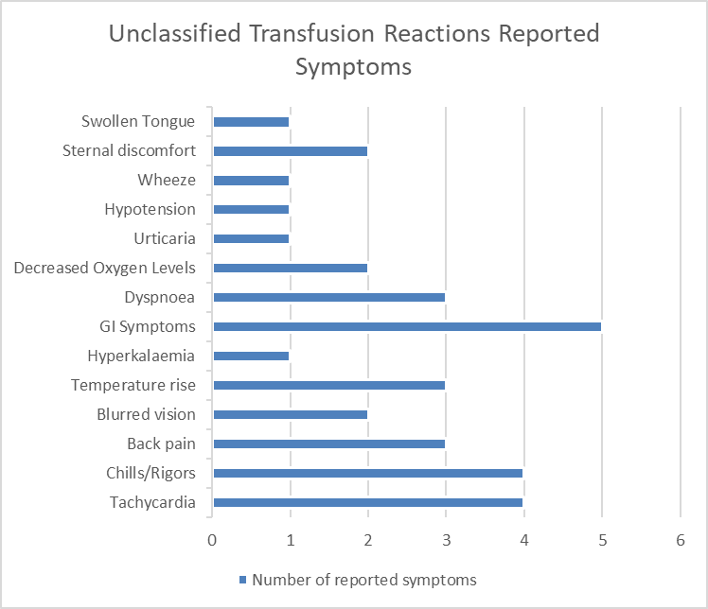
Unclassified Reactions
Notes:
They were associated with a variety of symptoms which didn’t allow the reaction to be classified into a SAR category. GI symptoms were most commonly reported.

Slide 23
Unclassified Reactions
Clinical Outcome:
Complete Recovery= 8
Minor Sequalae= 3
Notes:
Treatment also varied with anti pyrectics being most commonly administered

Slide 24
Unclassified Transfusion Reaction
Background:
Male patient aged 18-30 years with acute myeloid leukemia was transfused one unit of red blood cells for anaemia. Hb pre transfusion was 6.5g/dl.
Symptoms
Transfusion was stopped and discontinued after twenty-seven minutes as the patient developed:
abdominal pain,
backpain
chest tightness
hypotension
light headedness
blurred vision
patient was clammy but had no associated fever
Investigations:
Clinical screening out ruled haemolytic transfusion reaction and bacterial contamination.
CT abdomen/pelvis was undertaken, and results indicated no evidence of intra-abdominal bleeding.
Intervention:
oxygen
antihistamine
steroids
opioids
intravenous fluids
Outcome:
Complete recovery in 3 hours

Slide 25

Acute Haemolytic Transfusion Reactions (AHTR)
The NHO did not receive any reports of AHTR in 2023.
We received one report in 2024 whereby a O+ patient received 4 units of B+ RBC.
Ireland has collected 7 reactions of Haemolysis due to ABO incompatibility. Of these 4 reactions were due to WBIT. All patients made a complete recovery
Notes:
I would be remiss
It highlights the importance of patient identification

Slide 26
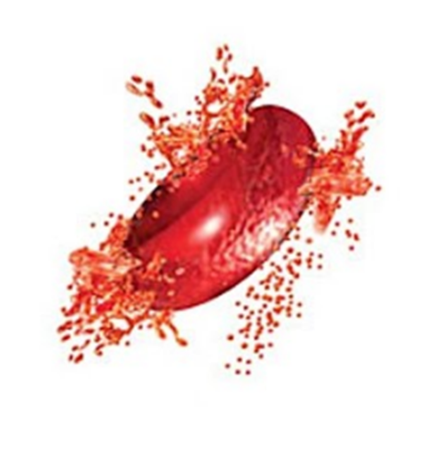
Delayed Haemolytic Transfusion Reactions (DHTR)
Findings
6 Reports received
Males vs Females
Males=0
Demographics
18-30 yr= 1
6 Reports accepted
2 Reports Mandatory
Females=6
51-70 yr= 1
70+= 4
Components
Notes:
May suggest that they were previously exposed to the antibody through pregnancy

Slide 27
Delayed Haemolytic Transfusion Reactions (DHTR)
Case No | Age | Gender | Findings | Antibody Identified | Outcome | Timeframe for developing antibody | Reaction caused by error
1 | 70+ | Female | ↑LDH | Anti-JKb | Complete Recovery | 2 weeks | No
2 | 70+ | Female | ↓Haptoglobin ↑LDH | Anti-Jka | Complete Recovery | 2 weeks | No
3 | 51-70 yrs | Female | ↑ Bilirubin ↑LDH ↓ Hb | Anti-Fya | Complete Recovery | 4 days | No
4 | 70+ | Female | ↑LDH Positive DAT ↓ Hb | Anti-Fya | Complete Recovery | 8 days | No
5 | 18-30 yrs | Female | ↑ Bilirubin, ↑LDH ↓ Hb | Anti-JKb, Anti-Fya, anti-S | Complete Recovery | 16 days | No
6 | 70+ | Female | ↓ Hb ↓Haptoglobin ↑ Bilirubin | Anti-Fya | Complete Recovery | 12 days | No
Notes:
Antibodies identified- Duffy -Fya 4, Kidd- Jka 1, JKb-2 and MNS- anti S-1
Timeframe to develop antibody ranged from 4 days to 2 weeks.

Slide 28
Delayed Haemolytic Transfusion Reactions (DHTR)
As many DHTR reactions occur when the patient has been discharged it is important that patients receive information on the signs and symptoms before leaving hospital.
If a patient has a known antibody educate the patient so that they can provide this information if future transfusions are indicated.
Notes:
These reactions often go unnoticed and may be asymptomatic.

Slide 29
Pulmonary Transfusion Reactions
Notes:
TACO has been the most commonly reported pulmonary transfusion reaction.

Slide 30
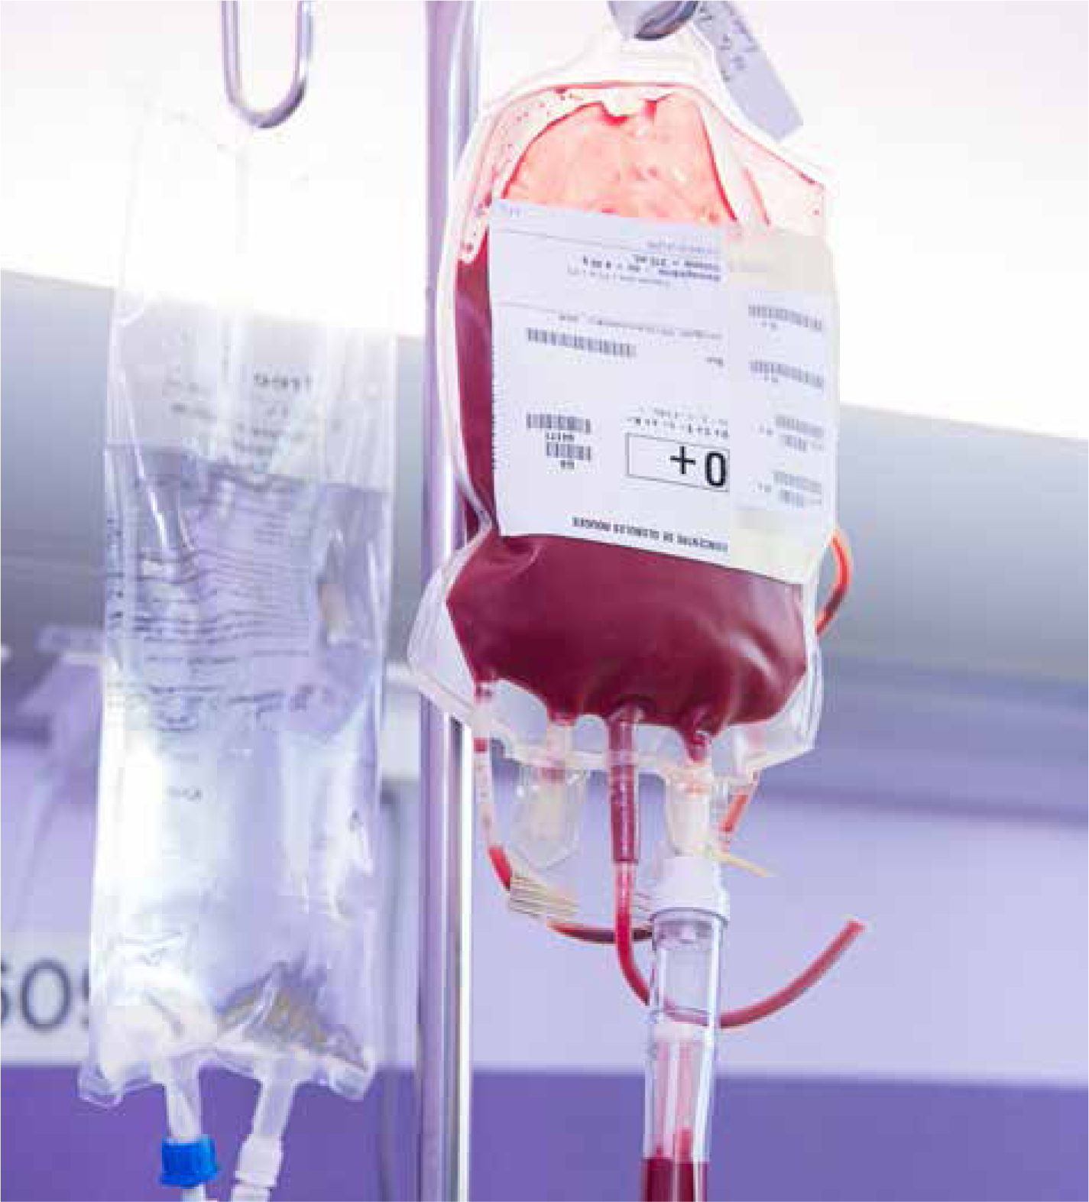
Transfusion Associated Circulatory Overload
Patients with TACO will present with acute or worsening respiratory compromise this might manifest as increased respirations, dyspnoea, cyanosis, wheezing or oxygen desaturation. Other accompanying symptoms might include hypertension, tachycardia, jugular venous distention, fever, and peripheral oedema.
Incidence of TACO are increasing internationally, factors causing this increase are unknown but there are two hypothesis
Increased recognition = increased reporting
Aging population (increased TACO risk factors)
Notes:
On April 4th 2024 the MHRA issued a national patient safety alert as they noticed an increase in TACOs in the UK.

Slide 31
TACO 2007-2023
Notes:
This slide depicts the number of TACOs received from 2007-2023 it also includes if they were categorised as mandatory or non mandatory. Mandatory TACOs overtook non mandatory in 2019 and this was due to changing TACO definition

Slide 32
Transfusion Associated Circulatory Overload
Findings
34 Reports received
Males vs Females
Males=22
Demographics
Infant 1-4 yrs=1
32 Reports accepted
30 Reports Mandatory
Females=10
18-30 yr= 1
51-70 yr= 6
70+= 24 (75%)
Component | Number of Cases n=32
Red Blood Cells | 32
Received RBC prior to implicated unit | 8
Multiple components | 1

Slide 33
TACO Risk Factors
Underlying Patient Cardiac, Renal and Respiratory Co-Morbidities
Cardiac | 26
Renal | 6
Respiratory | 12
Cardiac/Renal/Respiratory | 1
Cardiac/ Renal | 2
Cardiac/Respiratory | 8
Renal/Respiratory | 0
Positive Fluid Balance: It was difficult to determine if patients had a positive fluid balance prior to transfusion due to incomplete or absent fluid balance charts (n=25). Where fluid balance was completed n=4 patients had a positive balance.
Patient Weight: Like fluid balance this was not always recorded (n=9). When recorded:
>70kg= 11
60-69Kg= 1
50-59Kg=6
40-49Kg=4
<40Kg=1
B-type natriuretic peptide (BNP):
Raised BNP- n=8
No Pre BNP results available but results elevated- n= 7
BNP not performed- n=7
No significant increase in BNP- n=10
Notes:
The majority of patients had preexisting co-morbidities with cardiac issues being most prevalent with 26 reports. A number of patients also had more then one underlying risk factor.
Incomplete fluid balance and patients weights was common. With 25 out of 32 reports had an incomplete fluid balance and 9 had no weight recorded.
15 patients had a raised BNP post transfusion with 7 having no pre BNP but post BNP was elevated. 7 had no BNP performed.

Slide 34
Transfusion Associated Circulatory Overload
Treatment:
Diuretics= 28
Oxygen Therapy=22
Nebulizers/inhalers=12
Steroids=4
Anti-pyretics=4
Clinical Outcome:
Complete Recovery= 22
Minor Sequalae= 7
Death (unrelated to transfusion)= 3
Notes:
Not surprisingly respiratory compromise common with reports of dyspnoea, desaturation and wheeze.
Diuretics was the most common treatment.

Slide 35
TACO as a result of an error
3 out of the total 32 accepted TACO cases reported occurred as a result of an error with Human Failure been identified as the main cause of error.
Use of a TACO checklist would have identified these patients as high risk.
A total of 9 patients had a pre transfusion Hb >8.0 g/dl
Case Number | Age | Imputability | Human Failure | System Failure | Error Cause
1 | Elderly (70+) | Likely / Probable | Yes |  | Verbal instruction to transfuse 2 units in 45 minutes in hypotensive (non-bleeding) patient with cardiac history.
2 | Elderly (70+) | Likely / Probable | Yes | Yes | Patient with pre-existing cardiac problems, unit transfused too quickly
3 | Adult (51 - 70 years) | Likely / Probable | Yes |  | Weight of patient not taken on admission <50Kg and history of CCF, high TACO risk.
Notes:
3 out of the total 32 accepted TACO cases reported occurred as a result of an error with Human Failure been identified as the main cause of error.
The first 2 cases RBC were administered too quickly in a patient with a cardiac history.
Final case weight of patient not taken on admission <50Kg and history of CCF.
Use of a TACO checklist would have identified these patients as high risk.

Slide 36

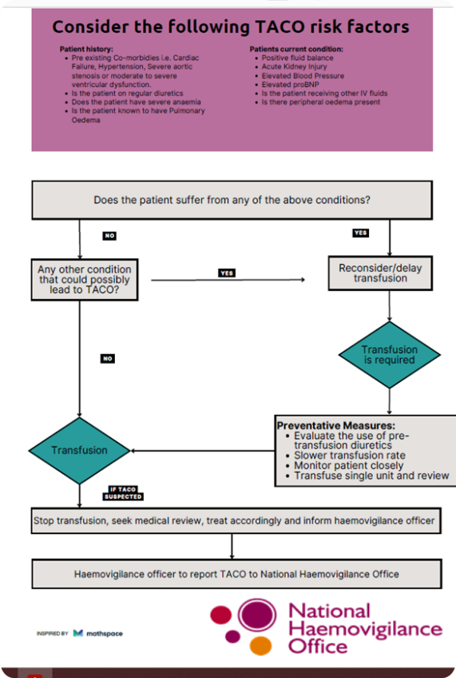
TACO Prevention
Avoid unnecessary transfusions.
Order single-unit transfusion.
Avoid transfusions more than recommended infusion rates.
Assess need for diuretic.
Ensure that fluid balance is documented prior to transfusion.
Complete a pre-transfusion TACO checklist.
Notes:
The pre transfusion patient-side safety check provides a final opportunity for staff to identify errors ensuring the right component is transfused. These safety checks serve as safety pauses to ensure staff safeguard patient well-being and prevent life threatening complications.

Slide 37

Transfusion Associated Dyspnoea (TAD)
TAD is defined as any respiratory distress within 24 h of transfusion that does not meet the criteria of TRALI, TACO or an allergic reaction and that cannot be explained by an underlying condition or any other known cause.
TAD is a clinical diagnoses of exclusion

Slide 38
Transfusion Associated Dyspnoea (TAD)
Background:
77 year old female patient received 1 unit of RBC for anaemia (Hb-7.7g/dl).
Symptoms (30 minutes into Transfusion):
Temperature rise
Tachycardia
Dyspnoea
Falling O2 saturations (90%-78%)
Intervention:
Oxygen
Steroids
Nebuliser's
Outcome:
Complete recovery

Slide 39
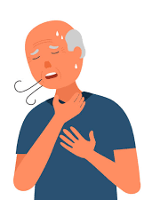
Transfusion Associated Dyspnoea (TAD)
It is important to provide as much detail as possible so correct categorization can be made.
Badami, K.G., Joliffe, E. and Stephens, M., 2015. Transfusion‐associated dyspnoea–shadow or substance?. Vox sanguinis, 109(2), pp.197-200.
Found that many reported TADs when retrospectively reviewed were TACO.
Notes:
Transfusion Reactions that were classified as TAD were re-reviewed using patient case notes. TACO was the reclassification in 16%/22%.

Slide 40

Suspected Transfusion Reaction
In the event of a transfusion reaction:
STOP the transfusion
Check that patient identity/ documentation and component are correct
Keep IV line open
Assess vital signs
Inspect the blood unit for any unusual clumps, or discolouration suggestive of bacterial contamination.
Seek medical review (patient can deteriorate rapidly).
Depending on suspected reaction specific treatment will be required.
Report reaction to blood bank and IBTS/ NHO where applicable
Continuing the transfusion should only occur after clinical assessment and medical review.
  Recommendations:
  Educate patient to self-report symptoms before commencing transfusion.
  Educate patient on discharge on signs or symptoms of a delayed transfusion reactions.
  Use a TACO checklist.
  Continue reporting cases with unusual symptoms or those reactions which may not fit into the criteria already in place.
  Avoid unnecessary transfusions

Slide 41


