Slide 1
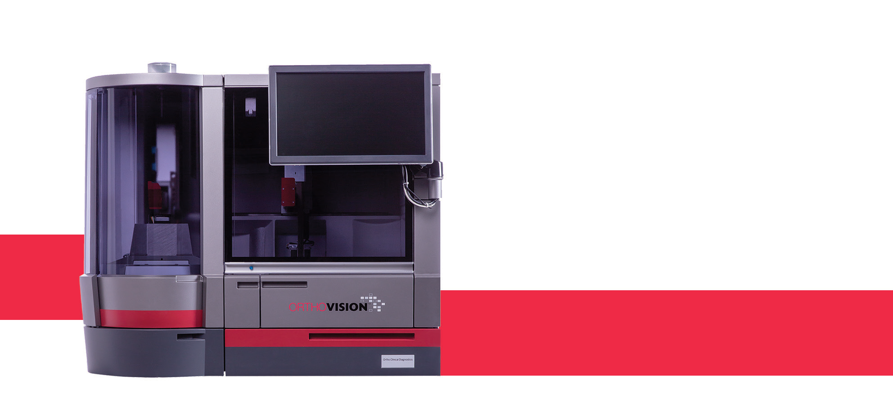
Ortho Vision Validation and Operation in RCI
Aisling Costelloe
Senior Medical Scientist
RCI Laboratory
Aisling.Costelloe@ibts.ie

Slide 2
Ortho Vision Validation and Operation in RCI
Role of RCI laboratory
Analyser requirements
Validation Process
Ortho Vision Validation – PQ
Validation Outcomes
Validation Deviations/Findings
Interface testing
Ortho Vision- Go Live
Ortho Vision Operation

Slide 3
Role of the RCI Laboratory
Hospital Blood Bank (3 institutions)
Red Cell Immunohaematology referral laboratory
2,500 samples per year (92% are complex in some way)
Antenatal testing
Investigation of complex patient samples
Red Cell Importation
Resolution of ABO/Rh anomalies
Research
Publish novel, unusual and interesting findings.
Notes:
Crossmatch and issue units for complex cases – which hospitals are unable to solve.
Undertake complex investigations involving rare red cell antigens and antibodies.

Slide 4
Analyser requirements
Blood Grouping & Rh/K phenotyping
Perform routine antibody ID (single specificities e.g. anti-D, anti-c
Perform antibody titrations
Perform red cell phenotyping
Perform compatibility testing
Overall perform more automated work to free bench for research/project work

Slide 5
Validation Process
URS/Tender Process
Validation Plans (IQ/OQ/PQ)
+
Writing SOPs
+
Development & Testing of LIS/Ortho Vision Interface
+
Staff training
Go live and post performance monitoring for 3 months

Slide 6
Ortho Vision Validation
IQ
Software installation verification
Hardware installation verification
System Configuration
OQ
Standard Operating procedures verification
Operator qualification
Installation verification by vendor
Operational verification
Consumables loading and verification
Alarm/ Antivirus verification
Backup and recovery verification

Slide 7
Ortho Vision Validation- PQ
Each assay tested under the following headings:
Sensitivity (including Limit of Detection)
Repeatability
Test and Process Robustness (Cross contamination)
Reproducibility
Intra assay Reproducibility (Repeatability)
Inter assay Reproducibility / Parallel
Notes:
Repeatability = one time point (repeat 10 times in one day)
Intra assay reproducibility = 3 different time points (Day 1, Day 4, Day 7)

Slide 8
Ortho Vision Validation- PQ
Assays validated:
ABO/Rh Typing
Antibody Screening
Rh/K Phenotyping
Antibody Identification
Compatibility Testing
Direct Antiglobulin Test (DAT)
Extended Phenotyping
(Duffy, Kidd, MNS, k, Cw, Kpa, A1, P1, Lea, Leb, Lua)
Notes:
ABO/Rh Typing Extended pheno 25 (10,10 & 5)
Tested each ABO/Rh group 36
Tested D variant samples (e.g. Weak D, DVI)
Tested samples at day 7
DAT positive samples
Neonate samples
ABO anomaly samples (e.g. A2, A3, Ax)

Slide 9
Validation Outcomes
Assay | Outcome
ABO/Rh Typing | PASS
Antibody Screening | PASS (with deviations*)
Rh/K Phenotyping | PASS
Antibody Identification | PASS (with deviations*)
Compatibility testing | PASS
Direct Antiglobulin Test (DAT) | FAIL
Extended Phenotyping (Duffy, Kidd, MNS, k, Cw, Kpa, A1, P1, Lea, Leb, Lua) | PASS (with deviations*)
Notes:
Deviations = didn’t completely comply with acceptance criteria?

Slide 10
Validation Deviations/findings
Assay | Deviations/findings | Action by RCI
ABO/Rh Typing | None | N/A
Antibody Screening | 1.Weak anti-E not detected 2. Enzyme only anti-E not detected | Performed LoD testing using anti-E sample The detection of weak antibodies is a known serological limitation. Weak antisera controls are in place for antibody screen testing.
Rh/K Phenotyping | None | N/A
Antibody Identification | 1. Unable to perform ENZ-IAT technique on Ortho Vision 2. Weak anti-E not detected 3. Cross-contamination occurred on three separate occasions | 1. Perform ENZ technique on Ortho Vision as opposed to ENZ-IAT. 2. As above 3. a. Daily probe maintenance blocked b. Fresh vial of BSA used daily c. Vials of reagent cells are numbered to avoid potential carryover
Notes:
Anti-E (different samples from same patient). Xcontamination – with anti-CD38, involving antisera controls and anti-Jka antisera when titred
Limit of Detection (Antibody Screen):
Anti-E (Titre: 64) – OV LoD=256
Anti-E (Titre:16) – OV LoD=64
Limit of Detection (Antibody Identification):
Anti-E (Titre:256) – OV LoD= 1024
Anti-E (Titre:1) – OV LoD= 128
ENZ-IAT – expand , background noise etc.

Slide 11
Validation Deviations/findings
Assay | Deviations/findings | Action by RCI
Compatibility testing | Incompatibility not detected between Fya+ donor cells and patient sample containing anti-Fya. | Incompatibility not detected by manual BioRad. Incompatibility was not detected due to sample condition. No corrective action required.
Direct Antiglobulin Test (DAT) | False negative results obtained with Ortho Vision for EQA samples only | RCI did not progress with DAT testing on Ortho Vision
Extended Phenotyping (Duffy, Kidd, MNS, k, Cw, Kpa, A1, P1, Lea, Leb, Lua) | Anti-N negative control giving positive results | RCI did not progress with N phenotype
Notes:
DAT false negative
EQA
Donor sample via ADG

Slide 12
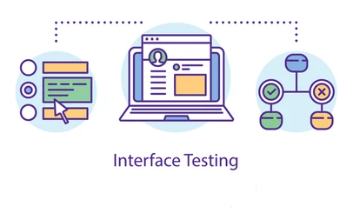
Interface testing
LIS = eTraceline (MAK)
Development of result transfer between IBTS-MAK-Ortho/Brennans
Multi-departmental

Slide 13
Ortho Vision- Go Live
Go live date: March 2021
4 x test samples ran initially which covered all testing profiles
Issues on go live:
Interface related only
Training
Basic training provided for all staff in advance
Priority given to on-call staff

Slide 14
Ortho Vision Operation
Advantages
Automated assays for previously manual methods
Titration
ID
Use of NHSBT panel for exclusions
Phenotyping
Bidirectional interface
Transfer of reaction grades, reagent lot #/ expiry date direct to patient file on LIS
QC tracking
Product & Lot No. easily tracked
Usage data available

Slide 15
Ortho Vision Operation
Disadvantages
TAT
Multiple different test profiles run at once
Sample Volume (system uses 50ul of plasma for Ab ID)
ENZ-IAT not available
Unable to modify sample type
Unable to register anti-Fya as a control (Antibody screen/ID gives discrepant results and thus fails QC)

Slide 16
Ortho Vision Operation
Incidents since go live:
Errors with interface
Weak Anti-D not detected by Ortho Vision – detected by manual BioRad technique
All negative results by ENZ and IAT are confirmed with manual ENZ-IAT
Phenotyping controls
M Type [Error: “?” or “TFC”]
Fyb Type [<2+ reactions i.e. not acceptable]

Slide 17
THANK YOU!

