Slide 1
Anti-Jra & importation of red cells amid a global pandemic.
Aisling Costelloe
SMS
RCI Laboratory

Slide 2
Overview
Background
RCI Serological Work Up
RCI Laboratory Test Results
JR blood group system
Anti-Jra
Clinical Management
Red Cell Importation during a global pandemic
Patient and Infant Outcome

Slide 3
Background
Antenatal patient, second pregnancy
Routine booking sample received at RCI Laboratory
Pan-reactive IAT and ENZ panels
Auto: Neg DAT: Neg
Sent for antibody investigation and antenatal workup

Slide 4
RCI Serological Work Up
Blood Group: B RhD positive
Rh/K Phenotype: C+ E- c- e+ K- (R1R1)
Extended Phenotype: Fy(a+b-) Jk(a+b+) M+ S- s+ k+
Antibody Panel Results:
DAT: Negative
Cell | 1 | 2 | 3 | 4 | 5 | 6 | 7 | 8 | 9 | 10 | 11 | Auto
IAT | 2+ | 2+ | 2+ | 2+ | 2+ | 2+ | 2+ | 2+ | 2+ | 2+ | 2+ | 0
ENZ-IAT | 3+ | 3+ | 3+ | 3+ | 3+ | 3+ | 3+ | 3+ | 3+ | 3+ | 3+ | NT

Slide 5
RCI Serological Work Up
Patient’s ethnicity = Chinese
SCARF programme
  Access to rare cells and antisera internationally
  Rare reference cell and antisera database at RCI
High incidence antibodies suspected:
  Jk3, Ge3, PP1Pk, Oka, Jra [Vel, Coa, Dib, Lua-b-, Sda, Lan]

Slide 6
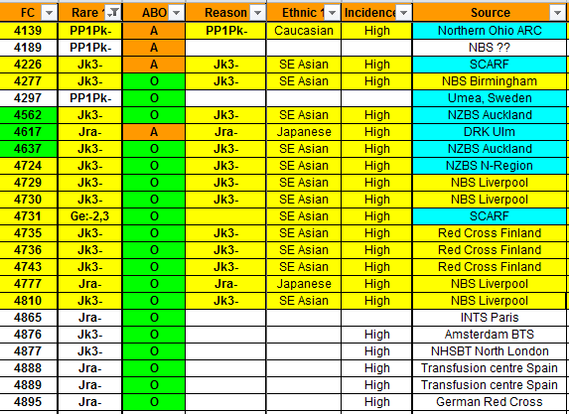
RCI Serological Work Up

Slide 7
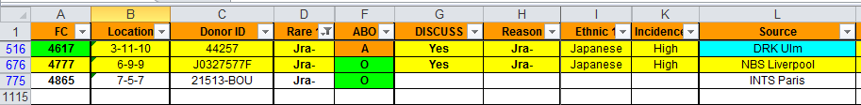

RCI Serological Work Up
High frequency antibody was identified as “Anti-Jra”
The presence of other clinically significant antibodies were excluded following allo-adsorption.
3 x rare anti-Jra antisera available however none suitable for Group B
Sample was referred to IBGRL for Jra phenotyping

Slide 8
RCI Laboratory test results RCI
Gestation | Result | Comment
12 | B D(+) anti-Jra | Titre (1)
16 | B D(+) anti-Jra | Titre (4)
20 | B D (+) anti-Jra | Titre (8)
24 | B D (+) anti-Jra | Titre (2)
28 | B D(+) anti-Jra | Titre (1)
Notes:
Results consistent low titre score and no additional alloantibody formation

Slide 9
JR Blood Group System
1970
Stroup & Macllroy described antibody observed in 5 Caucasian antenatal patients
Called “Jra” after patient Rose Jacobs
1990
ISBT Working party assigned JR blood group to the 901 series of high incidence antigens. The associated gene for the antigen was unknown at that time
Genetic basis of Jra antigen described by two independent groups(Zdinski et al, 2012 and Saison et al,2012)
Became JR Blood Group System [ISBT Number 052]
2012

Slide 10
Jra Antigen
The Jra antigen is located on ABCG2 transporter, a multipass membrane glycoprotein
Encoded by the ABCG2 gene- Located on long arm of chromosome 4

Slide 11
ABCG2 Transporter
ATP-binding cassette (ABC) transporter situated on cell membrane
It functions in transporting a broad spectrum of substrates out of the cell (detoxifying role)
A.k.a breast cancer resistance protein – due to its ability to confer mulitidrug resistance during chemotherapy
Notes:
Uses ATP energy to actively transport a wide range of substrates out of the cell – including chemotherapeutic agents

Slide 12
ABCG2 Transporter
It is widely expressed in normal cells and tissues e.g.
  Capillary endothelial cells,
  GI cells
  Hematopoietic stem cells
  Tissue of the liver, kidney and testes
  Maternal glands
    The maternal–fetal barrier of the placenta
ABCG2 expression levels in cord RBCs are higher than those of adults
ABCG2 is overexpressed on the surface of the placental villi therefore if the fetal blood group is Jr(a+), anti-Jra can be readily stimulated in maternal serum during pregnancy.

Slide 13
Jr Inheritance
Jr(a−) blood type have inherited two null alleles of ABCG2 gene.
Null alleles are as a result of frameshift and nonsense mutations
No antithetical antigen has been described thus far

Slide 14
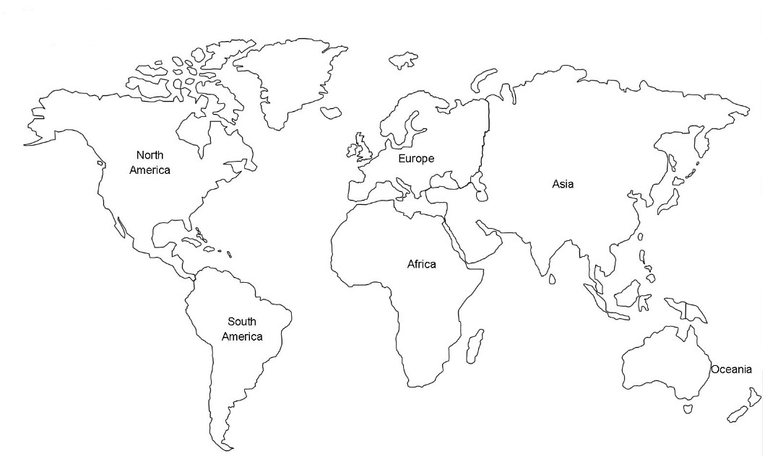
Ethnic Distribution of Jr(a-) phenotype
0.06%
Notes:
Jr(a-) phenotype is rare but it has been reported in a variety of populations
1976 Mexican female
1986 Bedouin Arab women (Israel)
2002 Northern Europe
The phenotype is more prevalent in the Asian population, the frequency is highest in Japan (0.06% approx).
As high as 1 in 58 in Niigata Region
As low as 1 in 3,800 in the Tokyo Region

Slide 15

Anti-Jra
IgG Subclass
Anti- Jra targets the 5D3 region
of the ABCG2 transporter
Majority of examples of anti-Jra have been documented in antenatal setting
Notes:
Important note is that this antibody has haemolytic potential and is potentially significant for HDFN

Slide 16
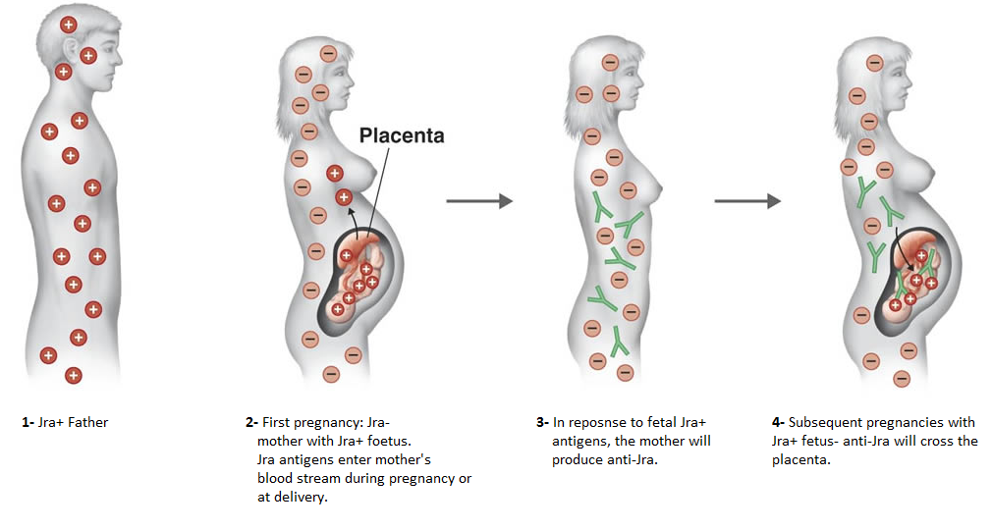
Anti-Jra and allo-immunisation

Slide 17
Clinical Implications of Anti-Jra
Transfusion reactions
  Mild to moderate DHTRs
  One report of acute haemolytic transfusion reaction
HDFN
  Cause of fetal anaemia ranging from mild to severe
  Also reports of:
    Fetal Hydrops
    Mirror Syndrome
Transfusion requirements: It is permitted in a clinical emergency situation or if antigen negative rbc unit(s) not available to transfuse serologically compatible or least incompatible red cells by IAT
Notes:
Results of one study concluded that the density of Jra antigens on the RBC surface is much lower than that of Rh antigens.
Genetically speaking – certain SNPs are useful to compare Jra antigen density It is believed that upon identification of Jra(a−)
and Jr(a + w) phenotypes, attempting gene analysis of genetic bases at positions 376 and 421 is useful when comparing Jra antigen densities. Low antigen density= asymptomatic High antigen density= symptomatic (Endo)
Mirror syndrome- hydrops of foetus, placenta and the mother
Because anti-Jra is so rare, it’s clinical significance is not clear

Slide 18
Clinical management considerations
Consideration | Comment
Avoid transfusion | Iron supplementation, optimum nutrition
Foetal monitoring | MCA Doppler early warning incipient foetal anaemia
Availability of local blood donor | Screen ethnic minority donors Chinese Korean and Japanese (n=84)
International rare donor file | Identify liquid Jra(-) donors and schedule collection
International frozen red cell banks | More difficult logistically, reduced recovery, not all donations qualified (HEV) and reduced shelf life
Notes:
Obtaining antigen negative and compatible donor blood to cover delivery would be difficult
Pregnancy managed to minimise risk of transfusion including iron supplementation and if possible induction of labour
Challenge is to have donor blood available from 37 weeks gestation with maximum shelf life
Contingency is least incompatible (IAT) acceptable in an emergancy

Slide 19
Clinical management considerations
ADG laboratory screen local donors for Jra(-)
RCI laboratory determine compatibility using patient plasma sample
Refer for biological assay (ADCC) to estimate haemolytic potential of antibody
Regulatory compliance of imported units as IBTS has a high compliance regime
Notes:
There was an outside chance of identifying local donor Jra(-) because of increased diversity of Irish population
The antibody dependent cellular cytotoxicity or monocyte monolayer assay could be access to measure haemolytic potential of antibody
IBTS applies anti-hepatitis core antibody and HEV RNA (individual donation) screen to all its donations for qualification
Permission from regulator if imported outside the EU

Slide 20
Biological assay - ADCC
ADCC test result of ≥30% is used to timely select pregnancies at risk for fetal hemolysis
Gestation (weeks) | Result (haemolysis %)
16 | <10
28 | <10
37 | <10
Notes:
Three assays including one at time of delivery indicated low grade haemolysis only

Slide 21
Screen for local donors
Ethnic minority | Result | Confirmed | Comment
n = 84 | One B (D+) Japanese donor (IAT compatible) | IBGRL weak Jra(+) | Reserved as potential donor (IAT compatible)to cover preterm delivery (returned to Japan because of Covid19)
Notes:
One Japanese international student was identified as a potential donor from targeted screening however, donor retured to country of origin due to covid 19 and declined to donate

Slide 22
Importation of red cell components
Challenge | Solution
Identify group O Jra (-) donors | Access Serum Cells and Rare Fluids panel 2 x group O K(-) Jra(-) donors identified in Valencia, Spain
Schedule collection | Scheduled for 36 weeks gestation
Arrange transport (Covid19) | Military aviation explored but civil aviation flights resumed just in time
Temperature controlled shipment and storage | Continuous temperature monitor log and validated storage container 24 hours ( 22 hours shipment time)
Notes:
Two potential donors were identified in Spain and two in Japan
No variation to licence required for importation from within EU

Slide 23
Importation of red cell components
Challenge | Solution
Qualification | ID HEV RNA and anti-hepatitis core antibody testing completed in IBTS on additional donor samples
Labelling | 42 day time expiry applied in Spain required IT work around and quality and compliance approval for release
Notes:
Additional virology testing was completed to qualify donations
Work around to enable e Progesa release
Serological cross match compatible and reserved for patient
Red cell units expiry = 35days (IBTS)

Slide 24
Patient and Neonate Outcome
Emergency delivery by Caesarean section for foetal bradycardia
250 ml blood loss and no transfusion outcome
Neonatal haemoglobin 19g/dl and bilirubin = 19 mmol/l
DAT positive (2+) and anti-Jra eluted
Red cell components recovered into SCARF
Thank you to colleagues in Spain and to donors
Patient has volunteered as a blood donor!!
Notes:
The best transfusion is the one not given
We were prepared and ready and the success is due to collaborative and multi disciplinary working
Transfusion medicine is truly international ( Ireland, the Netherlands and Spain)

Slide 25
References
Tanaka K, Hosoi K, Yoshiike S, Nagahama K, Tanigaki S, Shibahara J, Ohnishi H, Kobayashi Y. Mirror syndrome due to anti-Jra alloimmunization. Taiwan J Obstet Gynecol. 2020 May;59(3):456-459.
Saison C, Helias V, Ballif BA, Peyrard T, Puy H, Miyazaki T, Perrot S, Vayssier-Taussat M, Waldner M, Le Pennec PY, Cartron JP, Arnaud L. Null alleles of ABCG2 encoding the breast cancer resistance protein define the new blood group system Junior. Nat Genet. 2012 Jan 15;44(2):174-7.
Endo Y, Ito S, Ogiyama Y. Suspected anemia caused by maternal anti-Jra antibodies: a case report. Biomark Res. 2015 Aug 21;3:23.
Słomka M, Sobalska-Kwapis M, Korycka-Machała M, Dziadek J, Bartosz G, Strapagiel D. Comprehensive Analysis of ABCG2 Genetic Variation in the Polish Population and Its Inter-Population Comparison. Genes (Basel). 2020 Sep 29;11(10)

Slide 26
References
Ogasawara K, Mazuda T. Characterization of Jra antibodies by monocyte phagocytosis assays and flow cytometry analysis. Acta Haematol Jpn (in Jap) 1990;53:1131-7.
Fujita S et al. Expression levels of ABCG2 on cord red blood cells and study of fetal anemia associated with anti-Jra. Immunohaematology 56 (5): 1171-1181 [https://doi.org/10.1111/trf.13515]
Castilho L, Reid ME. A review of the JR blood group system. Immunohematology. 2013;29(2):63-8. PMID: 24094238.
Koelewijn JM and Slootveg YM et al. Diagnostic value of laboratory monitoring to predict severe hemolytic disease of the fetus and newborn in non‐D and non‐K‐alloimmunized pregnancies. Transfusion. 2019;60(2):391-399

Slide 27


