Slide 1



Transfusion Related Acute Lung Injury
Dr Kieran Morris
NHO Conference
25 March 2025

Slide 2
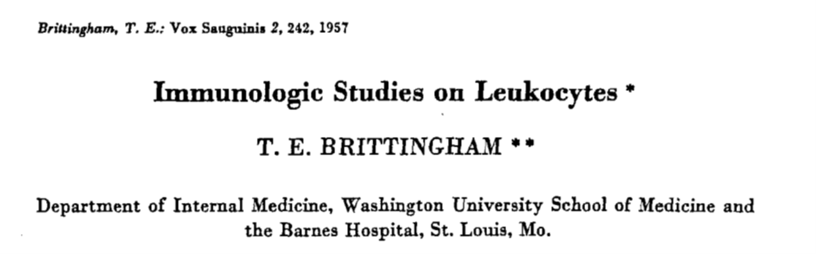

Slide 3
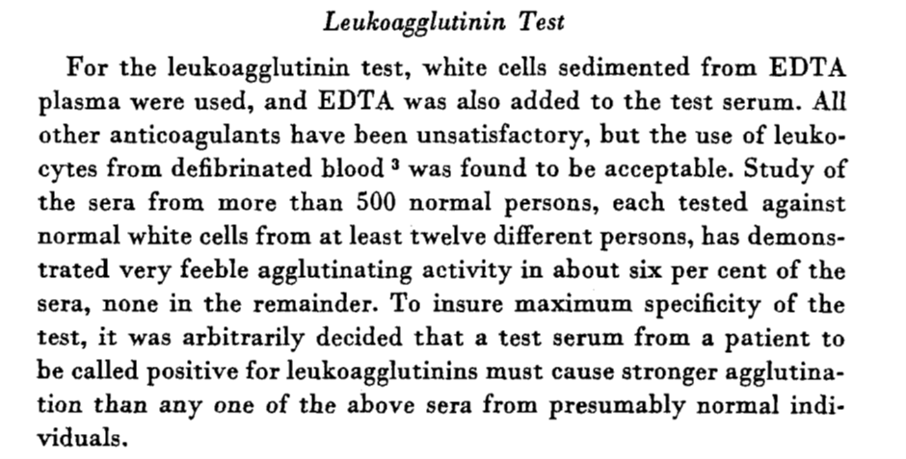

Slide 4
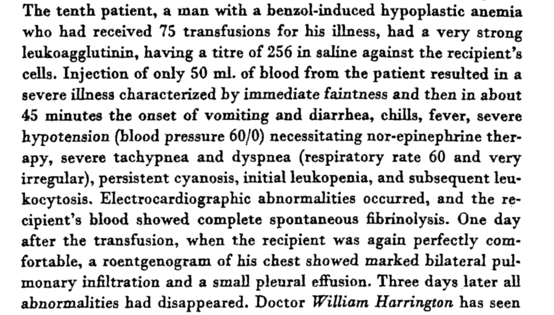

Slide 5
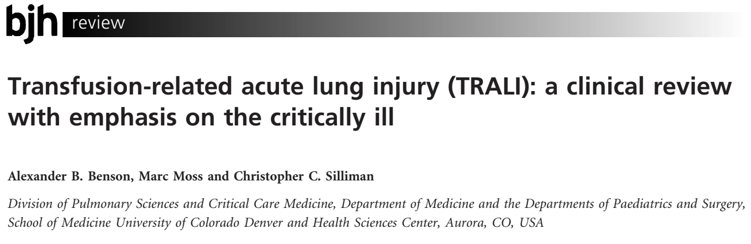


Slide 6
Summary
TRALI is a leading cause of transfusion related morbidity and mortality
It was first given this eponym in 1983
Consensus definitions only emerged in 2004 and remain controversial
Immune mediated TRALI is related to the infusion of donor antibodies that recognise leucocyte antigens in the recipient
Infusion of lipids and other biological response modifiers that accumulate during storage of blood components are also implicated

Slide 7
History
Non-cardiogenic pulmonary oedema during or shortly after transfusion was first described in the 1950s (Barnard, 1951; Brittingham, 1957)
The first case series (n=3) of TRALI was described in 1966 (Phillips & Fleischner, 1966)
Many descriptors have been used including hypersensitivity pulmonary oedema, allergic pulmonary oedema, incompatibility of undetermined nature and anaphylactoid reaction
Popovsky et al (1983) described 5 cases and gave the syndrome its current name TRALI, all 5 donors had leucoagglutinating and lymphocytotoxic in the serum and 3 of 5 recipients expressed the cognate antigen

Slide 8
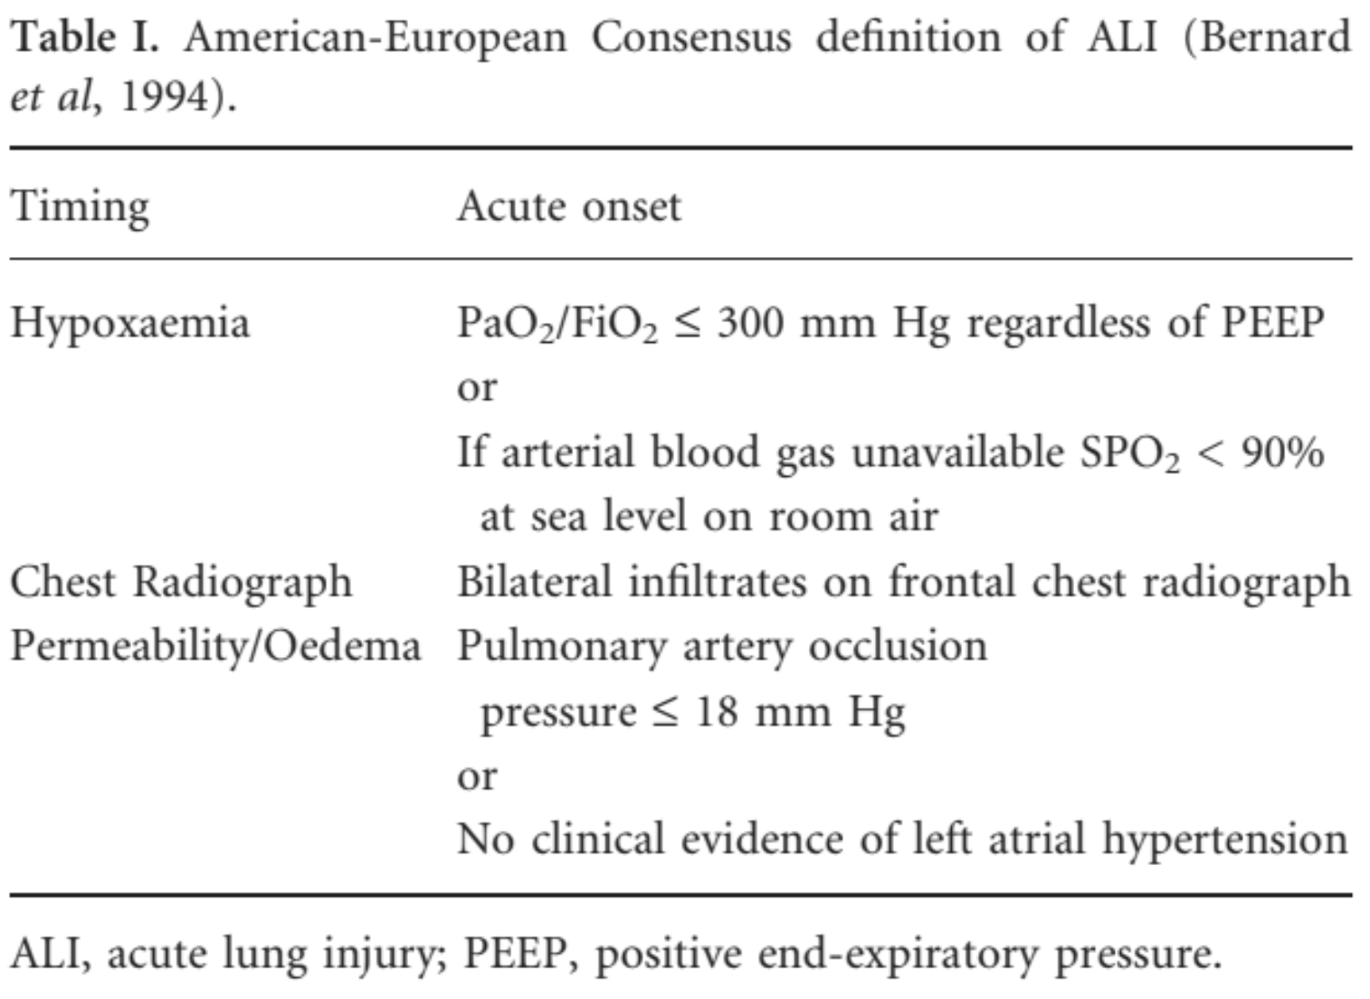

Slide 9
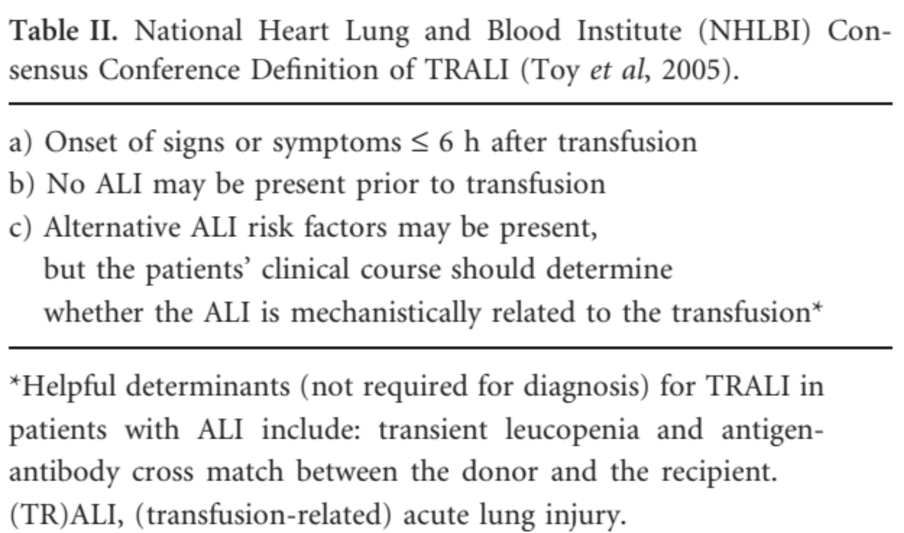

Slide 10
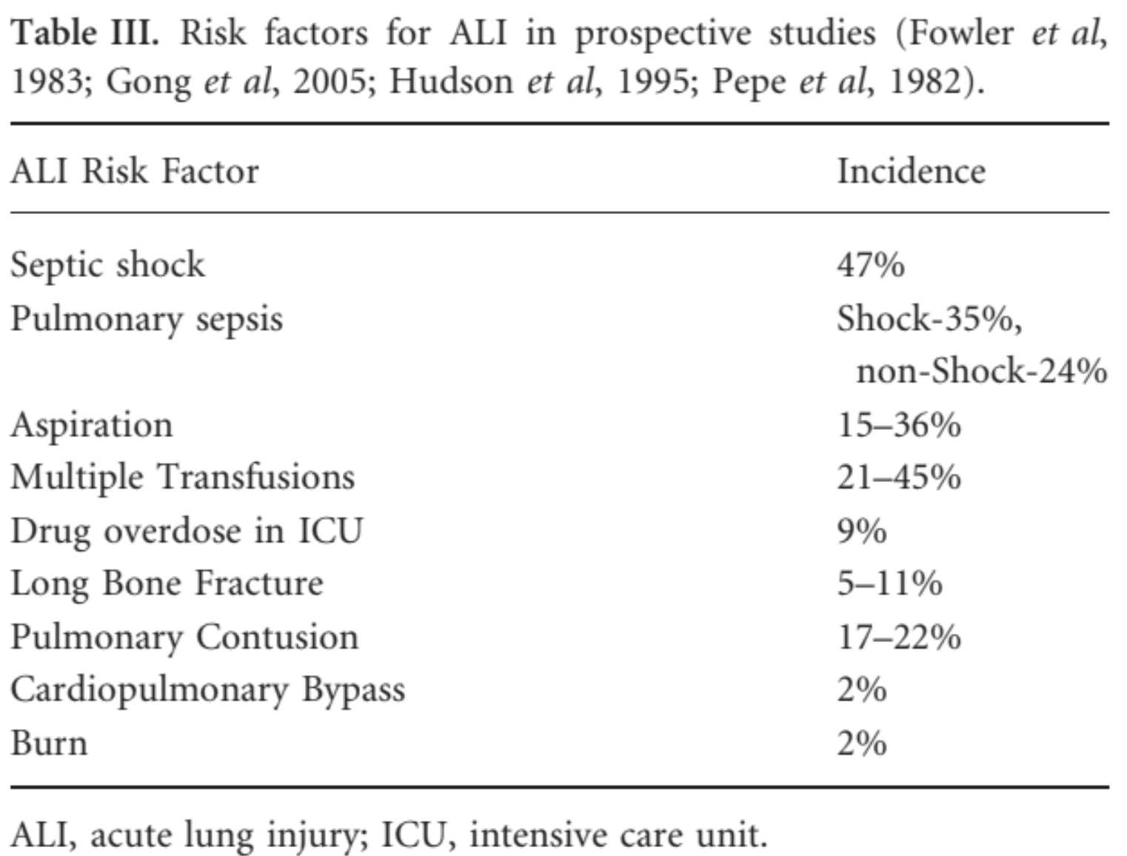

Slide 11
Incidence of TRALI in critically ill patients
In the intensive care unit 37-44% of patients receive blood components rising to 85% in patients with prolonged stay
Incidence of TRALI in critically ill patients is estimated to be 8%, transfusion incidence approaches 40% and 3% of all ICU admissions will develop TRALI (Gajic et al, 2007)

Slide 12
Differential Diagnosis (for patients who develop respiratory distress during or after transfusion)
TRALI
TACO
Anaphylactic transfusion reaction
Transfusion of contaminated (bacteria) blood components

Slide 13
Differential Diagnosis (for patients who develop respiratory distress during or after transfusion)
TRALI is the acute onset of severe dyspnoea, tachypnoea, worsening or new onset hypoxaemia, fever, occasional hypotension and cyanosis
Clinical presentation is clearly recognisable in non-critically ill patients, with 72% eventually requiring mechanical ventilation
In critically ill patients with other ALI risk factors this presentation is common and may not be attributed or linked to transfusion
Differentiating TRALI (permeability oedema) from TACO (hydrostatic oedema) is difficult in critically ill patients, especially in the setting of massive transfusion and resuscitation

Slide 14
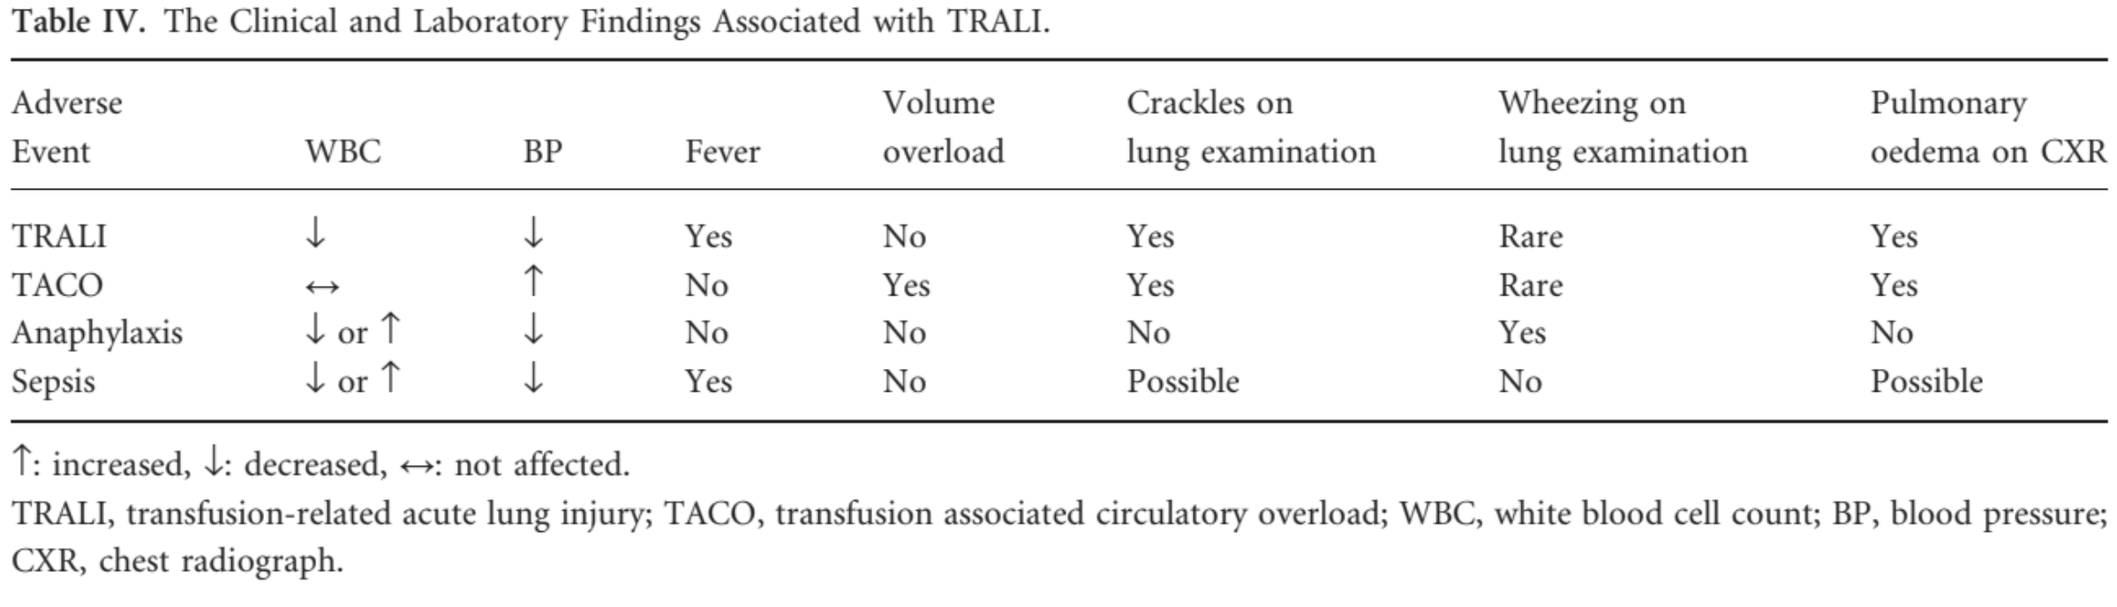

Slide 15
Epidemiology
Incidence of TRALI is variable and underreported (passive surveillance versus active case investigation versus prospective data collection)
TRALI is common in critically ill patients
TRALI is more common with plasma containing blood products
Transfusion increases mortality in patients with existing ALI

Slide 16
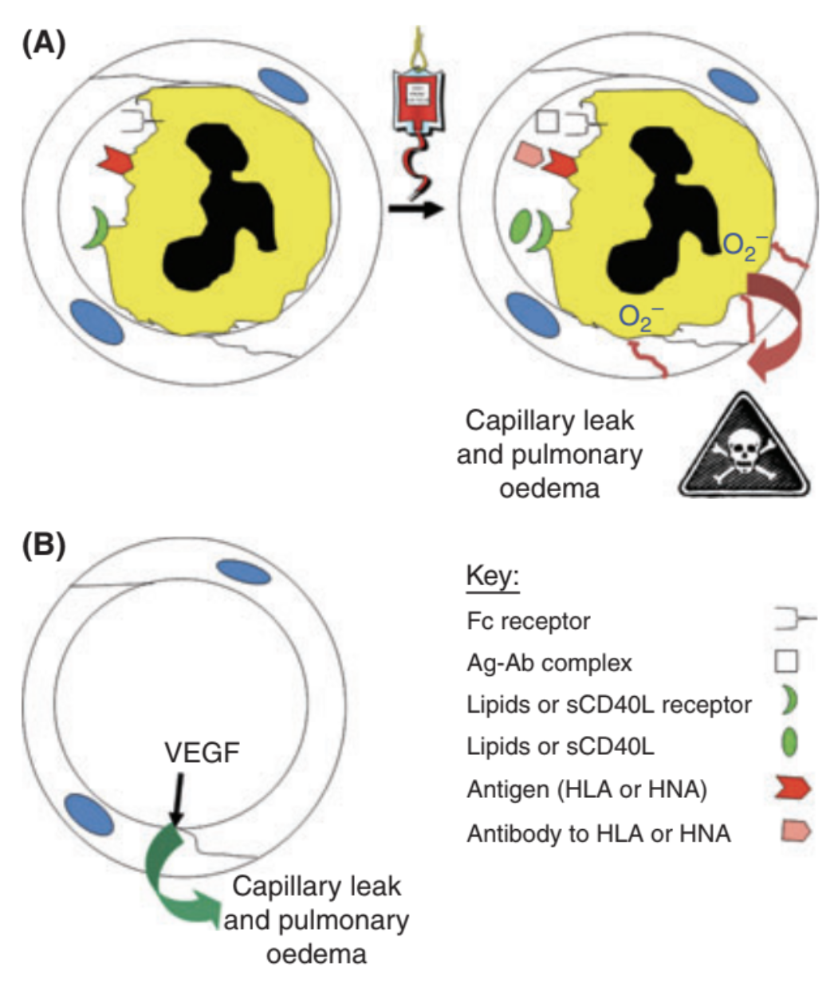
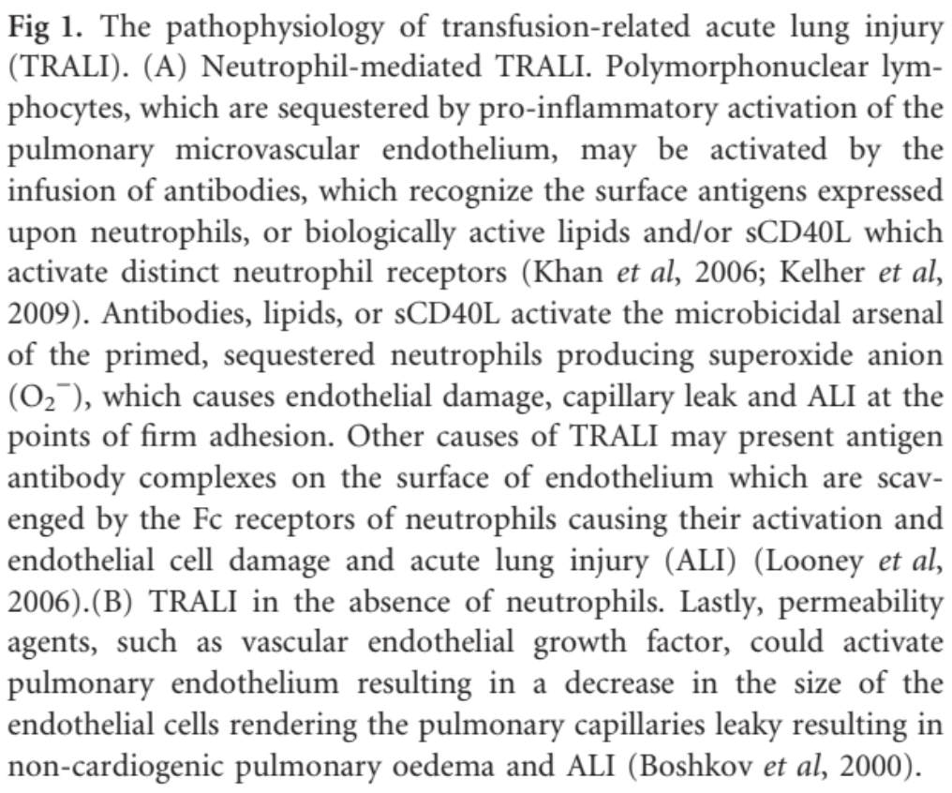
Pathophysiology (the two-event model)

Slide 17
Discussion
Age of blood and TRALI risk
Multiparity and TRALI risk

Slide 18
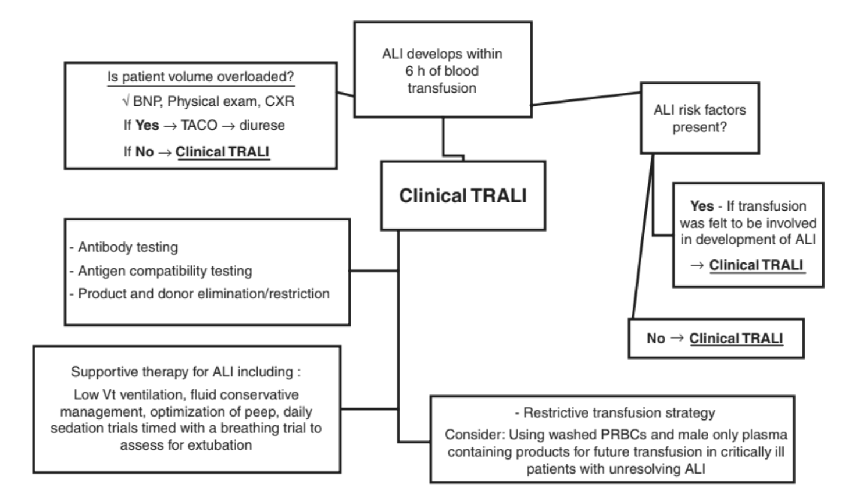
Management

Slide 19
Prevention and Future Directions
Case definition of TRALI
Detailed and complete serology investigations
Trace back and look back procedures
Appropriate use of blood components
Restrictive use of plasma containing components
SD plasma
Prospective randomised clinical trials in critically ill patients to include early and delayed TRALI syndrome

Slide 20
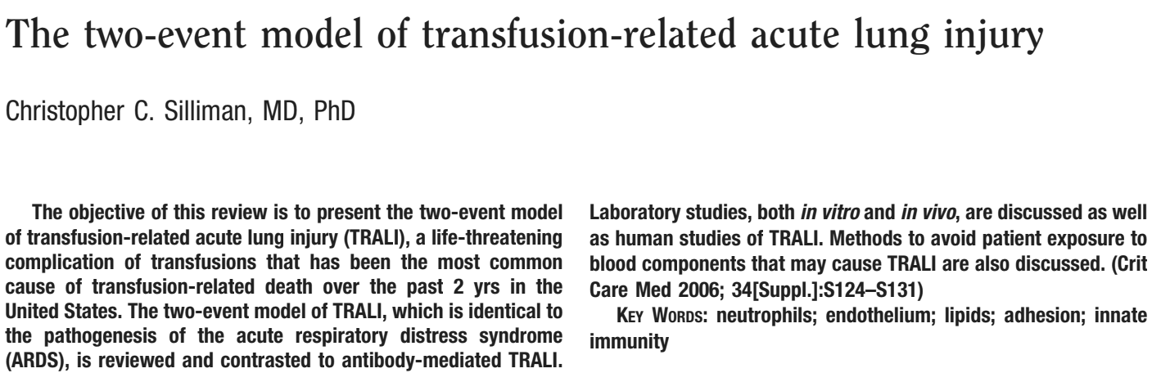

Slide 21
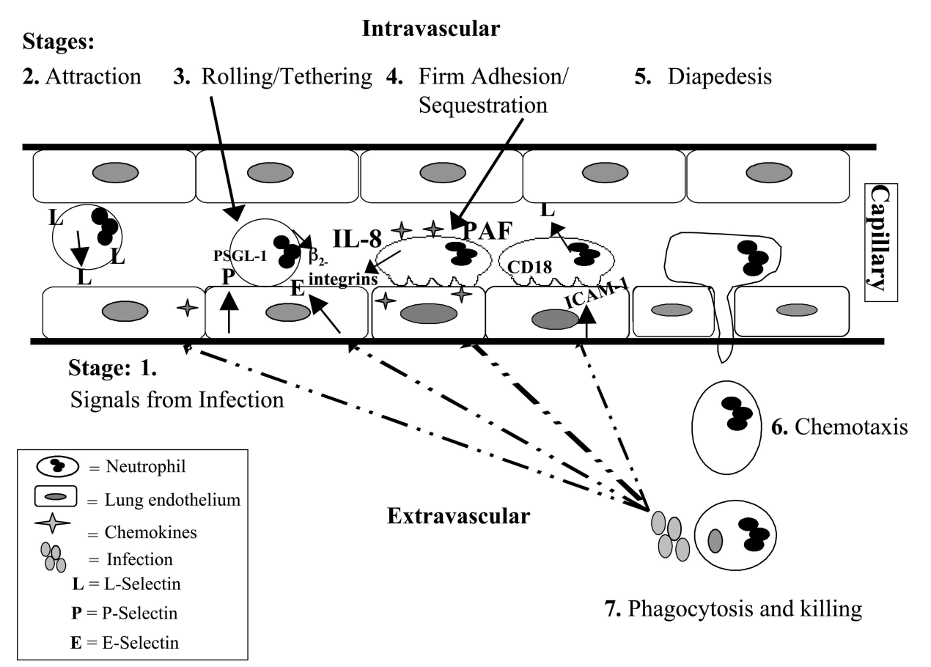

Slide 22
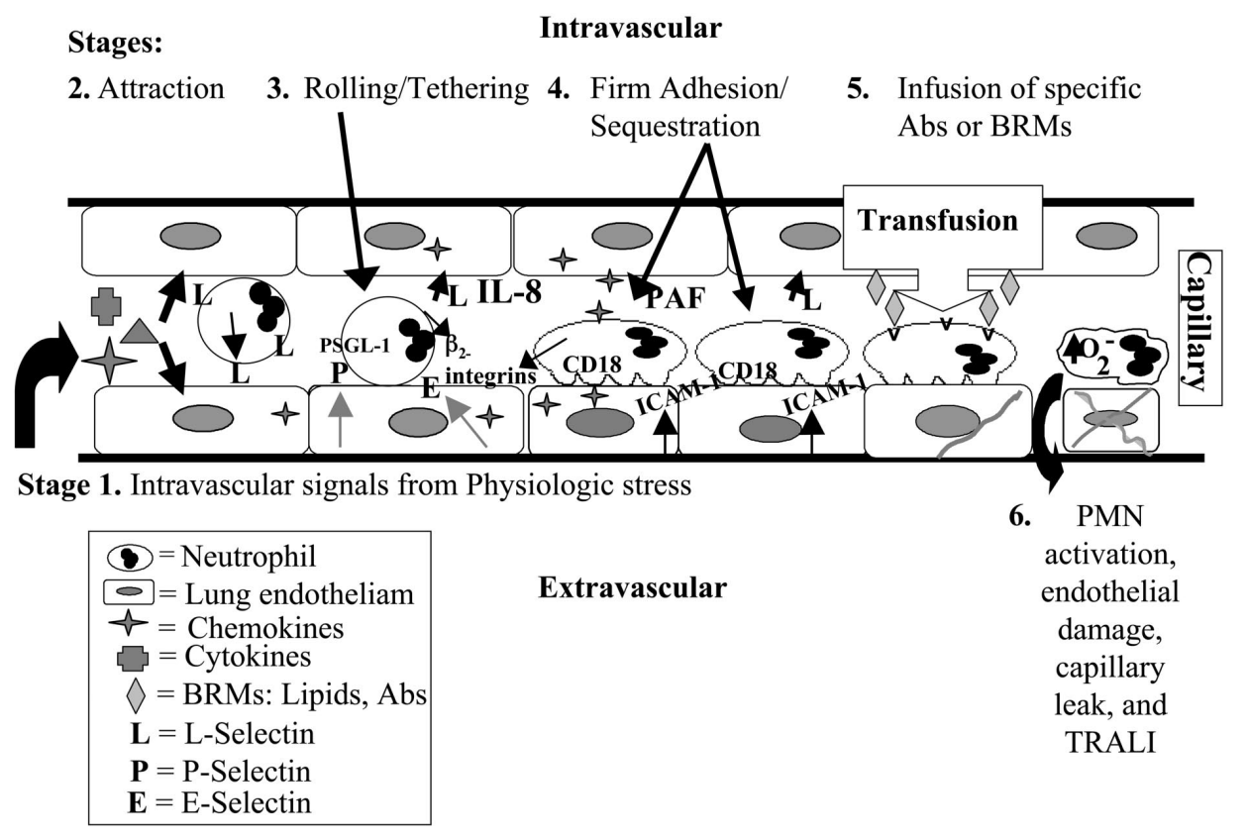

Slide 23
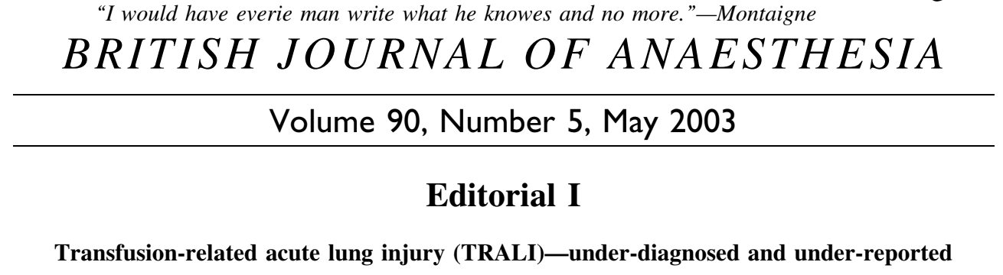

Slide 24
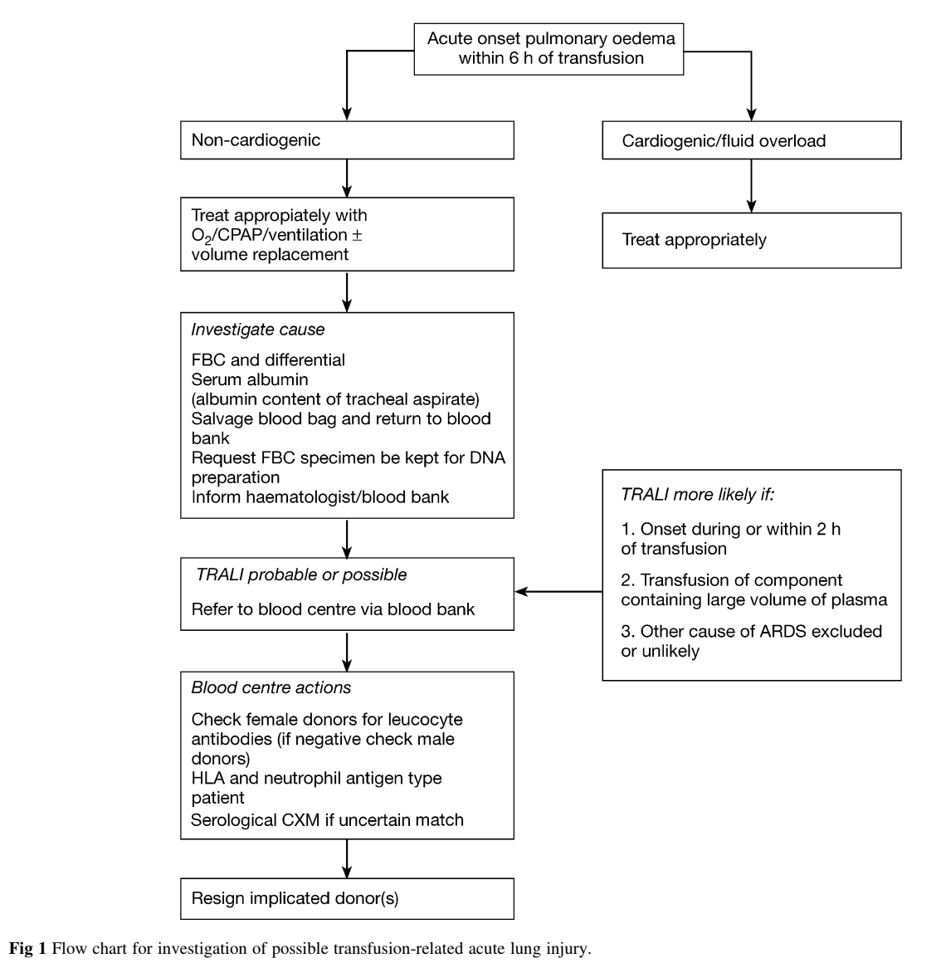

Slide 25
UK SHOT has recorded an overall mortality of 25% in cases of which TRALI was ‘possibly, probably or definitely’ indicated in the patient’s death
Note plasma implicated (12/31) and red cell component indicated 2/23
Alveolar leak syndrome is common after cardiac surgery, post bypass ARDS or ‘post pump lung’ of 1.4-1.7% (50% mortality) is reported and much reduced with restrictive transfusion practices
Kopko et al (2002) look back case study regular plasma donor anti-HLA 5b, 36 recipients traced 15 experienced transfusion reactions consistent with trial

Slide 26
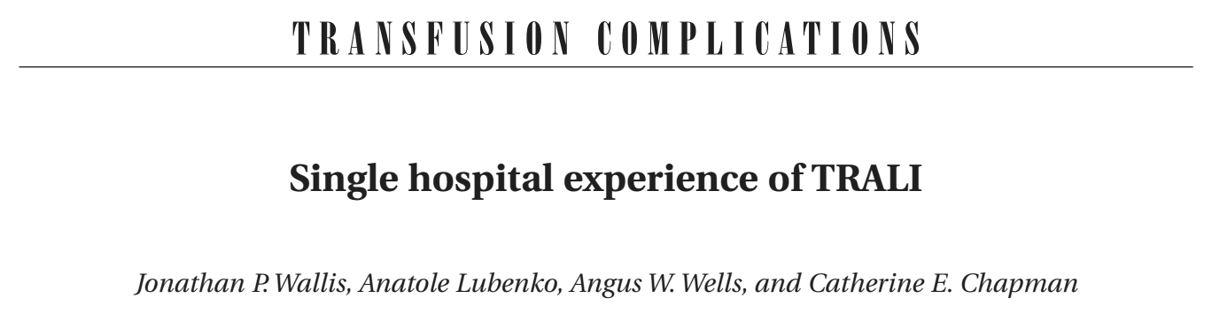

Slide 27
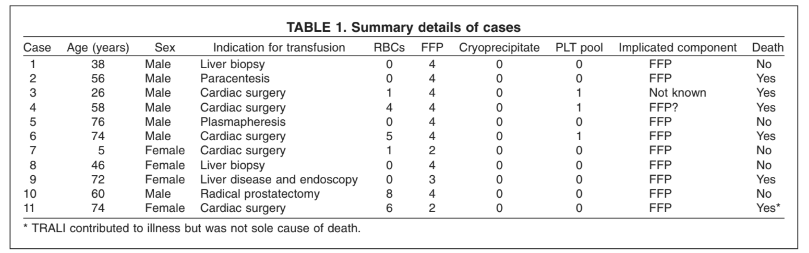

Slide 28
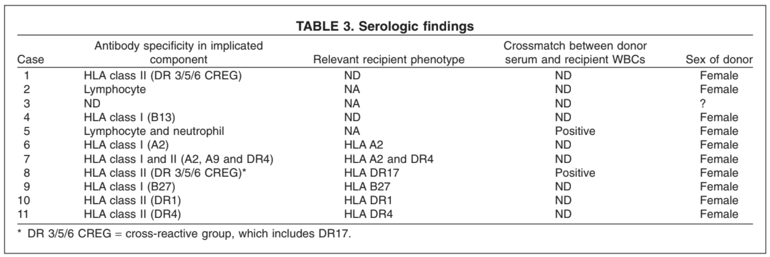

Slide 29
Illustrative case study Case 9
72-year-old female gender patient cryptogenic cirrhosis and ascites
CXR small bilateral pleural effusions, no interstitial lung disease
Melaena stool listed for endoscopy
3x FFP administered to correct prolonged prothrombin time
Adverse transfusion reaction during third FFP infusion, nausea, dyspnoea, cough, large amounts of frothy pink sputum
Oxygen and diuretics for presumed LVF
Continued to deteriorate, hypotensive and hypoxic despite 100% inspired oxygen (arterial blood gases pO₂, 6.25kPa; pCO₂, 12.8kPa

Slide 30
Illustrative case study Case 9
Mechanical ventilation with high PEEP, continued to produce high amounts of tracheal exudate and remained markedly hypoxic
ECG good left ventricular function, no cardiac event
Serum albumin fell from 27g/L to 11g/L and haemoglobin increased from 8.8g/dL to 12.5g/dL (no transfusion)
Rapidly developed oliguric renal failure, some improvement in pulmonary function after 48 hours, but general condition continued to deteriorate and patient died 6 days later
FFP component contained anti-HLA B27 and patient cognate antigen HLA B27

Slide 31
HV/104/23
Confirmed TRALI
Date of transfusion 23 May 2023
Infant 10 months, varicella, sepsis Streptococcus Pyogenes
Time transfusion started 03:20, time reaction noted 04:00, 43ml red cells transfused
Baseline observations T=35.5ºC, pulse 121, BP 71/44, O₂ saturations 99%
Serious adverse reaction - hypotension 52/30, O₂ saturations decreased to 40%, difficult to ventilate, CXR wet lungs

Slide 32
HV/104/23
Haemoglobin 97g/L (previous 74g/L)
PT: 25.4 (31.1 pre transfusion)
Albumin 27g/L
B natriuretic peptide 300
CK 52 (11 hours post event)
CRP 180 (previous 162)
HLA antibodies not detected in implicated donor
HNA antibodies (anti-HNA 1a) detected in implicated donor
Recipient cognate antigen HNA 1a

Slide 33
HV/189/24
Confirmed TRALI
Date of transfusion 11 September 2024
9-year-old with sickle cell disease, chronic exchange transfusion programme
Time transfusion stared 13:33, discontinued 16:19, 304ml red cells transfused
Baseline observations T=36.4ºC, pulse 80, BP 105/55
Serious adverse reaction – increased work of breathing, O₂ saturations falling 70% on room air, cough, CXR bilateral pulmonary infiltrates

Slide 34
HV/189/24
DAT negative, post haemoglobin 139g/L, PT 12.6 seconds, total bilirubin 48, direct bilirubin 19, BNP 70 (35-340)
CXR pulmonary oedema
ECG normal sinus rhythm
Physical examination chest subcostal recession, widespread crackles (chest clear 12 September 2024), normal cardiac elevation
Peripheral venous blood cultures negative after 5 days
HLA antibodies detected in patient, HLA antibodies detected in implicated donor anti-HLA A30, recipient cognate HLA A30
Associated platelet pool component recalled
Note patient received exchange transfusion subsequently, no adverse event

