Slide 1
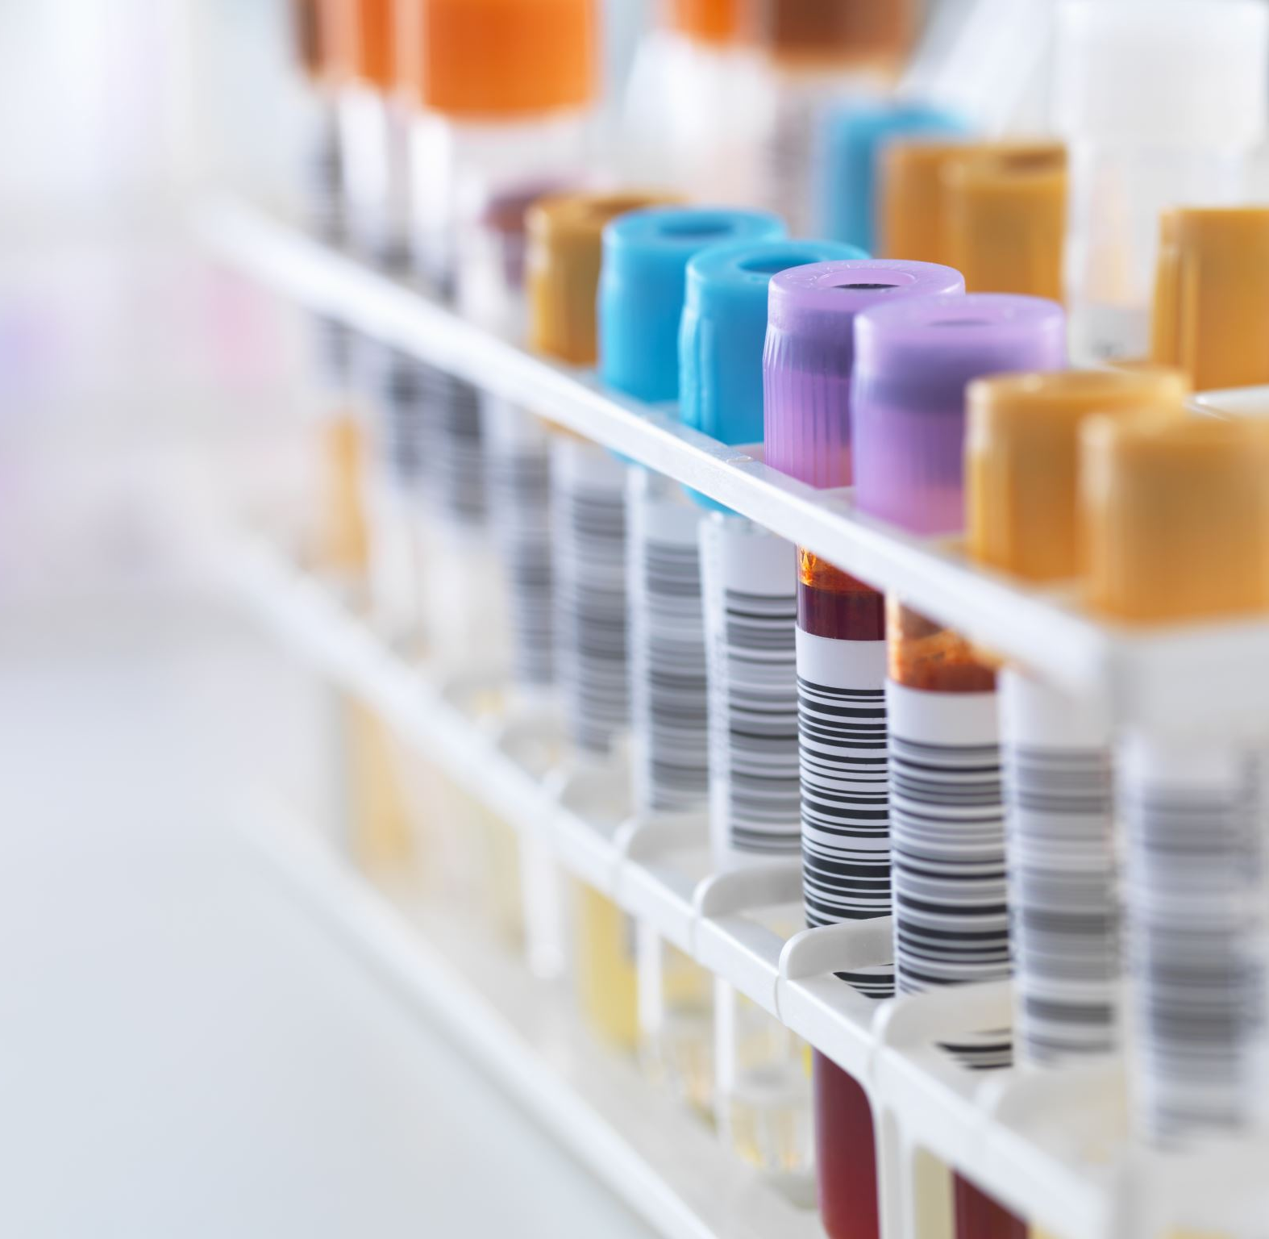
Investigation of samples referred for immune haemolytic anaemia Drug Induced Immune Haemolytic Anaemia
Dr Eileen Ryan, SpR Haematology
Aisling Costello, Senior Medical Scientist
Irish Blood Transfusion Service

Slide 2
Red Cell Immunohaematology Laboratory located at the National Blood Centre provides a specialist red cell serology service for hospital transfusion laboratories in the Republic of Ireland.
Two cases of suspected of drug induced immune haemolytic anaemia referred for further testing.

Slide 3
Immune Haemolytic Anaemia
Destruction of red blood cells due to antibodies directed against ones own red blood cells
AIHA frequency 1 in 80,000.
Cold AIHA
Warm AIHA
Drug induced/drug associated
Alloimmune
Haemolytic anaemia
AIHA
Cold AIHA
Incidence of drug induced haemolytic anaemia approx. 1 in 1 million
Notes:
Antibody mediated haemolysis is an important cause of haemolytic anaemia.

Slide 4
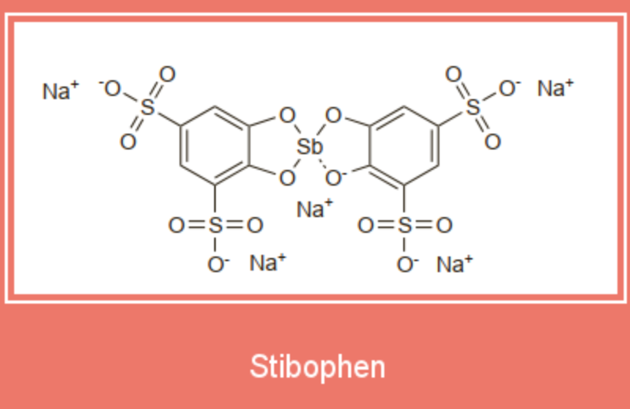
Drug Induced Haemolytic Anaemia
First described 1950s
Approximately 130 drugs have been suspected to be implicated
>1000 kDa
Notes:
Antibody-induced haemolytic anaemia caused by drugs is rare
but, when it occurs, it can result in acute, brisk and potentially life-threatening haemolysis.
Drugs were first suspected as a cause of immune hemolytic anemia (IHA) in 1953 when Snapper described a patient who developed pancytopenia with hemolytic anemia (HA), associated with a positive direct antiglobulin test (DAT), following ingestion of mephenytoin (Mesantoin).
First documented case linked to stibophen
Patient developed acute intravascular haemolysis
Positive DAT.
Patient serum reacted with reagent with red cells only when drug present
The patient had received a course of stibophen 10 years previously with no problems. During the second course, the patient developed acute intravascular hemolysis. The DAT was positive, and the patient's serum was shown to react with allogeneic RBCs only when the drug was present. The stibophen was stopped and the patient's hemoglobin returned to normal in 20 days; the serology became negative after about 60 days.

Slide 5
Diagnosis
Diagnosis of a DAT-positive haemolytic anaemia
Careful drug history
Serological demonstration of drug-specific antibody, which interacts with red cells.

Slide 6
Drug Induced AIHA
Four mechanisms described
1
Membrane Modification Mechanism
Immune Complex
Mechanism
3
2
Drug adsorption
mechanism
4
Autoimmune mechanism
Notes:
Stimulated antibodies react with the drug itself or to drug plus membrane components or mainly to cell membrane

Slide 7
Drug Dependent Antibodies
Only react when drug is present in test system:
Drug adsorption mechanism
Immune complex mechanism
Penicillin

Slide 8
Drug Dependent Antibodies
Only react when drug is present in test system:
2 subgroups:
Drug adsorption mechanism
Immune complex mechanism
Ceftriaxone

Slide 9
Non-Immunological Protein Adsorption
“Membrane modification mechanism”
Drug-induced, nonimmunologic modification of erythrocyte membranes, allowing the unspecific binding of diverse plasma proteins including IgG and complement factor 3 (C3), which leads to extravasal hemolysis in spleen
Platinum based chemotherapeutic
Beta-lactamase inhibitors
Notes:
Associated with cephalosporins mostly
Cephalosporin, in addition to the drug adsorption mechanism, can cause a positive DAT by modifying red cell membrane components. By this mechanism, a variety of plasma proteins, including immunoglobulin and complement may attach via a non-immune mechanism to the red cell membrane, resulting in a positive DAT, but rarely causing haemolysis. Cisplatin, carbo- platin and ribavirin in combination with interferon-α (IFN-α) or with pegylated IFN-α can all cause haemolytic anaemia by mem- brane modification. Ribavirin enters cells, is phosphorylated to ribavirin triphosphate and hydrolysed back to ribavirin in nucle- ated cells, which leaves the cells as the serum level declines. Red cells lack hydrolyzing enzymes so the triphosphate accumu- lates, alters the membrane and extravascular haemolysis occurs. With Ribavirin monotherapy, haemolysis may be compensated by increased marrow activity, but in combination with IFN-α,
bone marrow suppression by the latter agent inhibits the com- pensatory response. In this setting, management involves dose reduction (<800 mg/day) or supportive therapy with recombi- nant erythropoietin (EPO), which may allow continuation of therapy in 10–30% of patients.

Slide 10
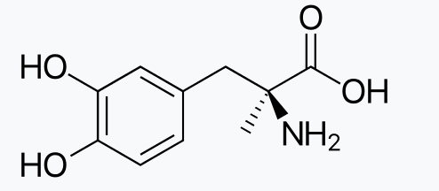
Drug Independent Antibody
First described with methyldopa in the 1960s
6 weeks before the DAT became strongly positive due to IgG on the red cell surface.
Usually minimal haemolysis
Mefenamic Acid
Procainamide
Fludarabine
Cladribine
Levodopa
Notes:
In methyldopa-induced AIHA, the drug has been shown to reduce reticuloendothelial clearance of IgG-coated red cells, a possible
explanation for the fact that many patients with a strongly positive DAT due to methyldopa have little or no haemolysis.
It is important to note that some drugs produce haemolysis by both the immune complex and autoimmune mechanisms, depending on the circumstances.

Slide 11
Drugs capable of inducing drug independent antibodies and drug dependent antibodies
Carbimazole
Cefotetan
Cefotaxime
Ceftazidine
Streptomycin
Diclofenac

Slide 12
Notes:
In a 2010 paper published by Garraty et al we can see the most frequent causes of DIIHA and fatalitis

Slide 13
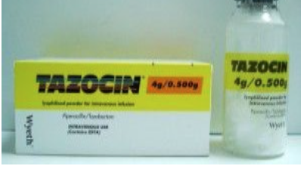
Case One
Referral SJH blood bank acute severe anaemia Hb =4.2g/dL. Investigation of drug induced immune mediated haemolysis
Piperacillin/tazobactam empirically for colorectal surgery

Slide 14
Serology
Positive DAT, pan-reactivity with enzyme panel, cells 1-11; 4+ grade reaction IAT panel cells 1-11; auto-control positive
4 x group O C-D-E-K- red cells components issued as suitable following red cell adsorption x 4

Slide 15
Initial sample referred 19 February 2013
 | Cell number |  |  |  |  |  |  |  |  |  |  |  |  | Positive control | Negative control
Method | #1 | #2 | #3 | #4 | #5 | #6 | #7 | #8 | # 9 | # 10 | #11 | Auto
Saline 18
Enzyme | C | C | C | C | C | C | C | C | C | C | C |  |  | V | -
IAT | V | V | 2+ | V | V | V | V | V | V | V | V | V |  | 2+ | -
Adsorbed (x4) (CDe/CDe) | - | - | - | - | - | - | - | - | (+w) | (+w) | -
Adsorbed (x4) (cde/cde) | - | - | - | - | - | - | - | - | - | - | -

Slide 16
Adapted Method Judd et al (2008)
Reagent cell | CDe/Cde Papainised Cells | cde/cde Papainised Cells | CDe/Cde Untreated Cells | cde/cde Untreated Cells
Patient plasma + drug | 4+ | 4+ | 4+ | 4+
Patient Plasma + PBS | 1+ (w) | 1+ (w) | - | -
Pooled serum + drug | - | - | - | -
Pooled serum + PBS | - | - | - | -
PBS + drug | - | - | - | -

Slide 17
Sample referred 21 February 2013 (drug discontinued)
 | Cell number |  |  |  |  |  |  |  |  |  |  |  |  | Positive control | Negative control
Method | #1 | #2 | #3 | #4 | #5 | #6 | #7 | #8 | # 9 | # 10 | #11 | Auto
Saline 18
Enzyme | - | - | - | 2+ | 2+ | 2+ | 2+ | 2+ | 2+ | 2+ | 2+ |  |  | V | -
IAT | - | - | - | - | - | - | - | (+w) | - | - | - | 2+ |  | 2+ | -

Slide 18
Conclusion
Using untreated cells (CDe/CDe) and (cde/cde) in the presence of drug implicates drug is implicated in haemolysis
Piperacillin is the 3rd most common drug causing DIIHA.
Patients often show signs of complement-mediated intravascular hemolysis
Antibodies usually IgM+ IgG
Positive DATs are usually due to RBC-bound IgG+C3
The antibodies react with piperacillin-coated RBCs, they also react with untreated RBCs in the presence of piperacillin
Often misdiagnosed as AIHA because in vitro reactions are seen with RBCs without adding drug in vitro
Within 48 h of stopping the drug, this reactivity will disappear.
Notes:
Piperacillin is a semi-synthetic penicillin but gives different in vivo and in vitro reactions to other penicillins (including other semisynthetics).
The latter approach is the best diagnostic test as a high percentage of random healthy donors and patients' sera react with piperacillin-coated RBCs but not by the-so-called immune complex mechanism detection tests (i.e. patient's serum+ drug+ untreated RBCs)

Slide 19
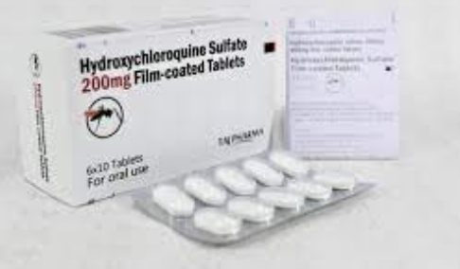
Case Two
Background: Sjogrens – on hydroxychloroquine
Hb 6.9g/dL at 20 weeks gestation (11.5g/dl at booking)
Hydroxychloroquine held
2x RCC transfused at 22 weeks
2x RCC transfused at 30 weeks
1 dose of IVIg at 30 weeks
27 y.o.

Slide 20
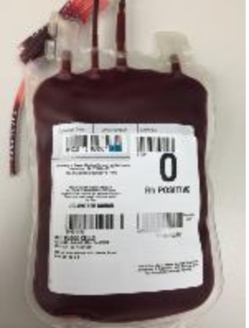
Day 2 post partum – developed symptomatic anaemia
Transfused 2U RCC
Azathioprine increased to 125mg OD
Remained on folic acid
Prednisolone increased to 20mg OD

Slide 21
Serology
Strong cold reacting antibody detected
Blood grouping performed at 37C
DAT positive: Anti IgG 1+(w); Anti-C3d 3+
Reactivity enhanced with aged/stored red cells (artefact)
Auto-control positive
Following allo-adsorption, no clinically significant antibodies detected
Group A (CDe/cde) K- issued as compatible.

Slide 22
Follow-up testing to exclude drug induced immune haemolytic anaemia
Hydroxychloroquine implicated in DIIHA
Adapted method Judd et al (2008)
Prepared drug solution which mimicked that of patient’s plasma (1mg/6ml approx)
Serial dilutions of drug solution 1:64 and 1:128 (to mimic in vivo)
Red blood cells then treated with hydroxychloroquine solution
Treated red blood cells were tested Vs patient’s plasma and patient’s eluate
Patient sample was tested in the presence and absence of drug

Slide 23
Results | Post 60min incubation at 37C |  | 4x saline wash + AHG
RBC = O rr | Patient Plasma | Patient Eluate | Patient Plasma | Patient Eluate
Drug treated RBC (1:64) | ++ | - | ++ | ++
Drug treated RBC (1:128) | ++ | - | ++ | +(w)
Untreated RBC | ++ | - | +(w) | +(w)
Drug treated RBC 2(1:64) | ++ (w) | - | - | +(w)
Drug treated RBC 2(1:128) | ++ | - | - | +(w)
Untreated RBC | +(w)/++ | - | - | +(w)

Slide 24
Conclusion
Pan reactivity by IAT and enzyme IAT, auto test cell positive
Variable reactivity detected vs reagent panel cells from different sources
Anti-Wra detected
Drug dependent antibody (Hydroxychloroquine) investigated
Method not validated, for research purposes only. Clinical interpretation and transfusion management of case by medical consultant advised
No differential effect observed presence/absence of drug and on balance drug induced immune mediated haemolytic anaemia excluded.
Relates to disease flare and warm-mediated AIHA
Note hydroxychloroquine withheld and subsequent red cell haemolysis
This is suggestive (but not definitive) of drug effect excluded
Notes:
Although no

Slide 25
Approach to and possible DIIHA
Diagnosis of a DAT-positive haemolytic anaemia
Careful drug history
Serological demonstration of drug-specific antibody, which interacts with red cells.
If DIIHA is suspected, relevant medication should be stopped.
Don’t forget:
Folic Acid.
Risk assessment for thromboprophylaxis. If receiving steroids, risk assessed for treatment to prevent glucocorticoid-induced osteoporosis and gastrointestinal bleeding. Tranfuse with ABO, Rh and Kell matched red cells if life threatening.

Slide 26
Acknowledgements
Dr Kieran Morris
Professor Fionnuala Ni Ainle
Red Cell Immunohaematology Laboratory, Irish Blood Transfusion Service

Slide 27
References
Garratty G. Immune hemolytic anemia associated with drug therapy. Blood Rev. 2010;24(4-5):143-150.
Leicht, H.B., Weinig, E., Mayer, B. et al. Ceftriaxone-induced hemolytic anemia with severe renal failure: a case report and review of literature. BMC Pharmacol Toxicol . 2018; 19: 67.
Garratty G and Arndt PA. Drugs that have been shown to cause drug- induced immune hemolytic anemia or positive direct antiglobulin tests: some interesting findings since 2007. Immunohematology 2014;30:66-79
Leger RM, Arndt PA, and Garratty G. How we investigate drug-induced immune hemolytic anemia. Immunohematology 2014;30:85-94.

Slide 28
Questions?

