Slide 1
Two novel antithetical KN blood group antigens
Aisling Costelloe
Senior Medical Scientist
RCI

Slide 2
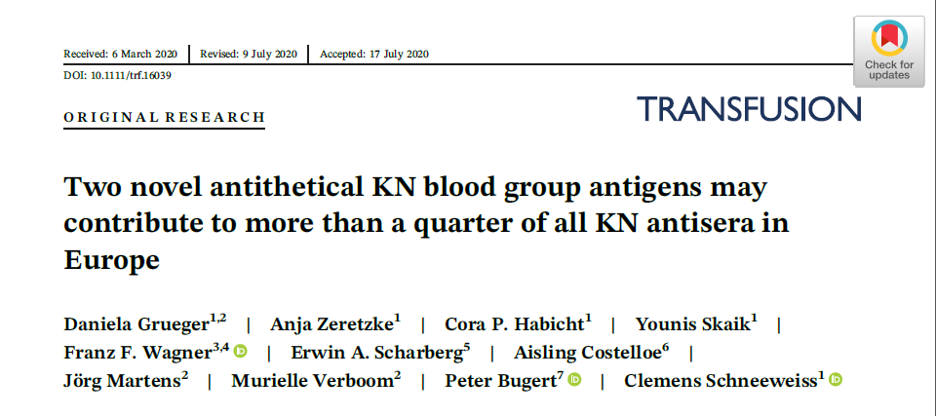

Slide 3
Two novel antithetical KN blood group antigens
RCI involvement
Knops system
Complement receptor 1
Grueger et al (2020)
Aims
Design/Methods
Results
Referrals of HTLAs to RCI
High Titre Low Avidity (HTLA) antibodies
Use of rare reference cells
Use of rBGPs

Slide 4
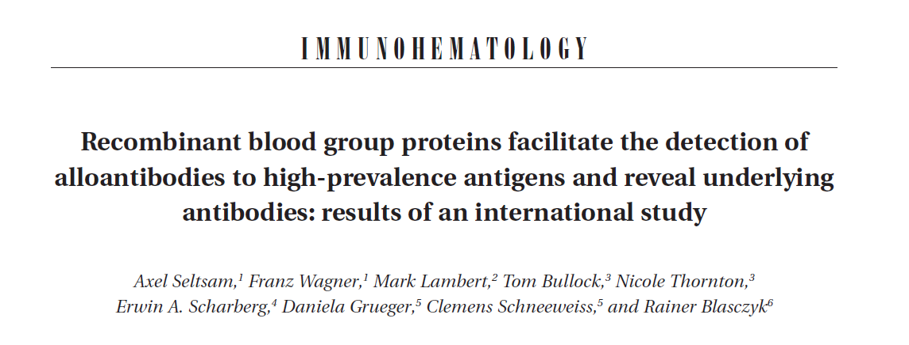
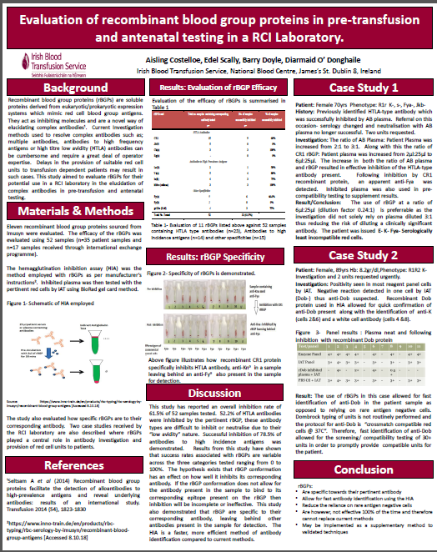
Two novel antithetical KN blood group antigens
2014
Seltsam et al (2014). Transfusion 2014; 54: 1823-1830
2018
Msc project presented at AABB 2018.

Slide 5
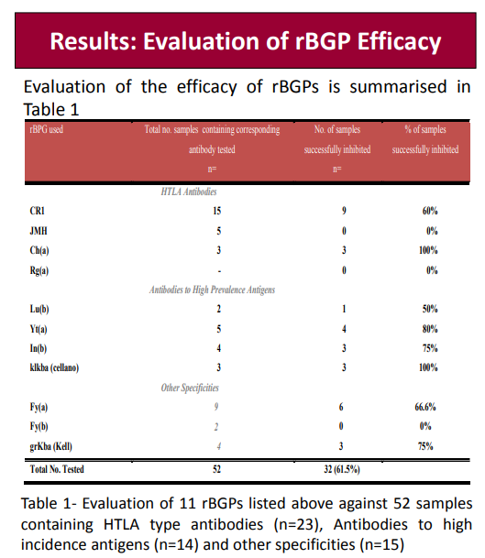
rBGP efficacy of 60%

Slide 6
Two novel antithetical KN blood group antigens
2020
Grueger D et al (2020). Transfusion. 2020;1-11

Slide 7
Two novel antithetical KN blood group antigens
RCI LaboratoryIBTS
Institute of Transfusion Medicine & Immunohematology, Baden-Baden
Imusyn GmbH
German Red Cross Blood Service
Institute of Transfusion Medicine & Immunohematology, Mannheim
Hanover Medical School

Slide 8
Knops System
25th blood group system of ISBT
Antibodies are “High Titre, Low Avidity” (HTLA)
High frequency (except Knb and McCb)
Difficult to adsorb/elute
Often occur in serum of multi-transfused individuals
Transfusion reactions or HDFN = No
BUT can mask underlying clinically significant antibodies
Known antigens:
Kn (a/b)
McC (a/b)
KCAM/KDAS
SI1-3
Yk(a)
Cr1- related

Slide 9
Complement Receptor 1 – carrier of KN antigens
2000 amino acid long approx
Membrane bound glycoprotein
Affinity for C3b and C4b
Located on several cell types including:
Erythrocytes and Leucocytes
Also: Kidney podocytes, phagocytic cells, peripheral nerves
Absent from platelets
Main functions:
Inhibit spontaneous complement activation
Binding opsonised pathogens
May be a receptor for Plasmodium falciparum (notably Sla)
Notes:
Made of 30 short consensus repeats grouped into four long homologous repeat (LHR) domains A-D

Slide 10
Complement Receptor 1 – carrier of KN antigens
Grueger et al (2020)
Previous work had suggested antigens may exist in this region also

Slide 11
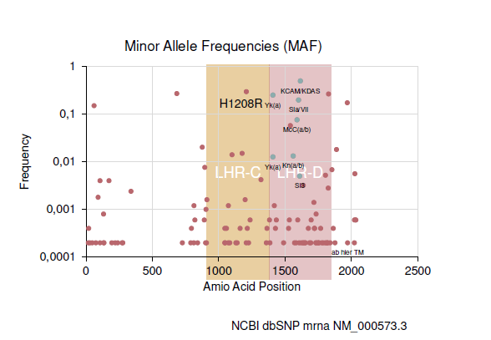
Grueger et al - Study Aims
Investigate possible polymorphisms in CR1 LHR-C that could define a new blood group antigen
Most frequent polymorphism in LHR-C was c.3623A>G in Exon 22 leading to amino acid change p.His1208Arg
DNA sequence amino acid 940 to 1394 was synthesised
Grueger et al (2020)
Notes:
Database single nucleotide polymorphisms

Slide 12
Grueger et al - Study Design/Methods
ligated transduce
DNA sequence Modified lentiviral expression vector HEK293 Cells
Produced recombinant proteins based on LHR-C P.1208
recombinant blood group proteins (rBGPs)
Used this rBGP to test against antisera containing “CR1-related” antibodies
RCI
Notes:
HUMAN EMBRYONIC KIDNEY

Slide 13
Grueger et al - Study Design/Methods
RCI identified HTLA/CR1-related antisera and supplied these antisera to the study
HTLA (n=2)
Anti- McCa(n=1)
CR1 related (n=5)
Anti-Kna(n=1)
Anti-KCAM (n=3)
Anti- Yka (n=2)
Anti- Sl3 (n=1)
Anti-Sla (n=1)
Hemagglutination inhibition assay/ IAT with rBGP

Slide 14
Grueger et al - Study Results
Reactivity detected with antisera vs recombinant CR1 p.1208His and p.1208Arg showed that novel antigens existed in this region
Novel antithetical KN blood group antigen pair found at position 1208:
DACY (KN011)
1208H
YCAD (KN012)
1208R

Slide 15
HTLA referrals to RCI
Antibody Identified | No. of Samples | No. of Patient’s
Anti-Ch/Rg | 10 | 9
Other HTLA-type | 10 | 10
CR1-related | 4 | 4
Figures from 2020

Slide 16
HTLA referrals to RCI
Varying strengths of reactivity
Auto = Neg
Reactivity in enzyme depends on what type of HTLA
Papain Sensitivity | Papain Resistance
Anti-Ch Anti-Rg Anti-JMH Anti-Kna (occasional) Anti-Yka (occasional) | Anti-Sla Anti-McCa Anti-Csa Anti-Kna (most) Anti-Yka (most)

Slide 17
HTLA referrals to RCI
Anti-Ch/Rg
Perform Neutralisation (with AB plasma/serum)
Anti-Ch / Anti-Rg are reactive against C4 component of complement
These antibodies can be neutralised using AB plasma (contains C4).
Others i.e. CR1 related (Kna, McCa, Yka), JMH, COST
Use of rare reference cells
Time consuming
Based around patients ethnicity/age
Patients phenotype/genotype is very important
Future of rBGPs

Slide 18
HTLA referrals to RCI

Slide 19
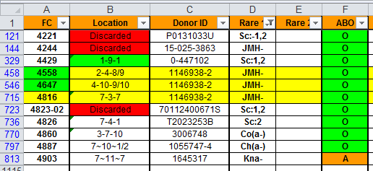
Rare reference cells
Rare cells available at the RCI laboratory are frozen (-65C) and recovered when required
Obtained from the Serum Cells And Rare Fluids international exchange (SCARF) program and UK Red Cell Exchange
535 frozen rare cells
Notes:
Reliance on scarf for availability

Slide 20
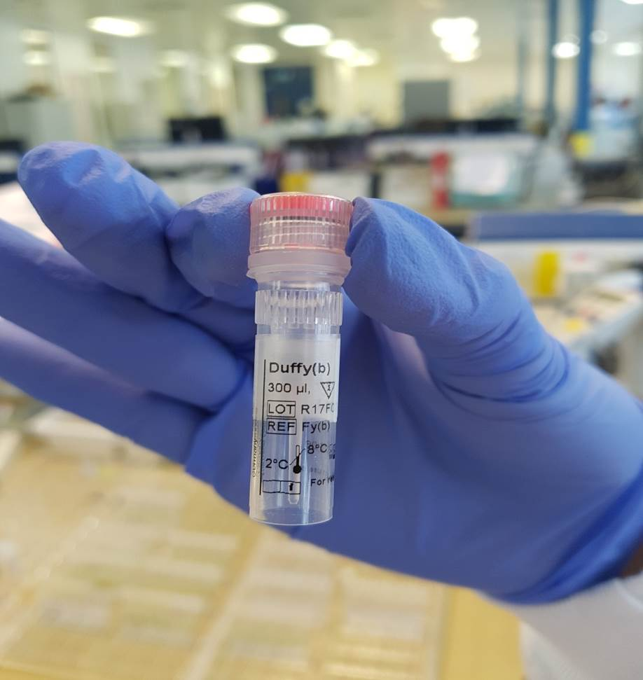
Recombinant Blood Group Antigens (rBGAs)
Synthetic blood group antigens
Supplier: Imusyn
Soluble
Each vial contains 300ul of rBGP
Stored (2°-8°c)

Slide 21
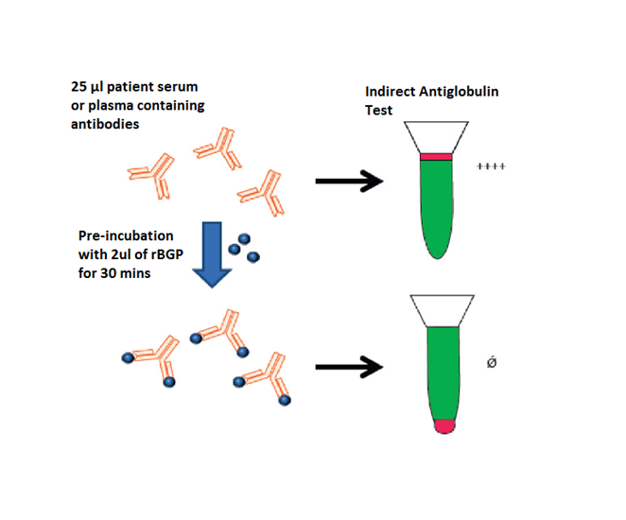
rBGAs – Test Assay/Principle
Hemagglutination Inhibition Assay (HIA)
2ul of rBGA to 25ul of plasma
Mix and spin (8000g for 5 seconds)
Incubate at room temperature (19°C-25°C) for 30mins
Include a negative control (2ul of PBS to 25ul of plasma)
Perform IAT using reagent panel cells

Slide 22
rBGPs – Test Assay/Principle

Slide 23
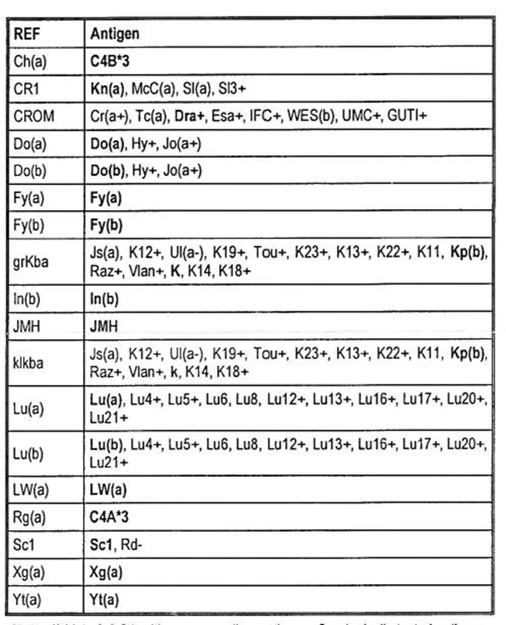
rBGPs

Slide 24
Future of rBGPs/collaborations
Continue to work with research groups involved
First author of the study will host presentation to RCI in 2022
Develop the use of rBGPs/ rare reference cells in RCI
Continue to develop the rare cell database
Continue to contribute/ receive cells from SCARF

Slide 25
References
Moulds JM, Rowe KE. Neutralisation of Knops system antibodiesusing soluble complement recepor 1. Transfusion. 1996;36(6):517-520
Moulds JM, Zimmerman PA, Doumbo OK et al. Molecular identification of Knops blood group polymorphisms found in long homologous region D of complement receptor 1. Blood.2001;97(9):2879-2885
Tamasauskas D, Powell V, Schawalder A, Yazdanbakhsh K. Localisation of Knops system antigens in the long homologous repeats of complement receptor 1. Transfusion. 2001;41(11):1397-1404
Grueger D, Zeretzke A, Habicht CP et al. Two novel antithetical KN blood group antigens may contribute to more than a quarter of all KN antisera in Europe. Transfusion. 2020;1-11

Slide 26
Thank you!
Questions?

