Slide 1
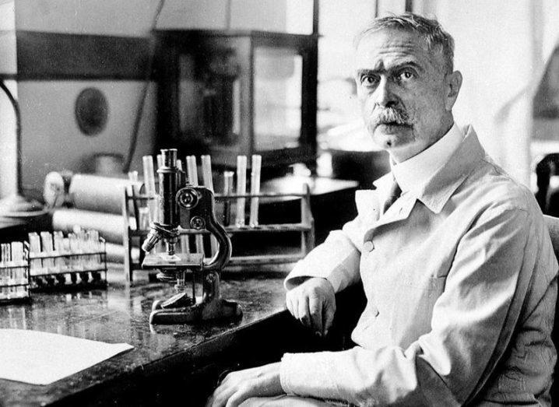
B Blood Group
Julie Long,
Senior Medical Scientist,
Red Cell Immunohaematology Laboratory
Notes:
Hello and Welcome. The general theme of this talk is based on the B blood group system. This presentation will cover a brief background on the B blood group and the subgroups accompanying it. It will also discuss two case studies where extensive serological techniques were used, including a sample that was referred for B subgroup investigation and a case of HDFN as a result of ABO mismatch.
Here is a picture of Karl Landsteiner who discovered the ABO blood group system back at the start of the 20 century and of course it still today remains the most clinically important blood system for transfusion medicine.

Slide 2
B Blood Group
Ireland 11% of the population have the B blood group:
9% B+
2% B-
Notes:
The B blood group is the least common blood group in the Caucasian population, but is not the case all over the world, for example 30% of the population in China are group B.
ABO gene is located on chromosome 9 and encodes 3 alleles, A, B and O. The A and B alleles produces the enzyme A-transferase or B- transferase which converts the acceptor H antigen into the A or B antigen in A, B or AB individuals. The O allele lacks both enzymatic activities so either A or B antigens are expressed.
Here is an image of the B antigen glycoprotein. The A and B antigen differ by an single sugar at the end of the antigen, whereas group O lacks this terminal sugar completely. Type A antigen has a terminal N-acetylgalactosamine whereas type B antigen has a terminal galactose.

Slide 3
B Subgroups
Quantitative or Qualitative.
Subgroups
weak or mixed field reactions in the forward group or
discrepant reverse groups.
Important to consider other factors also:
Diseases such as acute myeloid leukaemia or other haematological cancers can lead to the depression of ABO antigens.
Medications which may cause AIHA or direct binding to red cells.
Cold reactive antibodies.
Acquired B
Notes:
Subgroups can be a result of reduced number of normal A/B antigens or because of a production of slightly altered A/B antigens. Basically they can be quantitative or qualitative.
‘A’ subgroups are a lot more common than B subgroups.
Example on the most common subgroup we see is: A2 w/Anti-A1 which is usually identified due to additional reactivity in reverse group.
Extremely weak forward groups may be mistaken as group O w/o the reverse group. For example Ax or Bm
Acquired group B occurs when blood group A patients come into contact with certain gram-negative bacteria usually found in the colon. These bacteria carry an enzyme that removes a part of the A antigen (N-acetylgalactosamine), leaving behind a modified sugar, galactosamine, that makes the chain resemble the B antigen (which has a galactose at the end).

Slide 4
B Subgroups
Phenotype | Anti-A | Anti-B | Anti-AB | Anti-H | Common Antibodies | Unexpected Antibodies | Saliva Secretors | B transferase
B | 0 | 4+ | 4+ | 2+ | Anti-A | None | B, H | Yes
B3 | 0 | ++mf | ++MF | 3+ | Anti-A | None | B, H | Yes (weak)
Bx | 0 | wk | wk | 3+ | Anti-A | Weak anti-B | H | No
Bm | 0 | 0/wk | 0/wk | 3+ | Anti-A | None | B, H | Yes (weak)
Bel | 0 | 0 | 0 | 3+ | Anti-A | Possible anti-B | H | No
Notes:
B subgroups can be classified as B₃, B_{x}, B_{m}, and B_{el}, plus B_{w} for those that do not fit any of the other four categories.
Detection of B subgroups are of prime importance in donors as these may be wrongly typed as blood group O. These subgroups, if transfused to group O recipients, can result an adverse hemolytic transfusion reaction.
Antigen H is a precursor for ABO blood group antigen. Secretors refers to those who secrete ABH blood group antigens, based on their blood type, into their body fluids such as saliva, sweat and tears. (Blood, sweat and tears). 80% of people are positive for the Se gene (FUT2). Previous studies showed that non-secretors are more prone to certain autoimmune diseases and strains of norovirus.

Slide 5
Case Study 1: To B or Not to B!
 | Automated (Ortho Vision) | Tube | Card (BioRad Card)
Anti-A | - | - | -
Anti-B | - | - / +w* | +
Anti-D | C | C | C
Anti-D | C | C | C
Control | - | - | -
A1 Cells | V | ++s | ++s
B Cells | - | - | -
5-year-old female
Myelomonocytic leukemia.
Query ABO Anomaly
Forward and reverse group do not match.
Reverse group:
Tube Technique 4C incubation for 1hr
Increased plasma to red cell ratio (2:1)
*checked micro
Notes:
Our first line of ABO blood group testing is done on our OrthoVision automate. First time patients get a forward/ reverse and a confirm group.
The reverse group was further enhanced by incubated at 4C for an hour and by increasing ratio to 2:1 plasma to red cells and the resuts remained the same.

Slide 6
Additional Laboratory Testing
C+ E- c- e+ K-
Antibody Screen: Negative
DAT results: IgG- IgM- IgA- C3d- C3c-
Auto Test cell: Negative
Notes:
The patient was R1R1 K-.

Slide 7
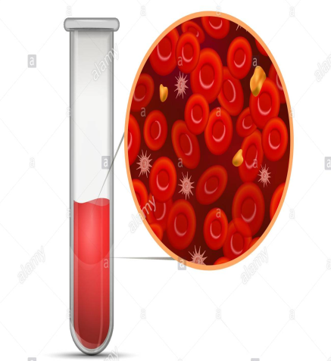
Adsorption / Elution technique.
Centrifuge
Add Saline
Pooled plasma from 5 group A donors (Poly anti-B anti-sera)
Anti-B is adsorbed onto the patients red cells by incubation at 4◦C for 1hr.
Remove supernatant and wash red cells to remove unbound antibody.
Removing of bound antibody through heat elution at 51◦C for 10 minutes.
Notes:
Some weak ABO subgroups are too weak to detect by direct agglutination. The presence of A or B antigens requires adsorbing anti-A or anti-B to red cells, followed by elution of bound antibody. The elute is then tested against A1 and B reagent red cells.
ABO/ Anti-B antibodies are mainly IgM in nature so operate best at 4 degrees.
Save final wash for negative control.

Slide 8
Adsorption/ Elution technique.
Test the eluate against group B and O Cells:
Ads/Elution | IAT | RT | Tube
Eluate: V233866-B | +s | ++s | +s
Wash: V233866-B | - | - | -
Eluate: V233872-O | - | -
This technique yielded only anti-B in the eluate indicating the presence of B antigen on the red cells.
Controls:
Final wash control to ensure unbound antibody is washed away and only bound antibodies are being detected.
Eluate tested against group O cells ensuring reactivity due to anti-B.
Additional control, adsorbed elution performed on a known group B sample in parallel .
Notes:
This technique yielded only anti-B in the eluate indicating the presence of B antigen on the red cells.

Slide 9
Final Report:
Notes:
Patients transfusion protocol: B pos red cells
Further Testing: Perform forward group testing with enzyme treated autologous red cells.

Slide 10
Conclusion
The weakened expression of the B antigen is most likely due to the patient’s clinical condition.
Diminished expression of ABH antigens can occur in hematological disorders such as leukemia, myeloproliferative disorders, myelodysplastic syndrome and in some cases of Hodgkin's lymphoma.
These modifications of blood group antigens usually revert to normal after remission is attained.
Notes:
Red blood cell (RBC) antigens expression is constant throughout the life of an individual. However, RBC antigen change has been occasionally described in association with hematological malignancies.
This is more common in myeloid neoplasm than lymphoid neoplasm.
There are two possible mechanisms for the weakening of ABO antigens in hematopoietic diseases; the inactivation of A/B transferases or the inactivation of H transferase. . A and B transferase genes are encoded on chromosome 9, and they may be inactivated as a 9;22 chromosomal translocation. Therefore the H antigen is not converted to A and B antigen due to the inactivation of the A/B transferases. The second suggested mechanism for the loss of ABO antigens is inactivation of the H transferase encoded at 19q13. H transferase inactivation would result in decreased H substance and a resulting decrease in A and/or B substance.
Weakening of ABH antigen expression suggests a pre-leukemic state as they appear even before recognizing the malignancy

Slide 11
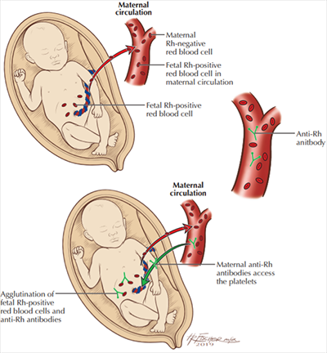
HDFN
Haemolytic disease of the foetus/ new-born (HDFN)
The foetus/new-born’s red cells are being attacked by maternal IgG antibodies.
A major cause of HDN is an incompatibility of the Rh blood group between the mother and fetus.
HDN due to ABO incompatibility is usually
less severe than Rh incompatibility.
The impact of HDFN ranges from mild to
severe with symptoms such as edema and
jaundice.
Notes:
The first description of HDN is thought to be in 1609 by a French midwife but it wasn’t until the 1950s that the underlying cause of HDN was clarified.
During pregnancy, some of the mother's IgG antibodies are transported across the placenta and enter the fetal circulation. This is essentials for newborn survival as they have only a primitive immune system however a downside to this protection is that maternal antibodies can also cause HDN.
A major cause of HDN is an incompatibility of the Rh blood group between the mother and fetus, particularly in the second pregnancy as this requires a sensitizing event. Typically, the sensitizing event occurs during the delivery of the first-born Rh D-positive child.
HDN can also be caused by an incompatibility of the ABO blood group. It is nearly exclusively arises when a mother with blood type O becomes pregnant with a fetus with a different blood type (type A, B, or AB).
Introduction of preventive antenatal care, such as prophylactic anti-D and intrauterine transfusions, has led to a dramatic decrease in the incidence of HDN, particularly severe cases that were responsible for stillbirth and neonatal death.

Slide 12
HDFN due to ABO mismatch
Case Study 2:
ABO incompatibility resulting in HDFN occurs in approximately 4% of all deliveries generally causing mild haemolysis.
However, some of these cases can present as moderate or severe haemolytic disease of the foetus and new-born (HDFN) with significant hyperbilirubinemia requiring intervention.
Fetal assessment is not routinely required but early recognition based on detailed maternal clinical history and laboratory investigation is key in preventing neonatal morbidity and mortality.
Notes:
HDFN can occur in any pregnancy, due to naturally occurring IgG anti-A/B
Mild hemolysis is seen as opposed to severe hemolysis due to lower level expression of A and B antigens on fetal red cells, most anti-A/B antibodies are IgM in nature and ABO antigens are also expressed on other tissues (widening their targets).
The most likely explanation for these rare cases is that exposure to antigens similar to the A or B antigen may occur from sources other than the fetus and stimulates IgG production in the mother. For example, an antigen similar to the B antigen is found in E.coli, and exposure to this organism may stimulate production of IgG anti-B antibody in type O individuals.

Slide 13
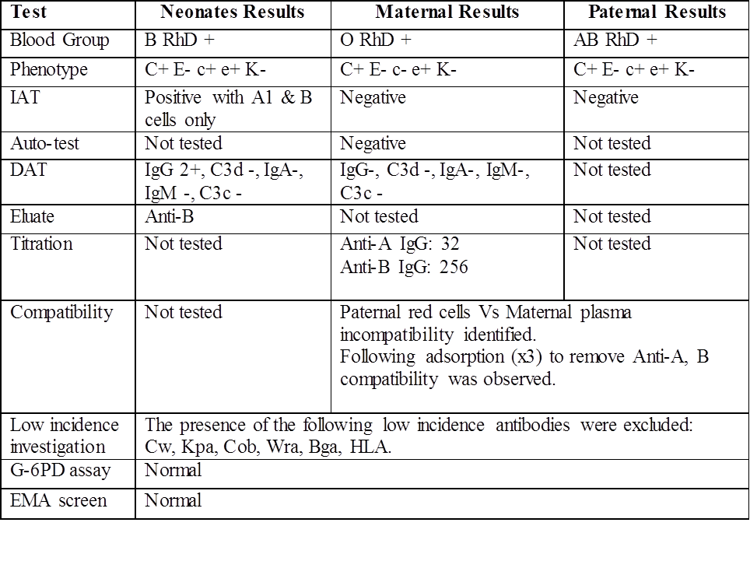
Case Study 2:
?HDFN due to maternal anti-B.
Mother: group O+
Baby: group B+
The neonate required phototherapy.
Two previous pregnancy were also affected.
Notes:
Interestingly when we put the neonate's plasma up against A and B cells, the reaction with the A cells was much stronger than the reaction with B cells. This was because the anti-B was bound to the neonatal red cells as opposed to free in the neonate's plasma. The anti-B was therefore detected in the elute.

Slide 14
Laboratory Testing of Maternal Sample
Group: O RhD+
Phenotype: R1R1 K-
Antibody Investigation: negative
Auto test cell and DAT: negative
Low incidence antibody investigation: Cw, Kpa, Cob, Wra, Bga, HLA excluded.
Compatibility testing: Paternal red cells versus maternal plasma and compatible result obtained .
Notes:
Investigation of low incidence antibody was carried out due the frequency and severity of HDFN in her three pregnancies. Firstly we carried out an IAT technique using maternal plasma and reagent red cells with known low incidence antigens and no reactivity was observed.
In order to definitively ruled out HDFN due to a low incidence antibody we crossmatched the paternal red cells against the maternal plasma. This would be incompatible if the mother had produced a low incidence antibody. However, this required adsorption studies due to an incompatible crossmatch, as the father was group AB and the mother group O. After successfully removing the maternal anti-A and anti-B from her plasma the crossmatch was compatible, ruling out the presence of a low incidence antibody.
Any subsequent pregnancy from the same partners will result in an ABO incompatibility.

Slide 15
Testing of Maternal sample continued
IgG Antibody Titration
Patient plasma is incubated with neutr-AB (1:1) at 4◦C for 1hr
The neutr-AB neutralised out IgM antibodies.
A doubling dilution is prepared using both neat and neutralised patient plasma.
Direct spin and IAT tube techniques are used for the detection of IgM and IgG anti-B in the neat and neutralised dilutions

Slide 16
Titration Results
Titration of Anti-B in maternal plasma versus B cells using direct spin and IAT techniques.
Dilutions | 2 | 4 | 8 | 16 | 32 | 64 | 128 | 256 | 512 | 1024
IgM Anti-B Near Plasma | C | C | C | V | V | ++ | +S | - | - | -
IgM Anti-B Neutralised | - | - | - | - | - | - | - | - | - | -
IgG Anti-B Neautralised | C | C | C | C | C | V | ++ | + | - | -
Notes:
The neutr-AB neutralised out the IgM, as seen in row two, and leaves behind the IgG.
The same procedure was used for tittering Anti-A against A cells and a result of 32 was obtained for IgG anti-A. This was presumably due to previous pregnancies.

Slide 17
Laboratory Testing on Neonatal Sample
Group: B RhD+
Phenotype: R1r
DAT: IgG 2+, C3d -, IgA -, IgM -, C3c –
Antibody screen: Negative, but anti-A and Anti- B detected.
Elution: Anti-B was detected in the eluate prepared from the neonatal red cells.
Notes:
Conclusion:

Slide 18
Report Conclusion
Maternal Results
Antibody investigation was performed on this sample and no clinically significant antibodies were detected.
The patient's plasma was tested against the following panel of low incidence antigens and no reactivity was observed; Cw, Kpa, Lua, Wra, Cob, Kpa, Bga, HLA, Ytb.
An Immune anti-B titration was performed and IgG anti-B titrated at 256.
An Immune anti-A titration was performed and IgG anti-A titrated at 32.
Neonate Results
Following three cell antibody screen, no clinically significant antibodies were detected. The patient's neat plasma was tested against A1 & B cells and reactivity was observed with both A1 & B cells. This is presumably maternal in origin.
An eluate was prepared from the patient's red cells and anti-B was detected. This is presumably maternal in origin.
Notes:
HFDN Due to maternal Anti-B

Slide 19
References
Nambiar, R. K., Narayanan, G., Prakash, N. P., & Vijayalakshmi, K. (2017). Blood group change in acute myeloid leukemia. Proceedings (Baylor University. Medical Center), 30(1), 74–75.
Akanmu, A. S., Oyedeji, O. A., Adeyemo, T. A., & Ogbenna, A. A. (2015). Estimating the Risk of ABO Hemolytic Disease of the Newborn in Lagos. Journal of blood transfusion, 2015, 560738.
Dean L. Blood Groups and Red Cell Antigens [Internet]. Bethesda (MD): National Center for Biotechnology Information (US); 2005. Chapter 4, Hemolytic disease of the newborn. Available from: https://www.ncbi.nlm.nih.gov/books/NBK2266/
Notes:
http://www.htct.com.br/pt-diminished-expression-b-antigen-mimicking-articulo-S1516848416300433

Slide 20
Thank you for listening.
Notes:
https://www.ncbi.nlm.nih.gov/pmc/articles/PMC5640541/#CR5
https://www.ncbi.nlm.nih.gov/pmc/articles/PMC5640541/

