Slide 1
Identification and Management of Anti-PP1PK in pregnancy
Ms Ruth Cleary, SMS RCI lab
Dr Kieran Morris, Laboratory Director RCI

Slide 2
Introduction
Background of PP1PK antigen and associated antibodies - Ruth
Case study introduction – Ruth
Laboratory Testing - Ruth
Patient management – Dr Morris
Postnatal Outcomes – Dr Morris
Summary –Dr Morris

Slide 3
Blood Group Etiology
The P blood group was first described in 1927 and was believed to comprise three antigens: P1, Pk, and P.
In the current classification, there are three different blood group systems
Six different antigens are included, based on the glycosyltransferase necessary for their synthesis.
The 3 blood group systems are: P1Pk, GLOB and FORS.
P1Pk System | GLOB System | FORS System
Pk Antigen | P Antigen | Forssman Antigen
P1 Antigen | PX2 Antigen
NOR Antigen

Slide 4
P and Pk Antigens
The P antigen (GLOB1) belongs to the GLOB blood group system.
The GLOB system antigens are a closely related set of glycosphingolipids synthetized by the action of glycosyltransferases.
The P and Pk antigens are high-frequency antigens (HFA), which means they are expressed by more than 99% of the world’s population.
Individuals in which these antigens are absent are known as having a p phenotype
This phenotype is extremely rare, with an estimated worldwide prevalence of 5.8/1,000,000.
Notes:
The p phenotype is the null of this blood group system, is a recessive trait and results from inactivating mutations in the gene which is responsible for galactosyltransferase synthesis. In the absence of this enzyme, Pk, P, and P1 antigens are not synthesized

Slide 5
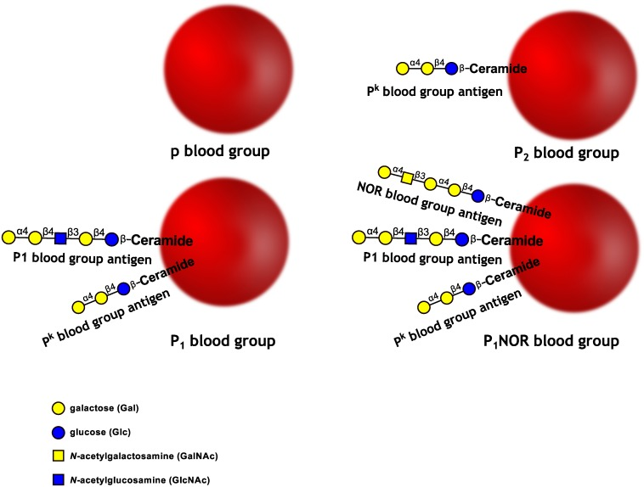

Slide 6
p Phenotype and associated antibodies
Consequently, P negative individuals can harbour one of the following phenotypes: Tj(a-) or p, P1 k or P2 k .
Anti-PP1Pk is a naturally occurring antibody and is a mixture of the following alloantibodies: anti-P (anti-GLOB1), anti-Pk (anti-P1PK3) and anti-P1 (antiP1PK1).
Anti-P and anti-PP1Pk antibodies belong to the group of antibodies to a high-frequency antigen (HFA).
Anti-P1 is a more commonly encountered antibody that is not considered clinically significant (on it’s own it’s crossmatch compatible).
Notes:
Anti-PP1Pk was previously known as anti-Tja

Slide 7
What’s all the fuss about? (Part 1)
There is no specific treatment or primary prevention strategy as these are naturally occurring antibodies.
The P (GLOB1) and Pk (P1PK3) antigens are expressed by placental, trophoblastic, and embryonic cells.
This explains why p patients with anti-P or anti-PP1Pk alloantibodies are particularly susceptible to spontaneous abortions before 20 weeks gestation.
Maternal anti-P and anti-PP1Pk alloantibodies recognize the target antigens expressed as early as 5 weeks gestation by the embryo and the trophoblastic cells, and then activate complement, thus causing destruction of the embryonic tissues.
When the P, P1 and Pk antigens are absent, the anti-PP1Pk antibodies, which are composed of regular IgM type, regular or irregular IgG type antibodies, or a combination of both, naturally arise.
Notes:
These antibodies cross the placental barrier, are efficient complement activators, and are responsible for antibody-mediated cytotoxicity.

Slide 8
What’s all the fuss about? (Part 1)
Some reports suggest a risk of early first trimester miscarriage between 50% and 70% in p patients.
In the last 35 years, there have been just 19 cases of pregnancies in women with anti-PP1PK in the literature.
Regarding management, there is no specific treatment for PP1Pk alloimmunization.
Contrary to Rh and Kell alloimmunization, in which plasmapheresis is especially important in the last trimester, in anti-PP1Pk pregnancies pre-conception surveillance and early treatment (if necessary) are essential.
Notes:
A literature review demonstrated 87% (68/78) of miscarriages in p patients.

Slide 9
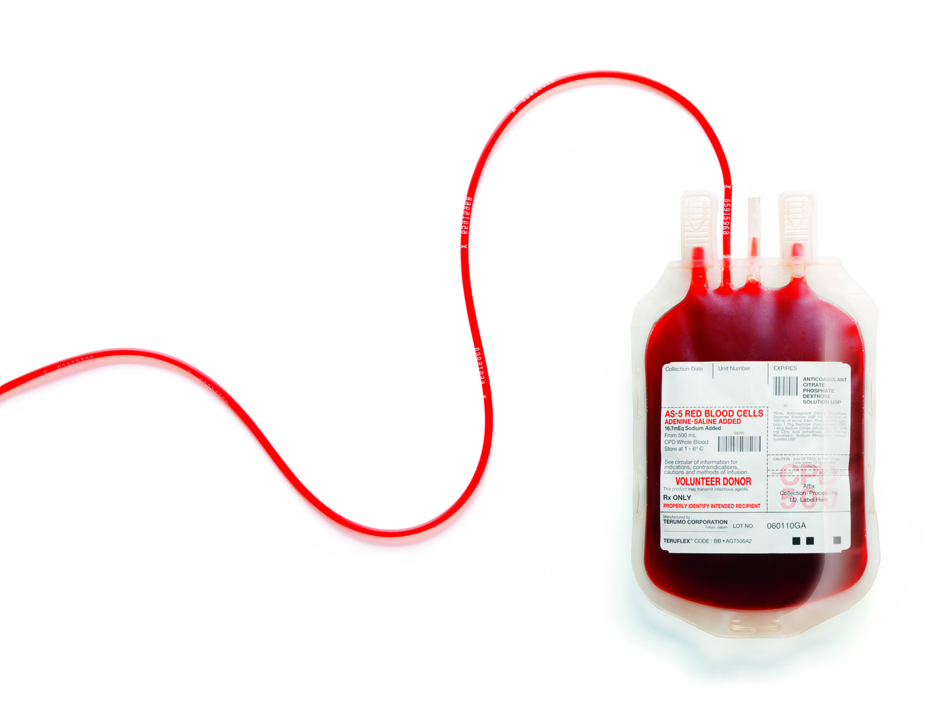
What’s all the fuss about? (Part 2)
Individuals with a Tj(a-)/p or P1 k or P2 k phenotypes have a rare blood group with very few compatible RBC donors in the world.
Remember the prevalence is 5.8/1,000,000!

Slide 10
EDQM
Notes:
European Directorate for the Quality of Medicines (EDQM) was created in 1996. Many functions, but the one we’re talking about here is a rare blood unit database.

Slide 11
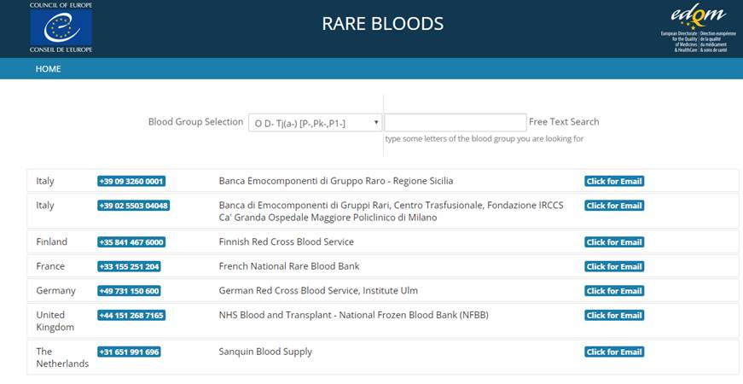
EDQM continued

Slide 12
Case Study
First referral for 27 year old antenatal patient on 15th April.
Blood Group: O RhD positive
Rh/K phenotype: C+E-c+e+ K-
Nothing too exciting so far!

Slide 13
BioRad Panel results
 | 1 | 2 | 3 | 4 | 5 | 6 | 7 | 8 | 9 | 10 | 11
ENZ IAT | 4+ | 4+ | 4+ | 4+ | 4+ | 4+ | 4+ | 4+ | 4+ | 4+ | 4+
IAT | 4+ | 4+ | 4+ | 4+ | 4+ | 4+ | 4+ | 4+ | 4+ | 4+ | 4+
Auto test cell | DAT
Neg | Neg
Extended phenotype: k+ M+ S+ s+ Fya+ Fyb- Jka+ Jkb+
So what next?
Notes:
No clues from the phenotype

Slide 14
Where in the world…..
Notes:
One of the RCI medical scientists suggested that the patient was of Middle Eastern descent, as she is from the UAE herself. With this in mind, we chose rare cells that would typically be found in Middle Eastern populations but also added some other rare cells to cover all the bases.

Slide 15
Further lab testing
The following rare cells/antisera were recovered and tested against the patient’s plasma:
Rare Cells Tested Against Patient Plasma
Oh- | AnWj-
Lu(a-b-) | Inb-
Hrb- | DISK-
Jsb- | Jra-
Yta- | Ge:2,3-
Era- | PP1PK* (rare antisera)
Vel- | LAN-

Slide 16
Further lab testing
We only had anti-PP1PK to suggest that this was the antibody .
We reached out to colleagues in Sweden and requested some p- rare cells as the Scandinavian countries have a slightly higher incidence of Anti-PP1PK than the rest of Europe.
Thankfully we received p- rare cells from Sweden after two weeks and were able to confirm the presence of anti-PP1PK.
Alloadsorption was used to check for antibodies other than anti-PP1PK.
Anti-P1 was detected post adsorption (x1).
Because the patient was antenatal, we performed a titre using both a P1+ and PP1PK+ reagent cell, and a P1- PP1PK+ cell.

Slide 17
Further lab testing
We also did an investigation into the composition of the antibody through IgM and IgG antibody inactivation studies.
We found that the antibody had both IgG and IgM characteristics.
The IgM component was a cause of concern.
It made the patient a dangerous recipient as the IgM component of anti-PP1Pk antibody would cause a severe life threatening transfusion reaction if transfused incompatible red cell component in an emergency situation.

Slide 18
Titres during the course of the pregnancy

Slide 19
Roadmap for managing the patient
Completed gestation (weeks) | Testing | Rationale
16 | Red cell antibody screen Titration complex P antibody only Extended red cell antigen profile | Trend antibody Exclude masked allo antibody Component selection potential IUFT
16 | ABO D (extended rhesus) Dad | Component selection potential IUFT
16 | Biological assay for haemolytic potential* | Inform clinical management and anticipate outcome
20 | Red cell antibody screen Titration complex P antibody only | Trend antibody Exclude masked allo antibody
24 | Red cell antibody screen Titration complex P antibody only | Trend antibody Exclude masked allo antibody
28 | Red cell antibody screen Titration complex P antibody only | Trend antibody Exclude masked allo antibody
28 | Biological assay for haemolytic potential* | Inform clinical management and anticipate outcome
30 | Red cell antibody screen Titration complex P antibody only | Trend antibody Exclude masked allo antibody
32 | Red cell antibody screen Titration complex P antibody only | Trend antibody Exclude masked allo antibody
34 | Red cell antibody screen Titration complex P antibody only | Trend antibody Exclude masked allo antibody
36 | Delivery plan | To be discussed and agreed with obstetric team

Slide 20
Sanquin ADCC Testing
Antibody-dependent cellular cytotoxicity (ADCC) assay is used to determine the destructive capacity of the antibodies.
In the Netherlands, the titre cut-off value of ≥16 and/or an ADCC test result of ≥30% is used to timely select pregnancies at risk for fetal hemolysis by non-D/non-K alloantibodies.
Sanquin Diagnostics perform an assay which measures the lysis of sensitized red blood cells by effector cells.
Chromium-51 (⁵¹CR)- labelled RhD positive erythrocytes are incubated with maternal serum and monocytes, and percent lysis is measured by the release of ⁵¹Cr from the red cells into the supernatant.
The result is given as a percentage which may influence the decision to import units or the number of units required.

Slide 21
Sanquin ADCC results June 2021
Notes:
Note the terminology, anti-tja which is the original name given to anti-PP1PK

Slide 22
ADCC Results continued September 2021

Slide 23
Potential Irish Donors
The patient’s partner and 3 siblings were tested to see if any of them would be suitable donors to cover the delivery.
Unfortunately none of them were suitable candidates as they were not p phenotype.
We also asked our RCI colleague to get tested to see if she would be a suitable donor…..Another example of RCI willing to go above and beyond!
Something to think about…..can we ask the patient to donate in the future?

Slide 24
Arranging Donors
Two x group O p (-) red cell components were received from Sweden when the patient was roughly 37 weeks gestation.
These units were collected 22 September 2021
The coordinated medical team agreed on a concession for CMV positive units
We sourced an additional group O p(-) red cell component from Valencia, Spain and received this unit on 06 October 2021 (date bled 04 October 2021)
This was requested as SAGM unit to cover any potential requirements for exchange transfusion, and was timed as close to estimated date of delivery.
We agreed to retain 1 unit here in the IBTS in case the unit had to be transformed into a pedipack.
Notes:
We also had a potential donor in Canada but there was a 24 hour post thaw expiry for units transported here

Slide 25
18th October 2021…..
The plan:
The patient’s EDD was 13th October. A natural vaginal delivery was the preferred option.
What actually happened:
On the 18th October, the patient was 40 weeks +5, and she was induced.
The sample arrived in RCI at 22:43 and red cells were released at 1am on 19th October!
Notes:
Testing went smoothly and units were compatible.

Slide 26
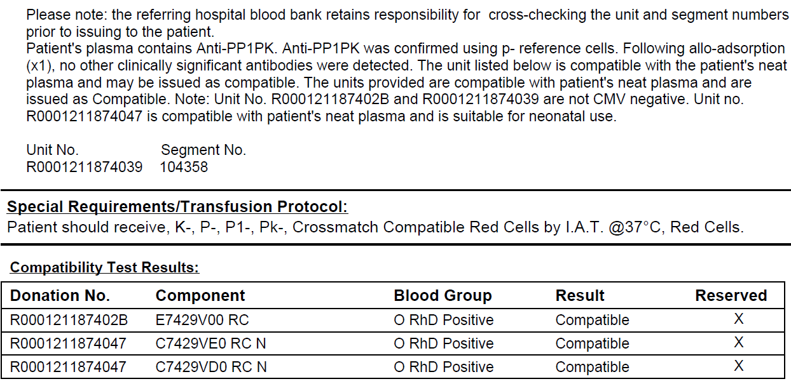
Reporting
Notes:
We had sent the units over to the referring hospital BB to keep on standby and segments were sent in with samples for each referral.

Slide 27
Laboratory Investigation of the Newborn
Blood group: B RhD positive (by tube and BioRad card manual methods)
Rh/K phenotype: C+ E- c+ e+ K-
DAT: negative
Eluate was pan reactive by ENZ-IAT only.
Cells were typed for P, P1 and Pk and were positive
Pan reactivity by ENZ IAT presumably as a result of maternal anti-PP1Pk.

Slide 28
Ciaccio P et al Vox Sanguinis (2021) 116 591-600
Early initiation of TPE (PEX) should be considered
Foetus should be monitored closely with interval foetal ultrasound and MCA PSV to screen for foetal anaemia
Timely sourcing of compatible red cell components is likely to be challenging and both autologous and directed donation should be considered
IRDP should be accessed

Slide 29
Literature review (published)
Factor | Outcome
Maternal age | 19-39
Ethnicity | Japanese (3) Burmese (2) Amish (2) Tamil Indian (2) Chinese (1) Israeli (1) Kuwait (1) Moroccan (1) Turkish (1)
Phenotype | P1 k (1); p (15)
Titre | 1:32-1:256
Management | TPE (PEX) (12): IVIgG (3); random plasma infusion (1) dydrogesterone (1); note conservative management (Amish) no HDFN maximum titre 1:16 term deliveries*
Foetal outcome | Foetal loss (3); foetal distress, anaemia, IUGR (4); positive neonatal DAT (5) – jaundice but not anaemic (2); severe HDFN (2); one woman severe PPH (placenta accrete) autologous and directed red cell components transfused
Maternal complications | TPE catheter complications (2); pre eclampsia (1); Severe post partum haemorrhage (1); post partum haemorrhage(1)
Miscarriage history | Recurrent miscarriage(two or greater) (10) (one woman had thirteen miscarriages); unreported (3)

Slide 30
Patient management
Consider the following:
Ig M reactive antibody associated with severe haemolytic transfusion reaction (dangerous recipient)
Ig G reactive antibody associated with early pregnancy foetal loss and haemolytic disease of foetus and new-born
Assessing pregnancy for foetal risk …serological monitoring and biological functional assay for haemolytic potential (exclude masked antibody)
Foetal medicine assessment (most predictive value and correlation with outcome)
Procurement of compatible red cell components for potential maternal transfusion (delivery) foetal transfusion (HDFN) and neonatal transfusion (HDFN)

Slide 31
Patient management
Serology ( see Ruth …anti P1 and anti PPk….titre score 1:32-1:64)
Biological assay predicts low haemolytic potential (note judgement call for 14 September sample)*
Initial search 57 cryopreserved and 4 walk in liquid donors (IRDP accessed)… no D (-) inventory
Logistics: recovered cryopreserved red cell loss and time limit for application
We have contact with Blood Canada …low glycerol method (LGM) validated for fourteen days post recovery
One group O D (-) p identified but pregnant …her sister sourced in Quebec (HemaQuebec)….one donation collected and preserved group O D (+) p 30 August 2021 Edmonton Canada (contingency)
Two red cell components collected by invitation bleed 16 and 18 September 2021 Sweden….SAGM (note passively acquired antibody in donor) and receipted 23 September 2021)…additional testing required to qualify donation (individual NAT HIV HBV and HCV…HEV) anti-hepatitis B core antibody

Slide 32
Patient management
Note measures being taken by our colleagues in Rotunda (MDT meeting obstetric foetal medicine haematology and neonatology)
Omit low molecular weight heparin/aspirin (normally indicated BMI 35) to minimise bleeding risk
Iron repletion
Intraoperative cell salvage deployed
Active management third stage of labour (uterine contraction)
Protocol for incompatible transfusion (emergency) high dose intravenous immunoglobulin and methyl prednisone

Slide 33
Patient management
Big dilemma for IBTS was cover for babe…..IUFT programme would have been extremely difficult…plan was to access (scheduled) recovered cryopreserved O (+) p (obligate D (+) inheritance and issue as a medical concession
Alternative was to bleed whole blood (non SAGM) Valencia (2 x CMV antibody negative) and re process in component despatch…remove plasma (anti-PP1Pk) and re suspend in single donor universal group AB plasma and issue as a medical concession
We sourced (see Ruth) one CMV antibody negative paediatric assessed donor in Valencia Spain invitation bleed 04 October 2021 receipted 06 October 2021 ….we knew we could hold for fourteen days then convert to a neonatal component and hold for five days and stay within specification
Once again quality and compliance required additional testing and relabelling of expiry date
(forty-two days for sorbitol bases nutrient preservative solutions)

Slide 34
Clinical outcome
Outcome for Mum (results)
Induction of labour, term +6, normal vaginal delivery, no transfusion outcome
Haemoglobin = 126g/L

Slide 35
Clinical outcome
Outcome for babe (results)
Date | Time | Blood group serology | Bilirubin (micromole/L) | Haemoglobin (g/L)
19 October 2021 | 12:16 | B D (+) DAT (+) Eluate pan reactivity versus PP1Pk cells C+E-c+e+P1+ K- P+ Pk+
19 October 2021 | 19:43 |  | 90.4 | 216
21 October 2021 | 08:24 |  | 127.9 | 211
22 October 2021 | 13:10 |  | 114.2
29 October 2021 | 10:12 |  |  | 200

Slide 36
Summary
First time mother presents early twenty-seven and no declared history of pregnancy loss or transfusion
High frequency red cell antibody anti-P1PPk detected and confirmed early (twelve weeks gestation)
Clear plan for monitoring and assessment agreed, communicated widely and openly and executed
International cooperation for red cell component procurement
Aim for normal conduct of pregnancy, normal delivery and no transfusion outcome mother and babe

Slide 37
References
Marlène Sohier Lépine et al. Multidisciplinary management of anti-PP1Pk or anti-P alloimmunization during pregnancy: A new case with anti-P and a literature review. Transfusion. 2021;61:1972–1979.
Nascimento, Sara et al. “Pregnancy with anti-PP1Pk antibody managed with prednisolone and low-molecular-weight heparin - A case report and literature review.” Case reports in women's health vol. 27 e00238. 30 Jun. 2020, doi:10.1016/j.crwh.2020.e00238
Handbook of Clinical Laboratory Testing During Pregnancy edited by Ann M. Gronowski
Transfusion 2008 May;48(5):941-52. doi: 10.1111/j.1537-2995.2007.01625.x. Epub 2008 Feb 1. Effect of screening for red cell antibodies, other than anti-D, to detect hemolytic disease of the fetus and newborn: a population study in the Netherlands J M Koelewijn ¹, T G M Vrijkotte, C E van der Schoot, G J Bonsel, M de Haas
Kaczmarek, Radoslaw et al. “Single nucleotide polymorphisms in A4GALT spur extra products of the human Gb3/CD77 synthase and underlie the P1PK blood group system.” PloS one vol. 13,4 e0196627. 30 Apr. 2018, doi:10.1371/journal.pone.0196627

Slide 38
We would like to thanks our medical and scientific colleagues in the Rotunda for allowing us to be part of this very special antenatal case

Slide 39
Thank you!

