Slide 1




Update on Pathogen Reduction of Platelets and the introduction of Whole Blood containing Platelets
3rd October 2023
Barry Doyle
Director of Production & Hospital Services
National Haemovigilance Conference 2023

Slide 2
Conflict of Interest Disclosure
I have no conflicts of interest to declare.

Slide 3
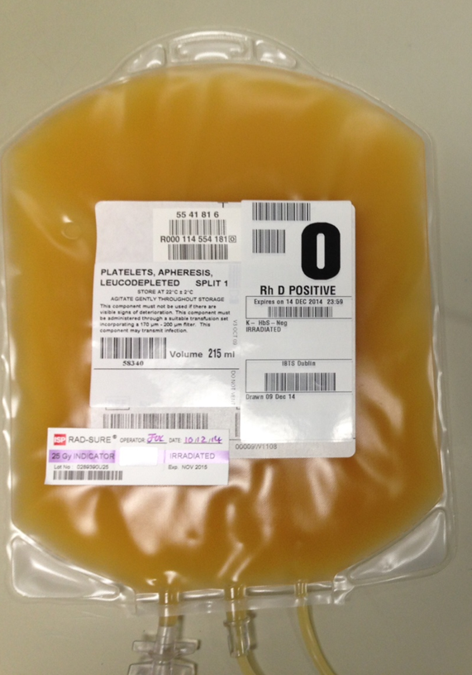
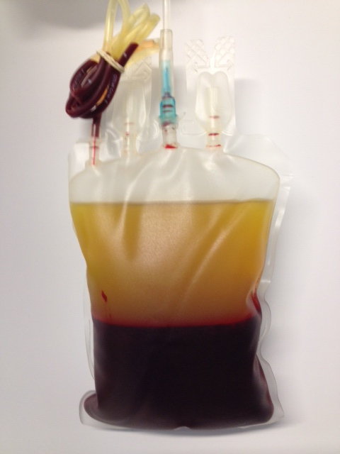
Blood Components
Plasma
Platelets
Red cells
  Irish Annual Blood Requirement
  130,000 whole blood donations - 26,000 platelets - 17,000 plasmas

Slide 4

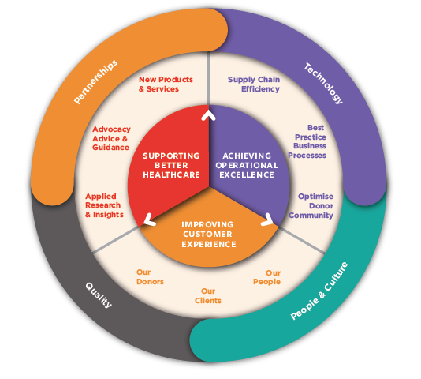
Key Strategic Initiatives
Assessment of pathogen reduction of platelets – a post collection blood product manipulation process
Develop new products and services designed to meet emerging healthcare needs

Slide 5
Pathogen Reduction of Platelets

Slide 6
Platelet Production Developments
Pathogen Reduction of Platelets - Cerus INTERCEPT Blood System
The INTERCEPT system is used to inactivate bacteria, viruses, parasites, and leucocytes.
This process is intended to reduce the risk of transfusion-associated transmission of viruses, bacteria, and parasites, and may also reduce the risk of adverse effects due to donor leucocytes.
Notes:
can’t find the same image but found this one which is missing the final step.

Slide 7
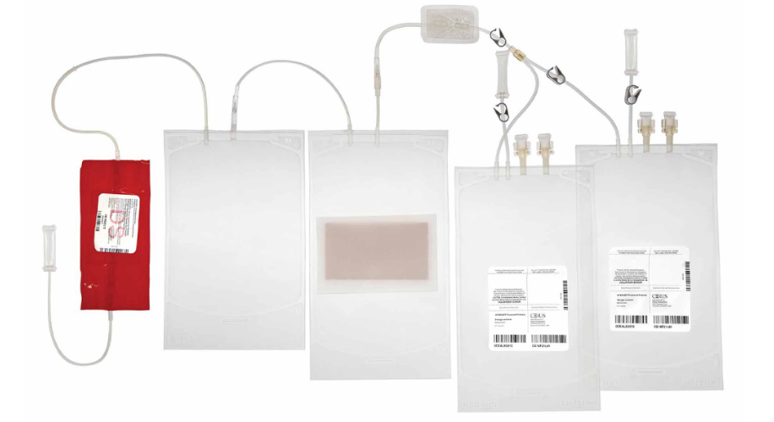
Pathogen Reduction of Platelets
INTERCEPT Kit
Final product – Pathogen Reduced platelets
Addition of psoralen (Amotosalen)
Illumination Bag – UV exposure
CAD – Compound Adsorption Device – Removes remaining unbound Amotosalen

Slide 8
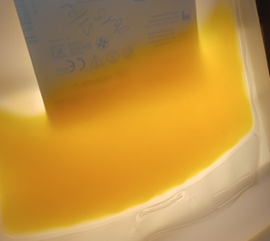
IBTS Pathogen Reduction Validation
Product Quality
Buffy Coat Optimisation
7 Buffy Coat Pool
Optimisation
Pathogen Reduction of Pools
Platelet
Pools
Platelet
Apheresis
Equipment Upgrade
Apheresis in Additive Solution
Pathogen Reduction of Apheresis
System Effectiveness
Platelet
Pools
Bacterial Spiking
IBTS Pathogen Reduced Pool

Slide 9
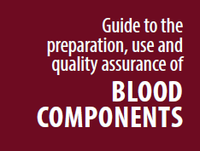
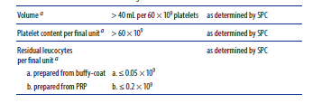


Platelet Quality Assessment
Next version of EDQM
Glucose measured at the end of the recommended shelf-life
Above Limit of Quantification

Slide 10
Platelet - Storage Study
Quality Parameters | Volume Platelet Content / Concentration Leucocyte Content Swirling Aggregation MPV
Metabolic | Glucose concentration
Biochemical | pH levels PO2/PCO2 Partial Pressure
Platelet Activation | CD62P expression Annexin V binding (%)
Comparison Study
Baseline testing then on day
2, 6 and 8

Slide 11
Feasibility Assessment Process - Validation
Project Management
Validation
Project Team
Change Management
Project Steering Committee
Quality Documentation
Programme Board

Slide 12

Validation
Product quality
System Effectiveness
National Consultant Group
Protection against pathogens
Bacteria
Viruses
Emerging pathogens
Medical & Scientific Advisory Committee Review
Product efficacy – literature review
Stakeholder Engagement
Operational Impact
Benefits to supply chain
Economic Considerations

Slide 13


Slide 14
Medical & Scientific Advisory Committee Review
Due to the very good validation data from the IBTS, a national clinical study could be considered, however, it became evident that a clinical study would not be feasible.
Based on the discussion and analysis of available information, the final recommendation from M&SAC on the 16th May 2023 was that :
Pathogen reduction of platelet concentrates are not implemented now.
The decision should be revisited after three years unless new situations require urgent action
  or
If further clinical evaluation /trials show superiority / non inferiority of PR of Platelets

Slide 15
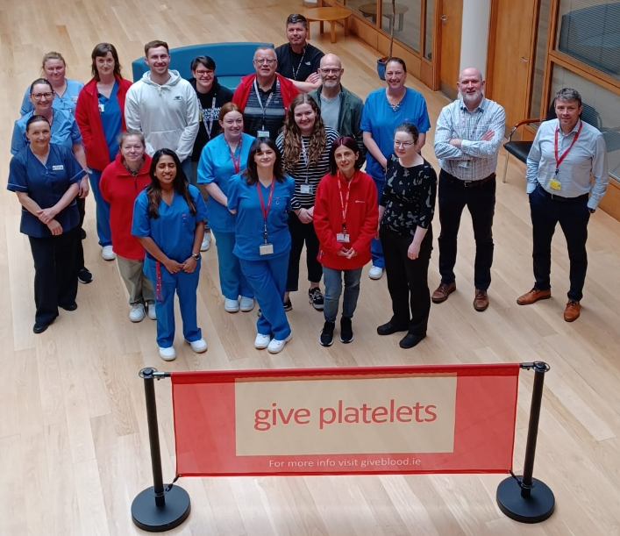
Donors
Apheresis Clinic
QA Dept.
Production Dept.
Validation Dept.
QC Lab
Component Scientists

Slide 16
Whole Blood containing Platelets

Slide 17
  Separation of Whole Blood
Maximise use of donated blood
Clinical need and avoidance of unnecessary exposure
  Red cell
  Buffy coat (platelets)
  Plasma
Optimise storage and shelf life
Need for plasma for fractionation

Slide 18
  What type of whole blood?
IBTS/PMF/SPEC/0203[4] Whole blood suitable for neonatal use
Not This!
Whole blood for trauma
Cold stored (4°C)
Low titre anti-A/B
CPD – storage time controlled by QC
Group O (RhD+/RhD-)
Leucocyte filtered with platelet sparing filter

Slide 19
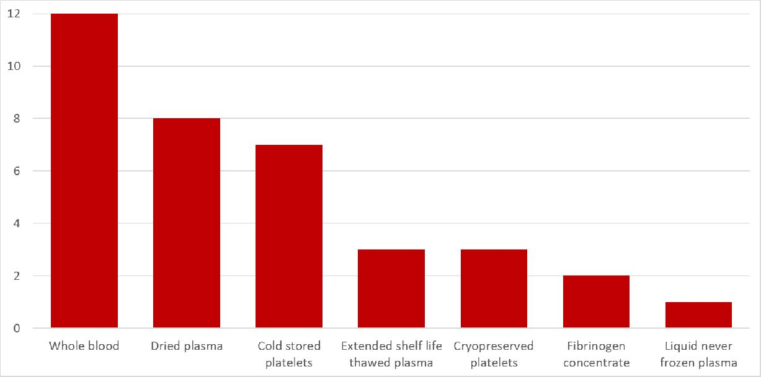
  Why is Whole Blood Needed Again?
EBA Working Group – New Products and Innovation – Major Haemorrhage Survey
15/26 EBA member states responded

Slide 20
  Usage of Whole Blood
In the EBA survey 5 countries currently use whole blood to treat major haemorrhage in some form
IBTS will establish usable shelf-life during validation
Country | Whole Blood Shelf Life
A | 21 days
B | 14 days
C | 7 days pre-hospital, then up to 21 days in hospital in ‘trauma fridge’
D | 21 days
E | 21 days

Slide 21
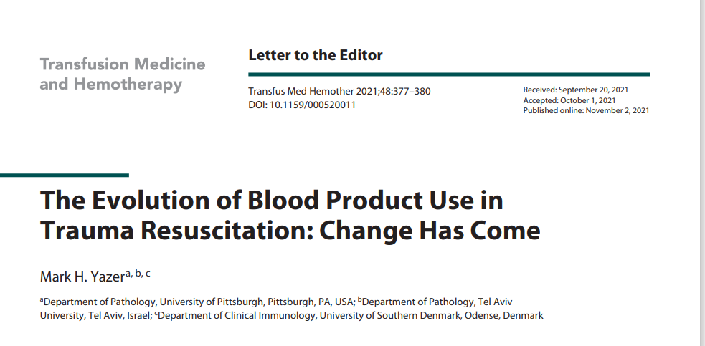

Slide 22
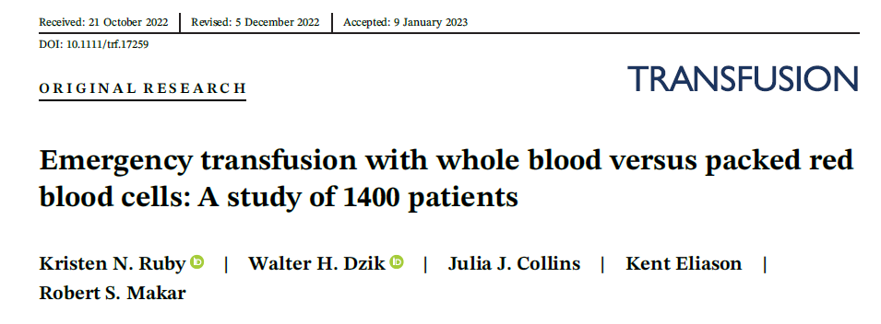
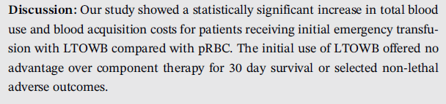

Slide 23
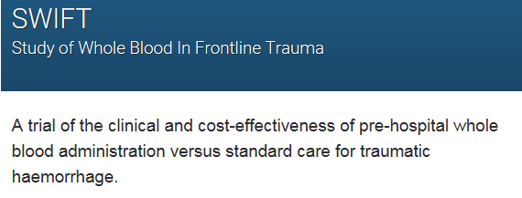


Study will look at whether giving whole blood instead of red blood cells and plasma pre-hospital will:
Reduce the number of deaths 24 hours after injury
Reduce the need for further large blood transfusions when patients get to hospital

Slide 24


  Next Steps
Step 1 Product validation
  Aim to complete validation this year in MRTC
Step 2 – Subject to successful validation & approval
  Pilot Study
Step 3 - Subject to approval - Plan to make available
  Supply logistics and management of wastage
  Clinical Use
    Pre-hospital ?
    In-hospital ?
    Potential impact on current major haemorrhage protocols
Aine Fitzpatrick
Chief Medical Scientist
Components and Hospital Services MRTC
Mark Lambert
National QC Manager

Slide 25




  Thank You
Connect with Us
TWITTER
LINKED IN
INSTAGRAM
@Giveblood_ie
Irish Blood Transfusion Service
@Giveblood.ie

