Slide 1
Education in Haemovigilance: A Northern Ireland Perspective
Denise Mckeown
Regional Haemovigilance Co-ordinator/ Manager of BHSCT Haemovigilance Team
Notes:
Welcome, everyone.
In recent years, Northern Ireland’s education landscape has undergone significant changes.
Since the pandemic, face-to-face training has declined, with a strong move towards online learning.
This shift has created a need for standardised regional training, allowing staff to move between wards/sites without needing additional retraining—especially in our increasingly digital world.
In short, E+T is continually being updated to keep up with these changes.

Slide 2
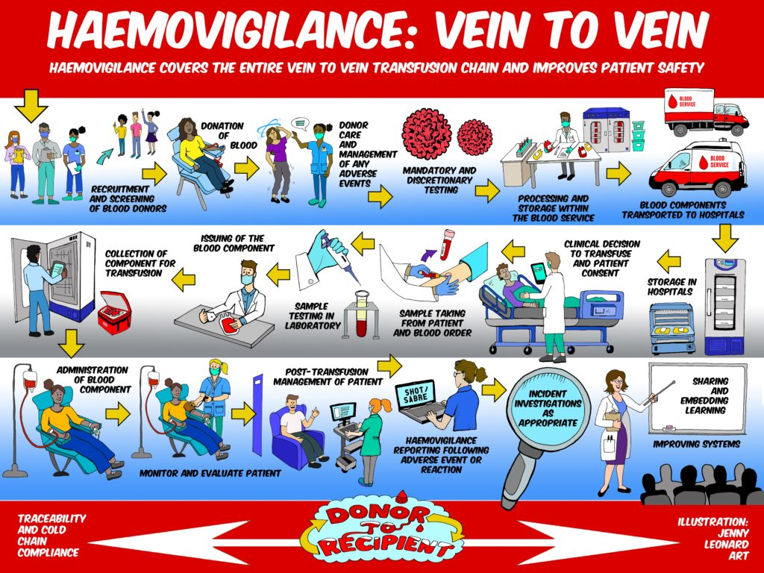

Notes:
What is Haemovigilance? WHO Definition
Its role in patient safety

Slide 3
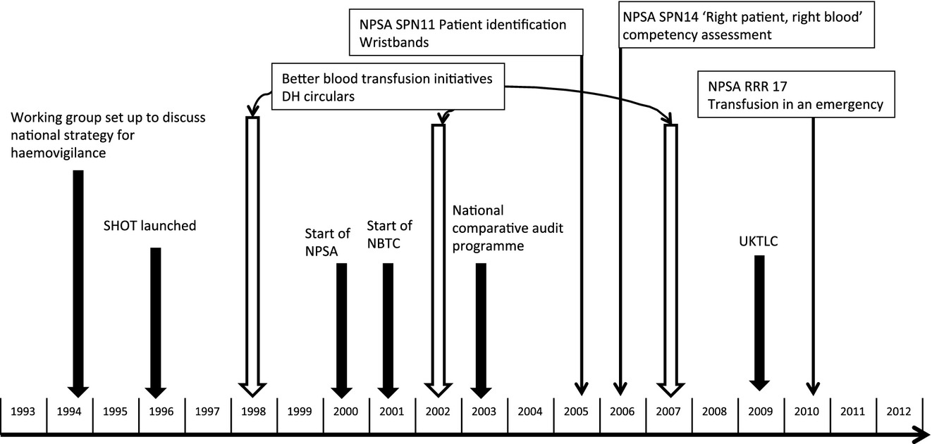
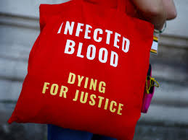
How did Haemovigilance come about?
Serious Hazards of Transfusion (SHOT) Haemovigilance and progress is improving transfusion safety
Br J Haematol, Volume: 163, Issue: 3, Pages: 303-314, First published: 14 September 2013, DOI: (10.1111/bjh.12547)
Notes:
-Haemovigilance emerged internationally as a response to increasing awareness of transfusion-related risks and the need for standardized safety measures, initially led by France in 1994 the system was adopted globally to improve patient safety by systematically monitoring, analysing, and preventing adverse transfusion events through national and international collaboration and data sharing.

Slide 4
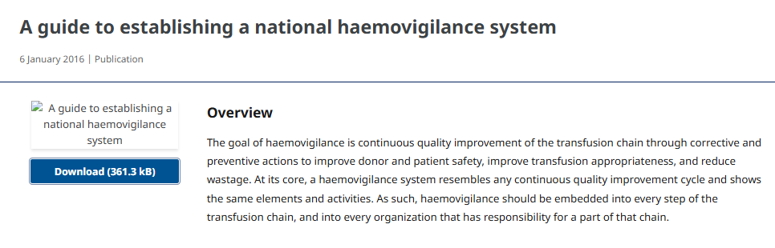
Notes:
Global Haemovigilance
UK HV Programme – SHOT

Slide 5
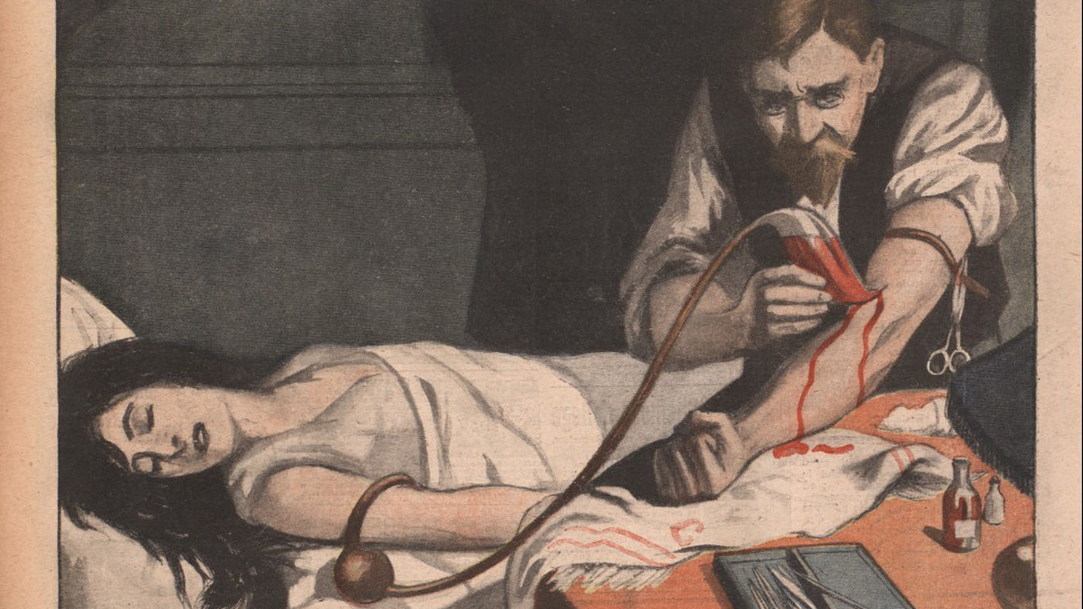
Oh my sweet Rhesus
Jean-Christophe Piot
Notes:
It has to be said that as soon as we talk about blood, everything gets complicated.
It took a long time for blood transfusion practice to become the safe and controlled process we know today

Slide 6
The Continued Need for Education in Haemovigilance
Transfusion safety doesn’t stand still—neither should our education
The reality is that mistakes happen—Haemovigilance is here to catch them, learn from them, and prevent them from happening again
Notes:
Haemovigilance is everyone’s responsibility—not just the transfusion team.
Secret service

Slide 7
Building the Foundation leads to Competent Workforce
Comprehensive Transfusion Training
Structured pathways
Prepared and Competent workforce
Notes:
Transfusion teams work closely with Trusts and Universities to ensure Healthcare Professionals are appropriately trained
Training programmes tailored to meet needs of the learners
Training ensures staff are competent, reduces risks and improves patient care and ongoing collaboration fosters continuous development

Slide 8
Maintaining Education and Training
A competent workforce is not just about initial training—it’s about ongoing development.
Ongoing education is essential to keep skills up to date
Notes:
A competent workforce is not just about initial training—it’s about ongoing development.
• Staff need refresher courses and competency reassessments to stay current with best practices.
• Simulation training, audits, and real-world case discussions help reinforce learning and prevent errors.
• A strong culture of continuous learning leads to safer transfusion practices and better patient outcomes.

Slide 9
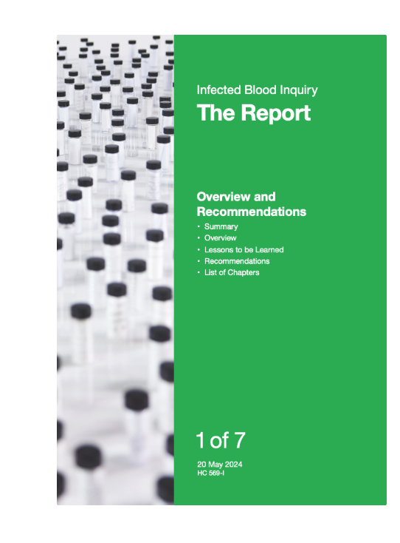
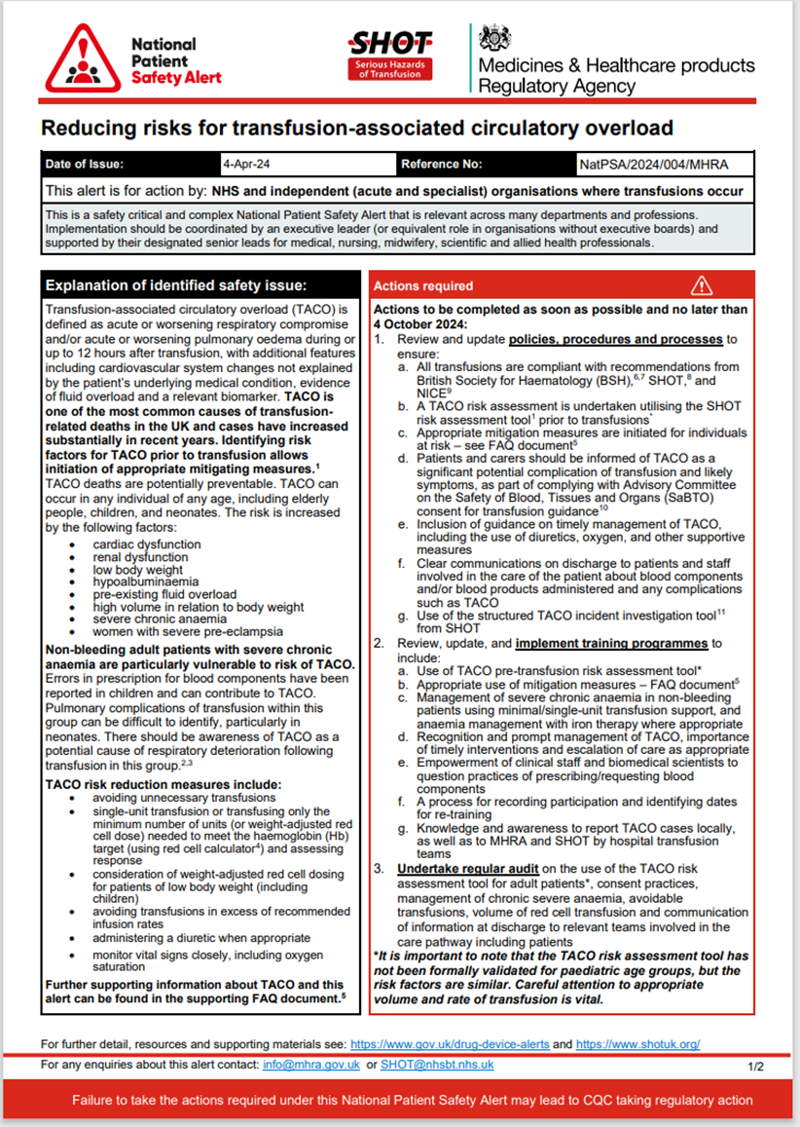
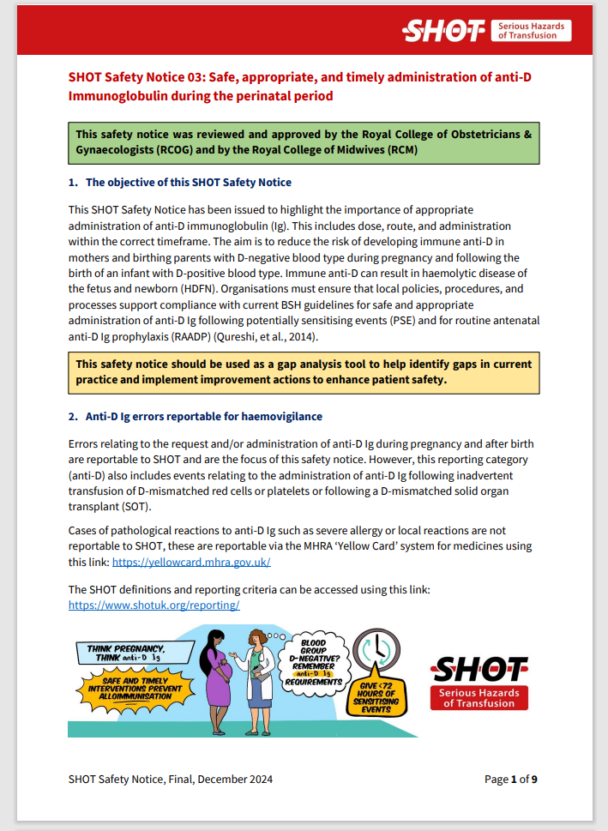
Constantly Changing Landscape with a patient safety focus
https://www.infectedbloodinquiry.org.uk/reports/inquiry-report
Notes:
Data driven approach to patient safety.
Key reports on preventable errors
Transfusion education has recently intensified its focus on patient safety, driven by recommendations from recent reports and alerts. The recent Infected Blood Inquiry (IBI) report has emphasised the importance of structured, safety-centric education, recommending a proactive approach to mitigate transfusion risks. This report underscores the role of specialised training in preparing healthcare professionals to manage complex cases effectively, thereby ensuring patient welfare.
The TACO (Transfusion-Associated Circulatory Overload) patient safety alert has further underscored the critical need for focused education. TACO is a serious, yet preventable, transfusion complication. The alert has recommended specific educational modules and updates aimed at reducing TACO risks by equipping staff with the skills to identify at-risk patients and respond rapidly in case of circulatory overload.
Where as the focus was on the blood component, education initiatives now focus on a patient safety-driven curriculum that incorporates these recommendations. Training not only enhances competency in transfusion processes but also embeds best practices for recognising and responding to potential complications, ensuring that healthcare staff are prepared to deliver safe, high-quality transfusion care.

Slide 10
From Education to Real-World Change
Education and training are essential, but they must evolve to keep pace with changes in practice
New systems, policies, and technology have transformed how we train staff
In Northern Ireland, several key changes have impacted how we educate, assess, record and maintain transfusion education and training
Notes:
• We’ve established that ongoing education and training are crucial—but the way we educate staff has been influenced by real-world changes.
• New IT systems, policy shifts, and training updates have transformed how we deliver haemovigilance education.
• In Northern Ireland, we’ve seen both opportunities and challenges—from the move to BTT modules to the impact of EPIC on training and competency assessments.
• Next, we’ll look at specific examples of these changes and their effect on transfusion education.

Slide 11
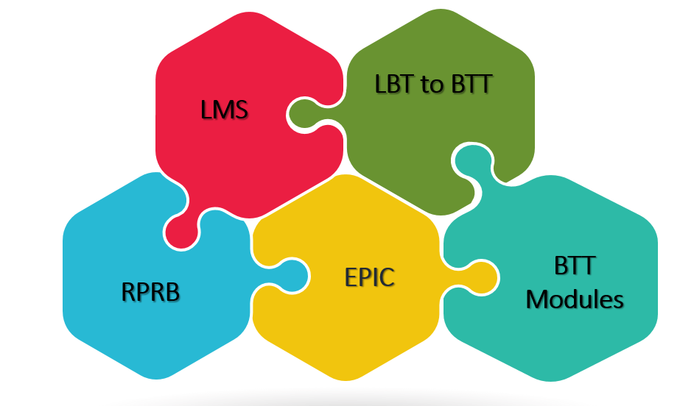

Slide 12
Learning Management Systems (LMS)
LMS - HRPTS LSO until April 2023
NI iLMS – Modules hosted regionally on LearnHSCNI - an interim system licensed for 3 years initially
EQUIP - 2026
Notes:
New LMS- why the need for change?
It’s a major upgrade from the previous HPRTS LSO, providing a wider range of functions and making things easier to use.
It offers better tools for recording, tracking, and reporting on learning and development activities.
- It supports access from outside HSC networks and is compatible with mobile devices (available on Google Play and the Apple App Store).
- Initially, this system was also used to support the rollout of the Encompass project.

Slide 13

Integration of all HSC eLearning
HSC Clinical Education Centre
HSC Leadership Centre
NIMDTA – Training records move with staff member
Notes:
The new iLMS consolidates all HSC eLearning, effectively merging both the HSCLearning and Belfast e-Learning platforms into a single system. One stop shop for staff to access their training.

Slide 14

From LBT to BTT
2025 LearnBloodTransfusion (LBT) - widely used by all four UK nations and the ROI as part of the training of healthcare staff and students.
In 2021/2022 - 2 UK countries started using an alternate elearning package for Transfusion Training – Blood Transfusion Training (BTT).
NI terminated their contract with LearnPro on 31st March 2024
Notes:
With fewer nations contributing, costs would be increased to use platform as well as workload on representatives from each nation in reviewing content.
Modules hosted on LearnHSCNI – accessed by Trust staff; for non-Trust staff via eLFH.
Independent - Sciensus- pay fees to host files on their own LMS

Slide 15
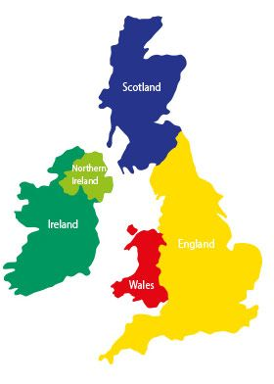
BTT Modules: UK Editorial Boards Unite!
Collaboration Overhaul: Editorial boards across the UK are pooling their expertise to redevelop current modules.
Standardised Yet Adaptable Content: New content suits regional needs and best practices across all of the UK&ROI
Better Quality Training: Ensures that all training content is accurate, up-to-date, and relevant to local practice.
Notes:
This move then prompted a review of the eLearning requirements with a focus on updating the BTT modules.
The UK&IBTN editorial board was formed to work collaboratively to streamline efforts (and thus minimising duplication of work) and promote, develop and maintain the already established elearning programme. The Editorial board includes representatives from across the UK and this collaboration means fewer regional differences and less outdated content , but adaptable enough to make sure it fits Northern Ireland’s specific needs.
Currently we are working together to revamp the current BTT to ensure they meet the needs of everyone

Slide 16

Have Your Say: eLearning Survey
Key messages
E-Learning is a good strategy for delivery of standardised training to large groups.
The modules should be as short as they practically can be; time to complete long compared to other elearning.
There should be clarity re: which modules users need to complete
Users like interactive elements and video/demonstration in the learning material
Use of basic language, explain acronyms; layer complex concepts/language in ‘advanced’ modules
Notes:
As part of the redevelopment of the BTT modules, it was decided to seek stakeholder engagement to help better understand the needs and wants of both learners and trainers with regards to transfusion eLearning and training. A survey was conducted to gather feedback on the current eLearning modules used, and ideas for future improvements
The survey received a good number of responses - 489

Slide 17


EPIC
Notes:
Another significant update is EPIC, a new digital system for managing patient health records that impacts the HVP Team:
EPIC has changed our approach to competency training, - Assessors need new, updated training resources and materials to align with these changes.
Updating RPRB assessment tools across Northern Ireland is a collaborative effort
New interactive tools are being developed and tested, though some challenges like a lack of equipment and resources (e.g., devices, printers) remain.

Slide 18
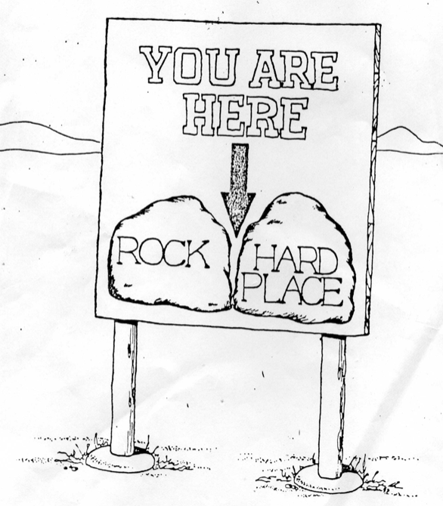
Notes:
EPIC is a game changer but it created gaps in training. tried to keep out of encompass training but we have ended up providing education on how to use encompass both at the elbow and via teaching sessions.

Slide 19
Right Patient, Right Blood Competency
Ensuring timely access to “Right Patient, Right Blood” training for agency staff
Grace period discussed
  NHSCT 4-6 weeks
  BHSCT 8 weeks but struggled
  SEHSCT – 12 weeks
  WHSCT – no grace period - need it completed before book shift
  SHSCT Haemovigilance team helps with any outstanding
Contracts Management Group is working on it!
Notes:
• RPRB competency impacted by roll out of EPIC
Many staff, especially agency are struggling to get their competencies signed off as assessors are limited
Delay can impact patient safety – as staff are not being allocated shifts or are taking up shifts but unable to partake in Transfusion practice till they are signed off
• Options appraisal submitted to Bank team who have taken it to Contracts Management Group for review and feedback.
Our goal is to make sure agency staff can complete this training on time – every time.

Slide 20

IT Transformation Beyond EPIC
The future of Haemovigilance isn’t just about training—it’s about technology
Notes:
WinPath and BloodTrack

Slide 21
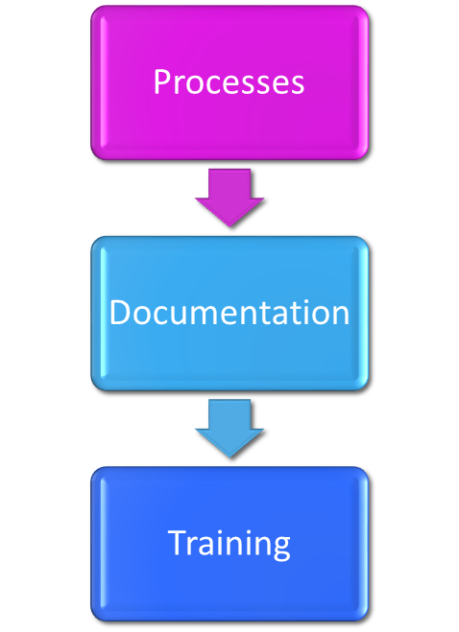
Impact of Implementing Change
Modernised, digital records for better efficiency
Streamlined learning processes
Enhanced competency and training
Safer transfusions and patient safety improvements
Standarised
Notes:
So, why does all this matter? These educational developments mean better training and safer practices, and they streamline our processes.
With e-LfH, we get a modern, user-friendly training platform;
The EPIC system means records are digital and easier to access and tailoring our Right Patient, Right Blood competency means will hopefully mean fewer mistakes.
The SHOT/MHRA workshops will provide continuous education and training on Haemovigilance and safety.
Altogether, these changes mean more efficient training and a safer environment for patients and staff alike.
• Essentially, we’re making the system smarter and safer, both for patients and for all the healthcare professionals working tirelessly.

Slide 22

Notes:
“With all these changes—whether in IT systems, processes, documentation, or training—one key question remains: Who ensures it all comes together seamlessly? Who drives these standards, monitors compliance, troubleshoots challenges, and supports teams on the ground?
That’s where Haemovigilance Practitioners come in. We are the bridge between policy and practice, between data and patient safety, and between change and continuity.

Slide 23

What do Haemovigilance Practitioners do?
Promote safe & appropriate transfusion practice
Risk assessments
E&T
Develop, maintain, deliver, and evaluate learning packages
Incident management
Develop and maintain processes for the reporting of incidents and reactions
Admin
Audits and feedback
Develop and implement practice standards and guidelines (policies/protocols)
Patient education
Research
Accreditation
Documentation
Reports
Manage Change
Engage key stakeholders and leaders
Develop and communicate plans
Risk assessment
Assess effectiveness
Miller K, et al, The Evolving Role of the Transfusion Practitioner, Transfusion Med Rev (2015), http://dx.doi.org/10.1016/j.tmrv.2014.08.00
Notes:
Our role spans education, governance, quality improvement, and frontline support—all essential to making these changes truly effective
We are like Swiss army knives – we can handle and are involved in just about everything and anything - from keeping an eye on transfusion safety through Haemovigilance and Patient Blood Management (PBM) to educating both patients and staff, handling admin duties to managing change within our Trusts or regionally
- Our job isn't just about making sure the blood's safe; it's about guaranteeing the whole transfusion process is safe, all while putting the patient at the heart of everything we do.

Slide 24
Collaboration is Key
Nursing
Medical
Surgical
Quality/Governance
Executive
Education
Laboratory
Patient/Carer’s/Families
Support Services
Internal
External
Government
Local & Regional programs
Manufacturers
Blood Service
Haemovigilance/Clinical Practice
Professional societies
Transfusion Practitioner
Notes:
work in close partnership with transfusion committees, laboratory staff, and educational bodies to ensure training is consistent, relevant, and effective. Collaboration allows them to gain insights into the challenges faced by staff on the frontlines and to tailor educational content accordingly.

Slide 25



Haemovigilance Practitioners
Notes:
We are anything if not adaptable - Its going to change their role and what they knew it to be New Regional LIMS

Slide 26

Bridge between clinical teams, laboratory staff, and patients

Slide 27
Looking to the Future
Future priorities for transfusion education in NI:
Enhancing digital learning and simulation-based training.
Addressing competency assessment challenges (especially for agency staff).
Ensuring Haemovigilance practitioners receive structured support, not just “learning on the job.”
Strengthening collaboration between IT, training teams, and clinical staff.
We must continue to adapt, innovate, and advocate for better education resources.
Notes:
Well, our editorial boards aren’t done yet – BTT modules will keep getting updates as needed.
We’re also hoping for more regional standardisation in E&T tools, so all staff are held to the same standards.
Point 3, 4, together will mean Better training for healthcare staff – they will be more prepared, more engaged, and more skilled, which directly benefits patients.
Look at the feasibility of Interactive learning - makes training feel less like a chore and more like an experience—and as training becomes more specific and tailored, it can directly impact patient safety in a positive way.

Slide 28
Key Takeaways – Moving Forward Together
Education is the foundation of safe transfusion practice
We have a strong training framework in NI, but maintaining and adapting it is crucial
IT transformations like EPIC and blood tracking bring challenges but also opportunities for improved standardisation
Haemovigilance practitioners are key players, but their role must be supported and recognised
Collaboration is essential—between training teams, clinical staff, IT departments, and leadership
The focus must remain on continuous learning, competency, and patient safety
Notes:
• We’ve covered a lot today—from structured training to IT challenges and the evolving role of HVPs.
• The core message is that education is not just about learning once—it’s about ongoing improvement, collaboration, and adapting to change.
• By strengthening competency assessments, embracing new learning methods, and ensuring HVPs get the support they need, we can build a safer, more effective system.
• We will continue to work together to improve Haemovigilance education and patient safety

Slide 29

Notes:
Thank you all for your attention!

