Slide 1
The challenges of managing O- red cell component blood supply
Users’ meeting 18 November 2020

Slide 2
Content
Compatibility rules
Absolute indications for O-
Relative indications for O-
Supply side collection and distribution
EBA benchmark comparisons
Internal IBTS data monitoring
Case study (1)
Case study (2)

Slide 3
Content
D variant consider as D-
Neonatal specification standing order
Case study (3)
OPTIMUS study
Conclusions
Recommendations and solutions

Slide 4
Compatibility rules
Transfusions should be ABO blood group identical or at least ABO blood group compatible
O may be given to O and O may be given to non O
D- should be given to D-
O D- is described as universal donor

Slide 5
ABO test and compatibility rules
 | O | A | B | AB
Anti-A | - | + | - | +
Anti-B | - | - | + | +
Anti-AB | - | + | + | +
A | + | - | + | -
B | + | + | - | -
O | - | - | - | -

Slide 6
Absolute indication for O-
Patient with antibody anti-D
Female gender O- patient who is potentially child bearing

Slide 7
Relative indications for O-
Emergency transfusion no blood group
Combinations of red cell antigens typed O- inventory
Neonatal specification red cell components
Substitution (cDe) haplotype sickle cell anaemia patients

Slide 8
Supply side collection and distribution
Element | Comment
Active O- donors (at least one completed donation since 01 October 2018) | 11,531
Donation index | 1.86
Activation of donors measures | SMS special invitation adjacent clinic sub panels
Reliability scores ( five invitations, five completed donation = 5) | 56% reliability 2 or less
Over bleeding risk | 25 % female gender presentations low/absent ferritin
Soft markers of donor resistance | Complaints, drop off in reliability
First time completed donations % O- conservation notifications | 5.1%

Slide 9
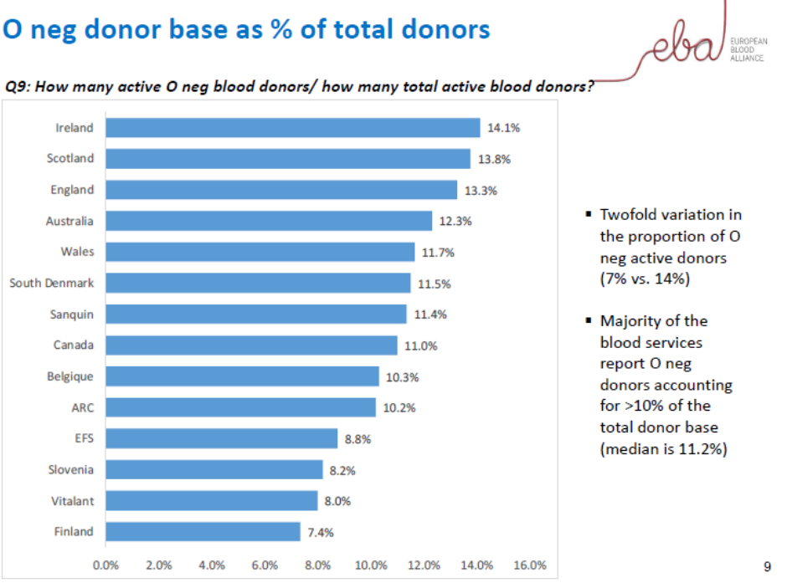
EBA bench marking comparisons

Slide 10
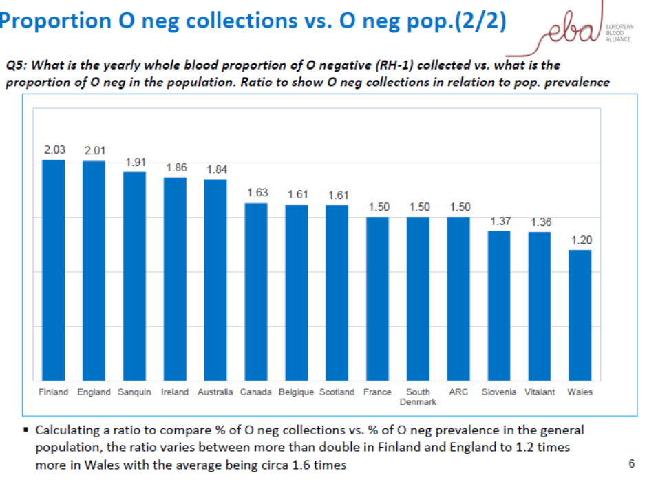
EBA bench marking comparisons

Slide 11
Distribution arrangements
45 HSE hospital blood banks, 9 independent sector
Controlled temperature storage and shipment and daily deliveries and twice daily deliveries
Re routing O- near time expiry (10-15%)
O- component attrition 0.5%
No agreed minimum tariff stock holding and sharing of information in structured electronic report

Slide 12
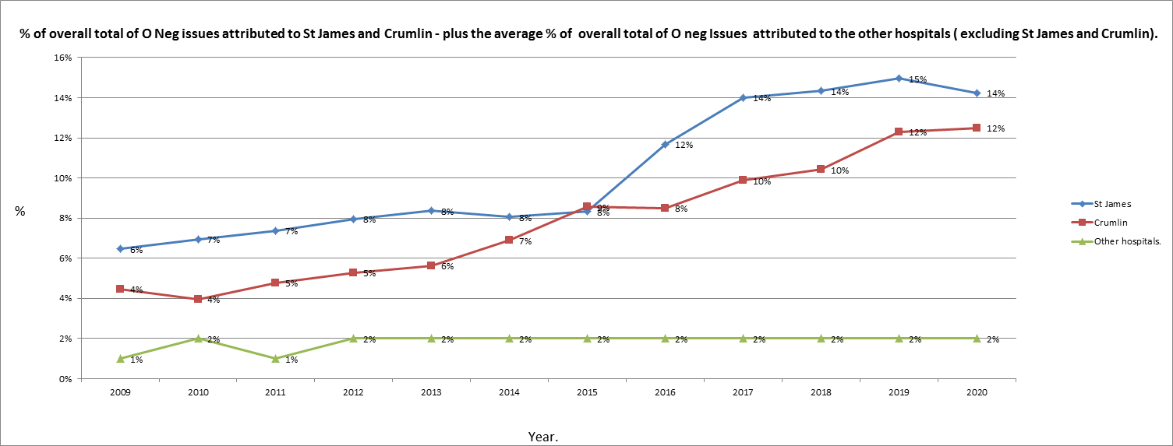
Issues trends

Slide 13
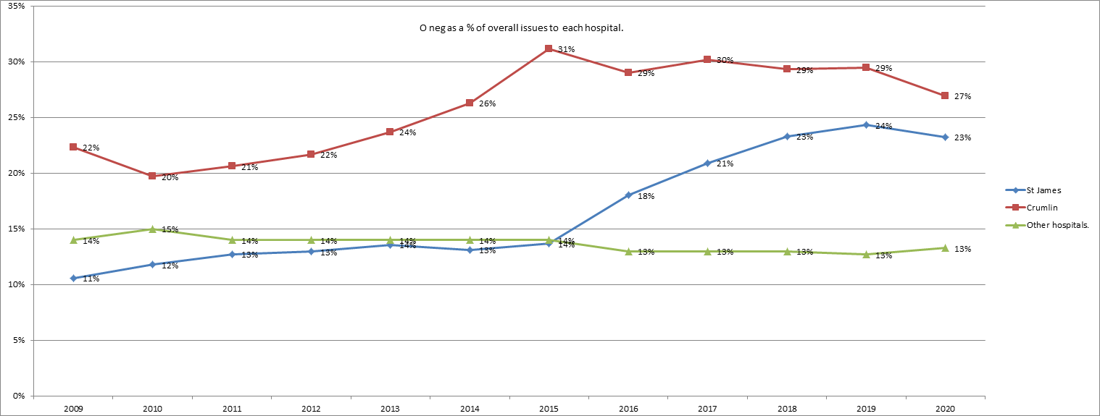
Issues trends

Slide 14
O- distribution hospital network selected examples (2018)
Hospital | O- (%) | Comment
St Vincent’s | 09.9 | Exemplar best practice
NMH | 40.1 | Reflects tertiary referral centre obstetrics and high risk pregnancies
CHI Crumlin | 29.1 | Reflects sickle cell anaemia cohort
St James’ | 22.9 | Reflects sickle cell anaemia cohort and default to O- for ABO mis-matched stem cell transplants

Slide 15
Collection performance 29 October 2020
Data in this report is as of: 30/10/2020 06:37
WB Collections Yesterday (W,X,Y,Z phlebotomies)
 | O+ | O- | A+ | A- | B+ | B- | AB+/- | Unk | Total
Dublin | 200 | 93 | 119 | 31 | 31 | 27 | 10 | 22 | 533
Cork | 111 | 19 | 49 | 9 | 14 | 4 | 7 | 12 | 225
Total | 311 | 112 | 168 | 40 | 45 | 31 | 17 | 34 | 758
Percentage | 41.0% | 14.8% | 22.2% | 5.3% | 5.9% | 4.1% | 2.2% | 4.5%
1 Day (Units) | 161 | 54 | 88 | 21 | 32 | 10 | 7 |  | 372
Day's Supply | 1.9 | 2.1 | 1.9 | 1.9 | 1.4 | 3.1 | 2.5 |  | 2.0

Slide 16
Stock report 30 October 2020
Total Banked RBCs
 | O+ | O- | A+ | A- | B+ | B- | AB+ | AB- | Total
Dublin | 539 | 198 | 210 | 108 | 144 | 29 | 62 | 21 | 1311
Cork | 201 | 72 | 63 | 36 | 47 | 6 | 15 | 4 | 444
Total | 740 | 270 | 273 | 144 | 191 | 35 | 77 | 25 | 1755

Slide 17
Stock projections tool
Est Stock at 12/10/20 | 882 | 278 | 423 | 146 | 335 | 58 | 104 |  | 2226 | -166 | 92.5%
 | -114 | -8 | -76 | 6 | 19 | -5 | 12
wc 12/10/20
12.9% Deferral | O+ | O- | A+ | A- | B+ | B- | AB+ | AB- | Total
Stock at 12/10/20 | 768 | 270 | 347 | 152 | 354 | 53 | 116 |  | 2060
Days Stock | 4.8 | 5.0 | 4.0 | 6.9 | 11.4 | 5.2 | 16.6
Est Banked | 946 | 332 | 492 | 133 | 185 | 60 | 37 | 13 | 2199 |  | -136
Est Issues | 1005 | 318 | 581 | 162 | 171 | 62 | 20 | 16 | 2335
Est Stock at 19/10/20 | 710 | 284 | 257 | 124 | 368 | 51 | 129 |  | 1924
1 days stock | 161 | 54 | 87 | 22 | 31 | 10 | 7
Est Days Stock at 19/10/20 | 4.4 | 5.2 | 3.0 | 5.6 | 11.8 | 5.0 | 18.5

Slide 18
Case study (1)
Level 3 hospital (1,500 red cell components)
Normal stock holding O- =9 (+ adult emergency, +1 neonatal large volume transfusion )
Eight months of results 196 received, 44 re routed and 69 neonatal specification
152 O- transfused (14.63%)
84% transfused to O- and emergency group not known
16% transfused to O+ near time expiry

Slide 19
Case study(2)
Factor | Comment
Transfused O- eight months | 152
Transfused O- twelve months | 218
Issuable stock index | 0.6
Stock holding | 15 days

Slide 20
Case study (1) control measures
Blood ordering tariffs surgery and gynaecology
Placenta praevia special consideration
Emergency transfusion switch to ABO group specific
Medical and nursing education programmes patient blood management
Active monitoring and reporting of red cell component usage and attrition

Slide 21
Case study (1) control measures
Retrospective audit massive haemorrhage
Formal review release un cross matched O-
Note total red cell components re routed =163 (15.7%)
Note O- red cell components rerouted= 44
Note neonatal specification = 66 O- (35.2%) and none disposed for this clinical indication (large volume transfusion neonate)

Slide 22
Case study (2)
Clinical category | Number of red cell components | Percentage
O- to O- | 940 | 35.0
Sickle cell anaemia patients | 979 | 37.0
Allogeneic stem cell transplants | 256 | 10.0
O- to O+ | 214 | 08.0
Emergency transfusion not grouped | 169 | 06.0
Patient with antibody anti-D | 056 | 02.0
Attrition | 046 | 01.7

Slide 23
Adult sickle cell anaemia service red cell component projected requirements
SJH sickle service projected demand for red cell components | Number of red cell components
2019 | 1991 (actual)
2020 | 3160
2021 | 3615
2022 | 4057
2023 | 4616

Slide 24
Case study (3)
Calendar year | SCD patients on transfusion programmes | SCD patients on exchange programmes | Number of red cell components transfused (per month) | Requested (cDe) haplotype (per month)
2018 | 86 | 15 | 401 | 146
2019 | 93 | 17 | 418 | 192
2020 | 94 | 20 | 507 | 182
Annual increase 15-21% recurring
Note 41% molecular genotype D variant (transfusion protocol O-)

Slide 25
Rh variant in sickle cell anaemia patients

Slide 26
Rh variant in sickle cell anaemia patients

Slide 27
Irish sickle cell anaemia cohort blood group frequencies
Red cell antigen |  | Percentage Irish blood donors | Percentage African ancestry recipients
Rh | D | 85 | 92
 | C | 68 | 27
 | E | 29 | 20
 | c | 80 | 96
 | e | 98 | 98
 | K | 09 | 02
Fy | Fya | 66 | 10
 | Fyb | 83 | 23
Jk | Jka | 77 | 92
 | Jkb | 74 | 49
 | S | 51 | 31
MNS | s | 89 | 93

Slide 31
Neonatal specification standing order
IBTS advice and guidance is all hospital blood banks (19) supporting maternity units should order routinely 2 x O- neonatal specification less than five days from collection (means twice a week)
Orders not filled 30%
Prioritisation protocol factors number of birth deliveries and distance from supplying blood centre

Slide 32
Case study (4) emergency transfusion not grouped (n= 257)
ABO group | Percentage
O- | 07
O+ | 17
ABO group specific | 76
Policy is obtain ABO group within 15 minutes of presentation in ED or clinical area
D group determined first valid sample issue D group specific
ABO group determined second valid sample Issue ABO group specific

Slide 33
Hospital locations where O D(-) transfused BEST collaborative study
1625 (7%)
2638 (12%)
9646 (44%)
3117 (14%)
4524 (20%)

Slide 34
Case study (4) decision making
Male gender patient aged 44 recidivist
Multiple trauma including head injury and neurosurgery intervention O- transfused (4) O+ transfused (10)
Presented to another hospital ten days later major haemorrhage acute severe gastrointestinal bleed only 3 x O- in stock

Slide 35
O- product transfusion, inventory management and utilization during shortage: the OPTIMUS study
Nancy M. Dunbar, Mark H. Yazer
Transfusion 2018;58;1348-1355

Slide 36
OPTIMUS Study
Study design and methods
Retrospective cross-sectional observational study use of O negative red cell components
26 sites global network, 475,830 units
42,960 O negative (9.0%)
Modelling exercise estimating the impact of O positive substitution for O negative recipients based on age and ward location

Slide 37
OPTIMUS Study
Impact of RhD switching modelled
Principle is to conserve O negative for female gender potentially child bearing and allo-immunised recipients
Patient Group | % Reduction
All patients >50 years | 44.5
All patients >80 years | 9.9
All patients >50 years critical care | 8.7

Slide 38
Conclusion
The space for inventory management is narrowing and the projected increase in demand is not sustainable

Slide 39
Solutions page
Some immediate relief obtained if neonatal specification O- standing order arrangement reduced/stood down
Recruitment (and retention) of African ancestry donors (cDe) haplotype to minimise O- substitution
Best practice inventory management in hospital blood banks (stock holding, remote location fridges, emergency transfusion not grouped, D switching

