Slide 1
When applied research really can make a difference: non-invasive predictive foetal D genotyping in the D (-) antenatal population
Users’ meeting 18 November 2020

Slide 2
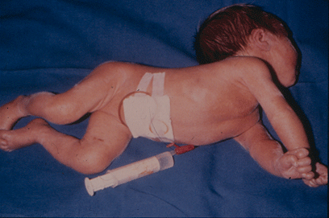
Infant with kernicterus (brain damage caused by hyperbilirubinemia)

Slide 3
Mortality due to rhesus D haemolytic disease of the foetus and newborn
Year | Perinatal Mortality (per 100,000 births) | Development
1967 | 46 | Premature delivery, phototherapy, post partum prophylaxis
1982 | 7 | Antenatal prophylaxis, potentially sensitising events
1993 | 5.4 | Antenatal prophylaxis, potentially sensitising events
2004 |  | Routine antenatal anti-D prophylaxis (third trimester)
2015 | < 1.6

Slide 4
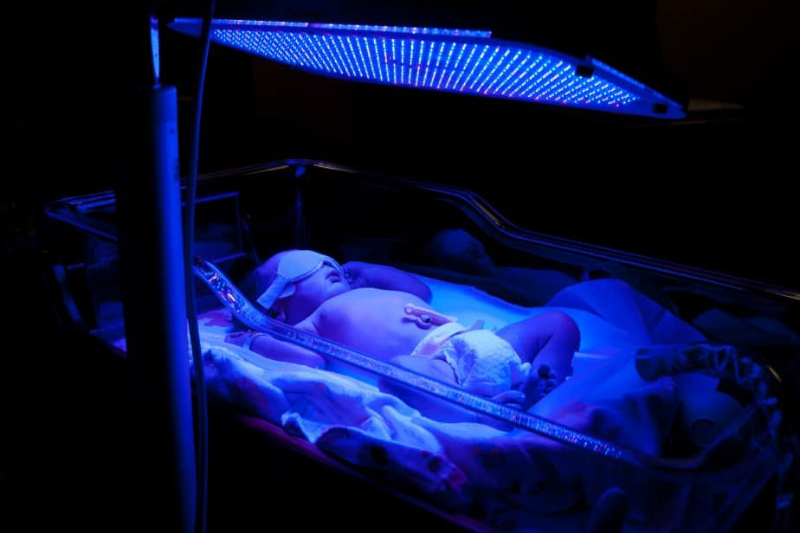
A jaundiced infant receiving phototherapy

Slide 5
Clinical Practice Guidelines
BCSH guideline for the use of anti-D immunoglobulin for the prevention of haemolytic disease of the foetus and newborn (http://www.bcshguidelines.com)
Royal College of Obstetricians’ and Gynaecologists’ Green Top Guideline No. 22 on the use of anti-D immunoglobulin for rhesus D prophylaxis (http://www.rcog.org.uk/files/rcog-corp/GTG22AntiDJuly2013.pdf)

Slide 6
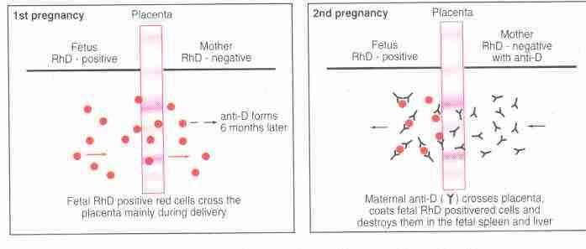
Mechanism of Rh D sensitisation during the first pregnancy and foetal red cell destruction during the second pregnancy with an Rh D positive foetus

Slide 7
Anti-D IgG prophylaxis after the birth of an Rh D positive baby or intrauterine death
If the baby is Rh D positive, a minimum of 500iu anti-D IgG should be administered to non-sensitised Rh D negative women, within 72 hours of the birth

Slide 8
Potentially sensitising events
Amniocentesis, chorionic villous biopsy and cordocentesis
Antepartum haemorrhage/vaginal delivery in pregnancy
External cephalic version
Fall or abdominal trauma
Ectopic pregnancy
Evacuation of molar pregnancy
Intrauterine death and stillbirth
In utero therapeutic interventions (transfusion, surgery, insertion of shunts, laser)
Miscarriage, threatened miscarriage
Therapeutic termination of pregnancy
Delivery – normal, instrumental or caesarean section
Intraoperative cell salvage

Slide 9
Anti-D IgG for potentially sensitising events in pregnancy
< 12 weeks | 12 – 20 weeks | 20 + weeks
Minimum dose 250iu anti-D IgG | Minimum dose 250iu anti-D IgG | Minimum dose 500iu anti-D IgG
Surgical intervention
Termination of pregnancy (surgical or medical)
Unusually heavy bleeding
Unusually severe pain
Unsure of gestation
Kleihauer test not required | Kleihauer test not required | Take maternal blood for Kleihauer test Further anti-D IgG if indicated by Kleihauer results

Slide 10
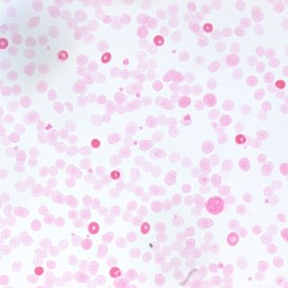
Kleihauer staining to show foetal red cells (dark staining) among maternal red cells (pale ‘ghosts’)

Slide 11
Non-invasive prenatal testing for foetal Rh D - implementing the NICE guidance
Elaine Chesworth Health Technology Adoption Manager, NICE Bloodlines 125 pp8-9

Slide 13
Advantages
Advantage
Preventing unnecessary administration of anti-D immunoglobulin | √
Avoiding unnecessary painful injections for antenatal patient NIPT predicts Rh D negative | √
Reducing the number of antenatal anti-D prophylactic clinic appointments | √
Reducing the amount of anti-D immunoglobulin used | √
Increasing availability of anti-D immunoglobulin for use following PSE in pregnancies where NIPT predicts Rh D positive | √
Reducing anxiety associated with PSE for Rh D negative antenatal patients where NIPT predicts Rh D negative | √
Providing information to allow Rh D negative antenatal patients to make an informed decision about whether to have treatment with anti-D immunoglobulin | √

Slide 14
Country | D (-) antenatal population | New cases alloimmunisation anti-D antibody | Residual rate of alloimmunisation anti-D antibody (%)
Northern Ireland | 4,000 | 12 | 0.3
Republic of Ireland | 10,000 | 64 | 0.6

Slide 15
Impact | Comment
Hospital blood bank | Pre transfusion testing Referral for quantitation Foetal maternal haemorrhage assessment Kleihauer Referral for flow cytometry Issue of anti-D immunoglobulin blood product
Red cell immune haematology laboratory | Repeat testing Quantitation Interpretation of results

Slide 16
Mrs Smith antenatal care pathway
Routine booking sample
Repeat testing referral for quantitation
Repeat testing referral for quantitation
Event
Delivery D (-) baby
PSE
RAADP
PSE
12
16
20
28
32
36
40
Weeks’ gestation

Slide 17
Mrs Jones antenatal care pathway
Routine booking sample includes NIPT predicted D (-)
Repeat testing
third trimester check
Event
Delivery D (-) baby
12
28
40
Weeks’ gestation

Slide 20
Midwife

Slide 21
HSE
Obstetrician
Patient

