Slide 1
Laboratory process improvement for patient’s on Daratumumab
Claire Canavan
Senior Medical Scientist
RCI Laboratory

Slide 2
DARATUMUMAB
Daratumumab (DARA) or Darzalex is a therapeutic human monoclonal antibody (mAb) with high affinity for the CD38 epitope which is uniformly expressed on the surface of nearly all myeloma cells.
FDA: approved November 2015 for use in patient’s with MM who had received at least three prior treatments.
EMEA: approved May 2015 for relapsed and refractory MM.
DARA licencing
Initially available for compassionate use in relapsed MM.
Used for treatment of newly diagnosed MM in combination with other medicines.
In patient’s with previously treated MM.
https://www.ema.europa.eu/en/medicines/human/EPAR/darzalex
Notes:
Developed by Janssen Biotech and Genmab for treatment of MM

Slide 3
MULTIPLE MYELOMA
Incurable malignancy of the B cell line which is characterised by a neoplastic growth of plasma cells.
1.8% of all cancers and 10% of haematological cancers.
Ireland – 222 patients /year.
Majority of patient’s 50+ years of age.
Survival of MM patient’s has significantly improved due to research into the pathogenicity of MM.
Relapse and disease resistance very common

Slide 4
The acronym CRAB was defined in criteria of the International Myeloma Working Group in 2003 to simplify the most typical clinical manifestations of multiple myeloma.
C – hypercalcemia
R – renal failure
A – anaemia
B – bone pain and fractures & increased bone reabsorptions by osteoclasts

Slide 5
How does it work?
CD38 is expressed on myeloma cells and therefore the anti-CD-38 developed can kill the myeloma cells using many different mechanisms
Image from https://www.lls.org/sites/default/files/National/USA/Pdf/Slides_Transcipts/slides_myeloma_1.6.17.pdf
Notes:
Complement activation. Induction of apoptosis. Promotes CD8+ AND CD4+ Tcell expansion and activation. Modualtion of tumour microenvironment mechanism of which is under investigation.

Slide 6
DARA & BLOOD TRANSFUSION?

Slide 7
INTERFERENCE IN PRE-TRANSFUSION SEROLOGICAL TESTING
CD38 is expressed on haemopoietic cells including red cells.
Treatment with DARA interferes with pre-transfusion compatibility testing as DARA binds CD38 on reagent red cells in vitro.
Patient’s receiving DARA will show reactivity with all reagent red cells in Indirect Antiglobulin Test (IAT).
Positive IATs can be observed for up to 6 months after DARA has been discontinued.

Slide 8
INTERFERENCE IN PRE-TRANSFUSION SEROLOGICAL TESTING
False positive IAT due to the anti-CD38 binding to the CD-38 epitope on the surface of the reagent red cells in vitro.

Slide 9
DARATUMUMAB INTERFERENCE
Panreactivity is observed in antibody screens and identification panels which may mask the presence of an underlying clinically significant alloantibodies.
Panreactivity is also observed in AHG crossmatch.
DAT may be positive for IgG but there is no evidence of clinically significant haemolysis.
This false positive agglutination may result in delays in issuing compatible blood to patients.

Slide 10
MITIGATING DARA INTERFERENCE IN PRE-TRANSFUSION TESTING
Since the introduction of DARA, serology laboratories have had to adopt new procedures to provide red cells to patients on this therapy.
In 2015, Chapuy et al published a method to mitigate the interference by DARA through the use of Dithiothreital or DTT.
Since 2017, the RCI laboratory have been successfully using this method to provide red cells to 902 patient’s to date.

Slide 11
MITIGATING DARA INTERFERENCE IN PRE-TRANSFUSION TESTING
DTT- Dithiothreitol
Reducing agent
Denatures CD38 by dissolving disulphide bonds
5 disulphide bonds in CD38 molecule
Image from: Blood Bank Guy https://www.bbguy.org/2016/05/31/010
Notes:
No longer capable of reacting with circulating anti-CD38

Slide 12
DTT TREATMENT
DTT method is pH sensitive
PBS pH 8.0 for preparation of 0.2M DTT
PBS pH7.3 for the washing of reagent red cells pre and post DTT treatment.
Control:
E+ and K+ control cells:
DTT treatment denatures the K antigen while preserving the E antigen.

Slide 13
FOLLOWING DTT TREATMENT
DTT reagent red cells & test with patient plasma (containing DARA)
Tube IAT technique / CAT IAT Technique
Compatibility Testing
Negative DTT Antibody Screen:
Give ABO/RhD compatible, K matched units
New antibody or known antibody present:
Provide phenotypically matched RBCs
Emergency Transfusion
Uncrossmatched ABO/RhD compatible RBCs may be given per local blood bank practices.

Slide 14
DTT SENSITIVE BLOOD GROUPS
Notes:
K Antigen is sensitive to DTT-treatment, therefore DTT-treated cells are unable to detect clinically significant anti-K.
Antibodies to the other DTT sensitive blood group systems listed are rare and encountered infrequently, however users must be aware of this limitation.
Antibodies to the other DTT sensitive blood group systems listed are rare and encountered infrequently, however users must be aware of this limitation.

Slide 15
OTHER LIMITATIONS
DTT treatment of screening cells is the method of choice to mitigate interference observed due to DARA.
However, method is labour intensive and time consuming, often only performed by reference labs which have additional resources and expertise
Performed on a case by case basis which is costly and not an efficient use of lab resources.
Donor red cells DTT-treated alongside reagent red cells in order to perform IAT/Coombs crossmatch for patients.

Slide 16
RCI PROCESS IMPROVEMENTS
In 2019, RCI evaluated a number of processes to improve the current process of pre-transfusion compatibility testing for DARA treated patients.
Extending the shelf life of DTT-treated reagent cells.
Change to a RT crossmatch in this patient cohort.
Evaluation of DaraEx.

Slide 17
EXTENDING SHELF LIFE OF DTT-TREATED CELLS
The utility of extending the shelf life of DTT- reagent cells was assessed by performing the following:
Reagent red cells from two different manufacturers , the ALBcyte three-cell screening panel and selected cells from the Datacyte panel, were batch DTT-treated.
Treated cells were stored for up to 28 days in a cell stabilisation medium, BioRad ID-CellStab.
Post DTT-treatment, at intervals, the stability of cellular antigens was assessed.
DTT-treated cells were typed for E, e, C, c, K, M, S, s, Jka, Jkb, Fya and Fyb antigens.

Slide 18
EXTENDING SHELF LIFE OF DTT-TREATED CELLS
The ability of stored DTT-treated cells to detect antibodies in patient plasma containing DARA and the concentration at which antibody is detectable was evaluated.
Haemolysis of DTT-treated cells was noted at each interval.
IAT investigations were performed using both tube technique and CAT.
Notes:
DARA patients can have cold reactive ab and or/rouleaux formation. This interference is evidenced by remaining reactivity using LISS/Coombs cards, thus both tube technique and CAT are employed when performing investigations for this patient group.

Slide 19
RESULTS OF EXTENDING SHELF LIFE
DTT-treated reagent cells remained stable for up to 28 days stored in a stabilisation medium.
However, due to haemolysis of cells and a decrease in the stability of some antigens (Duffy & Kidd), 28 days post DTT-treatment, our findings suggested that the shelf-life of DTT-treated reagent cells should be extended for no longer than 14 days.

Slide 20
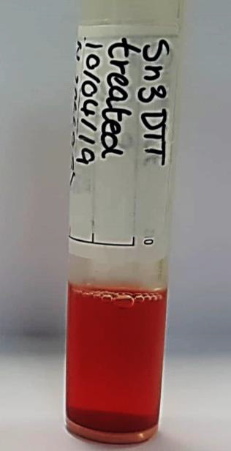
28 days post DTT- treatment excess haemolysis of reagent cells was noted and compared to a visual haemolysis chart

Slide 21
RCI currently prepare DTT-treated cells for 7 day storage.
Reagent red cells are stored in a 0.8% suspension in Cell Stab for 7 days.
Washed before use .
The extension of the shelf life of DTT-treated cells to 7 days has greatly improved turnaround times and provision of blood to referring hospitals.
Prior to this, the process from receipt of sample, to issuing compatible units took approximately three hours.

Slide 22
ROOM TEMPERATURE CROSSMATCH FOR DARA PATIENTS
Previously, both LISS/Coombs and RT crossmatches were performed for each patient on DARA who required red cells.
Segments are selected from appropriate units and an aliquot from each is DTT treated for 30 minutes prior to the start of the investigation
If a referring hospital provides segments from their own bank, testing is unable to commence until the sample is received in the lab.
Referring segments is a practice we encourage ☺
Notes:
30 Minutes- time consuming
This is to expedite the provision of blood to the patient or where units of a particular phenotype are required and are already available from the referring hospital’s blood stocks . Good for stock management.

Slide 23
POTENTIAL OPTIONS FOR CHANGE
RT crossmatch advantages
Quicker procedure – no need to pre-treat cells with DTT
Eliminate 30 minute step
In line with AABB Bulletin #16-02.
Disadvantages
Issues with cold-reactive antibodies which can give a positive crossmatch at RT – patients often have rouleaux and immunoglobulin interferences
Notes:
AABB Bulletin- patients with a negative ab screen using DTT-treated cells, an electronic or RT xmatch is sufficient for DARA patients, as inferference observed is as a result of the drug and not due to the presence of an allo-antibody.

Slide 24
Earlier this year, RCI evaluated the proposal of only preforming a RT crossmatch for patient’s who had received DARA
RT crossmatch involves the use of a neutral saline card which does not contain anti-human globulin.
RT crossmatch is used to detect direct agglutination of the donor red cells and the patient’s plasma which would be indicative of an ABO incompatibility.
The use of the RT crossmatch would remove the requirement for DTT treatment of donor cells, which in turn would reduce reagent use and time until units are issued.

Slide 25
POSSIBLE OUTCOMES FOR ROOM TEMPERATURE CROSSMATCH
DTT antibody Screen
Positive
Negative
Room Temperature Crossmatch
DTT Antibody Panel performed
Positive
Negative
Antibody Identified to Antigen unaffected by DTT treatment
Cold reactive antibody/rouleaux investigation. Group Rh/K matched Confirmed Units are issued
Patient receives their ABO and Rh/K matched units
Coombs DTT crossmatch performed. Group specific Rh/K matched units (antigen negative for the antibody identified) are issued.
Notes:
Negative antibody screen using DTT treated cells – RT crossmatch used for compatibility testing. If RT crossmatch is negative, patient receives ABO and Rh/K matched units. If RT crossmatch is positive, investigate for cold reactive antibodies/rouleaux and group confirmed Rh/K units are issued.
Positive antibody screen using DTT treated cells- further investigation using a DTT treated panel to identify the antibody. DTT treated LISS/Coombs crossmatch should be performed for these patients from then on.

Slide 26
RESULTS
In our retrospective analysis of DARA patients from April to June, 93.3% had a negative RT crossmatch (n=45).
In the event of a positive RT crossmatch, group confirmed units were provided for these patients and they were investigated for rouleaux and cold reactive antibodies.
The implementation of the RT crossmatch for this patient cohort has eliminated the need to DTT-treat donor red cells for compatibility testing and therefore reducing the laboratory TAT’s.

Slide 27
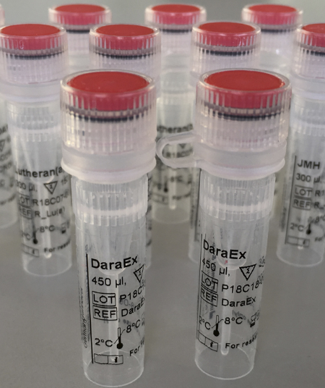
DARAEX
DaraEx, an anti-CD38 neutralising agent, is capable of mitigating interference due to DARA in pre-transfusion testing.
Incubate reagent red cells with DaraEx for 30min.
Cost £460.00 per vial (11 – 18 tests).
Positive Control £50.00 per vial.

Slide 28
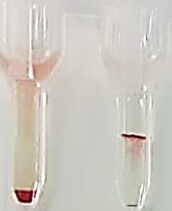
DARAEX EVALUATION
RCI evaluated DARAEX ability to resolve the interference of DARA in patient plasma.
Advantages:
K antigens are not denatured by DARAEX, allowing the detection of Anti-K in patient’s plasma, circumventing the need to give K matched red cells or K negative red cells where the K status is unknown.
IAT antibody screen-- reagent cells tested against DARA patient plasma spiked with anti-K. Well 1 contains DTT-treated reagent cells and well 2 DARAEX-treated reagent cells.

Slide 29
DARAEX EVALUATION
Disadvantages:
DARAEX ability to inhibit DARA interference was found to be dependant on the amount of DARA circulating in the patient plasma and possibly the number of CD38 antigenic sites on reagent cells.
Not currently CE marked and thus its use in clinical practice is restricted to reference laboratories such as RCI, where it may be utilised to support complex investigations.

Slide 30
Summary
DTT treated reagent red cells shelf life extended ✓
Stored as a 0.8% suspension in CellStab for up to 7 DAYS
RT crossmatch performed on patient’s who have received DARA ✓
Streamline of testing
In line with AABB bulletin #16-02
DARAEX evaluated ✓
Promising however doesn’t solve problem
Not CE marked
Notes:
Batch DTT treated reagent cells removed requirement to DTT treat cells for each patient individually , reducing sample TAT.
Streamline- quicker procedure, no need to pre-treat cells with DTT, eliminates 30 minute step.
Ability of DARAEX to inhibit DARA interference was found to be dependent on amount of DARA circulating in patient plasma and possibly the number of CD38 antigenic sights on reagent cells.

Slide 31
CASE STUDY
55 year old female initially referred with autoantibody.
Following serial allo-adsorptions (x2), underlying anti-Fya detected.
In May 2020, patient administered Daratumumab.
Mitigate interference presented by both the auto and allo antibody and DARA while also ensuring the identification of anti-Fya when present.

Slide 32
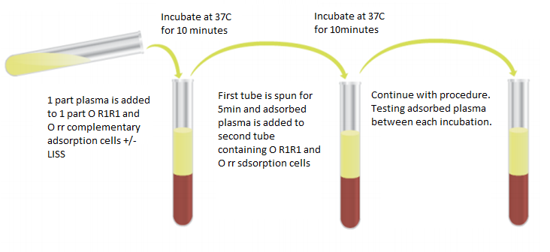
ABO/D typing and Rh/K Phenotype performed (Ortho AutoVue & manual tube technique)
Antibody ID and DAT (BioRad-ID column agglutination technique)
Adsorption studies performed by incubation of equal volumes of complementary adsorption cells, low ionic strength saline (LISS) and patient’s plasma at 37°C for 10 minutes

Slide 33
RESULTS
Patient grouped as O RhD Positive
Rh/K phenotype: C-E+c+e-K-
Extended phenotype completed by Molecular & Biological Genetics Department Cw- k+ Fya- Fyb+ Jka+ Jkb+ M- N+ S- s+ Doa+ Dob+ Vel+
Antibody ID: pan reactivity observed by IAT and ENZ-IAT, auto test cell positive
Prior to administration of DARA, anti-Fya was identified following serial allo-adsorptions (x2) using R1R1 and rr adsorption cells

Slide 34
Upon this referral however, up to 6 adsorptions using 1:1 and 3:1 ratios of red cells to plasma were tested and failed to remove the interference which we assumed to be DARA.
R1R1 x 6
rr x 6
Notes:
2 11-cell BioRad panels post 6 allo-adsorptions

Slide 35
Neat plasma was tested against a pre-DTT treated set of 3 screening cells and was positive – autoantibody.
A panel of DTT-treated red cells, which was prepared to include Fya positive and negative cells, along with exclusions for M and S were tested against R1R1 and rr adsorbed plasma (x2).
Antibody ID and compatibility testing performed by tube IgG technique.
LISS tube results
Positive reaction Negative Reaction
Notes:
Positivity- indicated presence of autoab.

Slide 36
No other clinically significant antibodies were detected and anti-Fya was detected by homozygous Fya+ Fyb- DTT-treated reagent red cells.
Anti-Fy(a+b-)
Anti-Fy(a+b+)
Anti-Fy(a-b+)
a
Subsequent samples from this patient showed weakening of the autoantibody and anti-Fya was no longer detectable.
Notes:
Weakening of auto and anti-Fya – due to transfusions

Slide 37
CONCLUSION
This particular case proved challenging owing to the range of methods required to deal with interference due to the autoantibody and DARA while also identifying or excluding the presence of anti-Fya.
Pressure on Automated Donor Grouping department to source R2R2 Fya- M-S- (extended matched) that were also CMV negative & suitable for irradiation (<14 days old).
Some international centres recommend providing extended phenotyped matched red cells for patients on DARA.
However, recent paper by Ye et al (2020), found that there was no significant risk of sensitization associated with providing ABO-Rh matched red cells over extended matched.
Notes:
Frequency of R2R2 red cells in Caucasian population is roughly <2%. Addition of extra requirements such as Fya antigen negative and CMV- makes this a lot harder to find.

Slide 38
REFERENCES
Kelly, M. (2010) Diagnosis and management of multiple myeloma | Irish Medical Times. Available at: http://www.imt.ie/clinical/2010/07/diagnosis-and-management-of-multiple-myeloma.html (Accessed: 11 April 2016).
Reid, M.E., Lomas-Francis, C. and Olsson, M.L. (2012) Blood Group Antigen Facts Book. 3rd edition. United States: Elsevier Science.
Chapuy, C., Nicholson, R., Aguad, M., Chapuy, B., Laubach, J., Richardson, P., Doshi, P. and Kaufman, R. (2015) ‘Resolving the daratumumab interference with blood compatibility testing’, Transfusion., 55(6pt2), 1545–54.
AABB (2016) AB#16-02 Mitigating the Anti-CD38 Interference with serologic testing. Available at: https://www.aabb.org/programs/publications/bulletins/Documents/ab16-02.pdf (Accessed: 28/10/20)
Ye et al. (2020) ‘Risk of RBC alloimmunisation in Multipe Myeloma Patients treated by Daratumumab. Vox Sang. Feb; 115(2): 207-212.

