Slide 1
SERIOUS Adverse Events 2022
National Haemovigilance Office
Caroline Casey

Slide 2
Breakdown of reports received by the NHO (2019-2022)
Report classification | 2019 (n=332) | 2020 (n=313) | 2021 (n=322) | 2022 (n=372)
SAE | 100 | 83 | 102 | 133
SAR | 135 | 118 | 133 | 134
WBIT | 54 | 77 | 56 | 57
Near Miss | 43 | 35 | 31 | 48
Table 1: The Breakdown of reports received by the NHO from 2019-2022

Slide 3
Components issued from 2019 - 2022
 | RCC | Platelets | Other
Total Number of components issued 2019 | 122,582 | 21,237 | 163
Total Number of components issued 2020 | 113,766 | 21,049 | 92
Total Number of components issued 2021 | 122,762 | 22,738 | 109
Total Number of components issued 2022 | 122,899 | 22,907 | 117
Table 2: The number of components issued per annum (2019-2022)
* Figures from NHO ANSARE(Subject to change)

Slide 4
Figure 1. The number of reports received by the NHO per annum from 2009 to 2022.

Slide 5
SAEs
What happened?
Who was involved?
Where did the error occur?
When did the error occur?
Why did the error occur?

Slide 6
SAE reports what happened?
Figure 2. Types of error that were reported to the NHO in 2022

Slide 7
SAE reports what happened?
Figure 3. Types of error that were reported to the NHO in 2022

Slide 8
ABO incompatible transfusion reports (2007-2022)
Figure 4. The number of ABO incompatible reports received by the NHO per annum from 2007 to 2022.
Notes:
There were 6 reports received in 2022 and 5 accepted . 5 ABO incompatible transfusion reports received in both 2021 and 2022. All errors occurred at the laboratory processing stage of the transfusion process and involved medical scientists.

Slide 9
ABO incompatible transfusions what happened in 2022?
Not following policies and procedures.
4 incorrect component issued
1 historical records not checked
Notes:
Most of these errors came from the same site in 2022. This location has had staff resourcing pressures could be considered a factor in the errors that occurred.

Slide 10
ABO incompatible transfusions what happened?
Patient received A+ RCC electronically cross-matched should have received Grp O or serological cross-match of group A.
O apheresis platelet issued to patient against policy
Medical scientist did not check if 2nd sample was required/received prior to issue.
A2 patient was issued A+ RCC unit in error. Medical scientist did not notice comment on file to give Group O.
Group O RCCs should have been issued to a patient as only 1 sample had been received at time of issue.

Slide 11
Inappropriate Transfusions
11% of all SAEs accepted at the NHO in 2022
Increase from n=15 in 2021 to n=20 in 2022.
Majority of inappropriate transfusions occurred at prescription stage, n=7 (35%)
Common themes (2022)
Transfusion based on clinical decision not in confirmity with guidelines- (n=10)
Transfusion based on incorrect or absent HB results – (n=4)
Dilute samples– (n=4)
Notes:
Failure to adhere to policies and procedures - (n=10)
Knowledge – (n=4)
Co-ordination and communication – (n=2)
Common themes 10 report

Slide 12
Inappropriate transfusion case
Background: Male patient (20+ years) with abscesses secondary to Crohns prescribed RCCs for anaemia Hb=7.5g/dl.
What happened? No FBC sample taken post transfusion of 1st RCC. Medical scientist advised clinical re-assessment and re-check Hb but guidance not followed. 2nd RCC transfused and post Hb=10g/dl.
Error: Human failure – failure to adhere to policies and procedures
CAPA: Patient’s Consultant contacted regarding taking Hb and timing and single unit policy adherence.

Slide 13
Failure to give an irradiated component
10% of all SAEs accepted by NHO in 2022
Decrease from n=18 in 2021 to n=13 in 2022
Majority of failure to give an irradiated component report errors occur at prescription stage of process; (n=8) in 2022.
Common themes (2022)
Failure to prescribe special requirements – (n=9)
Other - (n=3)
Incorrect component issued – (n=1)
Notes:
Failure to adhere to policies and procedures – (n=13)
Knowledge - (n=5)
Co-ordination and communication – (n=6)

Slide 14
Failure to give an irradiated component case
Background: Elderly patient (>70 years) with CLL transfused 3 non-irradiated RCCs.
What happened? 2 doctors failed to include patient’s special requirements on prescription. Patient’s first time in the hospital. Patient attended another hospital.
Error: Human error co-ordination and communication.
CAPA: Teams involved with patient contacted in both hospitals and informed of the error.

Slide 15
Transfusion of other antigen incompatible RCC (if no reaction)
10% of all SAEs accepted by NHO in 2022
Increase from n=2 in 2021 to n=13 in 2022.
Majority of these errors occurred at the lab processing stage of the transfusion process. 2 at supply centre.
Most frequently cited causative factors (2022)
Misinterpretation of results-human error – (n=4)
Historical records not checked – (n=2)
Incorrect component issued – (n=2)
Notes:
There was no common theme identified in these events. 4 reports were a result of misinterpretation of results due to human error. 2 reports were a result of historical recoords not being checked. 2 reports were a result of the wrong component being issued. Other reports were a result of incorrect documentation or paperowrk, an insorrect result due to technical error, a unit labelling error, one report was described as other

Slide 16
Transfusion of other antigen incompatible RCC (if no reaction) case
Background: Male patient (>70 years) with upper GI bleed prescribed 2 units of RCCs.
What happened?: This patient had multiple antibodies. Miscommunication between supply centre and hospital resulted in anti Jkb being removed from profile in error. 4 units transfused. Patient transfused with 2Jkb+ units.
Error: Human failure coordination and communication
CAPA: Detailed follow up of patient with Day 7 and day 10 blood sample. Patient had serological reaction no sign of HTR. Patient passed away but death was unrelated to transfusion.

Slide 17
Paediatric reports
16 reports accepted by NHO in 2022
An increase in number from 2021 – 9 reports
Other – (n=7)
Inappropriate transfusions – (n=3)
Failure to give an irradiated component – (n=2)
Failure to give CMV- and irradiated component – (n=1)
Incorrect RhD group transfused – (n=1)
Incorrect component/product transfused – (n=1)
Notes:
Unnecessary exposure to 2nd unit. Incorrectly stored sample. Blood giving set leak. Incorrect DOB on sample. Incorrectly labelled sample. Incorrect infusion device used. Admin error………In 2020 and 2019 incorrect component or product transfused was the most common report received for paediatric patients 4 reports for both years.

Slide 18
SAE reports and Anti D
(n =7) – 2021
(n=13) – 2022
Type of error | No. of reports 2021 (n=7) | No. of reports 2022 (n=13)
Delay in giving product >72 hours | 4 | 5
Failure to administer products | 3 | 8
Table 3. Number and type of Anti D related reports received by the NHO in 2021 and 2022

Slide 19
Anti D why failure to give?
Failure to administer product (n=8)
RAADP requirement missed (n=6)
Patient did not attend appointment (n=1).
RAADP not given due to false neg. cffDNA test (n=1)
Notes:
In the majority of cases where the requirement was missed the patient had a pregnancy sensitising event.

Slide 20
Anti D why the delay?
Delay in administering product (n=5)
Patient did not attend appointment and no follow up – (n=3)
Cyber attack – no booking list and booking blood not taken (n=1)
Results did not go to MNCMS and requirement missed (n=1)

Slide 21
Who was involved in the errors?
Figure 5. Staff members involved in SAE events reported to the NHO in 2022.

Slide 22
Locations where SAEs occurred 2022
Figure 6. No of SAE reports where the event occurred in A&E.
Figure 7. No of SAE reports where the event occurred in laboratories.
Notes:
Laboratories and wards remain the locations where the most events occur. We are seeing an increase in reports from wards up from 32 reports last year to 43 and in A and E from 7 reports in 2021 to 2022. We have seen small increases in reports in maternity wards, day wards and theatre.

Slide 23
Locations where SAEs occurred 2022
Figure 8. No of SAE reports where the event occurred on wards.
Figure 9. No of SAE reports where the event occurred in theatre.

Slide 24
Locations where SAEs occurred 2022
Figure 10. No of SAE reports where the event occurred on day wards.
Figure 11. No of SAE reports where the event occurred in ICU.

Slide 25
Locations where SAEs occurred 2022
Figure 12. No of SAE reports where the event occurred on maternity/labour wards.

Slide 26
Why are these errors occurring?
Types of Human Error | No. of reports (n=87) 2019 | No. of reports (n=67) 2020 | No. of reports (n=90) 2021 | No. of reports (n=107) 2022
Failure to adhere to policies and procedures | 60 | 33 | 48 | 64
Knowledge | 19 | 19 | 24 | 30
Co-ordination and communication | 14 | 14 | 13 | 17
Carrying out task incorrectly | 18 | 12 | 13 | 22
Other | 7 | 9 | 9 | 13
Verification | 25 | 7 | 3 | 4
Slip | 9 | 3 | 5 | 1
Monitoring | 4 | 1 | 1 | 3
Patient related | 2 | 1 | 1 | 2
Table 4. Number and type of human errors received by the NHO for SAEs in 2022.
Notes:
Failure to adhere to policies and procedures remains the most common human error factor cited on reports received by the NHO. Followed once again by knowledge, carrying out task incorrectly and co-ordination and communication

Slide 27
Key recommendations from 2022
Check
Prescription stage of the process:
Is Hb result present and correct?
Have the patient’s special requirements been met?
Lab processing errors are on the increase.
Care needs to be taken when interpreting results.
Remember to check historical records.
Make sure correct components issued.
Have RAADP requirements been met?

Slide 28
Near Miss Reports 2022
No. of reports received in 2022 – (n= 48)
Where in the process did the error occur?
Deviation | No of reports accepted in 2021 (n=20) | No. of reports accepted in 2022 (n= 28)
Compatibility testing | 3 | 6
Component selection | 2 | 3
Issue | 4 | 11
Other | 10 | 8
Storage | 1 | 0
Table 5. Where in the process errors occurred 2021 and 2022.
Notes:
Of the reports not accepted in 2022 10 did not meet criteria as outlined in the common approach document, 9 were clinical errors and one related to cryoprecipitate.

Slide 29
Why did the error occur?
Human error (2022) – n = 27 | System error (2022) – n = 1
Types of human error | No. of reports 2021 | No. of reports 2022
Verification | 20 | 0
Insufficient attention to detail | 21 | 25
Failure to adhere to policies and procedures | 3 | 25
Coordination and communication | 3 | 3
Knowledge | 1 | 0
Slip | 4 | 0
Table 6. Number and type of human errors cited on Near Miss reports in 2022.
Notes:
System errorElectronic Issue (EI) failure - EI of Red Cells allowed on a Pt with multiple historic pos antibody screens. RCC issued and available for collection in blood issue fridge for 8 hours. 01/11/22 - 2 x RCC were issued to a Pt blood Group O Neg with current screen neg. Pts historical antibody screen x 2 were positive due to prophylactic Anti D administration. As such RCC were issued via serological xmatch.The Winpath LIS cannot differentiate a pos antibody screen caused by immune antibodies vs prophylactic Anti D and therefore applies exclusion regardless. 02/11/22 - one of the 2 x issued RCCs was returned to stock to reroute to another hospital An additional RCC was issued to replace this unit but was issued using the EI function in error. Error was noted by BT MS on evening 02/11/22 which prompted a review of Winpath EI software. Critical IT system failure discovered Winpath LIS should automatically block EI on all patients with current or historic positive antibody screens. Failure also by issuing Scientist to identify historical positive Ab screen on history check. Issued Red Cell had not been transfused and was returned to stock immediately and serologically xmatched upon recognition of failure.

Slide 30
Near Miss case
Background: Manual tube group performed on incorrect sample during an obstetric haemorrhage emergency.
What happened?: Major haemorrhage protocol activated on patient . Tube group performed on incorrect sample by Scientist. Sample selected = A Pos. Correct patient group = O Pos.
Tube group results were then incorrectly interpreted by Scientist as O Pos instead of A Pos. Error noted by second scientist on call when performing second check.
Notes:
Excellent holistic approach to corrective and preventative actions.

Slide 31
Near Miss case ctd.
CAPA:
Retraining and reflective practice - MS involved.
Issue of memo to all staff re importance selecting correct sample and performing demographic checks.
Manual testing SOP updated.
Tubes in manual tube rack pre-labelled with reagent contents to aid staff during emergencies.
Major haemorrhage requests forms now in 'on call' rest rooms.
Procedure for issue of un-crossmatched blood reviewed and simplified.
7. On call scientists to partake in minimum 2 x emergency drills per training cycle.

Slide 32
Key Recommendations from Near Miss Data (2022)
Extra care needs to be taken when issuing components.
We need better understanding of why staff fail to follow policies and procedures.
Please include human factors on reports where appropriate.

Slide 33
Wrong Blood in Tube (WBIT)
Reports received – (n=57)
Reports accepted – (n=56)
 | No. of reports 2022 (n =56)
Sample taken from intended patient but labelled with another patient’s details | 39
Sample taken from wrong patient but labelled with intended patient’s details | 15
Notes:
1 WBIT event was described as other and the other report left this section blank

Slide 34
WBIT what happened?
Patient Identification errors reported to NHO | 2019 (n= 47) | 2020 (n=77) | 2021 (n=56) | 2022 (n=56)
Detail on sample not transcribed from ID band | 4 | 4 | 6 | 2
Patient not correctly ID at phlebotomy | 19 | 21 | 11 | 25
Patient not correctly ID at admission | 4 | 4 | 4 | 4
Sample not labelled by person taking sample | 4 | 15 | 7 | 9
Sample remotely labelled | 9 | 21 | 17 | 9
Other | 6 | 10 | 8 | 6
Unknown |  | 2 | 1
Pre-labelling | 1 |  | 2 | 1
Table 7. Types of human error cited as the cause of the event in 2022.

Slide 35
WBIT and Electronic Identification Systems 2022
EIS in use in 19/23 sites that reported WBIT events to the NHO in 2022.
77% of reported events were from sites which stated that an electronic system was in use at the time of the WBIT event.
25% of reported events an electronic ID system was not used during the sampling procedure.
Of the remaining WBIT reported 22 used EBTS, 6 used MNCMS and it was unknown if an electronic sampling system was used in 1 incidence.

Slide 36
Why did error occur with EBTS
Figure 13. Types of error that and the number of reports received by the NHO for WBIT events that occurred when using EBTS in 2022
Notes:
Reasons given for the WBIT event occurring despite the use of Blood Track varied:

Slide 37
Why did the error occur with MNCMS?
Figure 14. Types of error that and the number of reports received by the NHO for WBIT events that occurred when using MNCMS in 2022
Notes:
The number of errors using MNCMS has reduced significantly since 2020 where number was 18, in 2021 number of reports was 3.

Slide 38
Why did error occur with MNCMS
Printer at bedside not working and staff member had to print labels at the nurse’s station – (n=4)
In all 4 cases the printer printed out a previous label.
Staff member scanned the wristband from the wrong chart. This was a midwives clinic and ID bands were not worn by patients – (n=1)
Labels were printed remotely but no reason was given – (n=1)

Slide 39
Key Recommendations from WBIT data 2022
Ensure the patient has wristband and has correct wristband before starting process.
Remove wristbands from charts.
PPI is essential – not performing PPI is one of key causes of WBIT.
Never complete another staff members process. If asked to label re-start process.
Address printer issues.

Slide 40
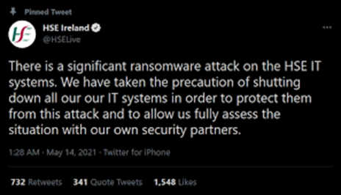
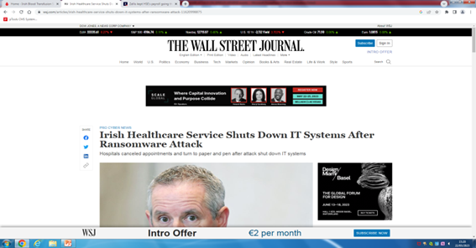
Ransom-ware attack and adverse transfusion events
On 14th of May 2021 the Health Service Executive (HSE) of Ireland suffered a major ransom-ware attack.
40 hospitals affected.
Notes:
12 hospitals category D hospitals who transfuse over 6,000 units a year.

Slide 41
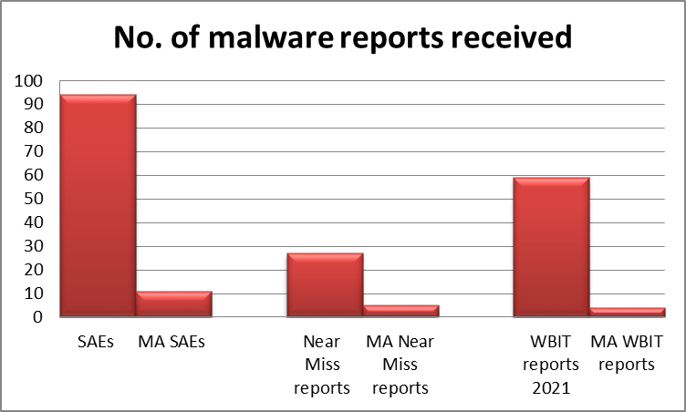
Reports associated with Ransom-ware attack
182 adverse event reports received by the NHO for events that occurred in 2021.
20 adverse events associated with the May 2021 ransom-ware attack.
12 SAEs reports
5 Near Miss reports
4 WBIT reports
Figure 15: No. of reports received for events that occurred in 2021 and number of reports associated with the malware attack
Notes:
Reports related to malware attack made up 10% of all events that occurred in 2021

Slide 42
SAEs and the ransom-ware attack (n=12)
What errors occurred?
(n=8) – Transfusion of an incorrectly stored component
(n=2) – Failure to give an irradiated component
(n=1) – Transfusion of an expired component
(n=1) – Delay in administering Anti D
Figure 16: Type of SAE reports received related to the malware attack
Notes:
The 8 reports of transfusion of an incorrectly stored component came from the one hospital, Where the REES temperature monitoring system was down and so Medical scientists were manually checking the temperature of the blood issue fridge every two hours instead of every hour
The failure to give an irradiated component case was because the doctor prescribing the unit had not put irradiated requirement on the form. The medical scientists would usually check LIS for historical information. However LIS was unavailable and so the irradiated requirement was missed.

Slide 43
Near Miss Reports and the ransom-ware attack (n=5)
What errors occurred?
(n=1) - ABO incompatible group released
(n=1) - Incorrect unit collected from blood issue fridge
(n=1) - Patient details incorrect on LIS
(n=1) - Expired component collected
(n=1) - Incorrectly stored components
Notes:
ABO incompatible group released because mS was performing 3 crossmatch requests at the same time and there was a transposition of compatibility labels. 2 labels were transposed and this was not noticed on verification check prior to issue. The staff use bag label verification on EIS as a 2nd check. O+ unit instead of A+ noticed on ward. Re-education of staff and a second check added for the down time
Incorrect unit was collected from blood issue fridge. Normally MS use blood track kiosk to perform the collection check however this was not in use and the nurse did not perform the correct check. Re-training.
Sample was taken and hand labelled. MS misread details on sample and entered them on to LIS incorrectly. Unit returned to lab and repeat group and crossmatch sample processed
During cyber attack the blood issue fridge was checked manually by HVO daily as Blood Track Kiosk was unavailable. They missed the expiry date on one of the units(RCC) and noticed on ward that unit had expired. Re-training of staff

Slide 44
WBIT Reports and the Ransom-ware attack (n=4)
What errors occurred?
3 reports accepted by NHO – sample taken from intended patient but labelled with another patient’s details
1 report not accepted by the NHO - mismatch between sample label and request form
Errors were not caused by IT downtime but may have been compounded by unavailability of electronic identification systems

Slide 45
Recommendations from Ransom-ware attack data
Hospitals should have robust mitigation strategies and policies in place.
Staff need to ensure a back to basics approach.
Clear written instructions and interdepartmental communication are key.
Verification is essential at all stages of transfusion process!
Notes:
9 reports were down to verification procedures not being carried out or being done incorrectly

Slide 47
Acknowledgements
NHO team
Haemovigilance officers countrywide
All staff who diligently report errors
HV sig team
Croke park team

Slide 48
Thank you

