Slide 1
Haemophilia gene therapy – a personal perspective
Brian O Mahony FACSLM
Chief Executive, Irish Haemophilia Society
Board member, IBTS
IBTS, May 2023

Slide 2
Haemophilia
Inherited deficiency in FVIII (Haemophilia A) or FIX ( Haemophilia B)
863 in Ireland- 279 severe
Bleeding into joints , muscles, life threatening bleeds
Standard treatment since 1970’s: intravenous injections of the missing clotting factor- when a bleed occurs ( on-demand) or regularly to prevent bleeds
Prophylaxis: infusion three times weekly for FVIII
: twice weekly for FIX
New extended half life FVIII/ FIX since 2015- less frequent infusion
New subcutaneous FVIII mimetic since 2019- weekly or every 2 weeks

Slide 3
History of treatment for haemophilia
Blood transfusion¹
Lyophilisation^{1,2}
Factor gene cloning¹
Viral inactivation technology¹
EHL technology^{1,2}
1950s
1960s
1970s
1980s
1990s
2000s
2010s
2020s
Non-factor therapies, gene therapies¹
Fresh frozen plasma cryoprecipitate^{1,2}
Plasma-derived factor concentrates²
Desmopressin (HA)^{1,4}
Recombinant factor concentrates^{1–3}
EHL factor concentrates^{5–7}
Emicizumab (HA)⁸
Prescribing information may vary depending on local approval in each country. Therefore, always refer to the local materials such as the Prescribing Information, Product Monograph, and/or the Summary of Product
Characteristics in your country. https://www.cslbehring.com/products/global-products-list. EHL, extended half-life; HA, haemophilia A.
1. Franchini M, Mannucci PM. Orphanet J Rare Dis 2012; 7:24. 2. Morfini. J Clin Med 2017; 6:35. 3. Manco-Johnson, et al. N Engl J Med 2007; 357:353–344. 4. Franchini M, Lippi G. Blood Transfus 2011; 9:377–382.
5. Alprolix PI; 6. Idelvion PI. 7. Refixia PI. 8. Food and Drug Administration. FDA approves emicizumab. Available at:
https://www.fda.gov/drugs/resources-information-approved-drugs/fda-approves-emicizumab-kxwh-prevention-and-reduction-bleeding-patients-hemophilia-factor-viii. Accessed Jun 2022.
Notes:
Slide notes:
Haemophilia A & B
Cryoprecipitates – FFP
pdFIX concentrates
rFIX concentrates – BeneFix, Alprolix, Idelvion, Refixia, Ixinity
EHL rFIX concentrates
Emicizumab - HA
Desmopressin - HA

Slide 4
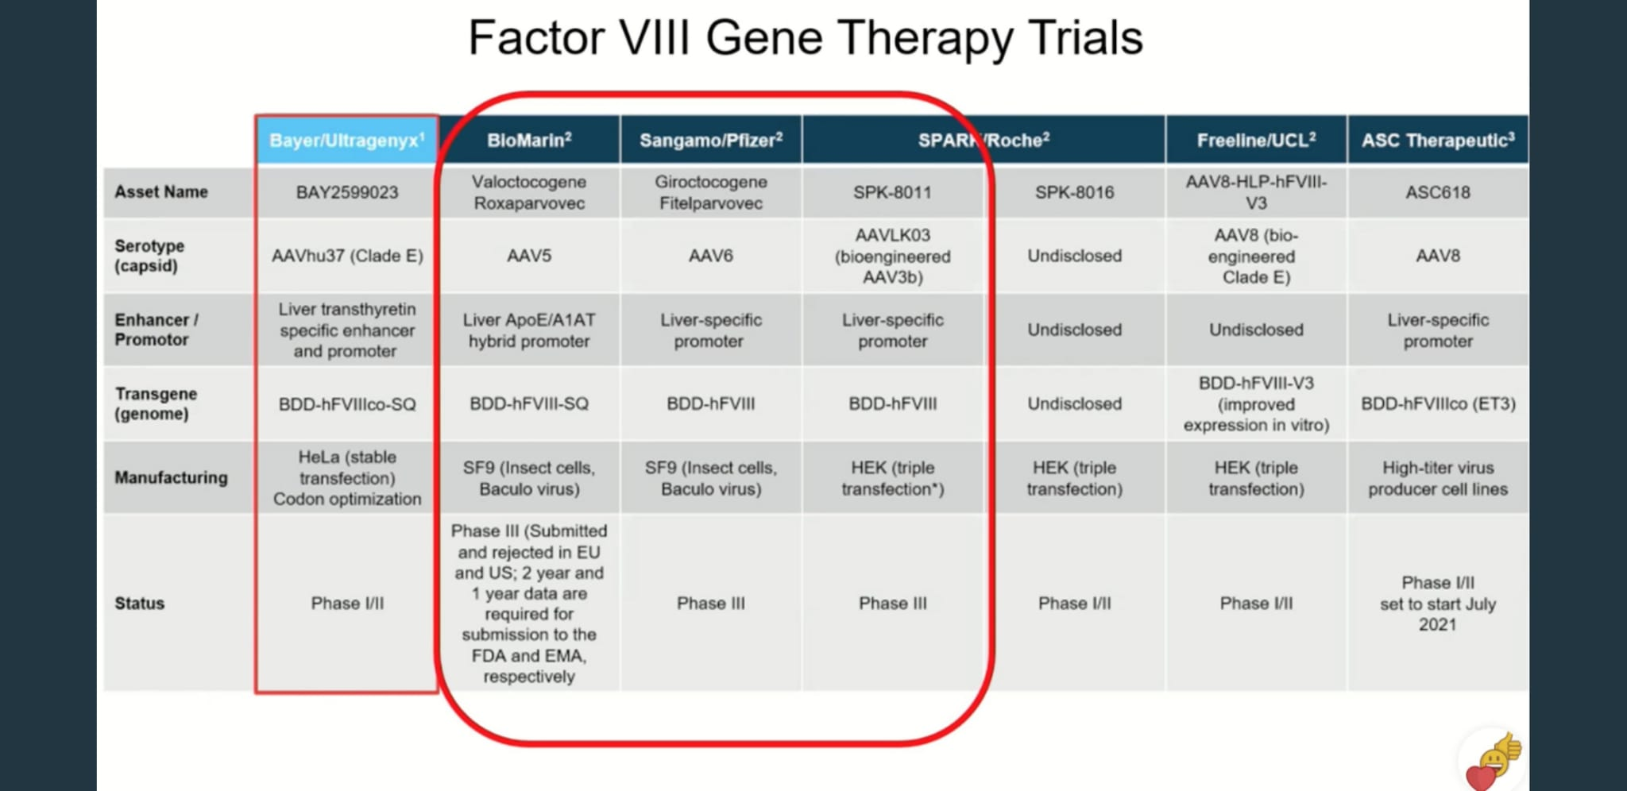
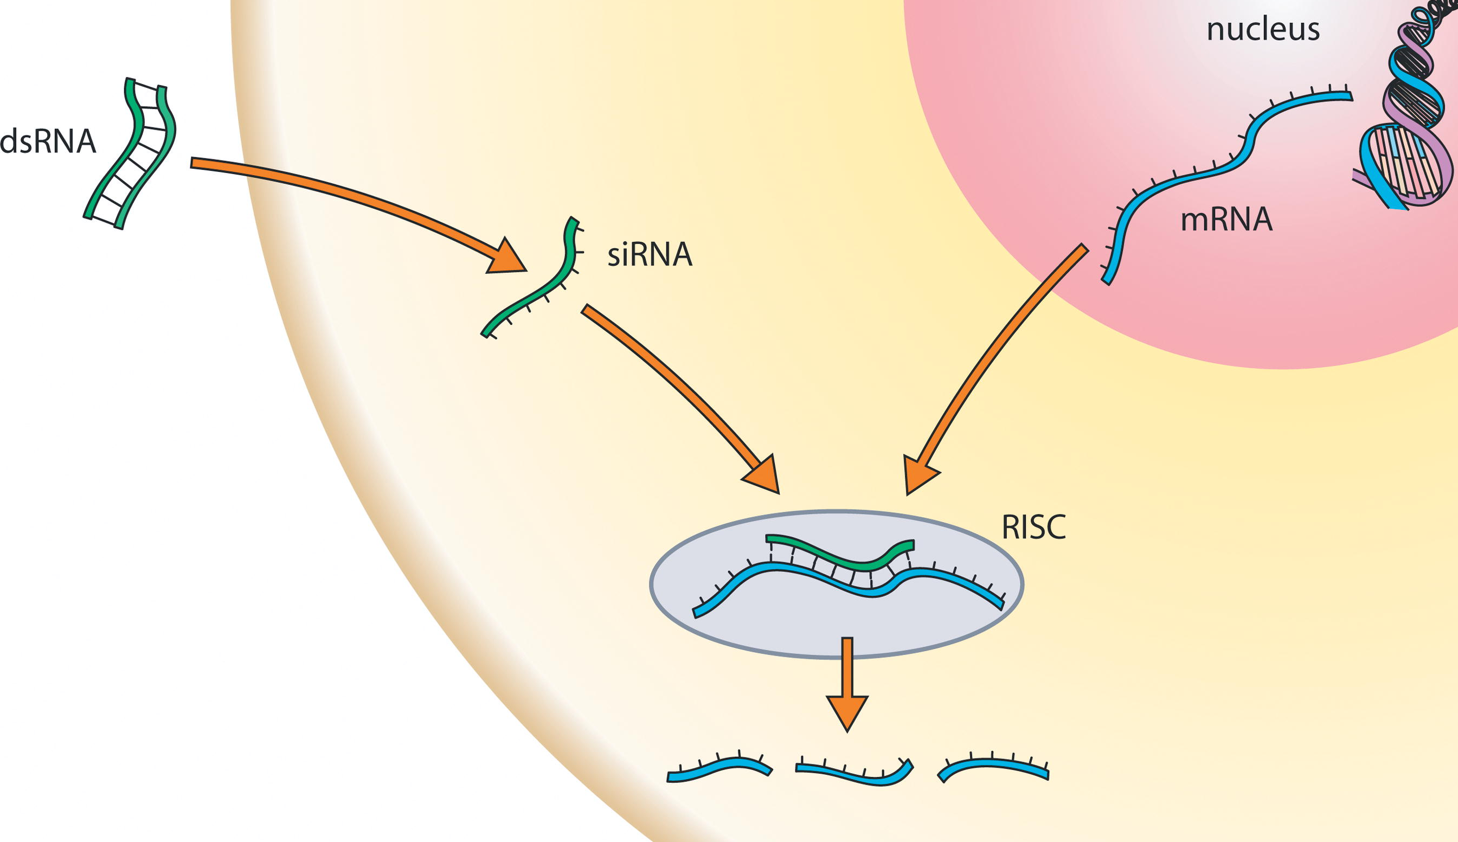
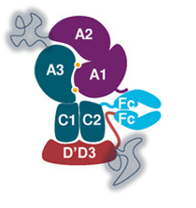
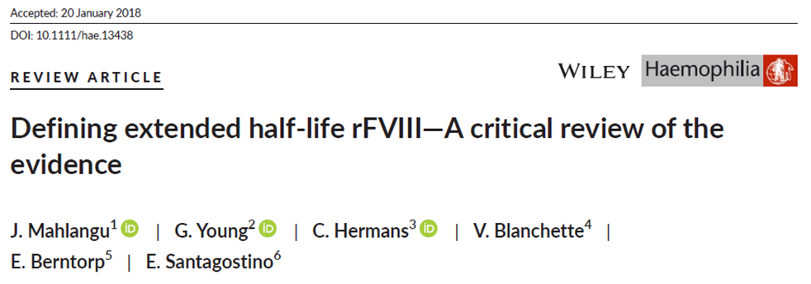
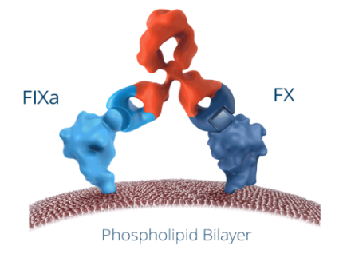
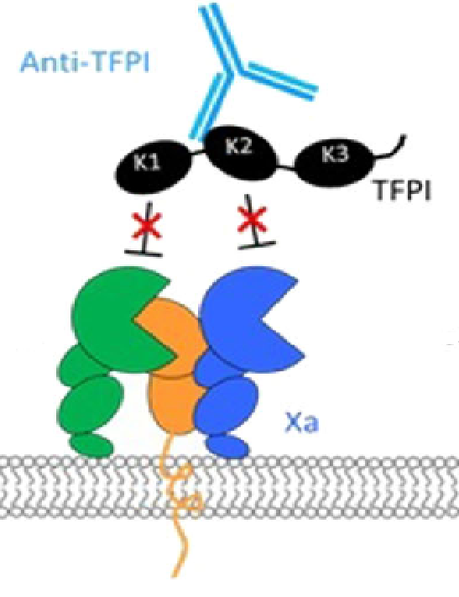
Therapeutic Options : FVIII
Licenced
In clinical trials
Clotting Factor concentrates*:
: Plasma derived (35)
: Recombinant ( 7)
:Extended half life (5)
: Super EHL ( Altuviiio)- FDA
Emicizumab ( Hemlibra)
Gene Therapy (1)- EMA
Fitusiran
Anti-TFPI (2)- Concizumab, Marstacimab
Serpin PC
Super EHL FVIII :EMA
Other mimetic- MiM8
Gene Therapy, Phase 3 (2)
XTEN
XTEN
Mahlangu J et al. Haemophilia 2018; DOI: 10.1111/hae.13438.
* Adapted from Online CFC registry www.wfh.org
Notes:
4

Slide 5
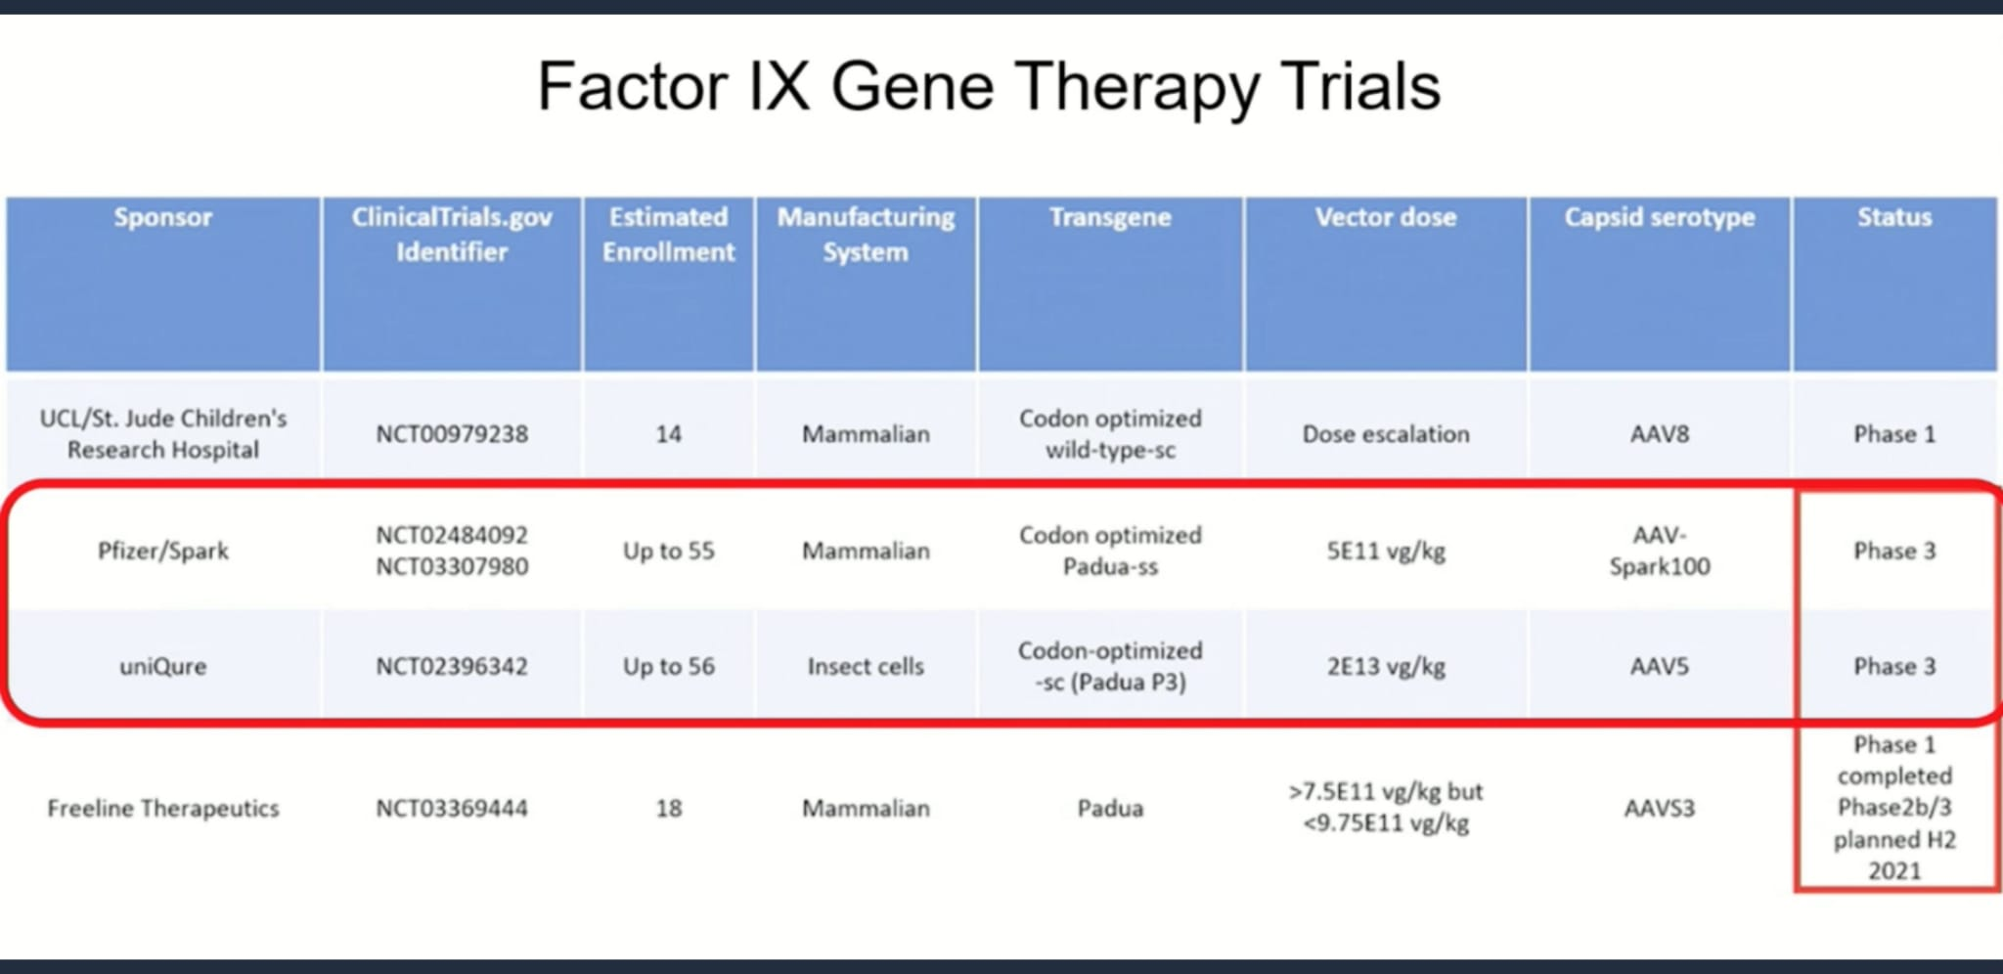
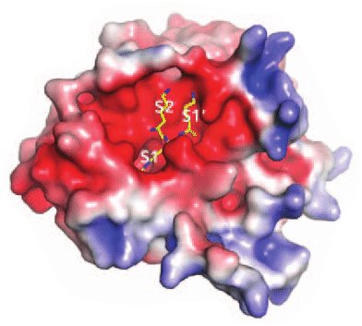
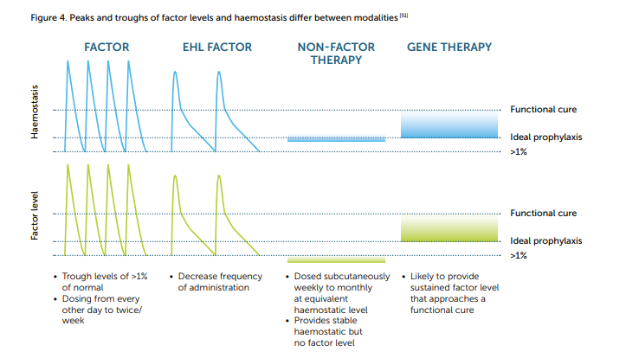
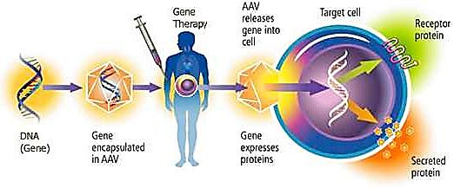
Therapeutic Options : FIX
Licenced
In clinical trials
Clotting Factor concentrates*:
: Plasma derived (18)
: Recombinant (3)
: Extended half life (3)
: Gene Therapy (1)- FDA, EMA
Fitusiran
Anti-TFPI (2)- Concizumab, Marstacimab
Serpin PC
Gene Therapy, Phase 3 (1)
Adapted from Onlice CFC registry. www.wfh.org
Notes:
5

Slide 6
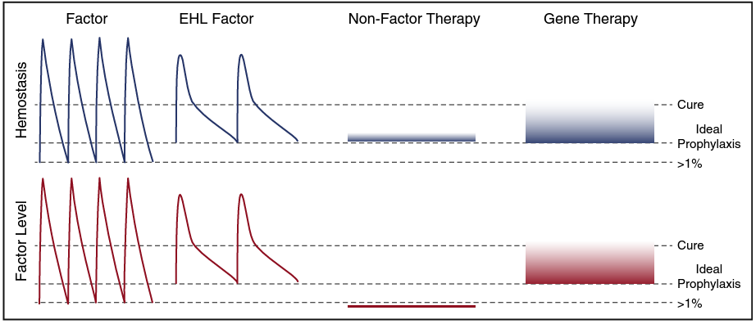
Increasing levels of protection against bleeding
Arruda VR et al, Blood, 2017

Slide 7
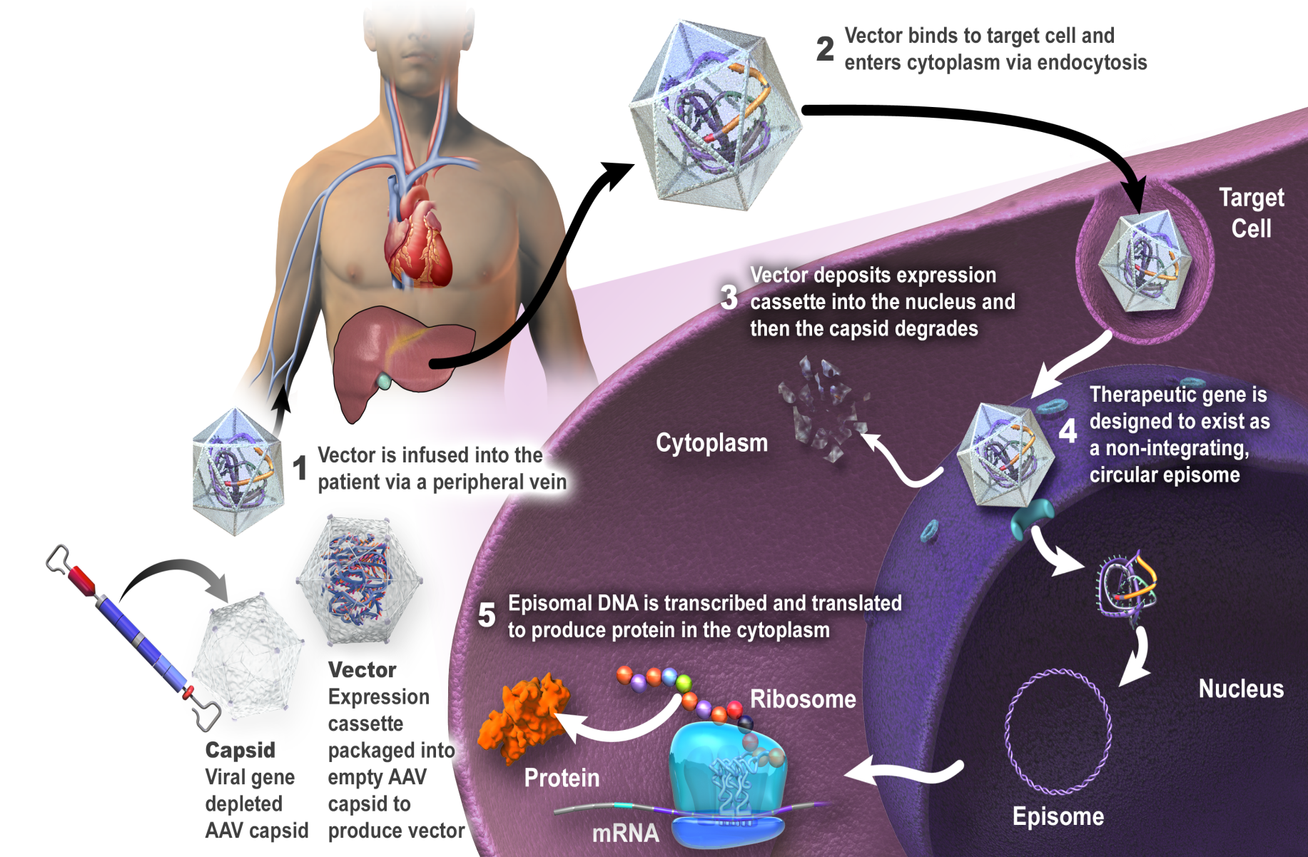
How Gene Therapy in Haemophilia works
DNA which codes for production of FVII/ FIX inserted in AAV vector
Vector infused intravenously at high dose: : 2E13 vg/kg – 6E13 vg/kg
: 70 kg man: 1.4 quadrillion vg
Vector hepatotropic- transduces hepatocytes to produce FVIII or FIX
Vector is primarily non- integrating
Transient immune response may lead to loss of factor expression:
: Treat with steroids

Slide 8
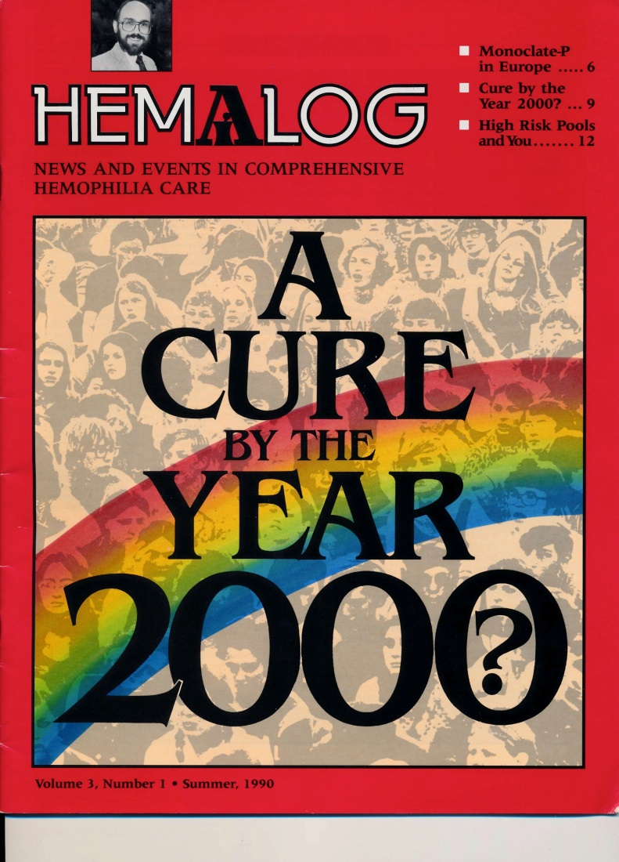


Development of Haemophilia Gene Therapy
Work ongoing since FIX gene cloned in 1982 and FVIII gene in 1984
Early progress with FIX- smaller gene
FVIII – B domain deleted version a tight fit for AAV vector
Early clinical trials discouraging:
- could not get increased expression
or
- could not sustain any increase if achieved

Slide 9
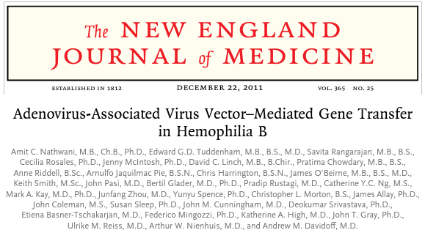
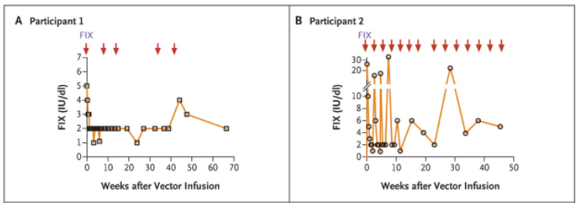
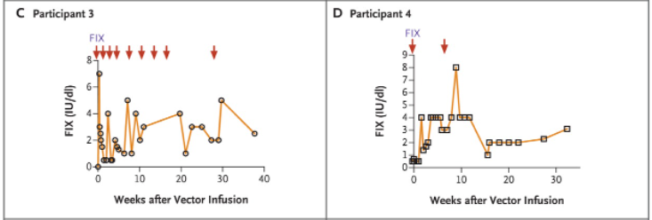
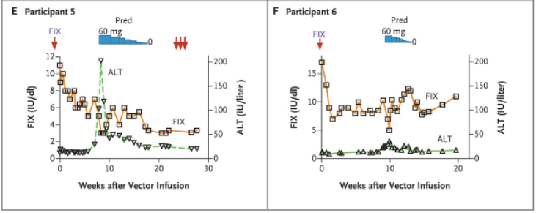
Encouraging initial results from UCL in UK with wild type FIX : 2010-2011
Stable FIX expression 1-5%
Prednisone stopped the loss of FIX
Immune response is dose dependent
FIX not sufficient…but a good start
Update: Reiss, Davidoff, Tuddenham High dose stable at 10 years post vector infusion

Slide 10
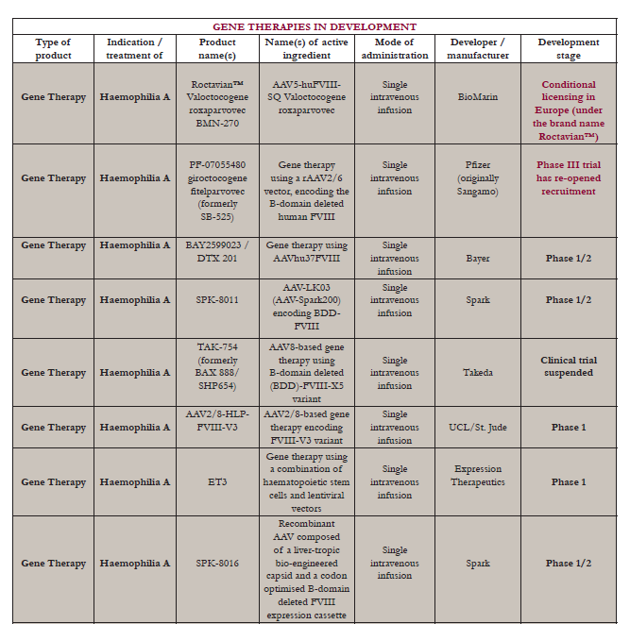


Slide 11
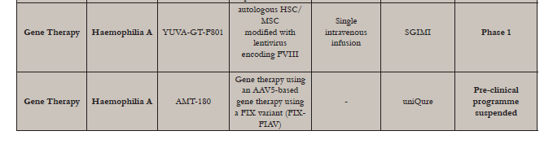
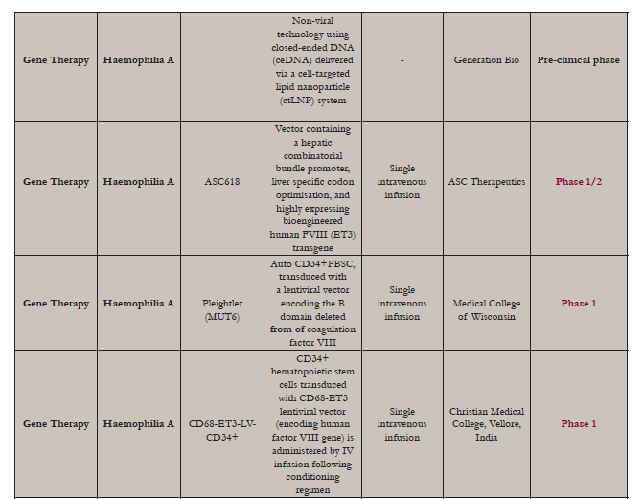

Slide 12
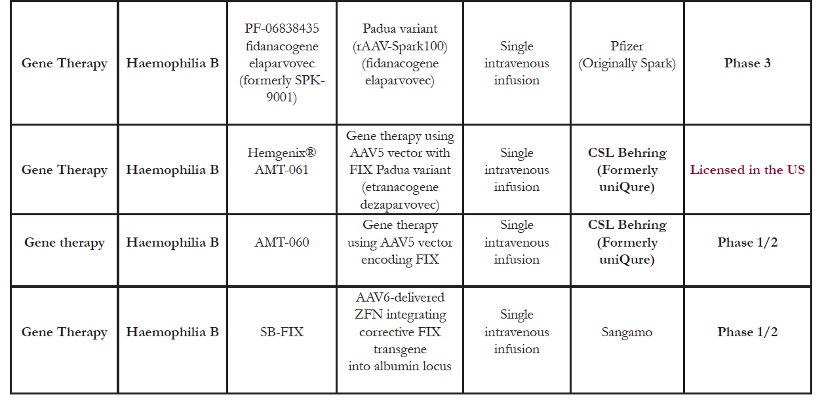

Slide 13
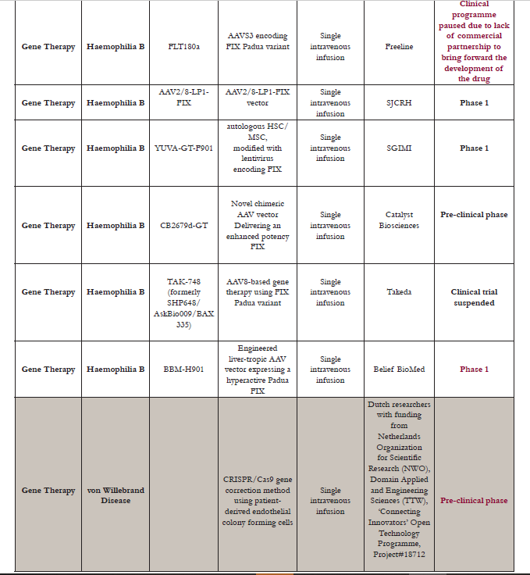

Slide 14

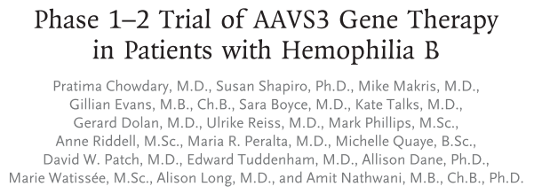
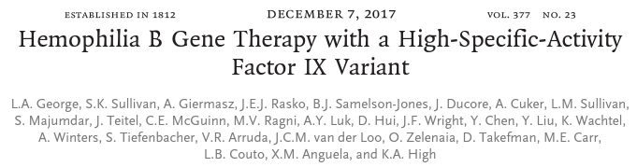
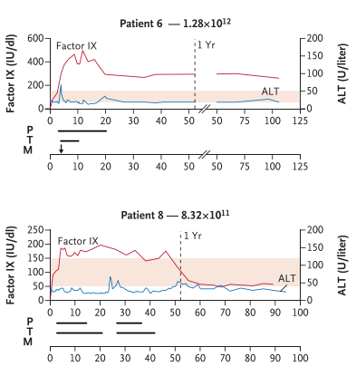
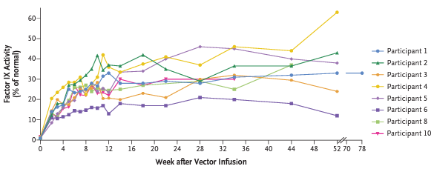
FIX Padua Works (sometimes too well)
6-8x increase in specific activity

Slide 15
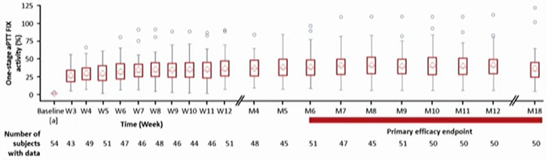
First completed FIX Phase 3 trial
FIX: Etranacogene Dezaparvovec (AMT-061)
54 patients received a single dose of etranacogene dezaparvovec (AMT-061) at the 2x10¹³gc/kg ( 3/54 from Ireland)
Mean FIX activity level was 36.9% (±21.4; 4.5–122.9) at 18 months post-infusion measured by one-stage clotting assay
Miesbach W et al EAHAD Congress 2022

Slide 16
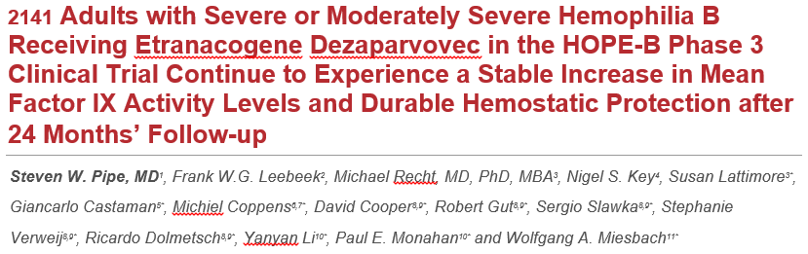
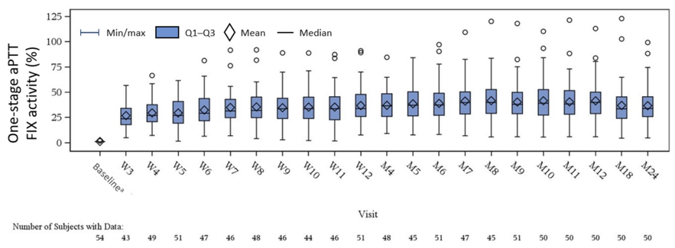

Phase 3 : HOPE-B trial: Etranacogene Dezaparvovec
Variable responses
Projected to last at least 25 years
J Shah et al (2023) Comprehensive analysis and prediction of long-term durability of factor IX activity following etranacogene dezaparvovec gene therapy in the treatment of hemophilia B, Current Medical Research and Opinion, 39:2, 227-237, DOI: 10.1080/03007995.2022.2133492

Slide 17
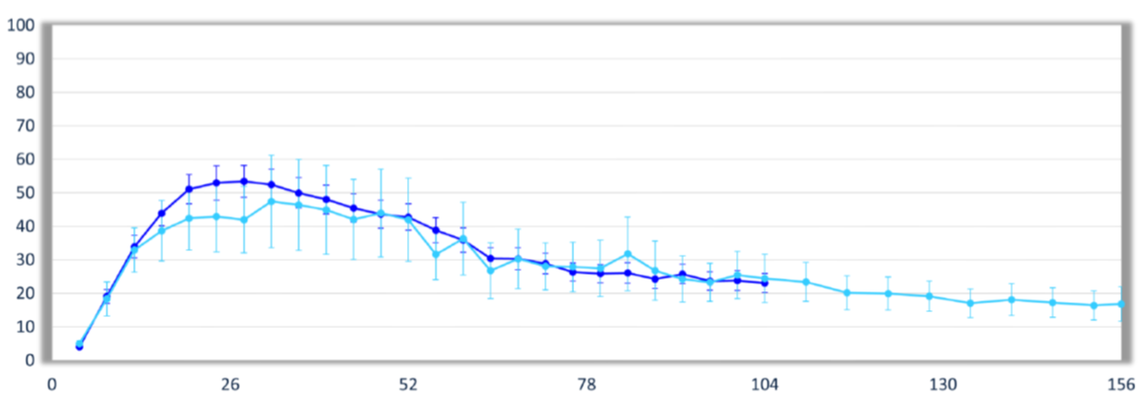
First completed FVIII Phase 3 trial:
Valoctocogene Roxaparvovec (BMN-270)
132 patients
17 patients
FVIII activity (CSA)
Mean 23 IU/dL
Median 11.8 IU/dL
FVIII activity (CSA)
Mean 16.8 IU/dL
Median 9.3 IU/dL
Mean (+/-) FVIII activity
IU/dL
CSA: Chromogenic substrate assay
Mahlangu J et al. EAHAD Congress 2022; https://www.fiercebiotech.com/biotech/biomarin-s-hemophilia-b-gene-therapy-hits-goal-phase-3-teeing-up-fda-filing-despite

Slide 18
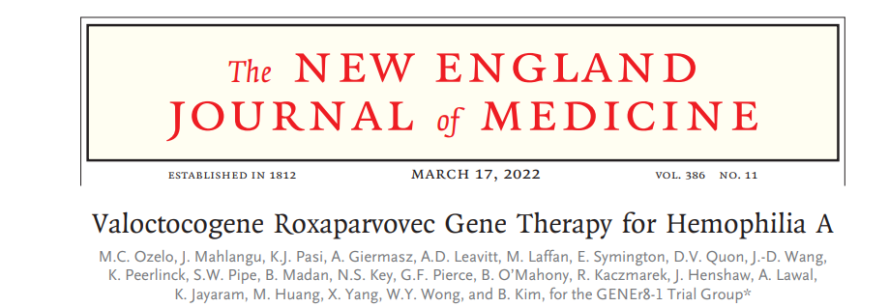
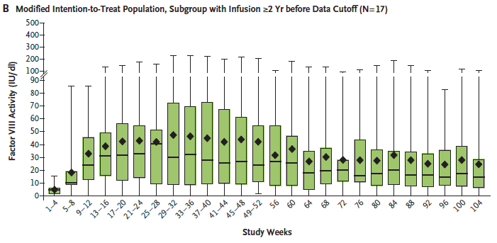

Slide 19
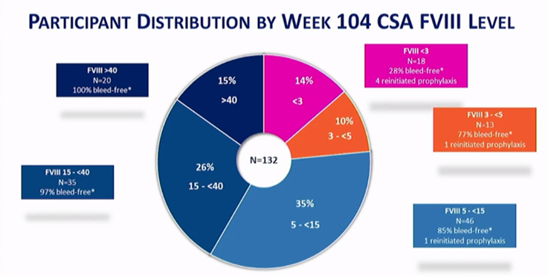
Valoctocogene Roxaparvoves Phase 3 FVIII Gene Therapy data
CSA: Chromogenic substrate assay
Mahlangu J et al EAHAD Congress 2022

Slide 20
Unique challenges facing FVIII gene therapy
FIX
IU/dL
Challenges in gene therapy unique to FVIII:
FVIII is primarily synthesized by LSECs (not hepatocytes)
Large and complex glycoprotein, difficult to express
Tends to misfold and aggregate
Large coding sequence, too big for AAV
FIX primarily synthesized in hepatocytes
FIX smaller protein- easily fits in AAV
FVIII
F8 or F9
years
ALT
FVIII or FIX
Kaczmarek R, Haemophilia, 2022, Malhotra 2008, Kapelanski-Lamoureux 2022, Poothong 2021, Poothong 2020

Slide 21
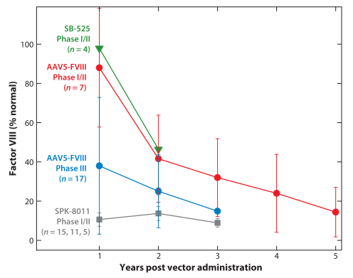
FVIII Gene Therapy clinical trials
Pattern emerging where FVIII expression decreases over time
Spark data did not include 2
people who lost all FVIII expression
FVIII Phase 3 AAV5 (Valrox)
>80% required steroids for average
7 months
Samelson-Jones BJ and George LA, Annu Rev Med, 2023

Slide 22
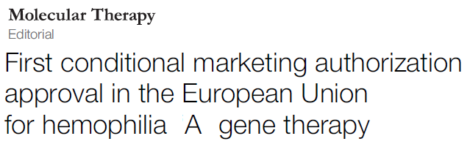
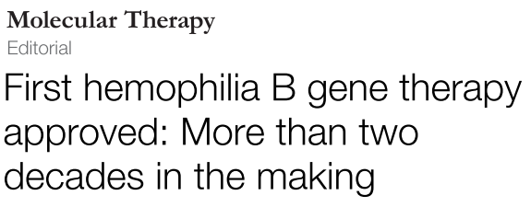



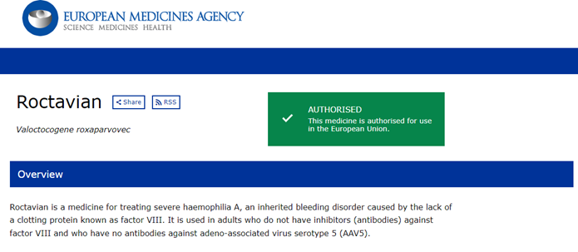

August 2022 ( EMA) November 2022 ( FDA)
February 2023 ( EMA)

Slide 23
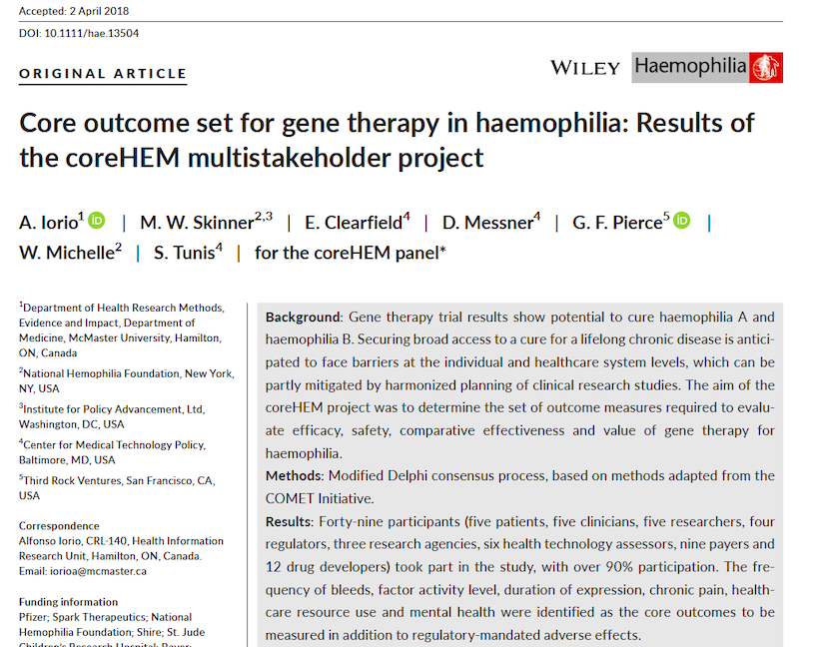
Consensus outcomes
Core outcome set | Adverse events
Frequency of bleeds | Liver toxicity – transaminitis
Factor activity level | Vector integration into host genome: insertional mutagenesis
Duration of expression | Short-term immune response to FVIII/FIX (inhibitor development)
Chronic pain | Thrombosis
Utilization of healthcare system (direct costs) | Development of other disorders
Mental health

Slide 24
Gene Therapy Unknowns
Factor Expression – wide variability from no increase in expression to supra normal
Predictability- can not predict which PWH will not get a good response, or no response.
Durability- how long will significant expression last
Safety- short term ( requirement for steroids) and long term ( risk of insertional mutagenisis - cancer)
Eligibility- relatively clear. 40% to 50% of those with severe Haemophilia
Affordability- new payment models required ?

Slide 25
GT: Haemophilia A v Haemophilia B
Hemophilia A Hemophilia B
Likely durability 5-7 years >10 years
Factor expression Wide variation Less variation
Lack of expression 9% - no rationale 2/54 (4%)- clear
rationale
Steroid Use > 80% <20%
Cost High Higher
Eligibility ( % severe) 44% * 48% - 60%*
Eligible with pre
Existing AAV ab. No Yes

Slide 26
Outcomes of Taking Gene Therapy in 2023
Once and Done? Maybe Yes Haemophilia B; Maybe Not Haemophilia A
Considerations | HaemB | HaemA
Ability to re-treat | No; may not be needed | No
Ability to boost a low result | No | No
Predictability of need for steroids, others | No, but short term | No, and some long term
Predictability of acute infusion reaction | No | No
Knowledge of the safety unknowns | No | No
Risk-benefit analysis favorable - HIC | Qualified yes | Many alternative therapies
Risk-benefit analysis favourable – LIC, LMIC | Yes | Possibly – - 7 year break from severe haemophilia
Works in children | No | No

Slide 27
Potential Benefits
Transformative- may free the individual from the burden of haemophilia for many years , or even a lifetime
Significant factor expression – may allow you to stop prophylaxis, increase your activity level, increase sports, travel or career options
Significant duration of expression- gives you a long period to be free of treatment except perhaps for surgery/ major trauma
May decrease chronic pain in joints, decrease subclinical bleeds
May allow individual to be more spontaneous
Use less time dealing with your haemophilia- decreased mental health burden

Slide 28
Potential Risks- Barriers
May not achieve significant factor expression or duration of expression – remain on prophylaxis
May not decrease your chronic pain or improve joint status
May suffer “ loss of identity”
May have to take steroids for significant period of time- and deal with side effects of steroids
There is some integration into DNA- theoretical risk of cancer
Lack of access due to affordability concerns

Slide 29



Decision drivers
Experience of living with haemophilia
Annualized bleeding rate (ABR) and bleeding phenotype
Existing state
of joints
Current activity level and barriers to increased activity
Needle phobia
or poor venous access
Fatigue of living with severe haemophilia
  – may wish to experience life without severe haemophilia
Access to existing therapeutic options –
how good is your current
therapy?

Slide 30
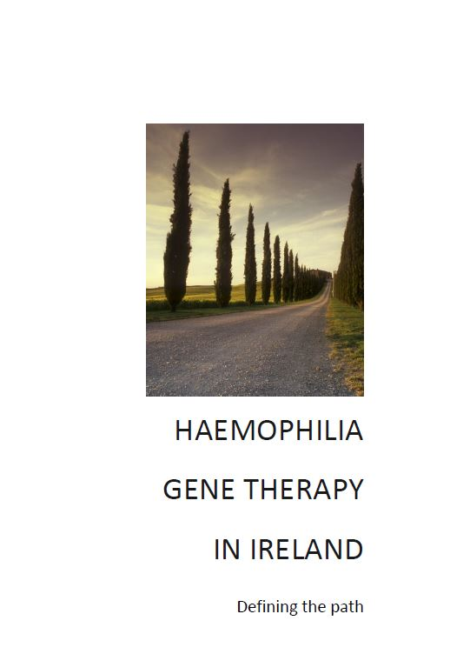

My decision process
Several years of exposure to the data – clinical trial updates
Organised meetings/seminars for members on gene therapy since 2013
We had been discussing participation in clinical trials for several years
I persuaded myself that I wanted to try gene therapy
I also wanted to lead – get this going in Ireland

Slide 31
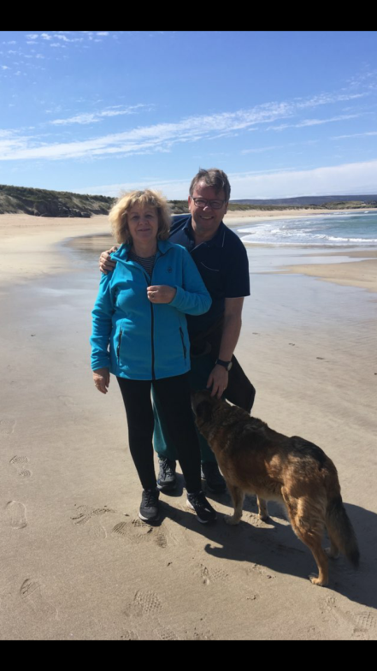




My rationale
Before gene therapy
Treatment with EHL FIX
Prophylaxis every 10 days
Venous access not great
ABR: 0–1
Knee replacement (2018)
Pre-existing joint damage with degree of chronic pain

Slide 32
Gene Therapy: My Expectations/ Hopes: Realistic
Duration of expression: at least 10 years
Factor Expression : hoped for 20-60%
Chronic Pain: Hoped for less pain in damaged joints - reduced sub-clinical bleeding
Mental Health: freedom from burden of regular intravenous infusions
: reduced time dealing with my personal haemophilia
ABR: 0 or close to 0 (previously down to between 0-1)
Factor Use: required only for surgery or major trauma
Activity Level: Hoped to increase my physical activity level/ fitness
Had to be prepared for a range of possible outcomes

Slide 33
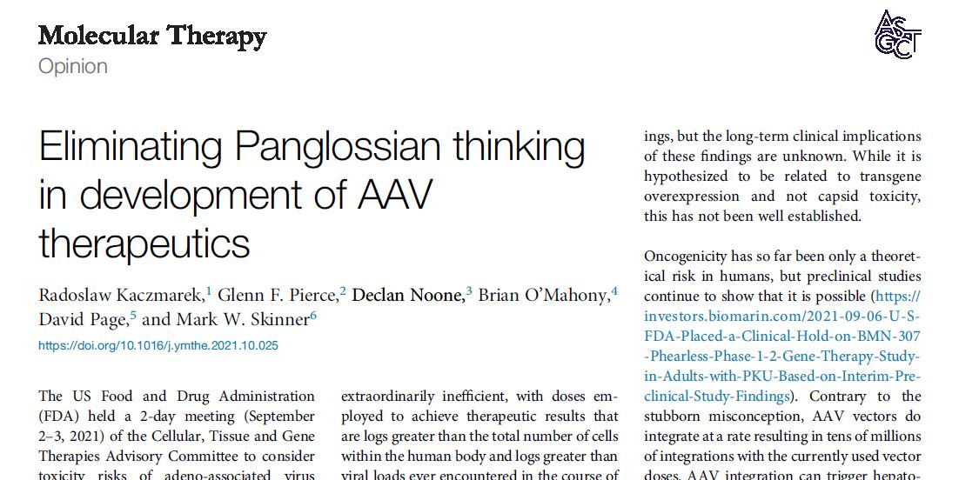
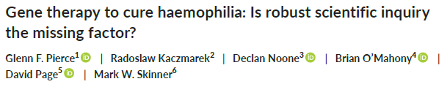
Gene Therapy: My Concerns
Transaminitis- being missed resulting in loss of expression
Transaminitis- requiring medium to long term steroid use
Risk of cancer from insertional mutagenesis
Risk of loss of expression achieved
No improvement in chronic pain

Slide 34


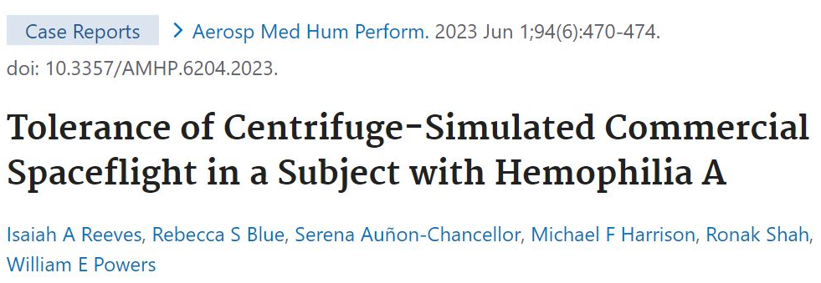
Managing expectations
Expectations of factor expression or duration may not be met
Gene therapy is not a genetic cure, but may be a phenotypic cure
Will not reverse existing serious joint damage
Gene therapy will not make you more active or get you off the couch – it should facilitate this, but you have to do the work
Gene therapy does not mean you can undertake very risky activities or sports with total impunity

Slide 35
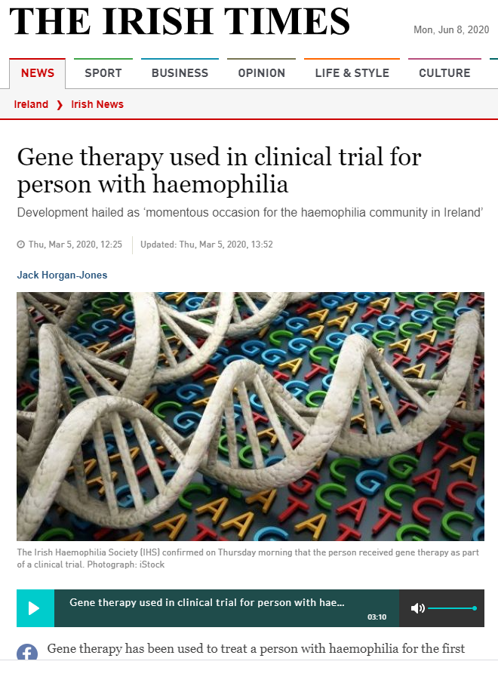
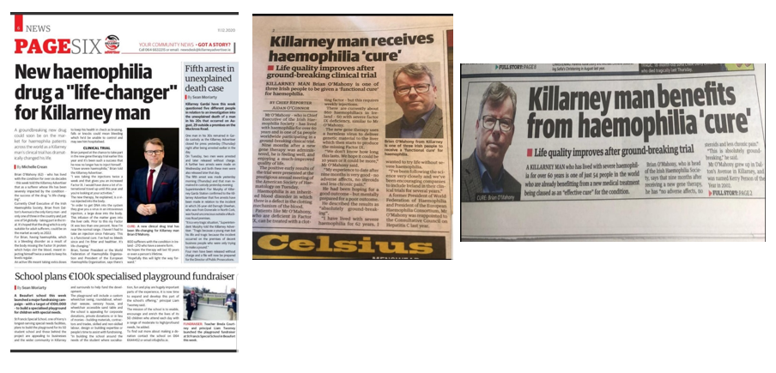
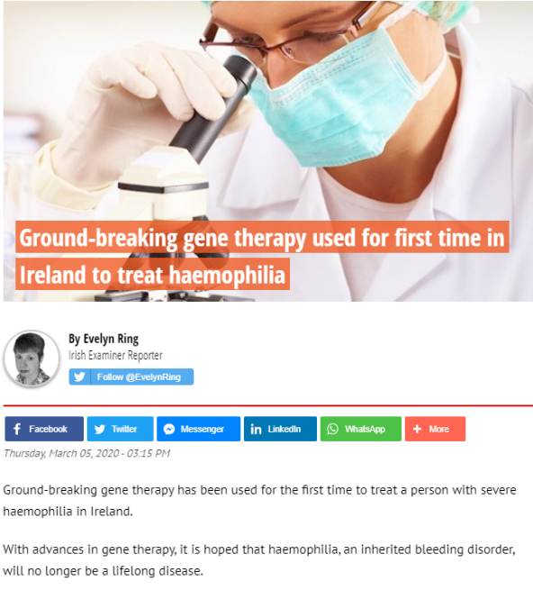
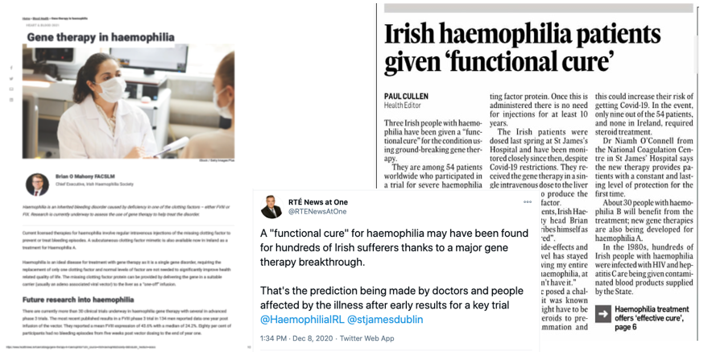

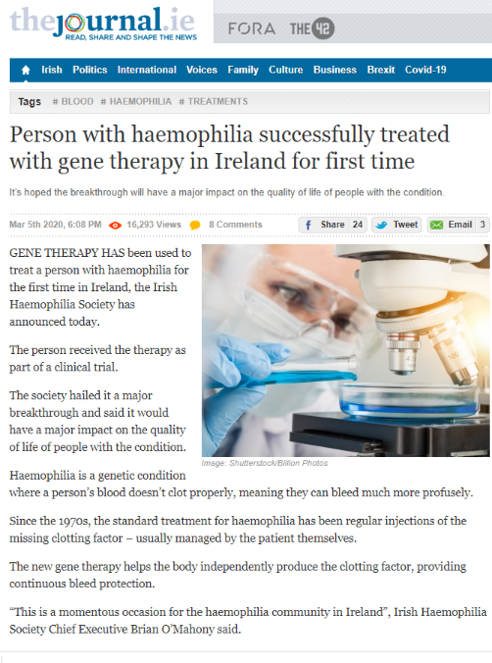
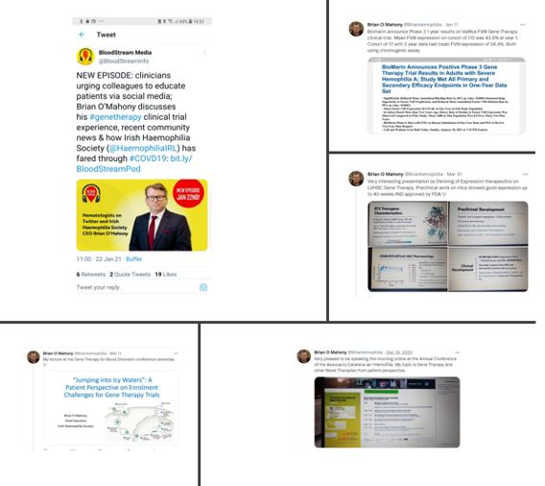
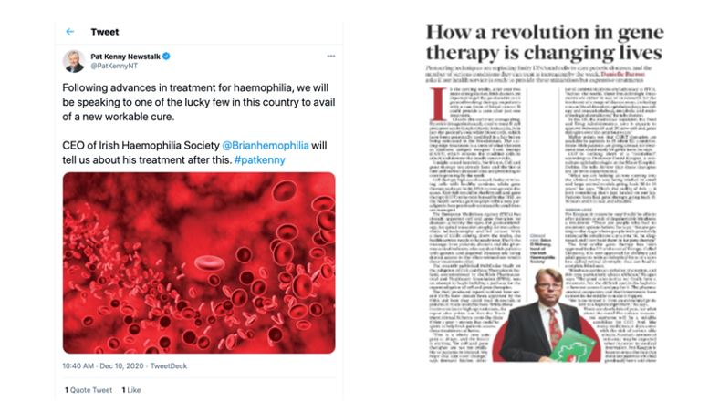


Slide 36

Cost
List price of FIX Gene Therapy in USA : $3.5 million
: equivalent to cost of 5 years treatment with EHL FIX
List price of FVIII Gene Therapy in USA: $ 2 million
: equivalent to 4 years treatment with EHL FVIII or 3.5 years treatment with Emicizumab
Indicative price for FVIII Gene Therapy in Germany: €1.5 million
: Equivalent to 5 years treatment EHL FVIII
Focus on the comparator in a country, not the quoted figure

Slide 37
Gene Therapy: Potential Outcomes-based Payment Models
Payment Models | Examples
Milestone (or installment, staged, or conditional treatment continuation) | Payment when outcome targets are met at specified intervals, e.g.: One-time payment at specified follow-up (e.g., at 30 days) Payments at specified intervals (e.g., at initial infusion, 6 months, 1-year)
Performance-based annuity | Annual (or other time interval) payments as long as therapy continues to meet outcome targets
Rebate (or “claw-back”) | Full payment is made at initiation of therapy, but payer received partial or full rebate when outcome targets are not met at specified intervals
Regimen-based pricing | Price decreases (or manufacturer rebates payer) when a patient needs an additional therapy to improve the effectiveness of the therapy
Value-based pricing | Price set on magnitude of net benefit (may be based on cost-effectiveness)
Indication-specific pricing | Price varies depending on magnitude of net benefit when therapy is indicated for different clinical purposes

Slide 38

Gene Therapy: Potential Finance-based Payment models
Payment Models | Examples
Expenditure cap | Per-patient cost capitation Subscription model (e.g., “Netflix model”)
Volume-based price | Price decreases when number of treated patients reaches specified levels
Annuity (‘mortgage’) payment | Spread payment over time (e.g., five annual payments)
Reinsurance/stop-loss | Protection against potentially catastrophic or unpredictable risks of large payments by transferring some portion of insurance liabilities to the reinsurer
Risk pool | Multiple payers contribute to a joint fund that reimburses providers or manufacturers for one or multiple therapies
Loans | Banks to consumer or payer Government to payers Manufacturer Managed Financing

Slide 39

Potential Outcomes for Contracting
 | Clotting Factor/Emi Consumption | Factor Expression | Annual Bleeding Rate (ABR) | Annual Joint Bleeding Rate (ABJR) | Joint Health (e.g. HJHS) /Ultrasound | Generic Qol tools (e.g., EQ-5D, SF36) | Disease Specific Qol tools - (e.g., PROBE, Haem-o- Qol)
Meaningful
Accessible
Timely
Measurable
Robust
Predictable

Slide 40



Informed Decision making: Shared decision making
Gene therapy is an irreversible (one-off) option but you
can return to CFC or other therapy
Fully consider all pros and cons before enrolling in trial
or therapy
Significant monitoring required in first year
Obtain information from society publications/website/
meetings
Engage fully and repeatedly with clinical team
Understand why you want gene therapy, your expectations
and how you will feel if suboptimal outcome
Not to be entered into lightly or inadvisably, but reverently

Slide 41
Role of patient associations
1
2
3
4
5
Inform PWH of gene therapy possibilities
via education and information
Publications, websites, webinars, apps
Initial group meetings for those interested
in trials
Further meetings
for those eligible
Clear balanced information
6
7
8
9
Opportunity to question and discuss in group setting
Be clear about
pros and cons
Educate –
not persuade
Bring PWH to the point at which they are ready for informed consent discussion with investigators/centre

Slide 42









Slide 43



Education Stages- Irish Haemophilia Society
Collaboration with St. James NCC- Hub centre
1. Basic information
2. Eligibility
3. (a)Gene Therapy v Other treatment options
(b) Information on each specific Gene Therapy
4. Informed decision- with teach back
5. Dosing
6. First 2 years of follow up
7. Follow up after first 2 years
Hemophilia gene therapy: your questions answered. Available at: www.dovepress.com/get_supplementary_file.php?f=355627.pdf. Accessed January 2023
Gene therapy for haemophilia. Available at:www.haemophilia.org.au/HFA/media/Documents/Haemophilia/Gene-Therapy-for-Haemophilia-for-Web.pdf. Accessed January 2023
Valentino LA, Blanchette V, Negrier C, O’Mahony B, Bias V, Sannié T, Skinner MW. Personalising haemophilia management with shared decision making.
J Haem Pract 2021; 8(1): 69-79. https://doi.org/10.17225/jhp00178.

Slide 44




Twitter handle
@Brianhemophilia

