Slide 2
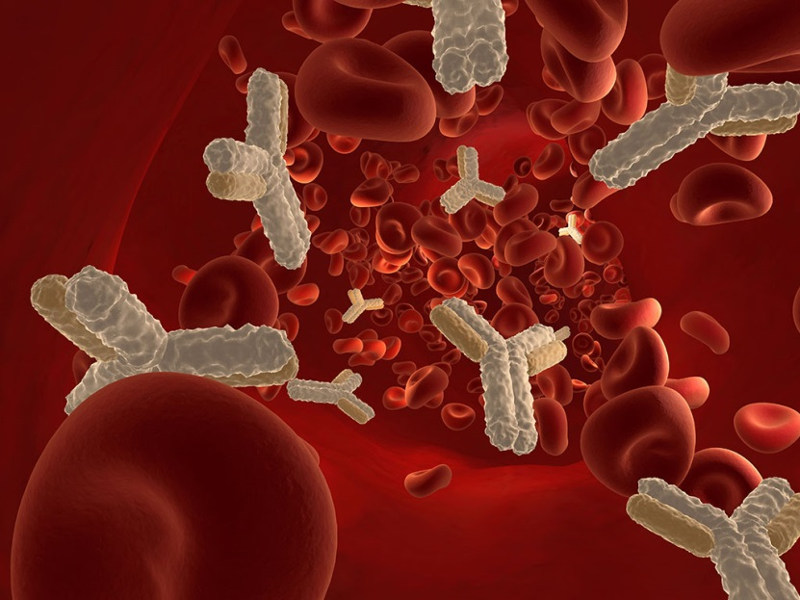

Not another antibody!
A complex serological case.
Cáit Geaney
SMS
RCI Laboratory
Irish Blood Transfusion Service
Cait.Geaney@ibts.ie

Slide 3

Initial Presentation
August 2019
78yr old male
Hb 8.8 g/dL
Haem/Onc patient- Myelodysplastic Syndrome
Group O RhD+
Previously transfused- apparent R1R1 phenotype
DAT negative
Referred for Ab ID investigation only
HTLA antibody (anti-Chido/Rodgers) and anti-E detected by enzyme treated cells only
Transfusion protocol: Patient should receive E-c-K- serologically least incompatible red cells
Transfusion dependent-weekly
Notes:
Anti-Ch/Rg is not clinically significant though it can be difficult to resolve serologically
HTLA antibodies have high titres, but low avidity to their antigens, and therefore do not cause problems during transfusion.
Generally considered clinically insignificant. However, they do mask other underlying clinically significant allo-antibodies.

Slide 4
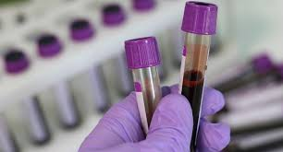
Subsequent Presentation
September 2019
Hb 7.4g/dL
Patient transfused three units between the 11th and 12th September 2019 in the referring hospital.
Delayed Haemolytic Transfusion Reaction suspected and reported to the referral lab on the 12th September 2019@16:00.
Three samples (Two pre txn, one post txn) received at the RCI Lab on the 13th September 2019 for a DHTR investigation and two RCC units requested urgently.
Notes:
Requested urgently due to the acute severe anaemia. Note the patient’s age, patient cannot compensate for anaemia.

Slide 5
Clinical Signs and Symptoms of DHTR
Unexplained drop in Hb or HCT/Failure to respond to transfusion
Apprehension/ Feeling Faint/ Weakness
Shortness of breath/Chest pain/Back pain
Notes:
Clinical signs and symptoms of DHTR ticked on the Delayed Haemolytic Transfusion Investigation Form at the referring hospital

Slide 6
Laboratory results for DHTR investigation
Hb | 8.1 g/dL
HCT | 0.24
Bilirubin | 32
Haptoglobins | <0.243
LDH | 315
Urea | 6.7
Creatinine | 72
DAT | Positive
Antibodies present | Positive
Notes:
Note the indices indicating haemolysis are mildly affected

Slide 7
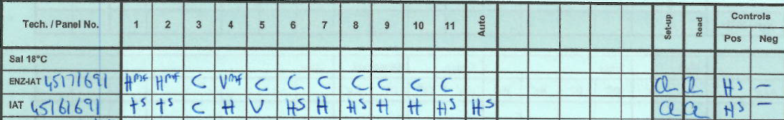

DHTR Investigation
Tests performed: Blood Group, Ab Screen, Ab ID, DAT and elution studies
Pre-transfusion sample (1): Taken on the 03/09/19 at 10:25
*Reaction strengths in the IBTS:
C = 4+
V = 3+
++ = 2+
+ = 1+
- = neg
Notes:
Please note we have two pre-transfusion sample. Taken at different times. Slide showing Panreactivity in IAT and ENZ-IAT, Positive DAT with IgG and C3d and a panreactive eluate (due to auto)
Explain nomenclature in relation to reaction strength. Mention controls.
Pattern suggests HTLA antibody and anti-E. DAT positive antibody was eluted

Slide 8
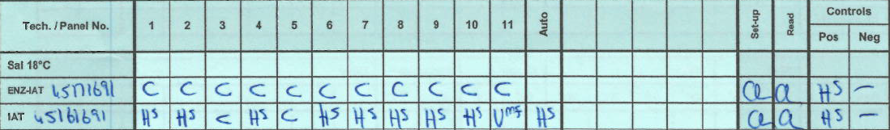
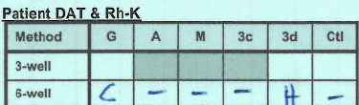
Pre-transfusion sample (2): Taken on the 11/09/19 at 11:25
Notes:
Slide showing Panreactivity in IAT and ENZ-IAT, Positive DAT with IgG and C3d and a panreactive eluate (due to auto)
All panel cells reactive with stronger reaction strength which signals change. DAT is positive and now includes C3d. Antibody eluted.
Complete reactions consistent with auto-antibody.

Slide 9
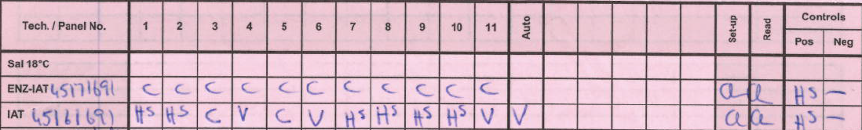
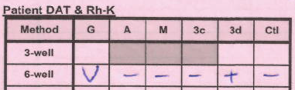

Post-transfusion sample: Taken on the 13/09/19 at 09:30
Pre and Post transfusion sample showed pan-reactivity by IAT,ENZ-IAT and with elution studies
DAT was positive with IgG and C3d
The auto-test cell was positive
Serological reactions increased in strength between pre-transfusion samples.
Complete reactions consistent with an auto-antibody
Notes:
Slide showing panreactivity (same as pre-transfusion)

Slide 10

DHTR continued……
Previously known HTLA antibody and enzyme only Anti-E
Neutralisation studies performed and pan-reactivity was observed
Due to the serological profile and auto-test cell result and positive DAT, an auto-antibody was suspected.
Adsorption studies were initiated- @37°C and 4°C
Masked allo-antibodies must be excluded for DHTR confirmation and transfusion protocol.
Red cell components requested urgently in actively haemolysing patient!!
Pre-transfusion
Post-transfusion
Notes:
So where do we go from here? Note previous results- known HTLA ab and enzyme only anti-E.
Neutralisation studies are a specialist technique that we carry out in the RCI Lab to detect HTLA abs.
Allo-absorption studies are also a specialist technique that we carry out in the RCI Lab to confirm an auto-antibody and any apparent specificity. Also we need to exclude masked allo-antibodies. This is important for lab confirmation of DHTR and for the transfusion protocol.

Slide 11
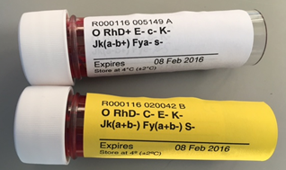
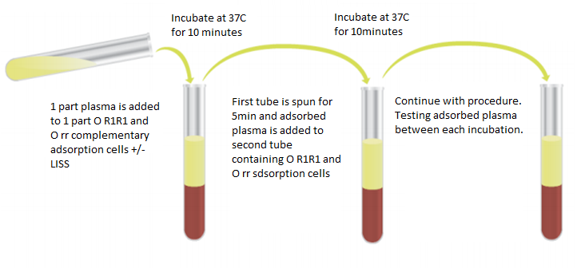
Allo-adsorption studies
Differential Allo-adsorption utilised to exclude the presence of clinically significant antibodies
Use papanised O R₁R₁ and O rr reagent cells, matched for Kidd, Duffy and MSs antigens
Incubate patient plasma with cells in a 1:1 ratio +LISS
Antibodies present are either adsorbed out or remain following IAT using the antithetical reagent red cells

Slide 12



Red cell components requested urgently in actively haemolysing patient!!
Patient’s full phenotype was sought from the referring hospital and extended matched units were sourced (D+C+E-c-e+K-Fya+Fyb-Jka+Jkb-M-S-s+)
A sample for genotype was requested and sent to BGGL confirming the patient’s phenotype
-D+C+E-c-e+K-k+Cw-Fya+Fyb-Jka+Jkb-M-N+S-s+Doa+Dob+Vel+
Patient had stabilised and units were no longer required overnight as per medical team in the referring hospital and the medical team in the IBTS.
However, the following day two units were requested and the extended matched units were issued as serologically least incompatible. (M neg units unavailable)
Notes:
Fortunately, the referring hospital could provide the extended phenotype which enabled us to provide extended matched units and provide safer components for the patient. It’s notable the referring hospital had the hindsight to perform the phenotype and was instrumental in our investigation.
We call this..steal the phenotype.. We know what the patient can potentially make.
Deciding to hold off on transfusion that evening highlights the number rule of transfusion… the best transfusion is the one not given.
Extended matched units- excluding M as this was unavailable. As we know anti-M causing a transfusion reaction is extremely rare. Anti-M which is IgG in nature are mostly cold reactive and therefore not clinically significant. A discussion with the medical team in the IBTS is had before issuing a unit that is not fully matched for the patient.
The compatibility testing is seen here. Please note the crossmatch was performed following allo-adsorption (x9) and reactions varied from +vw to ++s.

Slide 13
Patient follow up-Laboratory results (17/09/19)
Hb | 7.4 g/dL
HCT | 0.21
Bilirubin | 23
Haptoglobins | None Detected
LDH | 369
Urea | 11.4
Creatinine | 83
DAT | Positive
Antibodies present | Positive
Notes:
Results are from the 17/09/19. Interpretation is no significant haemolysis. Most likely anaemia of the disease

Slide 14
Patient follow up
Three units requested on the 17/09/19.
Pan-reactivity observed by IAT and ENZ-IAT
DAT positive- IgG (3+) and C3d (2+)
Positive Auto-test cell (3+)
Adsorption studies initiated
Following allo-adsorption (x9): Liaised with Medical Team
3 cell screen checks carried out
DAT check on adsorbed cells
2hrs 40mins to complete
V (3+) reaction evident anti-E is present
Neutralisation technique performed on adsorbed plasma (x9) due to known anti-Ch/Rg (HTLA ab) previously detected.
Notes:
3 cell screen of adsorbed (x9) plasma

Slide 15
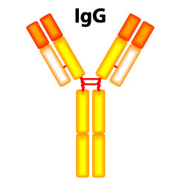
Anti-Chido/Rodgers
Neutralisation Technique
Anti-Ch1 and anti-Rg1 are considered nebulous antibodies
Anti-Ch1 named after Mrs. Chido in 1967
Anti-Rg1 named after antibody marker in 1976
Ch1 and Rg1 antigens occurrence: >96% in most population
Antigens are located on the fourth component of complement (C4), in the C4d region which becomes bound to RBC’s from the plasma.
Immunoglobulin class- IgG
Optimal technique- IAT
Unable to bind complement
Transfusion reaction- No, however anaphylactic reactions from plasma products and platelets have been reported
Not implicated in HDFN
Antigen positive serum/plasma can neutralise allo-ab
ISBT System |  | Blood Group |  | Common Name | Gene | Molecule
Name | Number | Number | Name
CH/RG | 017 | 001 011 | CH/RG1 CH/RG11 | Ch1 Rg1 | C4A C4A | C4B C4A
Notes:
Nebulous-vague/ill-defined,
HTLA antibodies have high titres, but low avidity to their antigens, and therefore do not cause problems during transfusion.
Generally considered clinically insignificant. However, they do mask other underlying clinically significant allo-antibodies.
The complement component C4 is not actually synthesised by erythroid cells; rather the soluble protein is adsorbed onto the RBC surface from plasma of all persons expressing the protein

Slide 16
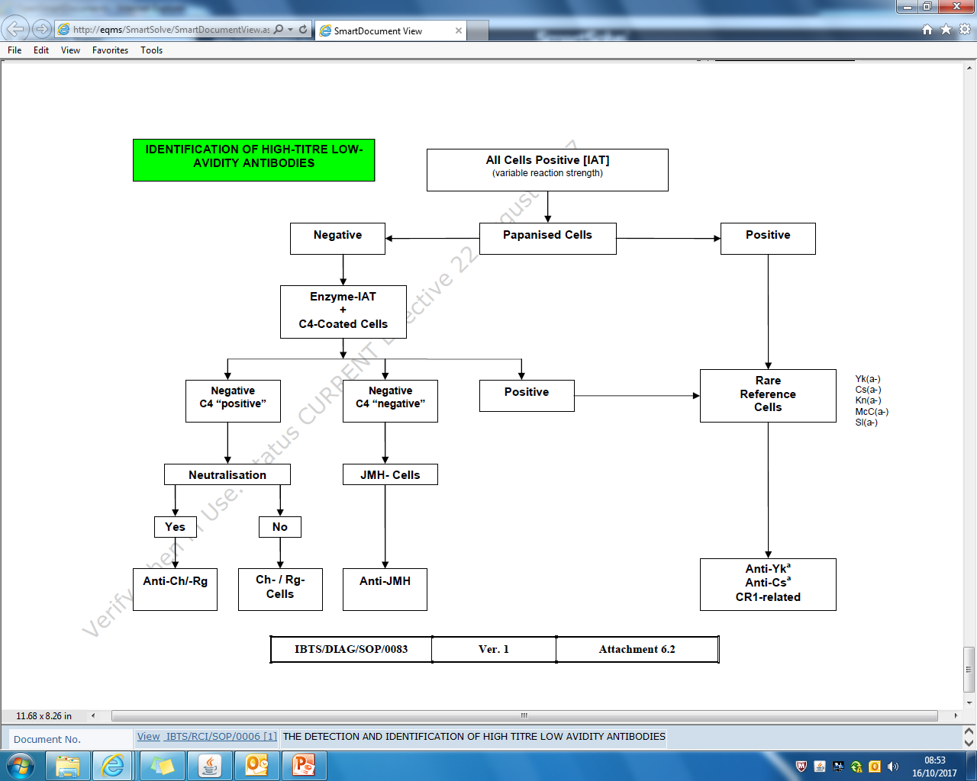
Anti-Chido/Rodgers
Neutralisation Technique
‘No fit pattern’ by IAT
Negative in ENZ-IAT
C4 coated cells (prepared in house) are tested Vs patient plasma by IAT
A stronger reaction with C4 coated cells is observed Vs uncoated cells
Patient’s plasma is incubated with pooled AB plasma/serum in a 2:1 ratio @RT for 30mins
Patient’s plasma is incubated with PBS in a 2:1 ratio to serve as a dilutional control
Notes:
Process flow of identifying a HTLA ab

Slide 17

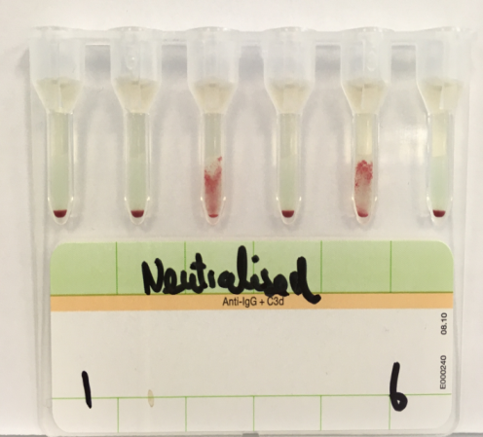
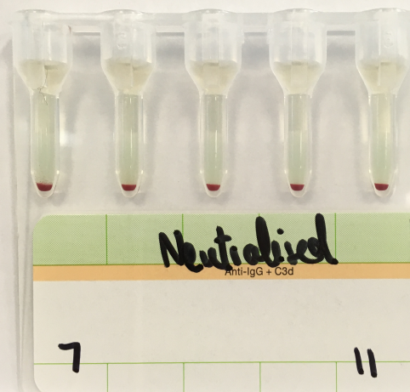


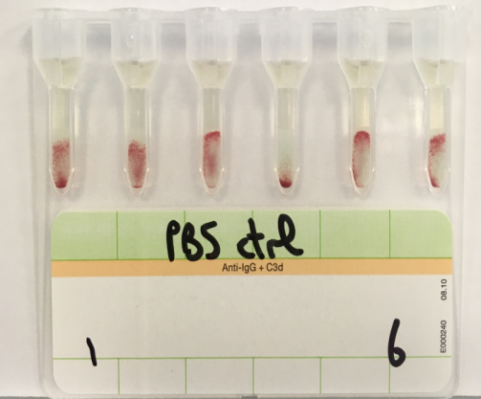
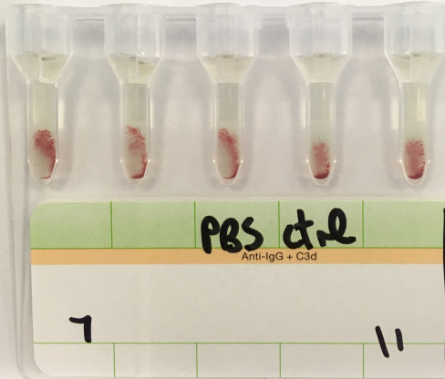
C4 coated Vs uncoated cells with patient’s plasma
Patient’s results post neutralisation of adsorbed R1R1 and rr plasma with AB plasma
R1R1
R1R1
rr
rr
Patient’s results post neutralisation of adsorbed plasma with PBS
Notes:
C4 coated cells (stronger with C4 coated)
Neutralised and PBS results- Cell 3 and 5 positive reactions indicating underlying allo-ab

Slide 18

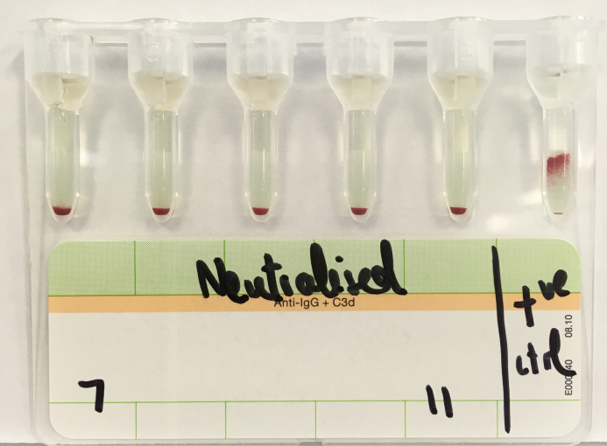
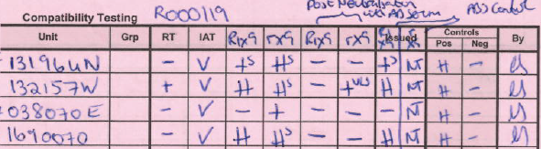
Underlying Anti-E detected
Compatibility testing was carried out and serological least incompatible units issued
Neat plasma
Adsorbed plasma
Neutralisation on adsorbed plasma
PBS ctrl
RCI’s job is to secure the result and issue a safe component
Notes:
Please note the compatibility results. Three units were required and decision making is carried out on the most compatible units. In this case, the unit 132157W would not be issued first as the rX9 result is +vw.

Slide 19
Patient report
Current Antibody: Auto-antibody, Anti-Ch/Rg and Anti-E
Transfusion Protocol: Patient should receive E-c-K- serologically least incompatible red cells
Patient is still attending Haem/Onc day ward for weekly transfusions

Slide 20
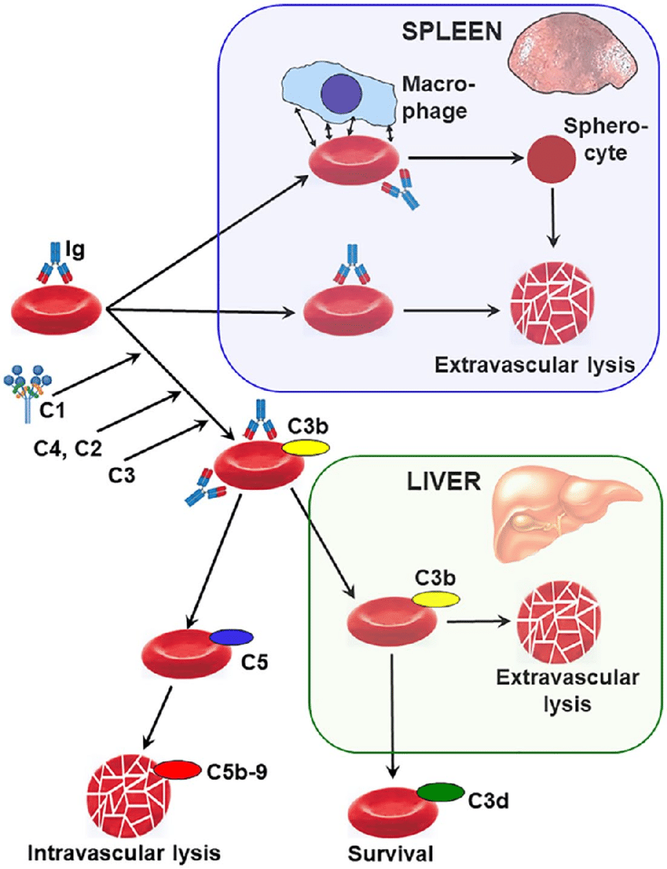
Patient outcome
Patient diagnosed with Auto-Immune Haemolytic Anaemia (AIHA)
AIHA is a decompensated acquired haemolysis caused by the host's immune system acting against its own red cell antigens.
The incidence is approximately 1 per 100 000/year
It can occur at any age but incidence rises with increasing age.
Serologically, cases are divided into warm type (65%), cold type (29% cold haemagglutinin disease [CHAD], 1% paroxysmal cold haemoglobinuria) or mixed AIHA (5%).
AIHA patients are ‘dangerous’ recipients of transfusion. Minimal or no transfusion is preferred.
The BT lab’s role is to exclude allo-antibodies and provide the safest components available (extended matched)
Notes:
A positive direct antiglobulin test (DAT) indicates the presence of immunoglobulin (Ig)G, IgM, IgA or complement (usually C3d) bound to the red cell membrane. In the presence of haemolysis, this suggests an immune aetiology but clinical assessment is required before a diagnosis of AIHA can be made. Typically monospecific anti‐IgG and anti‐C3d antibodies are used in the initial screening and these help to determine the type of AIHA.

Slide 21



Discussion
This case study highlights the various specialised techniques performed in the RCI Lab and their utilisation to provide safe components for our patients.
Haemovigilance report: Delayed Serological Transfusion Reaction (DSTR)
Delayed Haemolytic Transfusion Reaction (DHTR)
DSTR is one in which the patient lacks the clinical features but exhibits the laboratory features of haemolysis.
DSTR is appropriate due to the allo-anti-E detected on the initial presentation to the RCI lab (20/08/19), however markers of haemolysis developed on the 11/09/19.
E positive unit transfused on 06/08/19 on initial admittance into the referral hospital (Hb 5.3 g/dL)
Notes:
Approximately 30% of patients with AIHA have an underlying alloantibody (most commonly Rh or K) but these are rare if there is no history of previous transfusion or pregnancy

Slide 22

Acknowledgements
Referring Hosptial Blood Bank Laboratory
Medical Team IBTS
Haemovigilance Department IBTS
RCI Laboratory, IBTS

Slide 23
References
https://doi.org/10.1111/bjh.14478 The Diagnosis and management of primary autoimmune haemolytic anaemia- BSH guidelines
Reid, M., Lomas-Francis., C., Olsson, M.L., 2013. The Blood Group Antigen Facts Book. 373-381.
Pirofsky, B. (1975) Immune haemolytic disease: the autoimmune haemolytic anaemias. Clinics in Haematology, 4, 167–180.
Klein, N.P., Ray, P., Carpenter, D., Hansen, J.,Lewis, E., Fireman, B., Black, S., Galindo, C.,Schmidt, J. & Baxter, R. (2010) Rates of autoimmune diseases in Kaiser Permanente for use in vaccine adverse event safety studies. Vaccine, 28, 1062–1068.
Petz, L.D. (2004) Review: evaluation of patients with immune hemolysis. Immunohematology, 20,167–176
Berentsen, Sigbjørn & Hill, Anita & Hill, Quentin & Tvedt, Tor & Michel, Marc. (2019). Novel insights into the treatment of complement-mediated hemolytic anemias. Therapeutic Advances in Hematology. 10. 204062071987332. 10.1177/2040620719873321.

