Slide 1
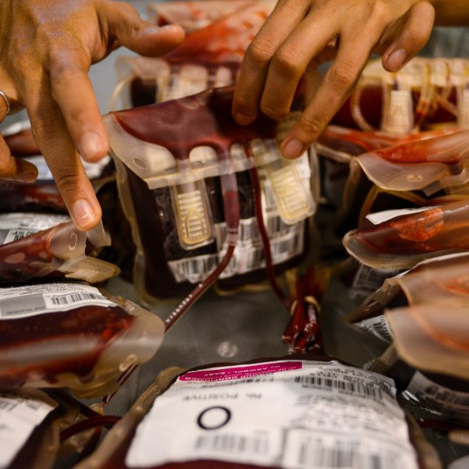
Emergency transfusion of adult males and females of non-childbearing potential with group O D positive red blood cells (RBC)
Dr Kathryn Maguire
Consultant in Transfusion Medicine NIBTS
National Haemovigilance Office Conference
Gibson Hotel Dublin 25/03/25

Slide 2
Overview
NI Regional Proposal and background
Guidelines
Audits and Reports
Evidence based research
Summary and recommendations

Slide 3
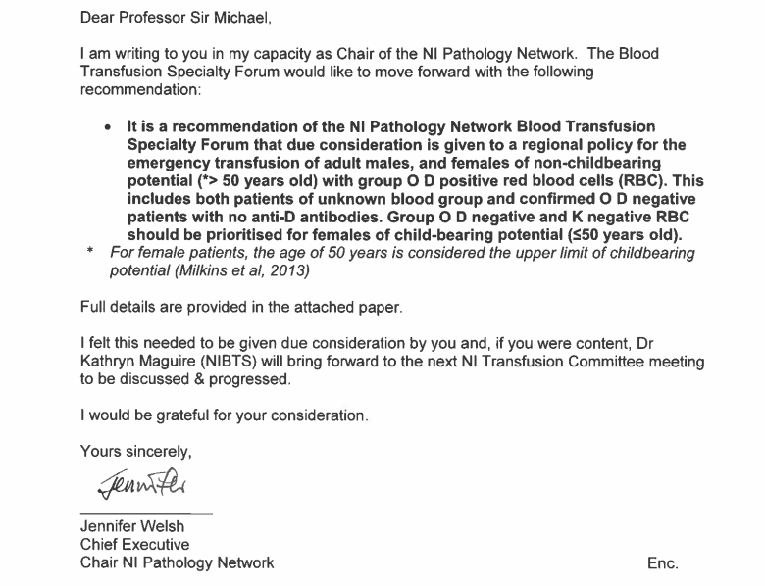

Slide 4
Why do NI need a regional policy?
A regional policy is required:
to enable hospitals and NIBTS to work within a consistent framework to ensure equal access for patients to available group O D negative RBC based on need.
It is also required to prevent significant shortages of O D negative RBC.

Slide 5
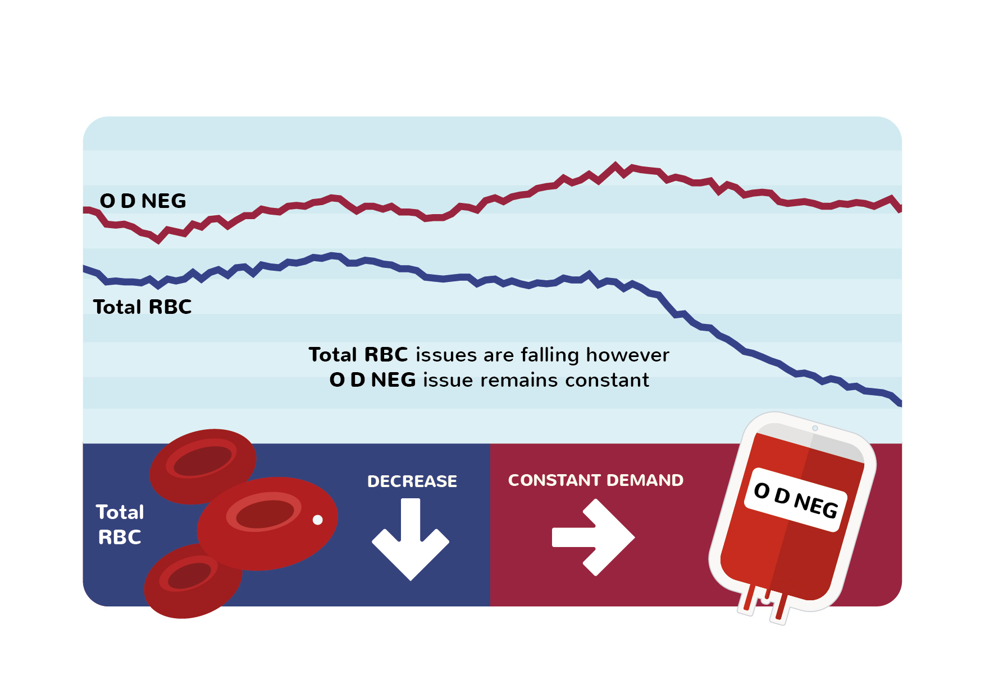

Slide 6
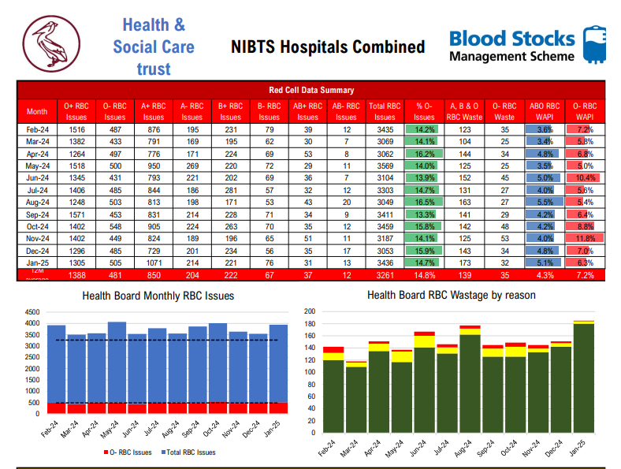

Slide 7
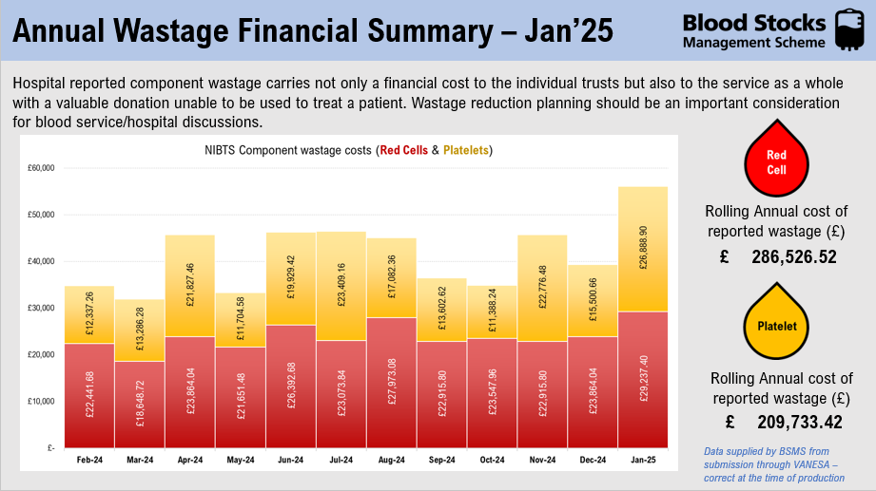

Slide 8
NIBTS O D negative importation data for the 6-year period June 2017 – June 2023
Approximately £260,000 spent in importing O D negative RBC over this 6-year period.
Imports of O D negative RBC
Year | 2017 | 2018 | 2019 | 2020 | 2021 | 2022 | 2023 | TOTAL
Amount | 100 | 170 | 260 | 278 | 359 | 164 | 177 | 1508

Slide 9
Current practice in NI
RVH (Trauma Centre) A&E: issue O D positive RBC upfront to all adult males of unknown blood group and those confirmed D negative with no anti-D
All other trusts and departments issue group O D negative RBC upfront to these adult males and females of non-childbearing potential in an emergency.
Massive Transfusion Protocols (MTP) vary across our 5 trusts as to when a switch is made from O D negative RBC to O D positive RBC in appropriate patients. This switch, if it does occur, is largely influenced by O D negative supply.
The Helicopter Emergency Medical Services (HEMS) in Northern Ireland currently hold 2 units of O D negative RBC on board.

Slide 10

Guidelines

Slide 11
British Society for Haematology (BSH): Haematological management of a major haemorrhage (Stanworth et al., 2022)
Group O RBC should be used in emergency until the patient has a valid blood group. Until the patient’s blood group is confirmed, group O D negative and K-negative RBC should be prioritised for people of childbearing potential, children and where the patient’s sex is unknown. Adults who do not have childbearing potential should receive group O D positive RBC.

Slide 12
British Society of Haematology: Guidelines for pre-transfusion compatibility procedures in blood transfusion laboratories (C Milkins et al.,2012)
Group O RBC should be used where transfusion cannot await full investigation and resolution because transfusion is deemed clinically urgent. Selection of D matched blood is the recommended best practice, however, in order to preserve supplies of D negative RBC for D negative women of child bearing potential, D positive RBC may be selected for D negative patients in the following situations:
  Female patients > 50 years.
  Adult males who are D negative or whose D status is unknown.
  Patients undergoing a large volume transfusion (> 8 units), excluding children, females of childbearing potential and patients with immune anti-D.

Slide 13
National Blood Transfusion Committee (NBTC) Guidance 2019 (nationalbloodtransfusion.co.uk)
(*national – refers to England).
Consistent with the BSH guidelines for pretransfusion compatibility procedures (Milkins et al., 2013) and management of patients with major haemorrhage (Stanworth et al., 2022).
Use of O D positive RBC:
  Adult males and women > 50 years old who are D negative or whose D status is unknown in emergency situations.

Slide 14
National Transfusion Laboratory Managers Group (NTLM)
NTLM is a working group under the direction of the National Blood Transfusion Committee NBTC (nationalbloodtransfusion.co.uk)
To protect national O D negative red cell stocks for patients who really need them the National Transfusion Laboratory Managers (NTLM’s) group recommend the following: Males: Use O D positive RBC; and females >50 years of age: Use O D positive RBC. Women and children: Use O D negative, K negative red cells.
Female patients with childbearing potential make up less than 40% of the typical patients who may require emergency stock. For patient’s outside this group, the use of O D positive RBC are of no greater risk and as such should be used whenever possible.

Slide 15
Blood Stock Management Scheme (BSMS): Inventory Management, Best Practice Guide, January 2022 (BSMS@nhsbt.nhs.uk)
To conserve O D negative RBC, the provision of O D positive RBC should always be considered for emergency use for males > 18 years and all females > 50 years.

Slide 16
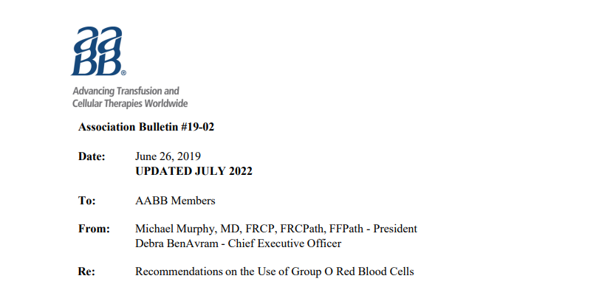
Recommendation 1: Group O Rh(D)-negative RBCs should be reserved for three cohorts of females of childbearing potential: those who are group O Rh(D)-negative, those who are Rh(D)-negative requiring transfusion when type-specific blood is unavailable, and those of unknown blood type who require RBCs before the completion of pretransfusion testing.
In emergencies, males and postmenopausal females should be given group O Rh(D)-positive RBCs, then switched to type-specific RBCs as soon as testing is completed. In addition, group O Rh(D)-positive RBCs should be given to group O Rh(D)-negative patients in cases of significant surgical or medical bleeding when group O Rh(D)-negative cells are not available or are in short supply. Under non-emergent conditions group O Rh(D)-negative males and females of no childbearing potential can also receive group O Rh(D)-positive RBCs when inventory conditions dictate, unless they are known to be alloimmunized to Rh(D).

Slide 17
Guidelines Summary
These guidelines all share the same recommendation to use O D positive RBC in adult males and females of non-childbearing potential in the emergency setting.
This practice is required to conserve O D negative RBC stocks

Slide 18

Audits and Reports

Slide 19
NITC Regional O D Negative Audit 2022
Audited 493 units of O D negative over a 4-week period
69.6% were transfused to O D negative patients. Wastage = 5.5%.
Emergency transfusion/ABO group unknown: 54 units transfused (11.7% of total O D negative transfused). 3 of these patients were females < 60 years old (note age< 60 years is currently applied in BHSCT as the limit of child bearing) and received 7 units. 47 units transfused to males and females > 60 years old.
60 units of O D negative were transfused during a massive transfusion protocol MTP (included all but 1 in emergency transfusion/ABO group unknown). 13.3% went to women < 60 years old. 86.7% transfused to males and females > 60 years.
If group O D positive RBC were used up front in all emergency transfusions involving adult males and females of non-child bearing potential in this audit period, this would have saved NI over two days stock of group O D negative.

Slide 20
NITC report – O Negative Red Cell Use in Northern Ireland (Damien Carson, NITC Audit lead, December 2021)
NITC issued a short report examining the individual Trust ordering trends, unit destination and wastage of O D Negative RBC across all NI Trusts over the previous three years
January - June 2021, NIBTS issued 19808 units of blood of which 3155 (15.9%) were O D Negative: an increase of 5.9% over the previous two years despite a 5.2% reduced red cell demand in other groups.
Standards in other UK countries (Wales 12%, England 12.5%)
Most Trusts > 4% standard with a range of 3.5% to 9.3%.
9 Recommendations were made:
  1. Trusts should review local transfusion policies and ensure they include recommendations on the appropriate use of O D Negative RBC. In the event of shortage, the use of O D Positive RBC for unknown / O D Negative adult male patients and female patients of non-childbearing age in an emergency should be Trust policy and employed as necessary.

Slide 21
National Comparative Audit of Blood Transfusion: 2018 Survey of Group O D Negative Red Cells
59.3% of O D negative RBC are transfused to O D negative patients. 2010: 70% of O D negative RBC were transfused to O D negative patients.
16% of the total number of units were used as “emergency units”. In 2010: 5.5%
6 % O D negative RBC were transfused in an emergency to males and females aged over 50 years.
Transfusion of up to 10% of the total O D negative RBC used during the audit period could have been avoided if hospitals were able to provide O D positive RBC to adult males & women of non-child bearing potential of unknown blood group requiring blood for emergency transfusions.
Hospitals were asked to review their local transfusion policies and ensure they included recommendations for the use of O D positive RBC for unknown/O D negative adult male patients and female patients of non-childbearing potential in an emergency.

Slide 22
National NHSBT Survey April 2021:
72% of trusts had a policy in place to give emergency O D positive in trauma and massive haemorrhage to males (82% used O D positive up front)
32% had coloured bags in emergency departments to supply O D negative and O D positive rapidly to the appropriate groups
59% of trusts had a policy to give emergency O D positive to females of non-child bearing potential

Slide 23
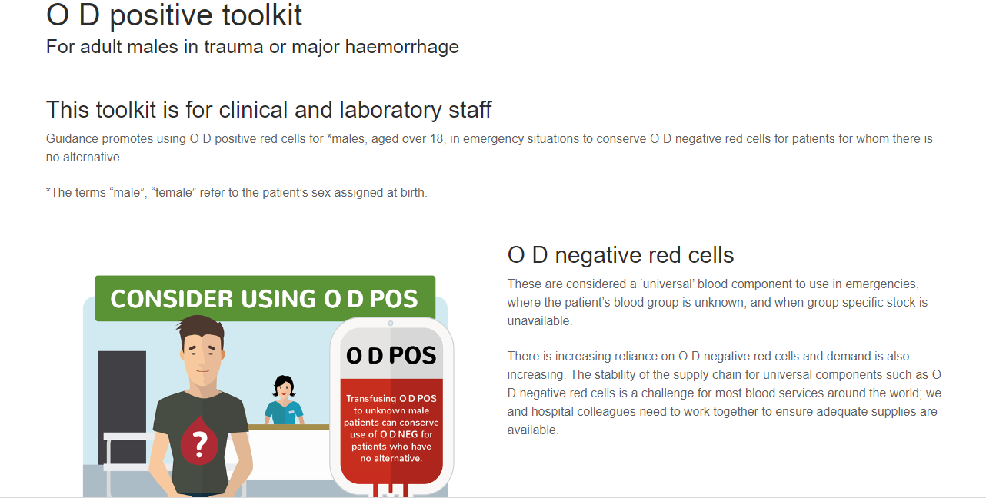

Slide 24
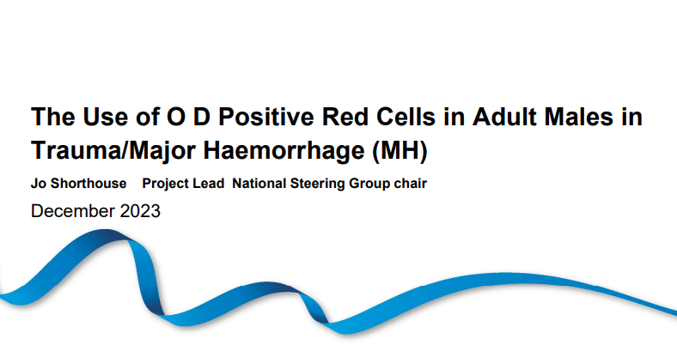

Slide 25
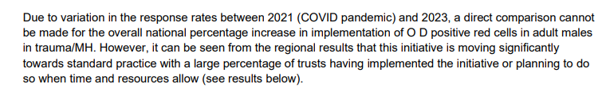
The North East and Yorkshire RTC region has achieved 100% implementation, London region 64% (82% response rate) The Midlands 71%, North West 67% (75% response rate) South East 82% and South West 93% implementation.

Slide 26
Example of good practice
St George’s University Hospitals, Southwest London. Population 1.3 million across 1100 beds. Tertiary services: cardiothoracic medicine and surgery, neurosciences and renal transplantation are provided to around 3.5 million people. St George’s is one of four major trauma centres in London, with trauma patients delivered to their helipad on a daily basis.
Despite this profile, an average of only 6.4% of the red cell units requested by St George’s are O D negative. They have managed this through a number of interventions including:
  minimising stock levels of group O D negative units (20 held in blood bank; 6 in ED; 2 in each of three satellite fridges);
  satellite fridge in ED Resus is stocked with 6 units of O D positive and 6 units of O D negative in colour coded boxes (blue for O D positive; pink for O D negative) for use in unknown trauma cases. Use of O D positive for male patients is audited;
  when the transfusion laboratory is notified of a major haemorrhage in a male patient, O D positive units are issued from the outset.

Slide 27

Evidence based research

Slide 28
Risks of transfusion in an emergency
Immediate and future harm.
A haemolytic transfusion reaction (HTR) can occur in association with the index transfusion (acute or delayed) due to pre-existing antibodies.
Future transfusions can be complicated by an HTR due to antibody formation from the emergency resuscitation.
Alloimmunisation in females of child bearing potential can result in Haemolytic Disease of the Fetus & Newborn HDFN (mainly due to anti-D, c, K antibodies).

Slide 29
Acute HTR post emergency transfusion of uncross-matched RBC
A Canadian group (Fiorellino et al., 2018) reported on a male stabbing victim who received three units of uncross-matched RBC complicated by acute HTR, DIC and renal failure.
A literature review by the authors of 14 studies (3398 patients evaluated who received almost 12000 units of uncross-matched blood) evaluating the frequency of acute HTR post-emergency transfusion of uncross-matched RBC concluded that the risk is very small. The authors found the following:
  3.7% of recipients had detectable RBC-reactive alloantibodies in their pre-transfusion sample
  Only 0.6% i.e. less than 1 in 100 recipients received one or more incompatible RBC as a consequence of transfusion with uncross-matched units.
  The overall probability of a patient developing an acute HTR, with or without consequence, was only 0.06 % i.e. less than 1 in 1000 RBC recipients, receiving uncross-matched RBC in an emergency setting.

Slide 30
Studies evaluating the emergency transfusion of group O D positive RBC to patients with unknown blood group or known D negative blood group.
Concern about alloimmunisation & HDFN in females of child bearing potential depends in part on the rate of RhD alloimmunisation
Alloimmunisation rate has been evaluated in several previous studies of trauma, surgery, and/or general hospitalised patients and has been found to range between approximately 11%–50% (Table from Yazer et al., 2021).
There is significant heterogeneity in the design of these retrospective studies, including the nature of the patients studied and the method by which the alloimmunisation rate was calculated.

Slide 31
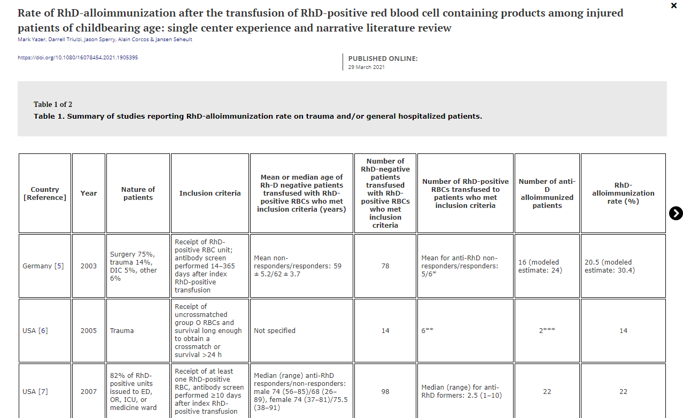

Slide 32
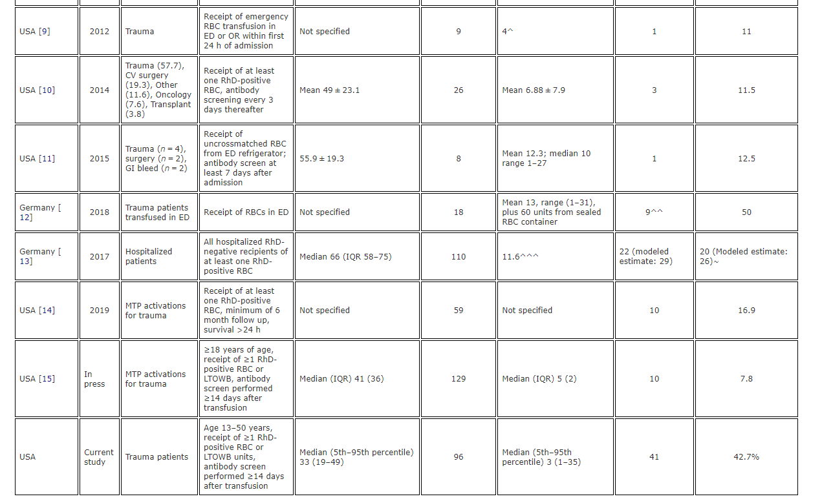

Slide 33
Rate of RhD-alloimmunization after the transfusion of RhD-positive red blood cell containing products among injured patients of childbearing age: single center experience and narrative literature review (Hematology; Yazer et al, 2021)
Over a 20-year period, 96 study-eligible patients, 93.8% male.
Overall, 41/96 (42.7%) of these patients became alloimmunized after receipt of a median of 3 units of RhD-positive RBC and/or LTOWB. The rate of RhD-alloimmunization in this study was at the higher end of rates that have been reported. None of the previous studies focused exclusively on trauma patients in the childbearing age range

Slide 34
Emergency transfusion of patients with unknown blood type with blood group O Rhesus D positive red blood cell concentrates: a prospective, single-centre, observational study (Lancet Haematology; Selleng et al, 2017).
This study, done between 1st Jan 2001, and 31st Dec 2015, assessed all consecutive RhD- patients at the University Medicine Greifswald who received RhD+ red blood cell concentrates (emergency patients with unknown blood type; and RhD- patients receiving RhD+ red blood cell concentrates during RhD- red blood cell concentrate shortages). The primary endpoint was anti-D allo-immunisation at 2 months follow-up or later
This study concluded that transfusing emergency patients with unknown blood type with O RhD+ red blood cell concentrates has a low risk of inducing anti-D antibodies (3-6%), but saves more than 10% of the total O RhD- red blood cell concentrate demand.

Slide 35
Unmatched Type O RhD+ Red Blood Cells in Multiple Injured Patients (Transfusion Medicine Hemotherapy; Flommersfeld et al, 2018)
823 patients
No adverse outcome due to incompatible transfusion was observed.
The decision to provide RhD+ (instead of RhD-) RBC in the ER was initially based on the fact that 85% of all patients are expected to be RhD+; and 66% are expected to be male, indicating that the majority of multiple injured patients is at low risk for RhD immunization and/or long-term effects associated with such an immunization (e.g., pregnancy).

Slide 36
Helicopter Emergency Medical Services (HEMS)
A recent study (Cardigan et al., 2022) estimated the risks of prehospital transfusion of D-positive whole blood to trauma patients who were bleeding in England. Transfusion of low-titre group O whole blood (LTOWB) prehospital is gaining interest
A universal policy change to the use of D positive LTOWB across England was modelled in terms of risk of three specific harms occurring: risk of haemolytic transfusion reaction now or in the future, and the risk of HDFN in future pregnancies for all recipients or D negative females of child bearing potential.
In general, the risks of acute or future HTR and HDFN are low, especially when compared to the benefits of providing transfusions early in the resuscitation.

Slide 37


Slide 38
The guidelines and audit recommendations are clear and consistent. O D positive RBC should be used in emergencies for adult males and females of non-childbearing potential
This practice is shown to be safe
Working together to the best practice guidelines will protect the supply chain and conserve adequate stock when patients need it.

Slide 39


Slide 40
The NI Blood Transfusion Specialty Forum recommends that due consideration is given to implementing the use of O D positive regionally in these two groups.
This applies to patients with both unknown blood groups and known D negative patients with no known anti-D.
Emergency settings include the Accident & Emergency Departments and all Massive Transfusion Protocols across the trusts.
O D positive should be given upfront in these emergency settings i.e. no initial use of O D negative, regardless of regional stock levels.

Slide 41
This recommended regional policy, alongside the other measures to conserve O D negative, should be supported with the use of a structured implementation plan, including education toolkits like in NHSBT.
NIBTS, NITC, & Hospital Transfusion Committees will be required to continue to work together to successfully implement this policy across NI.
Audits and regular MTP drills will reinforce the use of emergency O D positive in these patients.
The NI data clearly sets out the significant savings to be made in O D negative RBC with this policy, and so ensuring this precious resource is available for those patients who need it.

Slide 42
