Slide 1
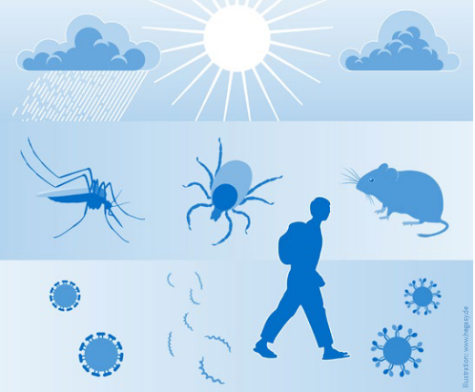
Emerging infections and climate change – influence on blood safety
Ruth Offergeld, Robert Koch Institute, Berlin, Germany
National Haemovigilance Office (NHO) Conference 2025
Dublin, March 25, 2025

Slide 2
Conflicts of interest
None

Slide 3
SoHO-relevant emerging pathogens (selection)
Pathogen | Main vector/transmission mode | Host/Reservoir
West-Nile-Virus | Culex | Birds
Denguevirus | Aedes spp | Humans, Apes
Zikavirus | Aedes spp | Humans
Chikungunyavirus | Aedes spp | Rodent, Apes, (Humans)
Krim-Kongo-Virus | Hyalomma | Livestock
Babesiosis | Ixodidae | Vertebrates, including Humans
Trypanosoma cruzi | Triatominae | Vertebrates, including Humans
Malaria | Anopheles | Humans, Apes
Mpox-Virus | Direct contact | Vertebrates (small mammals)
Marburg-Virus | Direct contact | Fruit bats

Slide 4
SoHO-relevant emerging pathogens (selection)
Pathogen | Main vector/transmission mode | Host/Reservoir
West-Nile-Virus | Culex | Birds
Denguevirus | Aedes spp | Humans, Apes
Zikavirus | Aedes spp | Humans
Chikungunyavirus | Aedes spp | Rodent, Apes, (Humans)
Krim-Kongo-Virus | Hyalomma | Livestock
Babesiosis | Ixodidae | Vertebrates, including Humans
Trypanosoma cruzi | Triatominae | Vertebrates, including Humans
Malaria | Anopheles | Humans, Apes
Mpox-Virus | Direct contact | Vertebrates (small mammals)
Marburg-Virus | Direct contact | Fruit bats

Slide 5
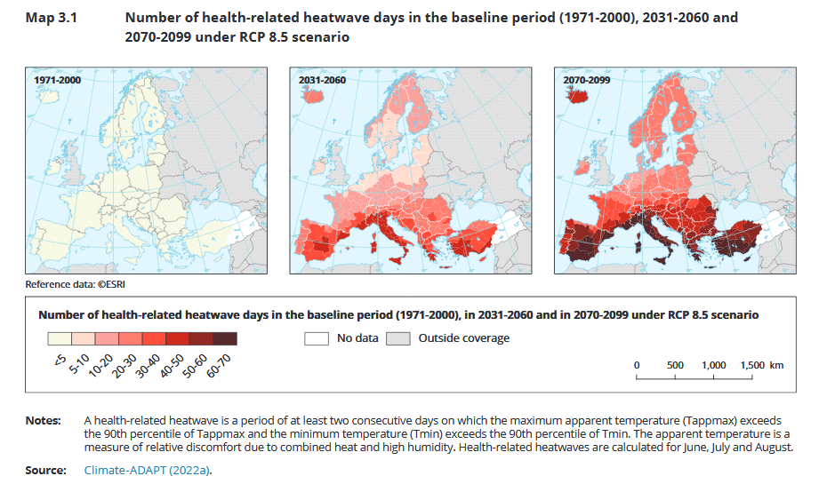
Climate change

Slide 6
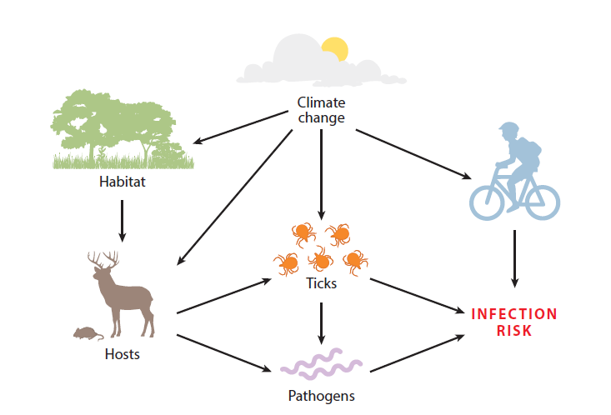

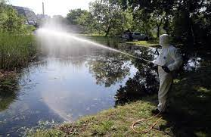
Context
Precipitation
Source: Stuttgarter Zeitung
Vectors
Vector control
Source: Ungarn heute
Modified from Gilbert, Ann Rev Entomol, 2021

Slide 7
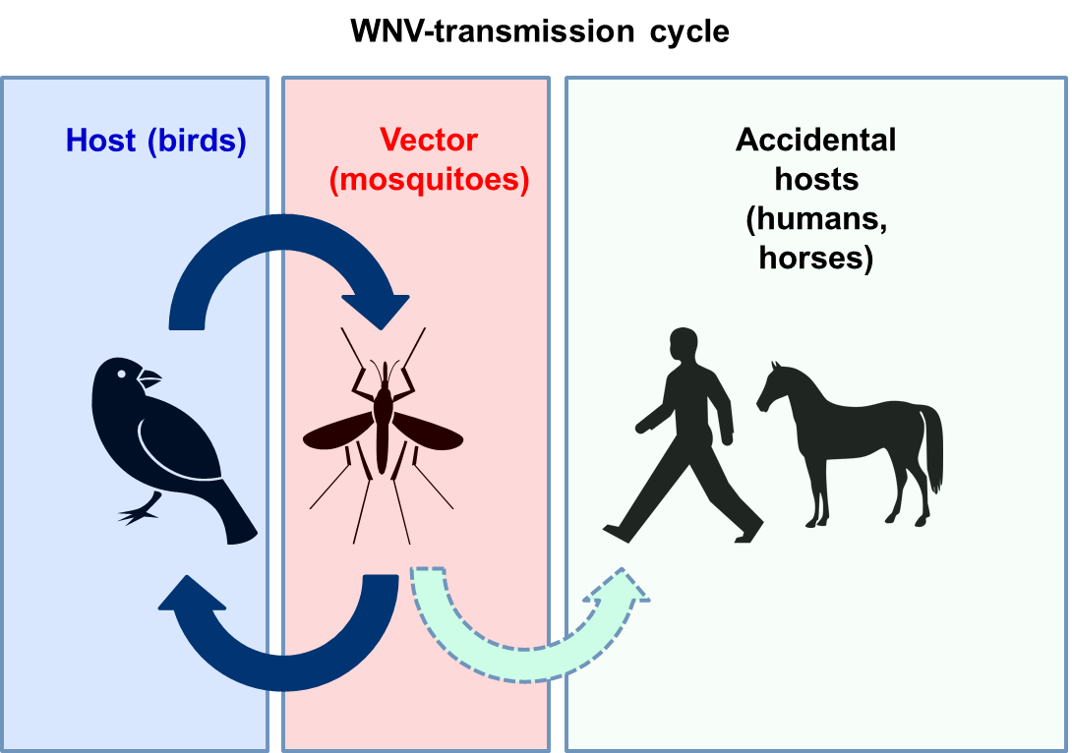
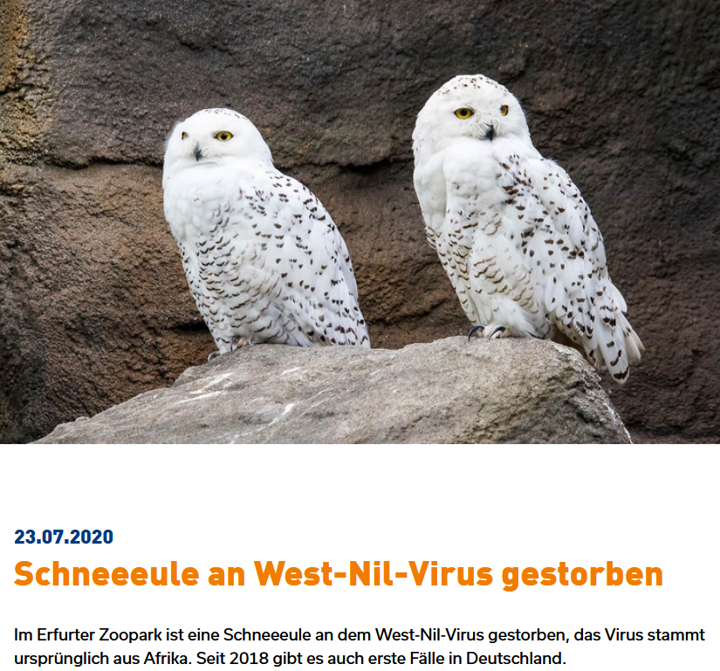
West-Nile-Virus
WNV = Flavivirus
Main vector: Culex spp.
Birds are amplifying hosts, high fatality in some species
Mammals including equines and humans are dead-end-hosts = low level viraemia
Humans: 80% asymptomatic, 19% WNF, 1% WNND
Transmission via SoHO well documented with adverse outcome
Offergeld et al., Hämotherapie 2022

Slide 8
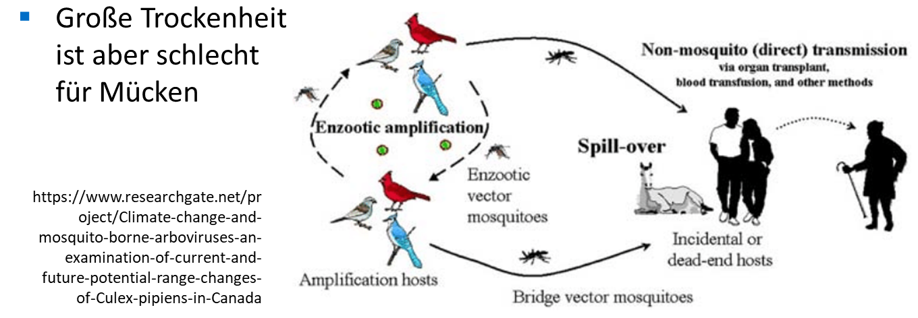
WNV and climate change
Main vector (Culex) established in Germany
Population densitity depends on weather conditions
Ecologically favoured regions (Wetlands)
Continuous warm temperatures shorten incubation period of the virus in the mosquitoe and prolong transmission season

Slide 9
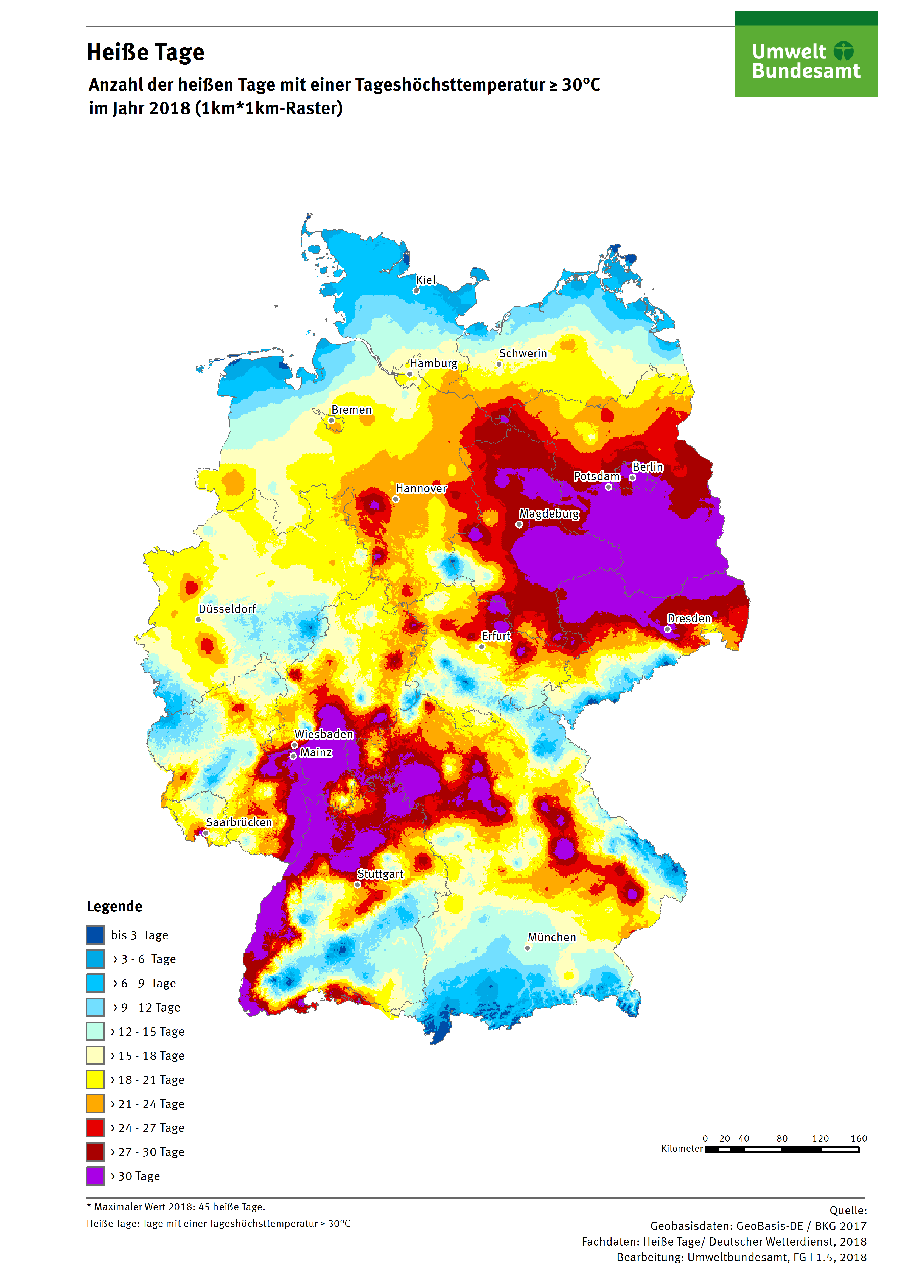
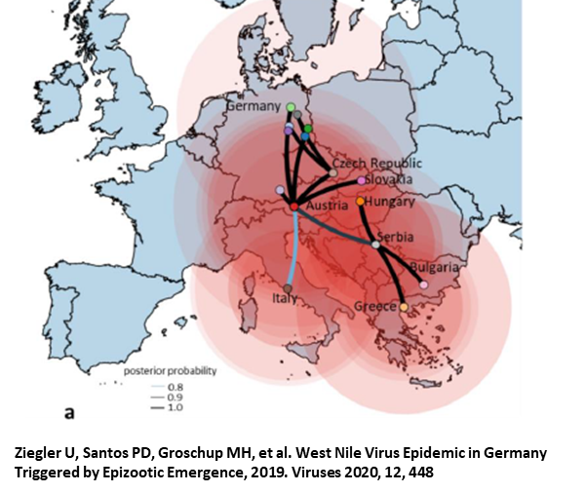
WNV in Germany 2024
WNV was first detected in Germany in 2018 after an unusually hot summer in the east
Local human infections since 2019
10-50 human cases identified each year, mid-July-October
Slow spread towards northern/western parts of Germany
Blood donor screening started 2020
Most infections identified in (asymptomatic) blood donors
No transmissions via SoHO in Germany reported to date
https://www.fli.de/de/aktuelles/tierseuchengeschehen/west-nil-virus/ and RKI data

Slide 10
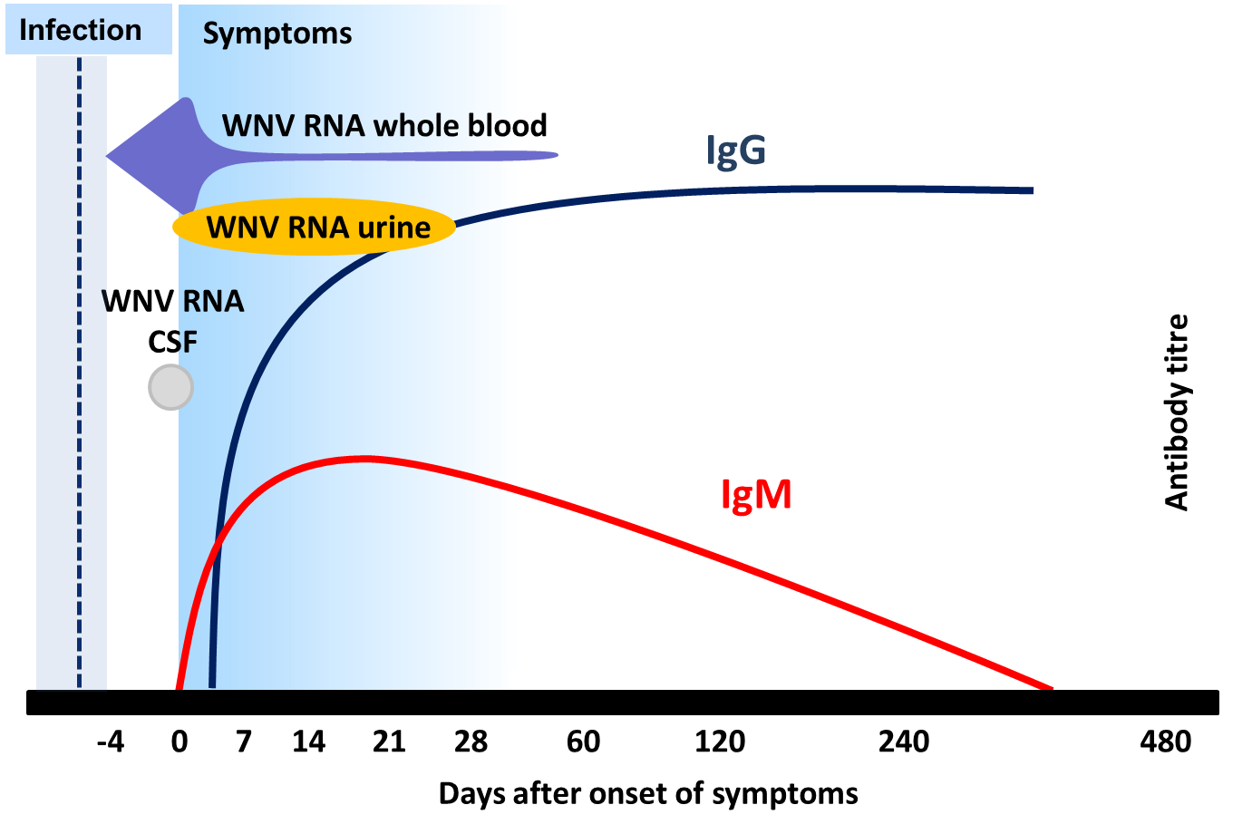
WNV markers of infection
Offergeld et al. Hämotherapie 2022

Slide 11
WNV testing
 | Clinical case | Blood donor
Initial test | NAT (plasma, whole blood, urine, CSF) WNV-IgM | WNV-NAT (LoD: 120 copies/mL relating to the single donation)
Confirmation/follow up | WNV IgG titre increase WNV IgM titre increase Specific NAT for WNV and USUV, respectively Next generation sequencing | Specific NAT for WNV and USUV, respectively Next generation sequencing
CSF: cerebrospinal fluid

Slide 12
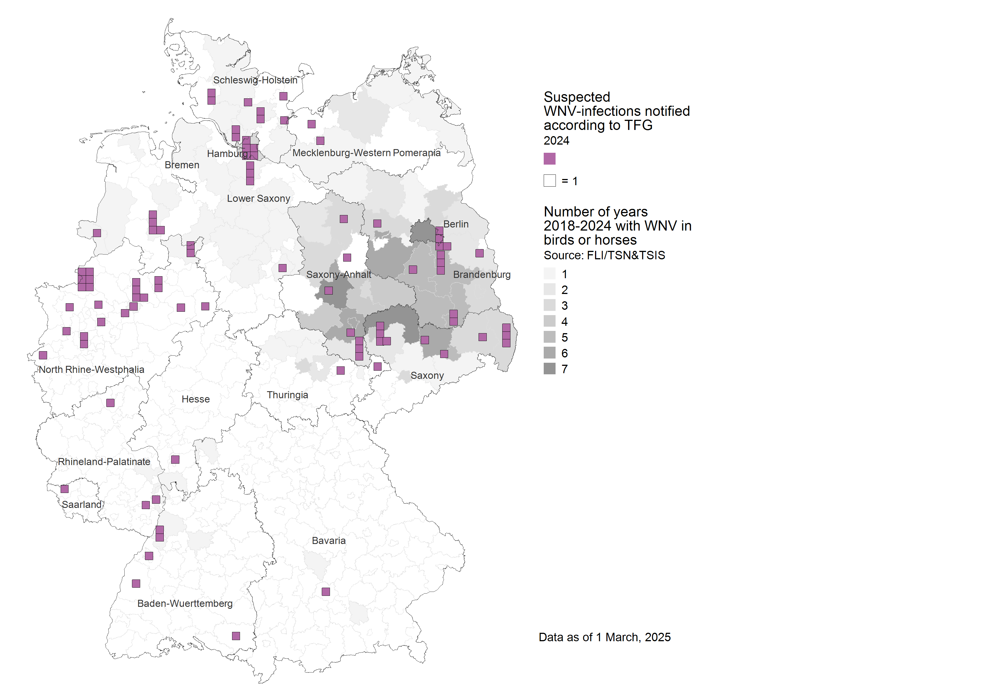
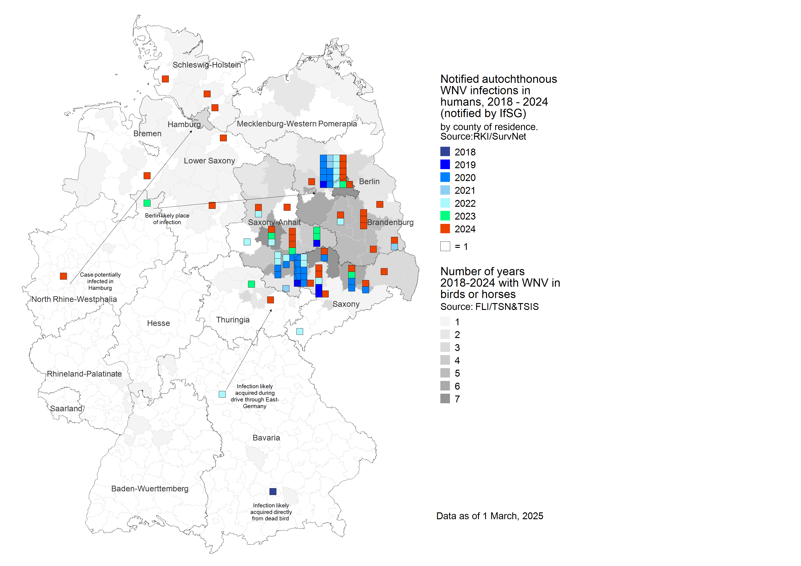
WNV 2024

Slide 13
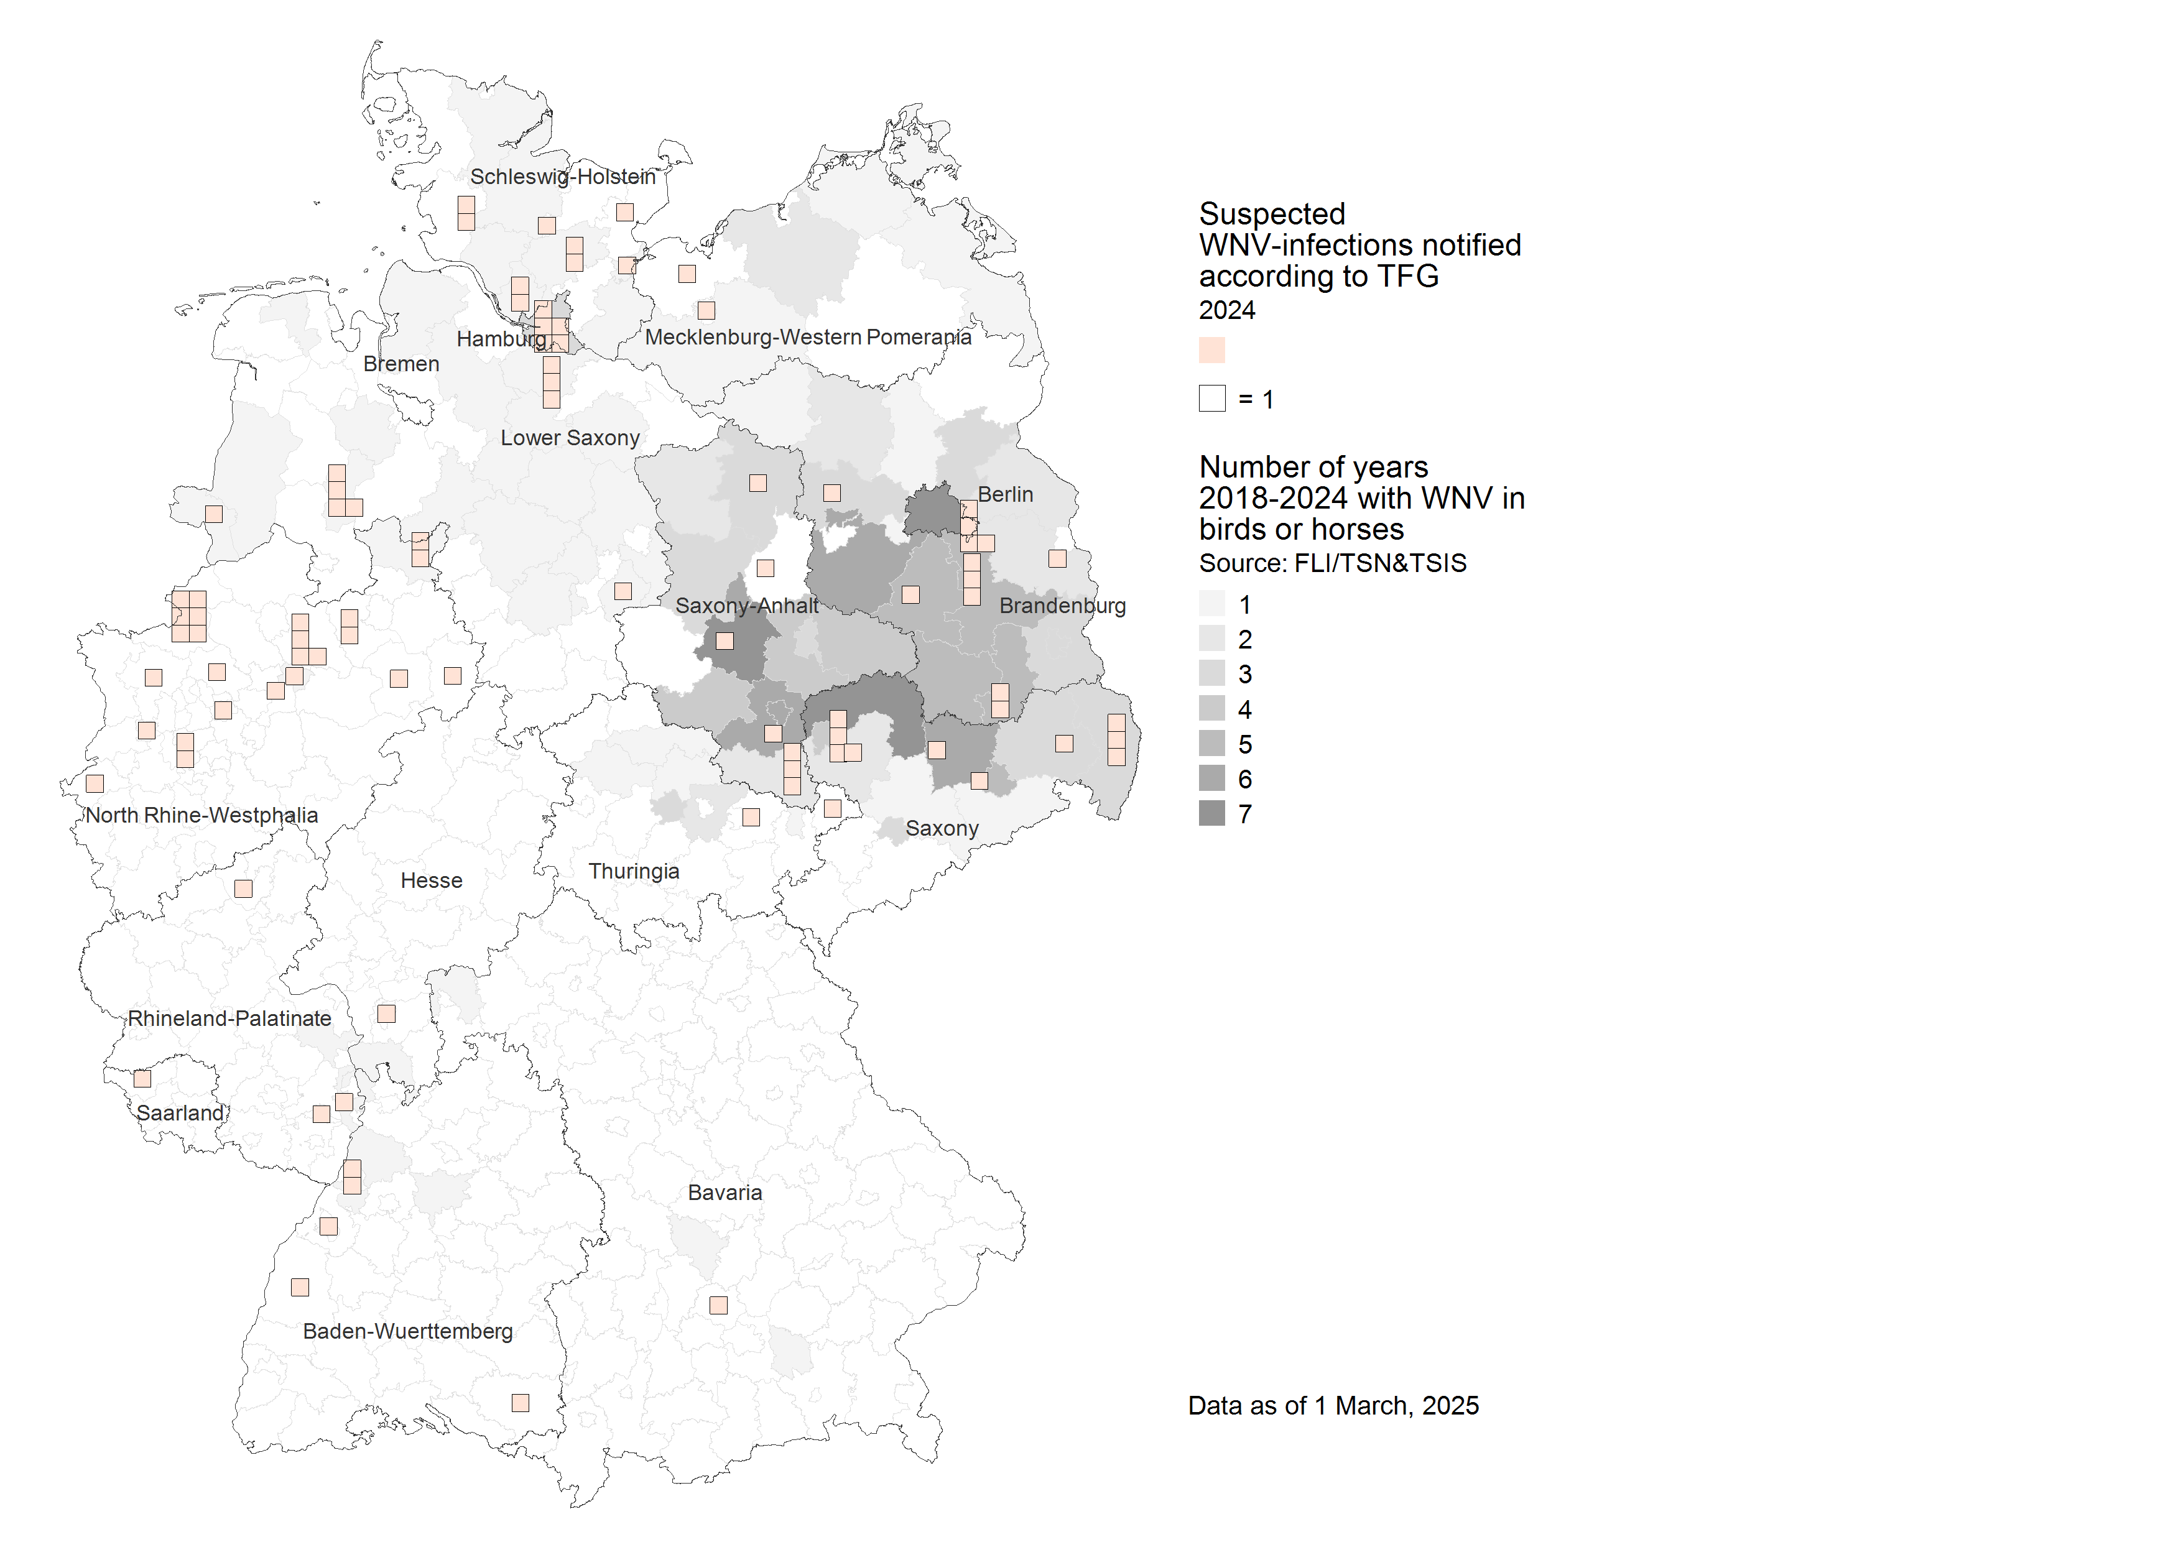
WNV testing in blood donors 2024
2.3 million donations tested
92 initially reactive blood donations
32 WNV (35%)
18 USUV (20%)
27 no virus detected (29%)
15 inconsistent results (16%)

Slide 14
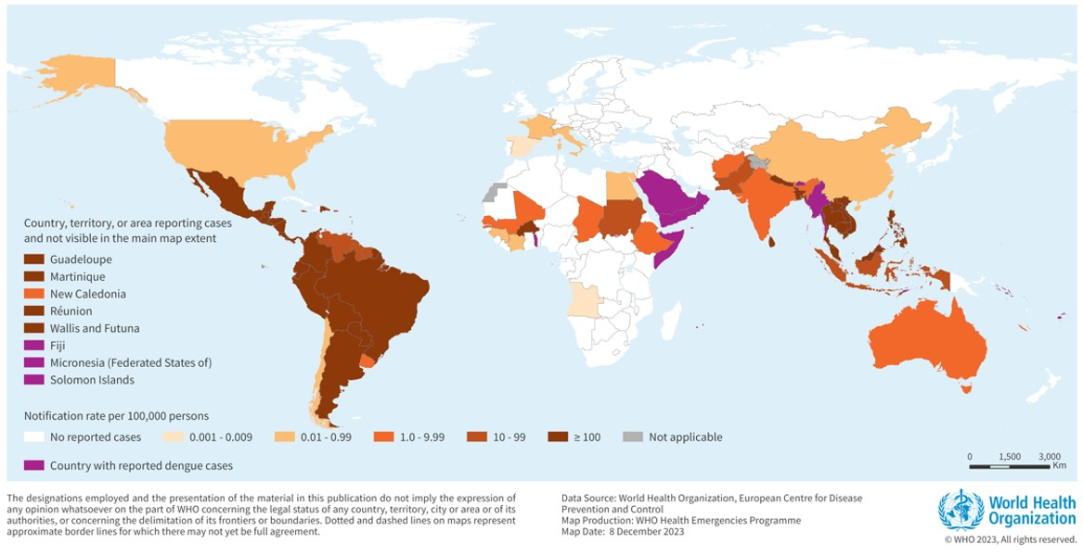
Dengue-Virus
DENV = Flavivirus
Main vector: Aedes aegypti (Aedes albopictus)
90% asymptomatic or with mild symptoms, 10% severe symptoms, haemorrhagic fever possible after infection with a different serotype
Transmission via SoHO occasionally documented with adverse outcome
Countries/territories/areas reporting autochthonous dengue cases (November 2022- November 2023)

Slide 15
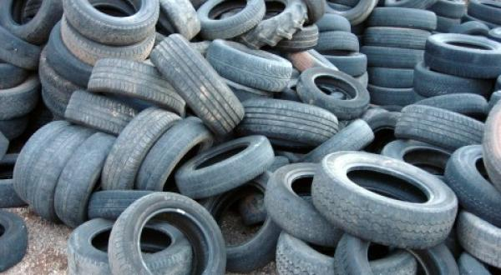
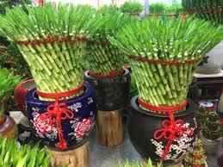
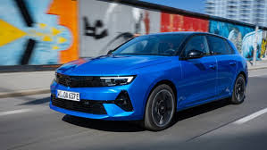
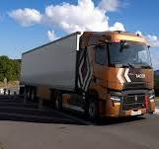
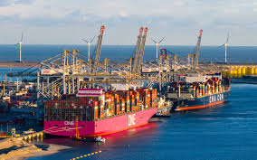

Vector travelling

Slide 16
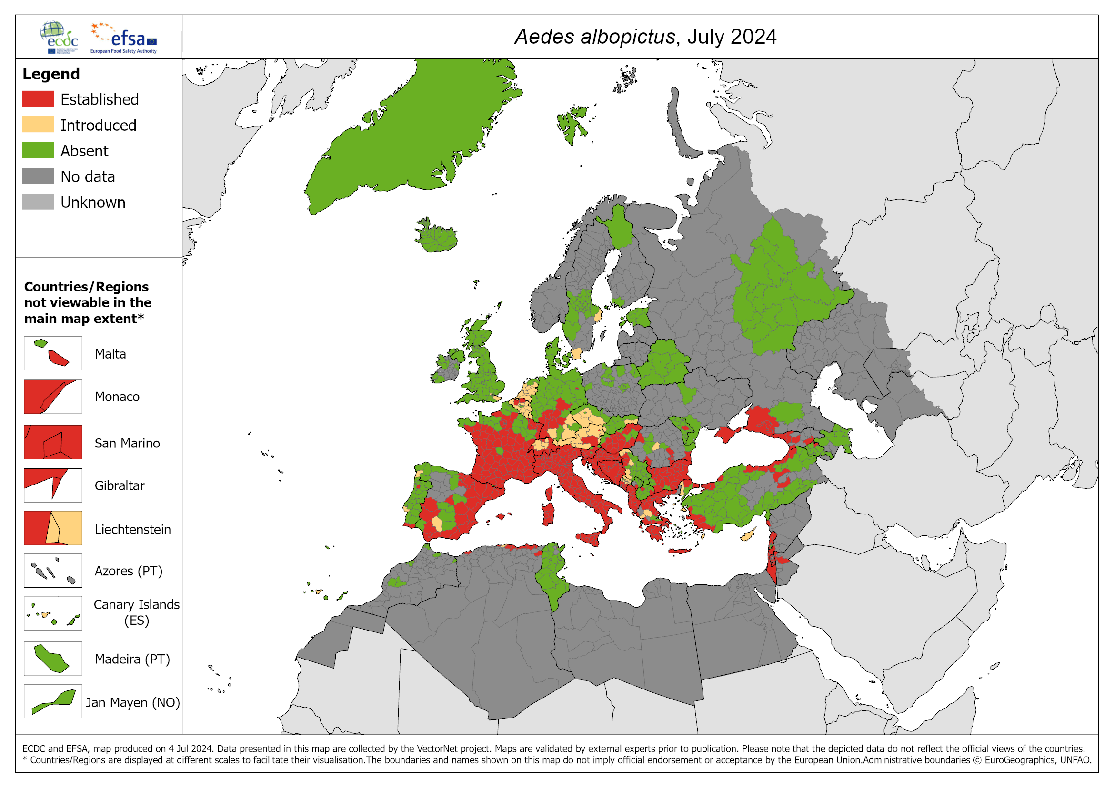
Aedes albopictus current distribution
Competent vector for
Denguevirus
Chikungunyavirus
Zikavirus
…

Slide 17
Aedes albopictus in the UK
Eggs and larvae of Aedes albopictus found in traps in 2016 and 2024 in southern England at international truck stops
Systemic mosquitoe surveillance in place
Countermeasures were taken
https://www.ecdc.europa.eu/en/publications-data/aedes-albopictus-current-known-distribution-july-2024

Slide 18
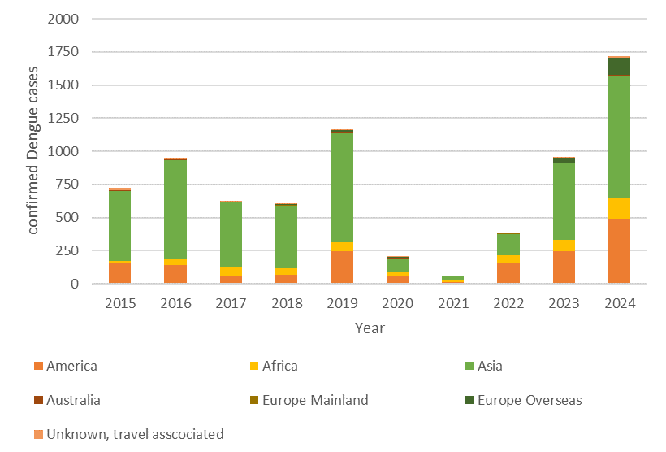
Dengue in Germany 2015-2024

Slide 19
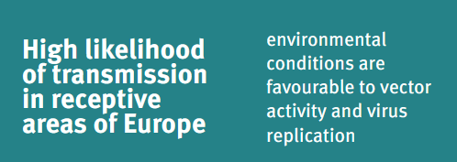
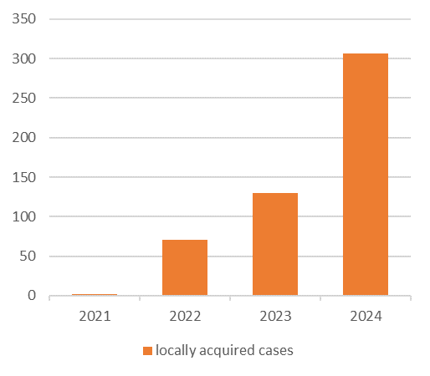
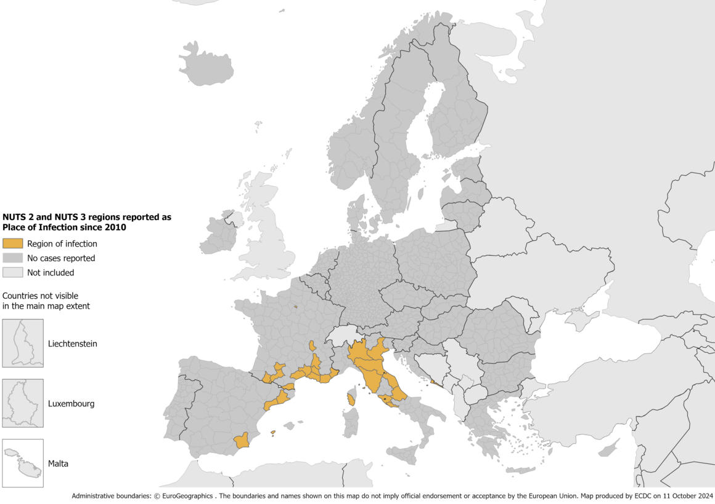
Dengue in Europe
ECDC:

Slide 20
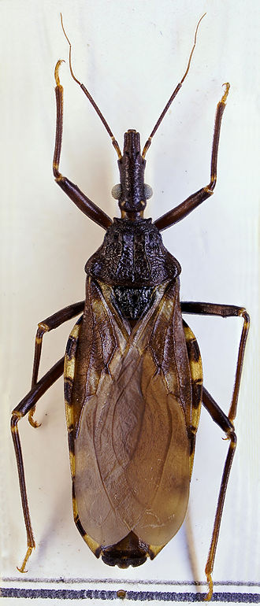
Chagas-disease
Pathogen: Trypanosoma cruzi
Endemic regions currently Latin America and southern USA
Main vector: Triatoma spp. (kissing bug)
Many vertebrates are hosts
Initially swelling, fever, unspecific symptoms, then asymptomatic phase, late stages cardiomyopathy, bowel disorders, neurological symptoms
Transmission via SoHO documented with adverse outcome
Triatoma infestans
Source: Wikipedia

Slide 21
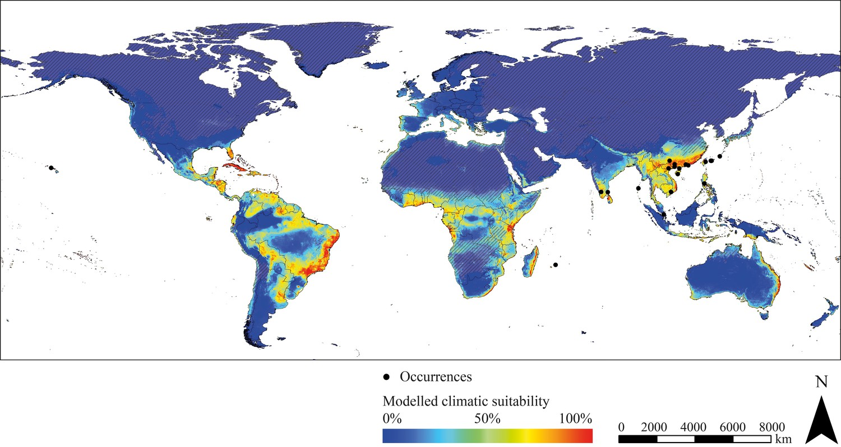
Risk for vector endemicity (Triatoma rubrifasciata)
Favourable conditions in coastal regions of Italy Portugal, Spain, France, Greece, Albania, Croatia and Southern England and Ireland
Likelyhood of import?
Fanny E Eberhard, Sarah Cunze, Judith Kochmann, Sven Klimpel
Modelling the climatic suitability of
Chagas disease vectors on a global scale.
eLife 2020;9:e52072. DOI: https://doi.org/10.7554/eLife.52072

Slide 22
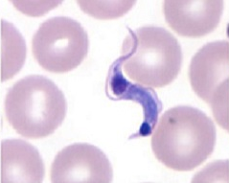
Potential carriers of T. cruzi
In Germany, roughly 170.000 residents have either migrated from potential endemic regions or are offsprings from female migrants (2nd generation).
Additionally, >1.3 million flight passengers per year from Germany to endemic regions
Source: © Statistisches Bundesamt (Destatis), 2023
Trypanosoma cruzi Trypomastigot in blood, Source: CDC

Slide 23
Characteristics of SoHO-relevant pathogens
 | Asymptomatic carriers | Local cases in Germany | Vector endemic | Infected animal hosts | Vacci nation
WNV | + | + | + | + | -
Dengue | + | - | (+) | n.a. | (+)
Chagas | + | - | - | - | -

Slide 24
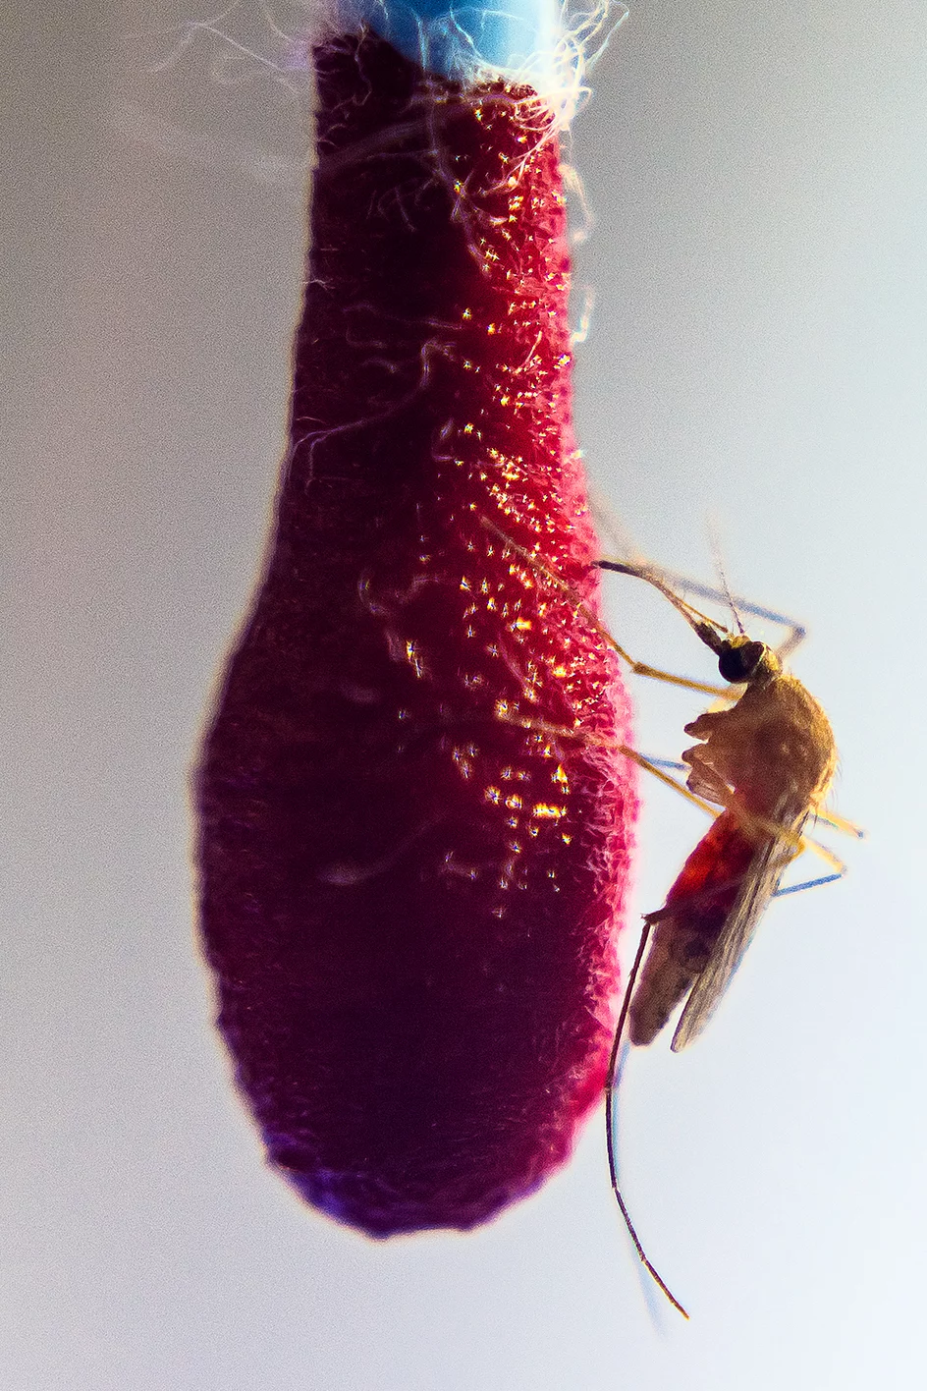
How to maintain blood (and SoHO) safety
Abundant experience with relevant pathogens
Testing strategies well established
New screening tests (NAT) can be developed quickly
Donor selection criteria can be modified
Pathogen inactivation
Common house mosquito (Culex pipiens) feeding in the S3-Insektarium at the BNITM Source: BNITM

Slide 25
What does it need?
Effective Surveillance/ vigilance
One-Health-Aproach
Timely communication and cooperation between SoHO establishments and authorities

Slide 26
Conclusions
The risk for relevant emerging pathogens is increasing esepcially due to climate change/global warming and worlwide travelling
The impact depends on various additional factors
Donor selection, testing for pathogens and – where applicable – pathogen inactivation are important to avoid transmissions
Intensified surveillance of emerging pathogens in animals and humans (one health approach) and close cooperation between authorities and SoHO entities are essential to ensure product safety
26

Slide 27
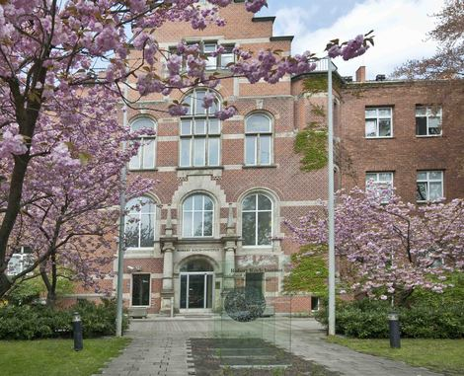
Thanks to
Karina Preußel
Christina Frank
Raskit Lachmann
Thank you for your attention!
www.rki.de
epiblut@rki.de

