Slide 1
Haemovigilance in Norway
Dublin October 3rd, 2023
Øystein Flesland, MD, PhD

Slide 2
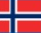
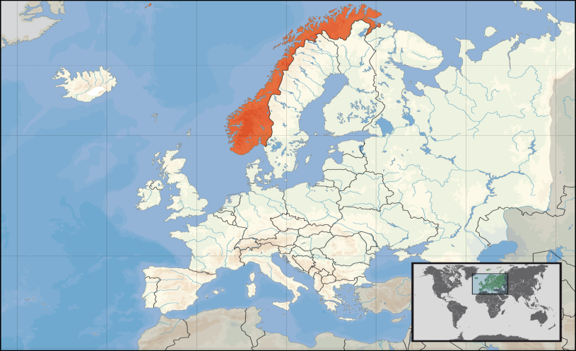
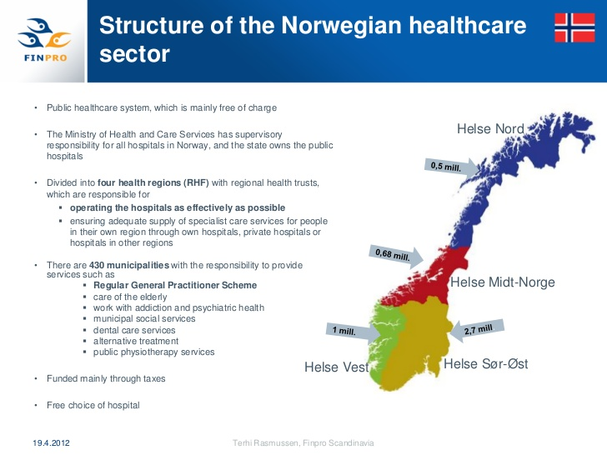
Norway
E
Population: 5,5 million
4 «Health regions»
33 hospital-based blood banks (hospital departments)
73 donation sites
250 000 blood components transfused/year
500 haemovigilance reports
Notes:
No centralised transfusion service
Each blood bank is responsible for recruiting donors, donations, testing production of components, pretransfusion testing and issuing blood.
All hospitals are owned by the government.

Slide 3
Haemovigilance in Norway
2004
  Professional need
    What are the real risks?
  Inspiration
    SHOT
    EHN/IHN
    DART
Start in 2004
  Voluntary
  Donors and patients
  Profession based
  Non-punitive
  Anonymous
2007
  EU-directive
  Compulsory
  Donors, patients and events
  Based on the voluntary system
  Non-punitive and anonymous
2016
  Norwegian Directorate of Health
    More difficult to give advice
Notes:
From 2007 – in practice the same system run by the same people. Financed by the government.
Norwegian Knowledge Centre for the Health Services

Slide 4
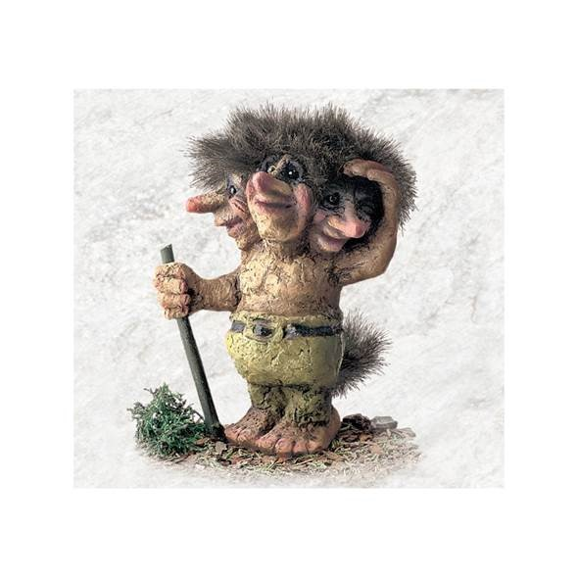
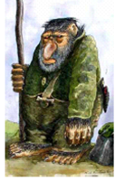
TROLL
Notes:
From the start we called the system TROLL. It is not an acronym, but when the sun shines on a troll, it explodes.
Similarly, when haemovigilance show what the risks are, they can be dealt with, and removed.

Slide 5
Data collection
One contact person in each hospital.
Reports often sent by the contact person, but in some blood banks anybody can send a report.
Identity of donor, patient (only sex and age group) and staff involved is not reported.
Information can be added to a report at a later stage.
Description of the case in free text in one field only.
Patients and relatives cannot report.
All reports are read, and quality checked, by a specialist in transfusion medicine.
Serious reports are flagged and read within 24 hours.
All data stored in a data base for further analysis.
Additional communication with the reporter and discussions in the haemovigilance group is documented.
Notes:
Liberal view on what is serious. After some time more restrictive for febrile, non haemolytic transfusion reactions and mild vasovagal reactions

Slide 6
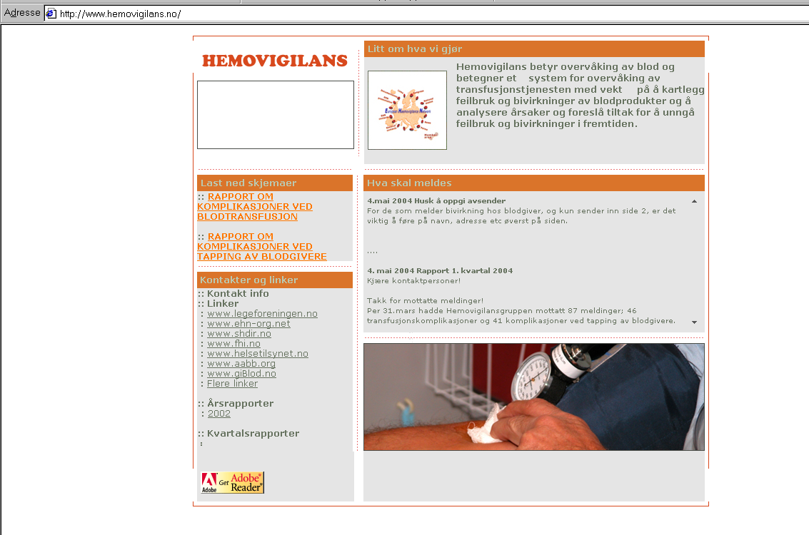
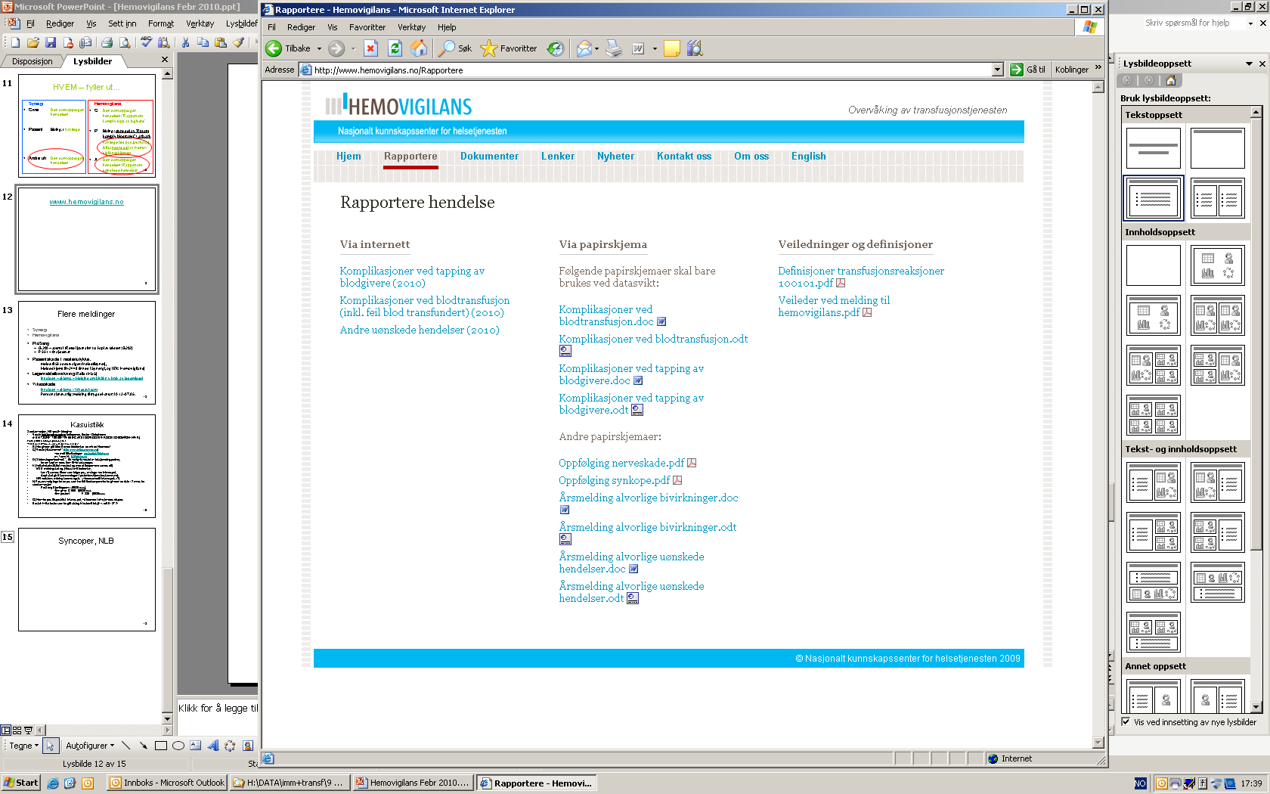
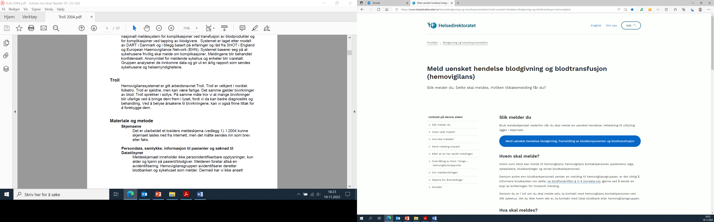
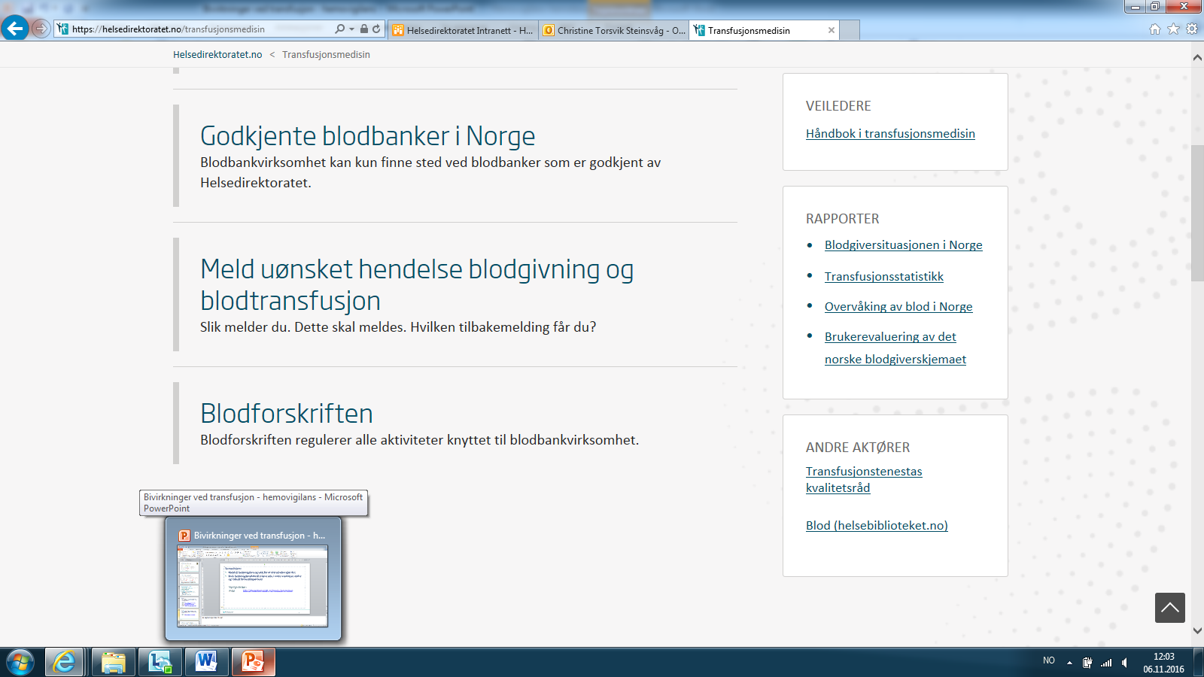
2009
2004
2016
2021 www.melde.no

Slide 7
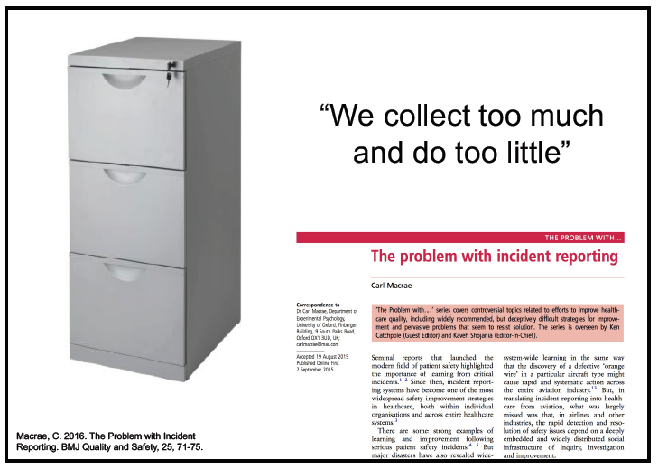

Data
Only collect data that can be used for improvement.
“Keep it simple”.
Use data to check that improvement efforts actually led to improvement.
Notes:
Eg: We started collecting data on the indication for transfusion, but we wanted to much data and ended up with useless information
Detailed information without good background date is not much help.
Eg that a transfusion took place in a medical department, but we do not know how many transfusions do take place in medical departments

Slide 8
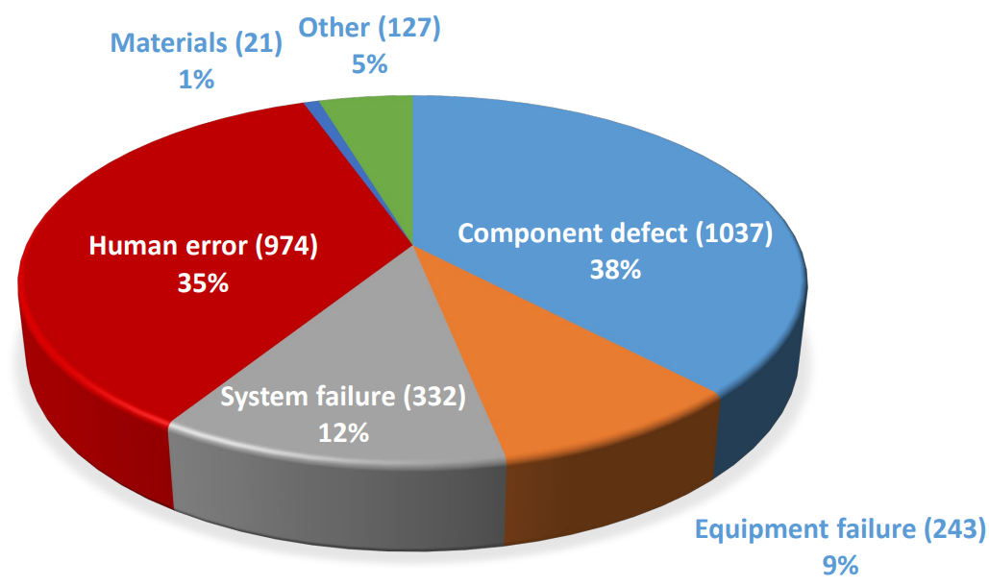
Classification
SARE Reporting for Blood and Blood Components. 2021 data
Same national classification as used in hospitals for their R&L systems
Location
One type of event
Contributing factors. Here we welcome many (RCA²)
  Human error is not a valid classification.
  Failure to adhere to policy and procedure is.
    Why?
Preventability
Outcome in this case
(Worst) possible outcome in similar cases
Frequency of similar events in your blood bank
Additional specific classification
The haemovigilance group can reclassify
Notes:
You cannot learn from classifying an event as a human error. Human errors are almost always present, but you need to look at the system causing or not preventing the human error.
One reason for asking the reporter to classify is to make them think.
RCA
Actions
The two last ones are used for risk assessments. (frequency and severity)
Up to 4 levels – process – problem
Failure to adhere to policy and procedure is 21 % in 2022

Slide 9
Classification - purposes
Facilitate data analysis
Facilitate search for similar cases
  E.g., blood components, symptoms, location
Indicate what we consider should be reported
Inspire to RCA
Inspire to Risk and vulnerability analysis

Slide 10
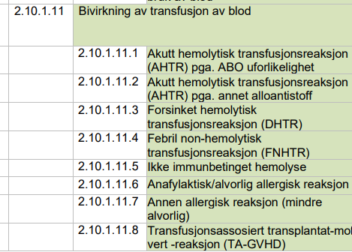
Norsk kodeverk for uønskede pasienthendelser.pdf (helsedirektoratet.no)
Notes:
2= type of event
10= Blood, cells and tissues, organs
1= blood
11= Adverse transfusion reaction
1= Type of transfusion reaction

Slide 11
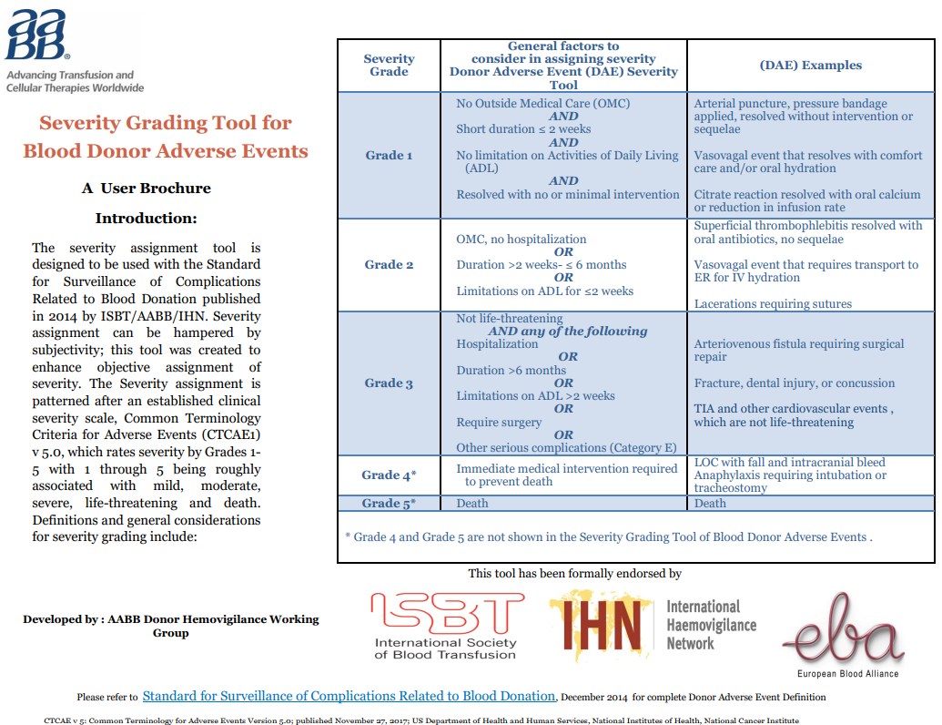
Definitions
Important for standardisation
Transfusion reactions from ISBT WP 2010
Donor complications 2014
EU Common approach
Important with international cooperation
Should not change often
Notes:
Try to use international definitions. In the beginning. Harmonize in the Nordic countries.
Continuous process.

Slide 12
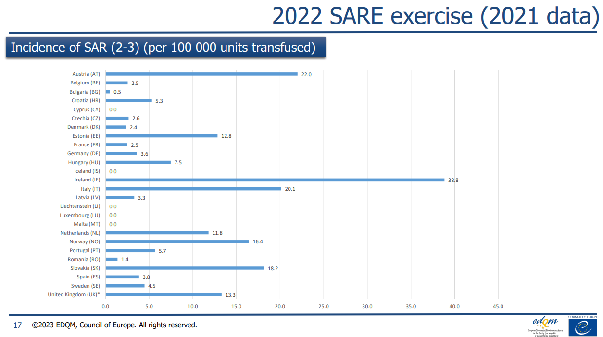
Notes:
Just to illustrate the importance and difficulty with the definitions. It is no reason in my mind to believe that these four countries really are any different.

Slide 13
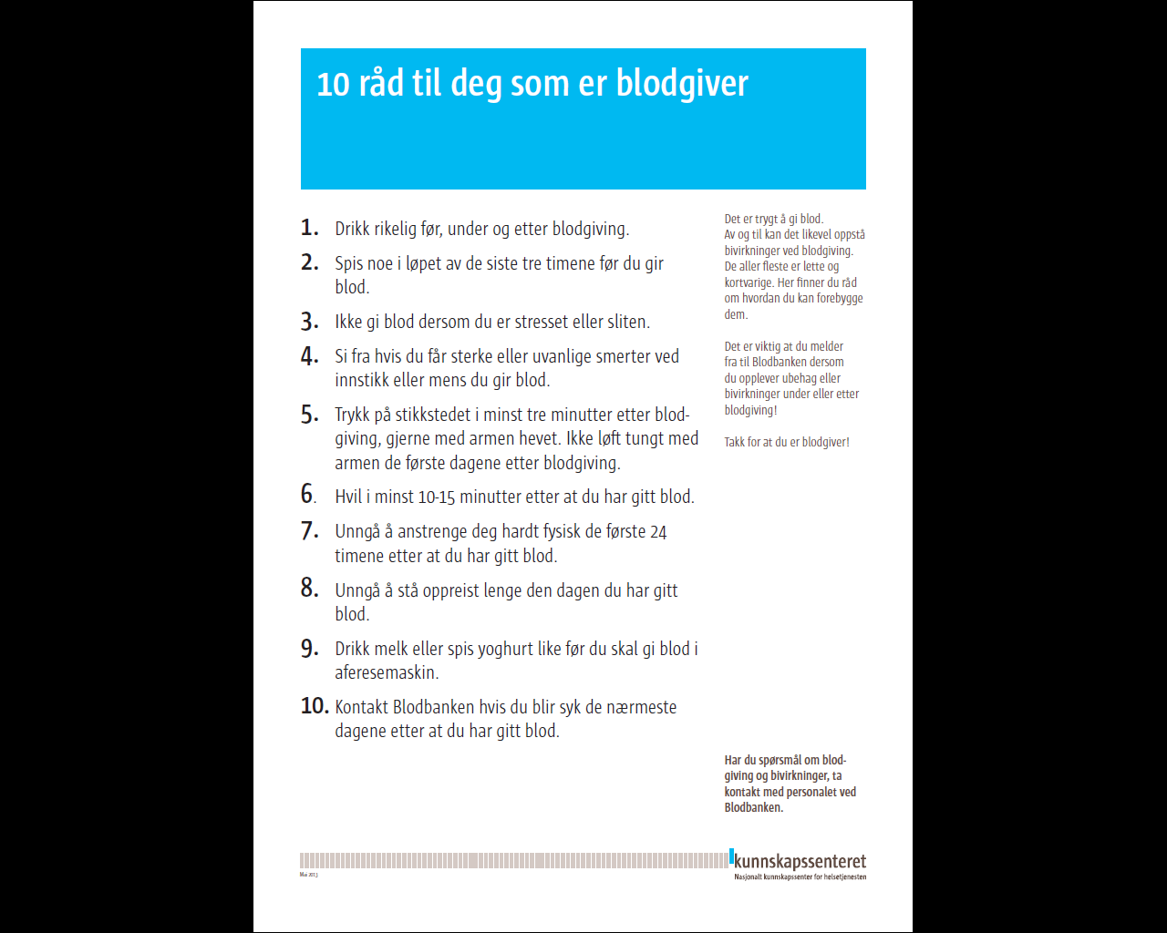
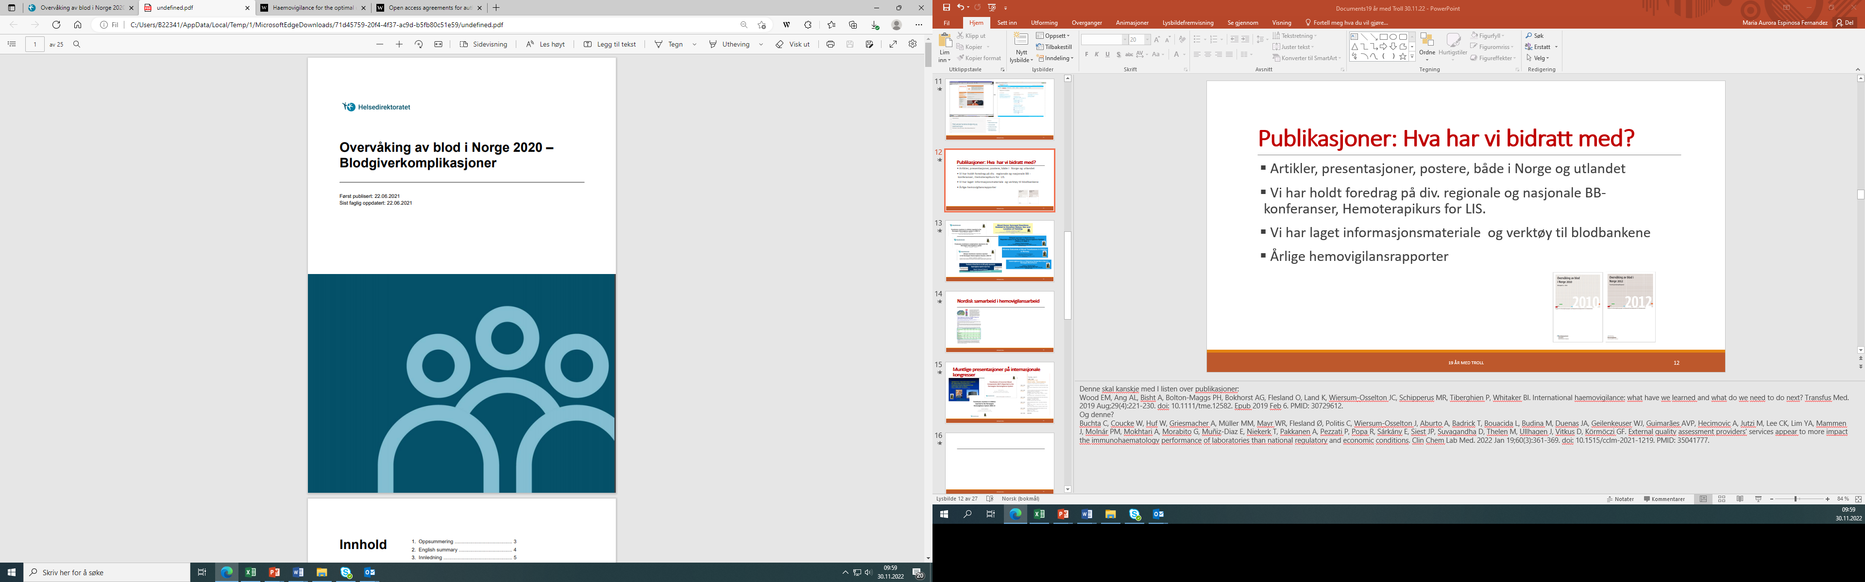
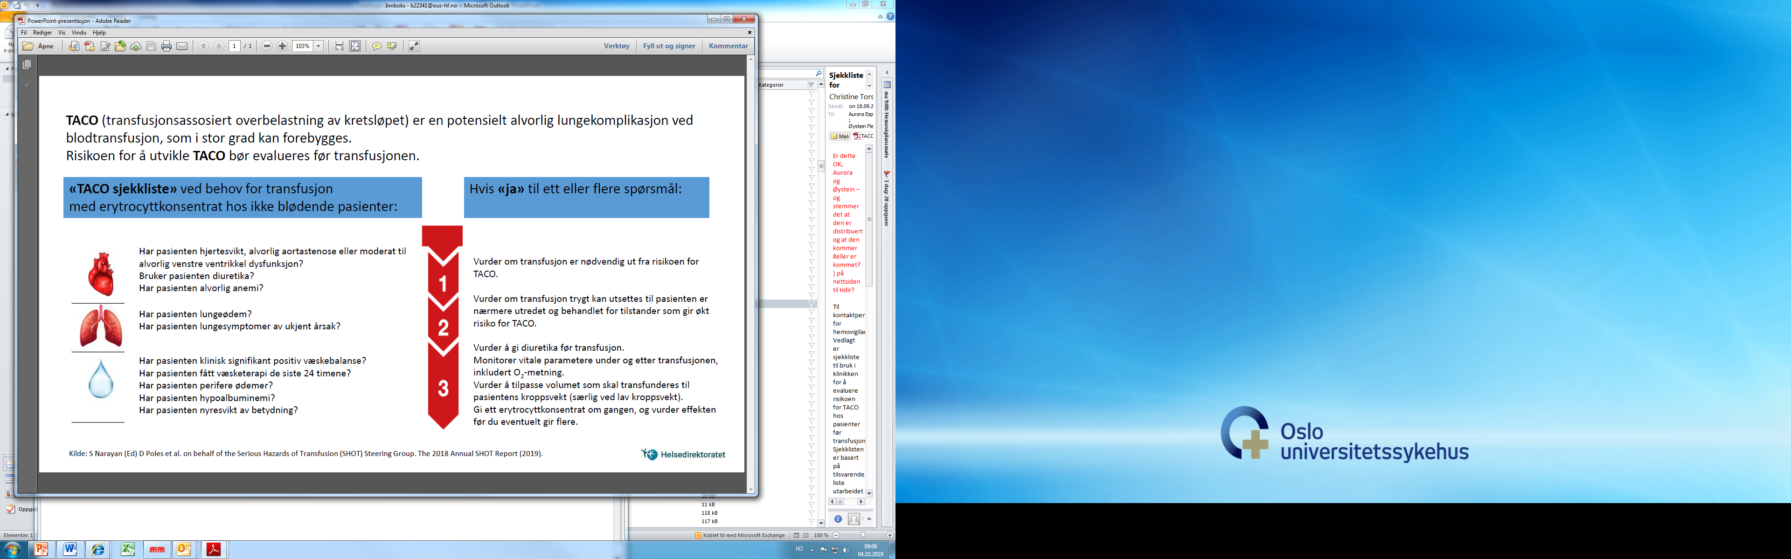
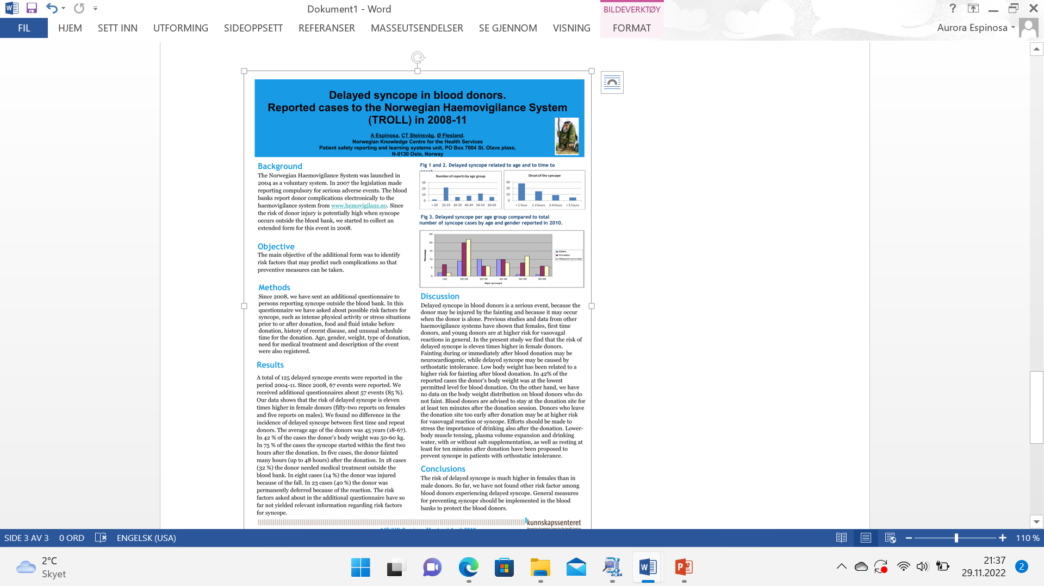
Feedback to the blood banks
Direct communication
  Additional questions
  Discussion
  Advice
Annual reports (in Norwegian, some with summary in English)
  Data
  Stories
  Making tables and figures available in PPT format
Other publications
  Scientific papers
  Oral presentations and posters at international meetings
Newsletters, checklists etc
Annual seminars
Other teaching opportunities
User surveys

Slide 14
Results
We know more about the actual risks. What they are and how frequently they occur.
It is safe to donate blood and to be transfused.
Our experiences used in other national R&L system.
We still learn from other countries.
Examples:
  TACO is a problem.
  TTIs is not a problem.
  Small women faint outside the blood bank.
  Product quality – Octaplasma is a good choice.
  Small blood banks vs. big suppliers.
  Donor selection is difficult.
  Communication
    Within the transfusion service.
    With clinical departments.
      Blood delivered too late.
  IT-systems have their own problems.

Slide 15
Basic requirements for a haemovigilance system
Canadian Patient Safety Institute
In well-functioning reporting and learning system one commonly found that:
Adverse events and near misses were analysed by an independent organization with enough competence.
Feedback to the reporter was given in a timely manner.
Suggestions on how to improve the system were given.
The health care system is open for suggestions for system improvement.
The system is nonpunitive.
Notes:
NB! Nonpunitive on a national level. Hence, should be anonymous on a national level.

Slide 16
WHO. Global Patient Safety Action Plan 2021–2030
Towards eliminating avoidable harm in health care
Guiding Principles
Engage patients and families as partners in safe care
Achieve results through collaborative working
Analyse and share data to generate learning
Translate evidence into actionable and measurable improvement
Base policies and action on the nature of the care setting
Use both scientific expertise and patient experience to improve safety
Instill a safe culture in the design and delivery of health care
Notes:
Engaging patients – we are not good enough

Slide 17
Strengths Weaknesses
Well accepted by the transfusion community.
Non-punitive.
Anonymous (de-identified).
Data and histories are used in local teaching.
Haemovigilance data is used when guidelines are updated.
The Norwegian Board of Health Supervision uses national haemovigilance date when planning their inspections.
Clinicians that transfuse blood components should be more involved.
  They take for granted that “blood is safe”.
  Their interest is important for getting correct clinical data in a timely fashion.
The relationship between Haemovigilance and Patient Blood Management is not clear.
How do we detect “new” SARs.
We probably miss SAR that occur late
Iron deficiency and anaemia

Slide 18
Collaborators
From 2004
Christine Torsvik Steinsvåg
Aurora Espinosa
Bjarte Skoe Erikstein (2020)
Thomas Larsen Titze (2021)
Barbora Jacobsen (2022)
hemovigilans@​helsedir.no

Slide 19
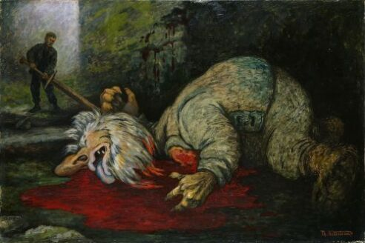
Thank you for your attention
Notes:
Øystein

Slide 21
Ireland vs Norway
From your reports I see that Ireland and Norway have the same problems.
There are certain interesting differences
N Report SAE even if blood not transfused (N include Near miss in SAE)
N transfuse more RBC (150 000). Octaplasma is reported (40 000)
N All transfusions reported back to blood bank
N We have no HPRA (Health Products Regulatory Authority)
  Haemovigilance may become part of a new HPRA (January 1st, 2024)
N The term Human error is not used.
N Treatment of SAR not in the report

