Slide 1
Serious Adverse Events 2023: The year in review.
Caroline Casey HVO, National Haemovigilance Office

Slide 2
Learning from the PAST.
‘Those who cannot remember the past are condemned to repeat it’
George Santayana
Notes:
I came across this quote from spanish poet and philosopher George Santayana and it sums up perfectly a key message regarding the need to remember why haemovigilance exists and its importance

Slide 3
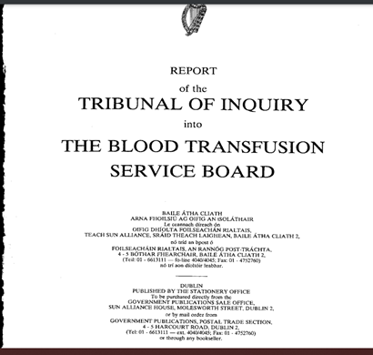
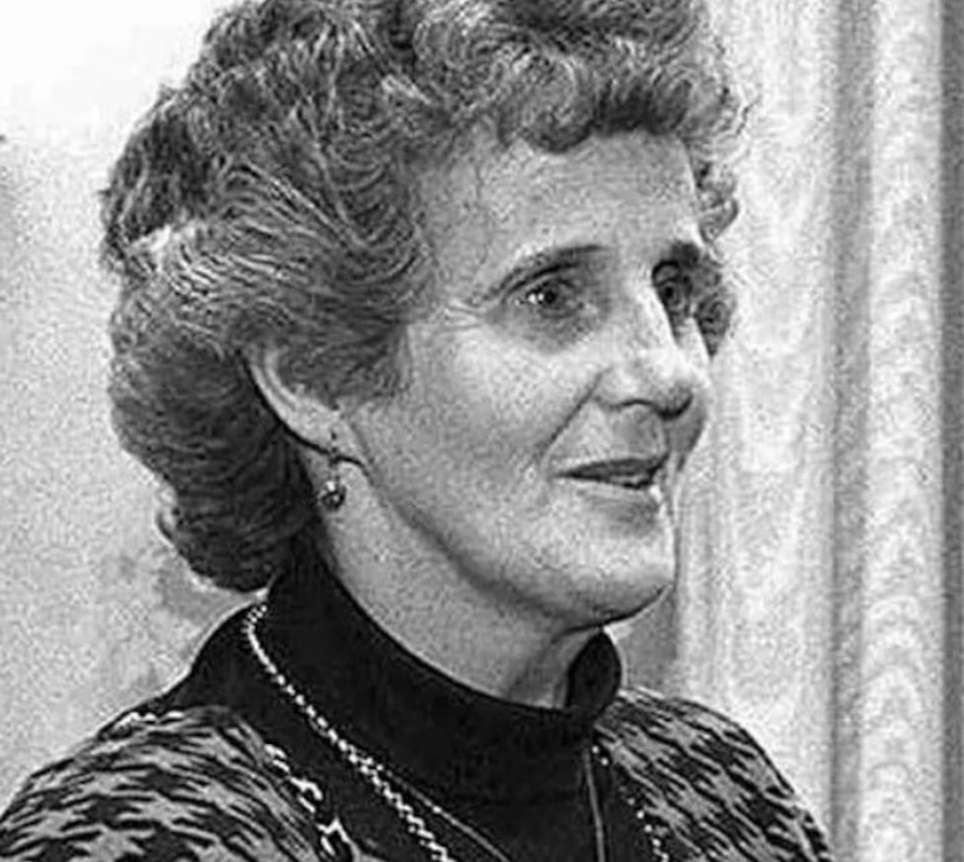
25 Years of Haemovigilance in Ireland
Findings from Finlay Tribunal:
Failure to follow own policies and procedures
Failures to investigate, failure to report reactions
Failures in communication
Staff resourcing pressures
Notes:
In October the NHO celebrated 25 years in existence. The office was borne out of recommendations from the Finlay Tribunal. It is important that staff understand that the infection of multiple women with Hepatitis C as a result of the administration of contaminated Anti D was not caused by persons with intent to do harm but rather staff failures to follow existing policies and procedures and subsequent failures to capture these failures. Haemovigialnce acts provides oversight of errors and capturing events early prevents harm to further patients. With this in mind I felt it appropriate to look at haemovigilance participation in greater detail.

Slide 4
Haemovigilance participation 2023

Slide 5
SAE Reporting and European benchmarking (ANSAE 2022)
Notes:
It is difficult to assess haemovigilance participation as how can we know what we are not receiving? We looked at the most recently published ANSARE report to see how Ireland compares to their EC counterparts when reporting mandatory reports. Ireland was one of the top 5 reporters in 2021. This would suggest that we are good at capturing, investigating and reporting mandatory reports. We know that the number of reports sent to EC

Slide 6
NHO Reporting Trends (2014-2023)
26 mandatory SAEs accepted
32 Near Miss accepted
Notes:
But how good are we at reporting non-mandatory reports. If we look at reporting trends form the last few years we can see that the number of SAEs reported corresponds with the number of units issued annually. Our near miss reports stay within 30 to 57 reports annually with a decrease this year. 2023 was the 5th year of WBIT reporting and there was an increase in these reports in 2023.

Slide 7
How Many hospitals reported?
9 hospitals in category D (>6,000 units) - 9 hospitals reported.
6 hospitals in category C (3,000-6,000 units) – 6 hospitals reported.
14 hospitals in category B (1,000-3,000 units) – 12 hospitals reported.
37 hospitals in category A (<1,000 units) – 18 hospitals reported.
Notes:
So while we know from reporting trends that the overall number of reports remains consistent from year to year with the exception of WBIT reports we know that certain categories of hospitals and certain hospitals report more than others. All category C and D hospitals reported at least one report. Most category B hospitals reported at least one report. Less category A hospitals reported but this is expected as the number of units issued is less.

Slide 8
Haemovigilance reporting and hospital category
Notes:
When we look closer at the categories and report breakdown we can see that our category D hospitals are the most prolific reporters. Category C hospitals report less frequently than other categories but they are less in number. Category A hospitals reported the most WBIT reports.

Slide 9
Reporting Near Miss events
Transfused events
‘Discovery, processing and reporting of transfusion errors is a sign of a functioning quality management system’ – Swissmedic 2022
Legal obligation to report events that occur within Hospital blood bank and Blood Establishment that have the potential to cause harm or affect the quality of the blood and where the unit has been issued.
Near Miss Events
Notes:
We know that the number of NM reports received from hospitals varies. It is possible that events that occur within the hospital blood banks are captured before units are issued and while the national number of mandatory SAEs is less than the number of Near Miss Reports received it is important that we err on the side of caution and remind staff that the discovery processing and reporting of all transfusion errors signals a functioning quality management system and staff are legally obliged to report all Near Miss events.

Slide 10
Haemovigilance participation in FOCUS
Mandatory reporting comparable with our EC counterparts
Possible under-reporting of Near Miss and non-mandatory reports
Variance in reporting between hospitals in categories A and D
Delays in reporting
Notes:
So to sum up our mandatory reporting is comparable to our EC counterparts however when it comes to the full picture we know that some mandatory reports such as our inappropriate reports are not always captured. We also know that our NM reports are low and there is a possibility that these are being under reported. We do not know why there the range of reports submitted varies greatly from some categories and better understanding of why and how hospitals report is needed. Delays in reporting are an issue and staff need to be reminded that it is important to report as soon as possible to ensure that both the process and the quality systems are effective at capturing and preventing errors that may cause harm.

Slide 11
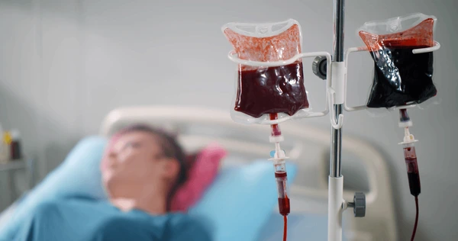
Serious Adverse Events 2023 SAEs
Notes:
So we know how we report lets look at what has been reported in 2023 starting with SAEs

Slide 12
Serious Adverse event reports accepted by the NHO in 2023
Notes:
You can see the breakdown of SAE reports from 2023. The most frequently reported SAEs remain similar to previous years with other, inappropriate transfusions and failure to give an irradiated component the making up over half of all reports received. There has been an increase in Anti D reports received and on a more positive note a decrease in reports received of incorrect ABO group transfused if no reaction.

Slide 13
Inappropriate transfusions (n=15)
Notes:
Inappropriate transfusions are reports that I want to place focus on going forward. We received 15 reports in 2023 but we know that these events are underreported because they occur more frequently in some locations. Of the reports received in 2023 8 were a result of a clinical decision made that was not in conformity with the guidelines and only 3 were a result of incorrect or absent Hb results. Of the three classified as other in one case the nuring staff transfused against advice given by Consultant Haemtologist. One was because antenatal anaemia was untreated and another the decision to transfuse was based upon patient receiving a direct anti coagulant

Slide 14
Inappropriate Transfusions why did they happen?
Notes:
The majority of these cases were attributed to human failures although system failures were described in 5 cases. Knowledge was a common cause of the event that occurred. Suggesting that reinforcement of single unit policy may be necessary.

Slide 15
Single Unit policy
Reduce
Reduce risk of TACO
Reduce
Reduce patient exposure to other risks associated with transfusion
Reduce
Reduce cost
Reduce
Reduce blood usage and pressure on blood supply
Notes:
So that brings me to our single unit policy. Staff may need to be reminded of the costs and benefits of the single unit policy. Inappropriate transfusions can cause TACO in those vulnerable to TACO, this was the case in 5 TACO events in 2023. Exposure to unnecessary units puts patients at risk from other adverse reactions associated with transfusion from febrile non haemolytic transfusion reactions to TTIs (even if that risk is minimal). Units of blood are costly both financially and in terms of the resources and energy that go into providing them. These are precious resources that should not be used unless necessarry. Finally we like other blood services internationally are at a point in time where the requirement for blood at times exceeds the supply. Inappropriate transfusions can contribute to pressure in supply at a time when conservation is best advised

Slide 16
Case Study
Background: A male patient 60 + years received 1 unit of RCC for anaemia. Patient’s Hb was 8.7 post transfusion of 1 red cell component. Patient was asymptomatic with no bleeding.
What happened?: 2nd unit administered by nursing staff. Nursing staff administering unit thought unit would be wasted if not used. Patient’s Hb was 10.7 post 2nd transfusion. Transfusion carried out at night.
Human failure: Knowledge, co-ordination and communication, failure to follow policies and procedures
CAPA: Included stressing importance of single unit transfusions at education sessions. Nurses informed that units can be returned to the hospital of origin. Single laminated poster included with blood documentation in clinical areas.
Notes:
I thought it would be nice to include a case study and included this one because it is unusual but highlights the fact that events often occur because of multiple factors in this case gaps in knowledge and co-ordination and communication discuss……

Slide 17
Failure to give an irradiated component (n=10)
Human failures
Failure to follow policies and procedures (n=10)
Gaps in knowledge (n=6)
Co-ordination and communication errors (n=4)
Hodgkin lymphoma (n=5), Non-Hodgkin lymphoma (n=3), Di George (n=1), CLL (n=1)
Notes:
We had 10 cases reported to us of failure to give an irradiated component. While we have not had an event of GvHD reported at least since 2007 and likely before and leucodepletion is likely a factor in preventing GvHD the severity of this type of reaction means we need to actively work to reduce these events occurring. GvHD is a devastating reaction with an over 90% fatality rate. These cases were mainly a result of failure to prescribe and failure to request with one case where the historical record was not checked . While all reports cited failure to follow policies and procedures gaps in knowledge and coordination and communication errors were cited as contributory factors. Focussed traing and education on special requirements and assessing how handovers are conducted may help reduce these events.

Slide 18
Incorrect ABO group transfused if no reaction (n=3)
Notes:
I am happy to say that in 2023 the number of incorrect ABO group transfused if no reaction. But I am sure you would like to know what happened

Slide 19
Incorrect ABO group transfused why?
All cases involved plasma
All errors occurred in lab and involved lab staff. 2 cases from same site.
What happened?
- Plasma was from another patient (incorrect separation from primary tube) x 2
-Plasma transfused to patient with no historic group and one handwritten sample x 1
Knowledge x1, failure to follow policies and procedures x2, carrying out task incorrectly x2
Notes:
Read

Slide 20
Anti D related errors (n=19)
Type of error
No. of reports 2021 (n=7)
No. of reports 2022 (n=13)
Type of error | No. of reports 2021 (n=7) | No. of reports 2022 (n=13) | No. of reports 2023 (n=19)
Delay in giving product (>72 hours) | 4 | 5 | 10
Failure to administer Anti D | 3 | 8 | 9
Notes:
As you can see from the above table we have had an increase in the number of anti d related events. With increase in delay in giving product and failure to administer from previous years.

Slide 21
Delays in Anti D administration (n=10)
PSE occurred and Anti D requirement missed x 5
Patient did not attend appointment x 2
Insufficient dose post FMH x 1
RAADP requirement missed x 1
Unclear x 1
Knowledge x 2, failure to follow policies and procedures x 4, co-ordination and communication x 1, slip x 2, patient related x 2
Notes:
So what happened? Well the reasons vary but we can see that some delays occurred for patient’s who experienced a PSE and we only had one delay in RAADP administrtaion failure to follow policies and procedures was common but knowledge was a factor in 2 cases and in 2 cases the patient did not arrive for their appointment

Slide 22
Failure to administer Anti D (n=9)
PSE and requirement missed – n=4
Missed RAADP – n=4
No details – n=1
Co-ordination and communication errors – n=3
Failure to follow policies and procedures – n=4
Gaps in knowledge – n=2
Notes:
Similarily PSE events were a common factor in failure to administer but RAADP was not administered in 4 cases. Coordination and communication errors occurred in 3 cases. Staff need to be reminded of the importance of follow up but education of women regarding anti D administration may help to reduce these types of error as they will be aware of the need to receive anti D in event of a PSE

Slide 23
Human Errors and SAES 2023
Types of Human Error | No. of reports (n=87) 2019 | No. of reports (n=67) 2020 | No. of reports (n=90) 2021 | No. of reports (n=107) 2022 | No. of reports (n=79) 2023
Failure to adhere to policies and procedures | 60 | 33 | 48 | 64 | 47
Knowledge | 19 | 19 | 24 | 30 | 27
Co-ordination and communication | 14 | 14 | 13 | 17 | 4
Carrying out task incorrectly | 18 | 12 | 13 | 22 | 16
Other | 7 | 9 | 9 | 13 | 10
Verification | 25 | 7 | 3 | 4 | 6
Slip | 9 | 3 | 5 | 1 | 1
Monitoring | 4 | 1 | 1 | 3 | 3
Patient related | 2 | 1 | 1 | 2 | 1
Trip |  |  |  |  | 1
Notes:
Human error reamins most common reason for the event occurring cited on reports. Followed again by knowledge, carrying out task incorrectly and knowledge

Slide 24
Areas of Focus (SAEs) for 2025
Report – Inappropriate transfusions
Single unit policy
Educate patients to advocate for their needs – Anti D + special requirements
Handovers – need to ensure patient’s requirements communicated
Training and Education –Prescription/Request Errors – 19% of all errors reported

Slide 25
Near Miss
Notes:
Next we will have a look at our near miss reports

Slide 26
Deviations Stage in transfusion process error occurred (n=32)
Notes:
Currently the way we capture Near Miss reports mean that we obtain information differently to SAEs and WBITs but what we can say from reports received that the majority of errors were cited to be from the stages in process described as other and issue

Slide 27
Common themes identified in near miss reports 2023 (n=31)
Specimen reception errors – n=7
LIS entry errors – n=7
Wrong unit selected – n=6
Handover – n=2
Unit returns – n=4
Blood processed for wrong patient – n=1
Transposition of labels – n=4
Notes:
When we looked at the errors described as other the majority of them were from specimen reception and we can see from the above that specimen reception errors and LIS errors make up nearly half of all near miss reports received. We also had a number of wrong unit selected, transposition of labels and return errors

Slide 28
Near Miss areas of focus for 2025
Take care at specimen registration!
Take care when entering information on to Laboratory Information System!
One at a time! – when issuing units
Ensure Good Communication - returns.
Avoid Distractions – unit selection
Notes:
From a lab perspective staff need to be reminded that specimen reception is where sampling, labelling and other clerical area errors can be captured. Incorrect entry at specimen reception and when entering data into LIS are common points of error within hospital laboratories. The majority of issue errors received by the NHO occur when more than one unit is being issued at a time. It is preferable to issue one at a time. All returns errors were associated with communication problems. Clinical staff need to be reminded that they have to inform lab staff when a unit requires return. Distractions are a major cause of error at the unit selection stage with phone calls the primary cause of distraction. Staff should be reminded to check from the beginning rather than returning and starting where they left off.

Slide 29
WBIT

Slide 30
WBITS what happened? (n=78)
Notes:
Despite recommendations staff continue to fail to perform PPI and label samples remotely. These were major sources of error for WBIT events that occurred in 2023. Wristband related errors were common also.

Slide 31
Locations of WBIT errors 2023
Increase in reports from maternity/labour wards
Increase in reports from areas categorized as other (outpatients, external/private clinics, phlebotomy)
Notes:
We noticed an increase in the number of WBITS in 2023 and my colleague Niall investigated what occurred and noted that there was an increase in BWIT events reported from maternity and labour wards. We also saw an increase in reports from locaions described as other

Slide 32
Staff involved in WBIT Events 2023
Notes:
We then noticed that events that involved midwives had increased too and interestingly we had 8 reports involving phlebotomists

Slide 33
Maternity Samples and WBITS (n=37)
Notes:
The NHO decided to examine more closely the events that occurred that were related to maternity samples and found that there were 37 reports in total. WBITS related to maternity samples made up 47% of all WBIT events that occurred in 2023 and 39% of PPI events. Understanding why staff fail to perform PPI in these areas is key. Finding ways to encourage PPI such as remving stickers from charts may help

Slide 34
Electronic identification systems and WBIT errors 2023 (n=52)
Notes:
Once again the main errors that we see occurring with EIS include remote labelling and wristband related errors such as scanning from charts and barcode not readable

Slide 35
Human Factors and WBIT Events 2023
Notes:
Human factors play a role in many errors that occur with busy environments, issues with sample printers, patients with same or similar identifiers and distractions playing a role in the majority of events that occurred

Slide 36
Key Recommendations from WBIT Reports in 2023
Departments providing maternity care are high risk areas for WBIT events
Positive patient identification more likely to lead to positive patient outcome!
Labelling is an important step in process – verify!
Never label away from bedside
Wristbands must be on patient and correct with barcode readable – perhaps regular checks should be conducted

Slide 37
NHO what else were we up to in 2023 and 2024?
Online Database
E-learning modules
Annual report for 2023
Hosting online monthly meetings

Slide 38
Thank you
Caroline Casey
Caroline.casey@ibts.ie
www.giveblood.ie

Slide 39
Catching WBITs
Specimen reception – 26 cases
Historical checks - 19 cases
2 sample rule – 18 cases
Clinical area – 10 cases
FBC sample error – 2 cases
PPI of patient – 2 cases
No details – 1 case

